Slide 1
GRAMMAR FOCUS “ PRESENT CONTINUOUS”
The present countinuous tense is used to talk about actions that are happening right now
Click on the following link to study and practice present continuous
https://www.youtube.com/watch?v=J7c8eQjWiWc

Slide 2
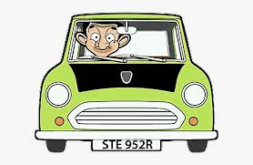
PRESENT CONTINUOUS “statements”
+
To be
+
Verb- ing
Subject
Form
He is
driving his car

Slide 3
Practice statements
Write complete present continuous statements, use the verbs in the box
Mimi is studying

Slide 4
PRESENT CONTINUOUS “ yes/no questions”
To be
+
Subject
+
Verb- ing
Form
Is he
driving a truck?
No, he is not driving a truck. He is driving a car

Slide 5
Practice Yes/No questions
Answer the following yes/no questions

Slide 7
PRESENT CONTINUOUS “ Wh.. questions”
+
+
Subject
+
Verb- ing
Wh
To be
Form
What
is he
driving?
He is driving a car

Slide 8
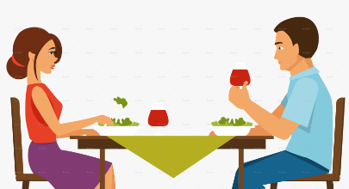
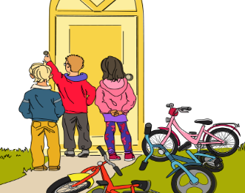
Practice Wh questions

Slide 9
Present continuous practice

