Slide 1
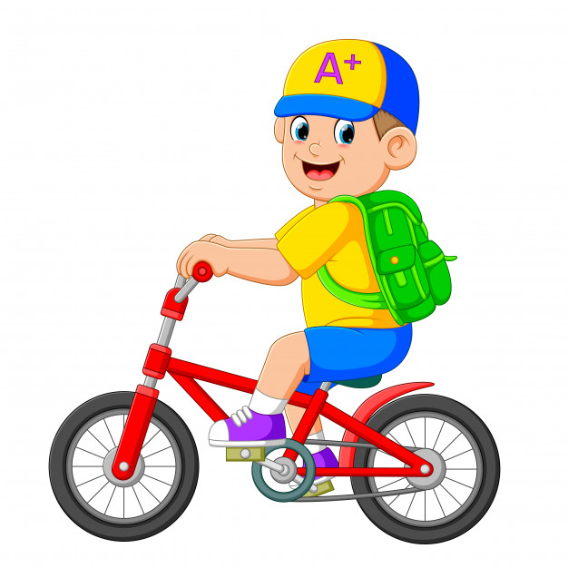
UNIT 6 “ROUND UP”
I ride my bike to school
UNIT OBJECTIVES:
Discuss transportation and family
Discuss daily and weekly routines

Slide 2
GRAMMAR “ SIMPLE PRESENT NEGATIVE STATEMENTS”

Slide 4
Time Expressions
early late everyday every-weekend | On monday tuesdays teekdays weekends | At nine o`clock night midnight noon | In the afternoon the morning the evening

