Slide 1
Hello dear students!
I had to attend a meeting today, therefore I won’t be able to be with you in class today. I’m so sorry.
Please work in teams or individually to complete the following tasks and upload your products to Escuela en Red in the Activity ENGLISH CLASS – MARCH 19TH, KAHOOT and PADLET (https://padlet.com/alvaradocris87/btrml0zwovpq7dv2)

Slide 2
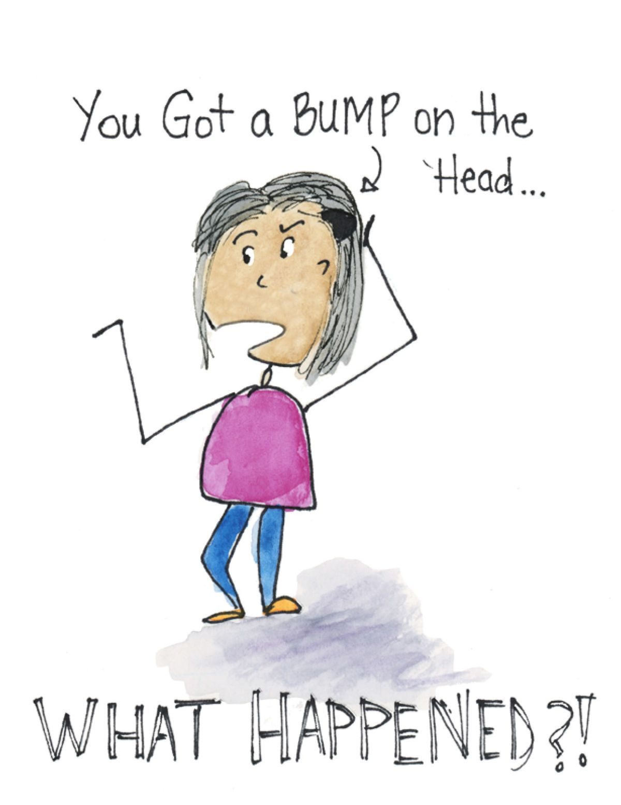
UNIT 4 WHAT HAPPENED?
Write a short story telling what happened to this girl, why does she have a bump on her head???

Slide 3
OBJECTIVE OF THE UNIT
Describe past events and tell stories.

Slide 4
Past tense of verbs (regular and irregular)
Write the past tense of 10 regular and 10 irregular verbs you remember.

Slide 5
Write which story you would like to read and why.

Slide 9
Read the sentences and correct the mistakes.
YOU CAN DO THIS ACTIVITY IN TEAMS.

Slide 11
Let’s play!
Go to the following link and complete the challenge. GOOD LUCK!
https://kahoot.it/challenge/01980541?challenge-id=3a17a0cc-a7de-4a91-b9c3-0214c8d1c6b9_1616169579711

Slide 12
STORYTELLING
Work in teams or individually to write a short story for each one of the following pictures. What were they doing? What happened to them? Where were they? Etcetera. USE THE SIMPLE PAST AND THE PAST CONTINUOUS.

Slide 13
