Slide 1
OBJECTIVES
To ask and answer questions about jobs
To describe routines and daily schedules

Slide 2
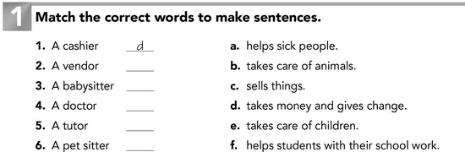
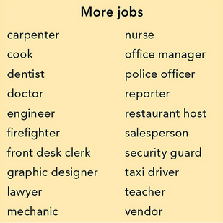

Slide 3
JOB | WORKPLACE | ACTIVITY | ADJECTIVE TO DESCRIBE | ADJECTIVES Interesting Boring Difficult Exciting Dangerous Stressful Relaxing Easy ACTIVITIES Cook Help Fix Do Teach Study Take care of Write Work Sell Drive
Cook | Restaurant | Cooks food | Relaxing
Accountant
15 more

Slide 4
Vocabulary review
STUDENT A : Answer yes/no
CLASS: Ask yes/no questions
Does this person work in a ____ ? (workplace)
Is this job ______? (adjective)
Does he/she _____? (activity)

Slide 7
ALEXA’S JOB - Editing
I’m Joshua, I am a dentist, I have my own office and I work in a hospital too. I live with sister Alexa.
Alexa is a teacher. She work at Escuela Normal de Educación Preescolar and she love her job. She start classes at 7:45 a.m. and finish at 2:00 p.m. She always have hot cakes for breakfast and drive to school. In the afternoon she go to the gym, take a shower, and she go to bed at 10:00 p.m.

Slide 8
