Slide 1
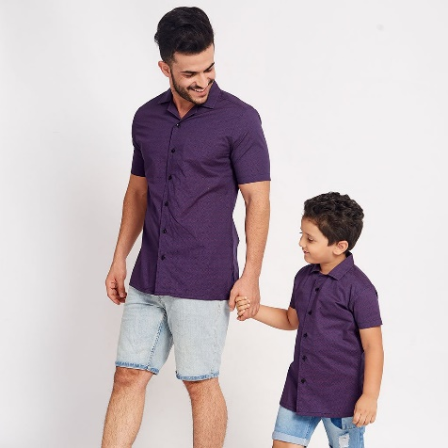
LESSON 8
“Present continuous Statements”
Subject + to be + verb(ing) + complement
+ They´re wearing shorts
- They´re not wearing jeans
- They aren´t wearing jackets
Lesson objectives:
Identify and use the present continuous in affirmative and negative statements

Slide 2
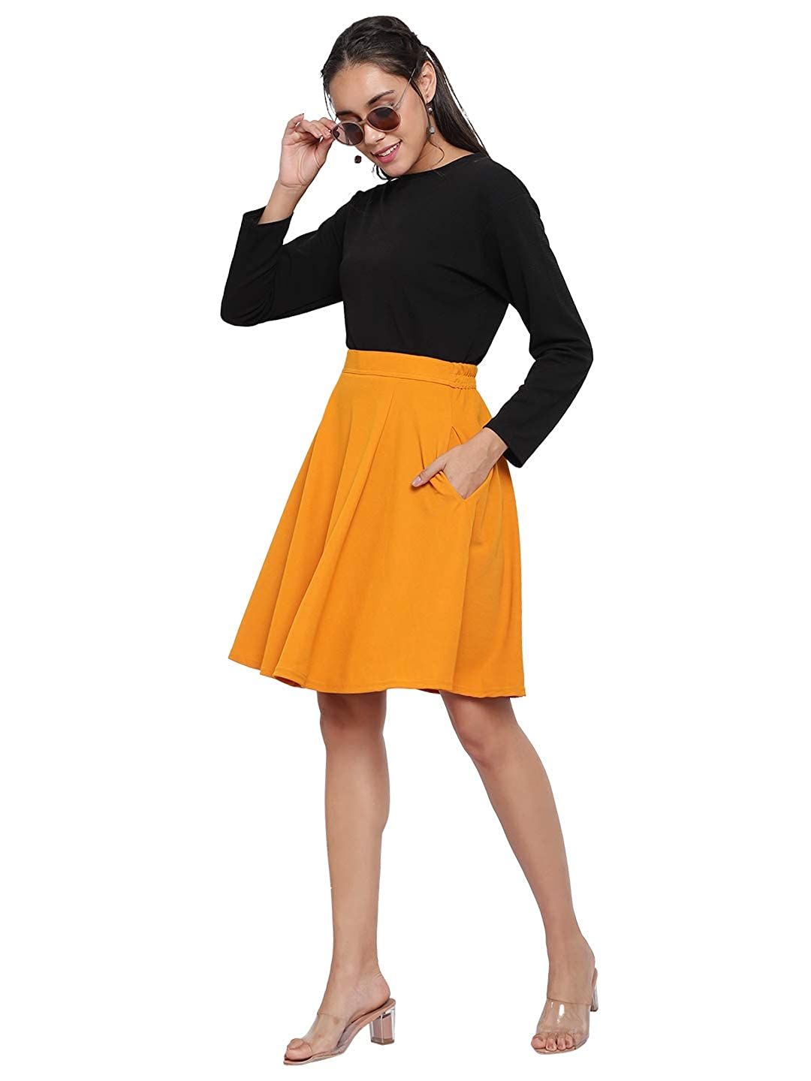
What is Tania wearing?
+Tania is wearing an yellow skirt
+She´s wearing a black blouse
+She´s wearing beige higheels
She´s not wearing a scarf
She´s not wearing a coat
Tania

Slide 3
What is Tom wearing?

Slide 4
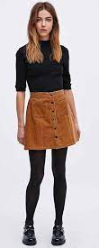
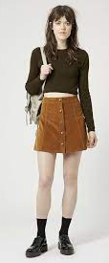
What are they wearing?

Slide 5
LESSON 9
Unit objectives:
Identify and use conjuctions and, but, so in statements

Slide 6
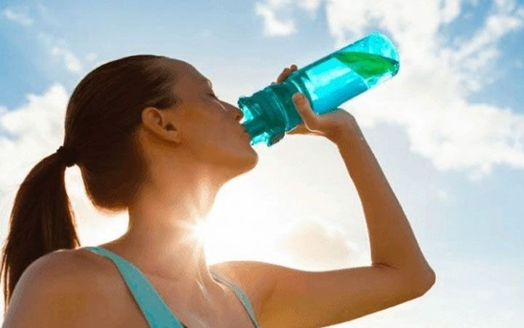
GRAMMAR “USE OF CONECTORS”
Conjuctions are used to join words, phrases or clauses.
AND To connect similar ideas Para conectar ideas similares | BUT To connect opposite ideas Para conectar ideas opuestas | SO To connect cause and effect Para conectar causa y efecto
It´s hot and sunny | It´s hot but she´s not wearing a hat | It´s hot so they are wearing swimsuits

Slide 7
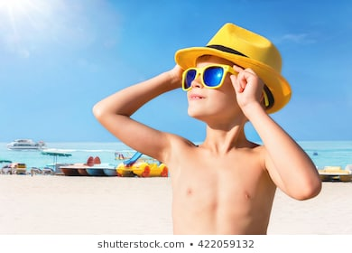
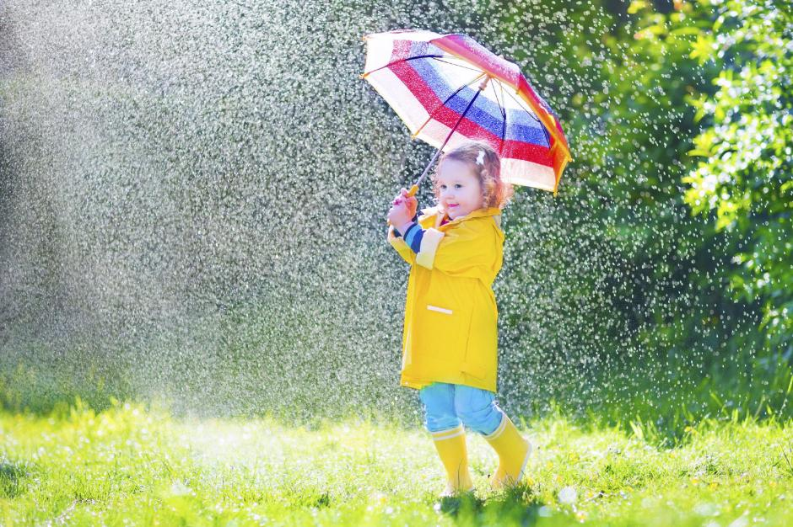
Complete the following sentences using connectors and, but, so
It´s _____
It´s sunny ___ hot.
____ He´s wearing a cap _____sunglasses
It´s spring
It´s warm ___ it´s raining. ___ She´s wearing boots___ a raincoat.

Slide 8
It´s _______, it´s cold today.
_____she´s wearing a hat, a coat, ____ gloves.
It´s _______,
It´s snowing ____ it´s cold,
___ they´re not wearing winter clothes.

