Slide 1

ESCUELA NORMAL DE EDUCACIÓN PREESCOLAR
CICLO ESCOLAR 2022-2023
INGLES
Unit 1. Generic competences:
•Use critical and creative thought for solving problems and taking decisions.
•Learn in an autonomous way and demonstrate initiative for self-regulation and strengthen her /his personal development.
•Cooperate to bring about innovative projects having a social impact.
•Act with in an ethical way, by interiorizing social rules and principles needed for a better coexistence.
•Use information and communications technology, as well as other languages, for understanding, explaining and offering alternative solutions to the problems encountered.
Docente:
Guadalupe del Rocío Robledo Corpus
Alumna:
Naela Yamileth Alvarado Hernández #2
Semestre y sección: 5° A
Project unit 1 It´s a really great place!
Saltillo, Coahuila Septiembre 2023

Slide 2
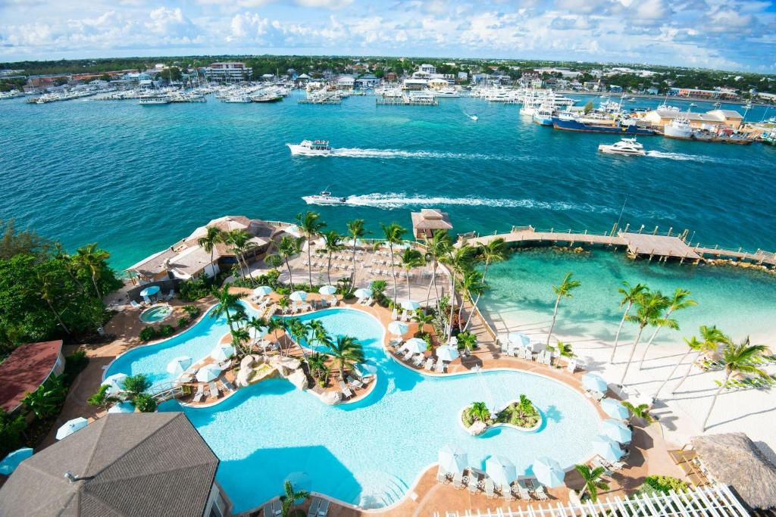
BAHAMAS
What’s it like?
Is very beautiful, nice, relaxing and modern
What can you do there?
You can visit beautiful beaches, swim with pigs or swim with sharks
What should you see there?
It has a great beautiful beaches
What’s the weather like?
The wather ir vey hot
What’s the best time of the year to visit the place?
The best time of the year to visit is in summer
What things can you buy?
Can but straw products

Slide 3
