Slide 1
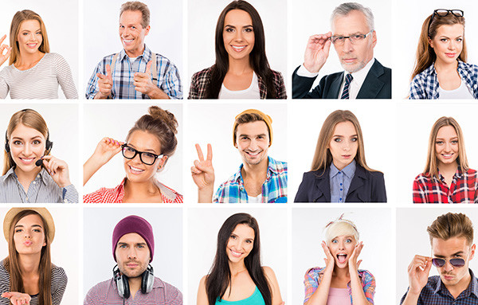
Unit 3
Lesson 2
DESCRIBING PEOPLE
Lesson objective:
Use adjectives to describe people (personality and physical appearance)
Ask and respond to yes/no and wh questions with be

Slide 2
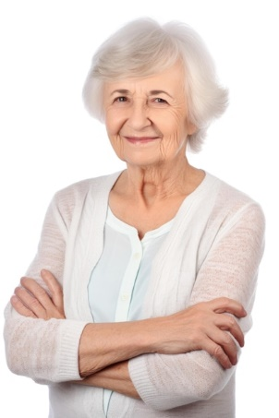
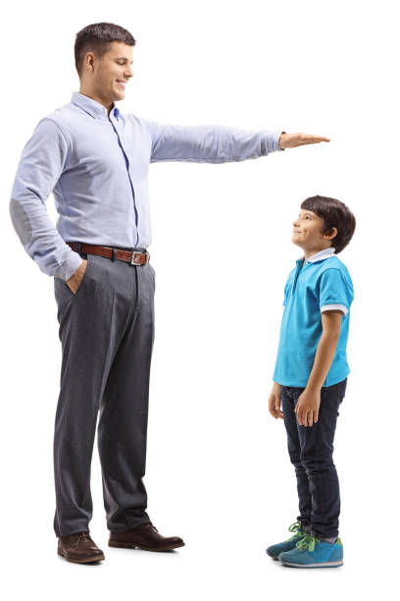
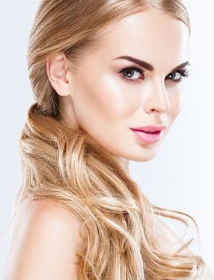
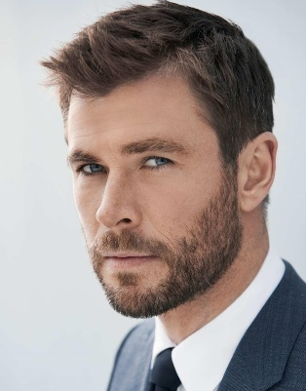
Vocabulary, Adjectives of physical apearance
Adjectives are words used to decribe the appearance or personality of a person
What do they look like?
Old
young
heavy
thin
pretty
handsome
Tall
short
Good looking

Slide 3
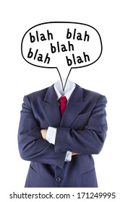
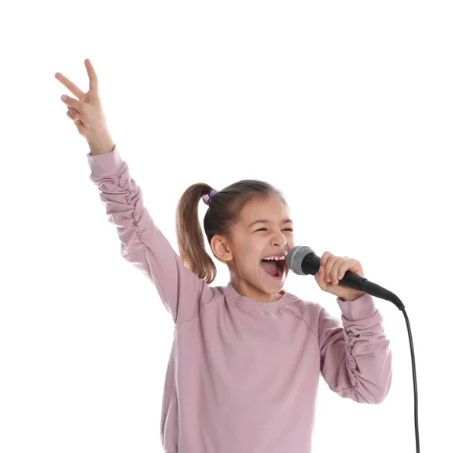
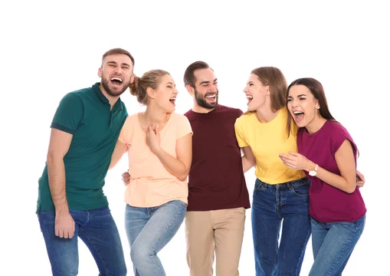
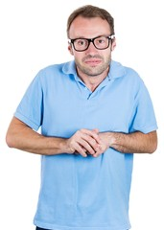
Vocabulary, adjectives of “personality”
Adjectives are words used to decribe the appearance or personality of a person
What are they like?
talkative
serious
kind
shy
funny
friendly

Slide 4
Vocabulary practice: What are they like?
Student´s book pg 21 ex 9A
Listen and practice

Slide 5
Vocabulary practice: What are they like?
Student´s book pg 21 ex 9B
Complete the chart with the Word from part A. Add two more words to each list.
Personality | Appearance
Kind | Pretty
Shy | Handsome
Friendly | Short
Quiet | Tall
Serious | Heavy
Funny | Thin
Talkative | Good looking

Slide 6
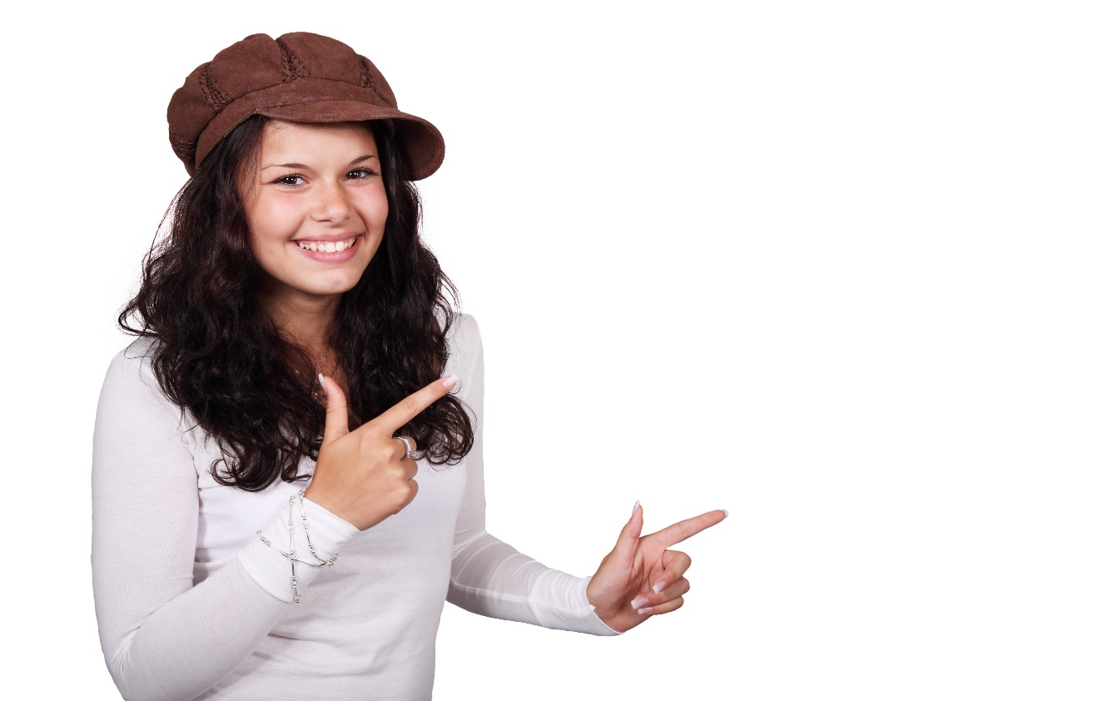
Speaking practice: What are you like?
Student´s book pg 21 ex 9C
Describe your appearance and personality, to a partner.
I am…
Personality | Appearance
Friendly | Short
Kind | Pretty

Slide 7
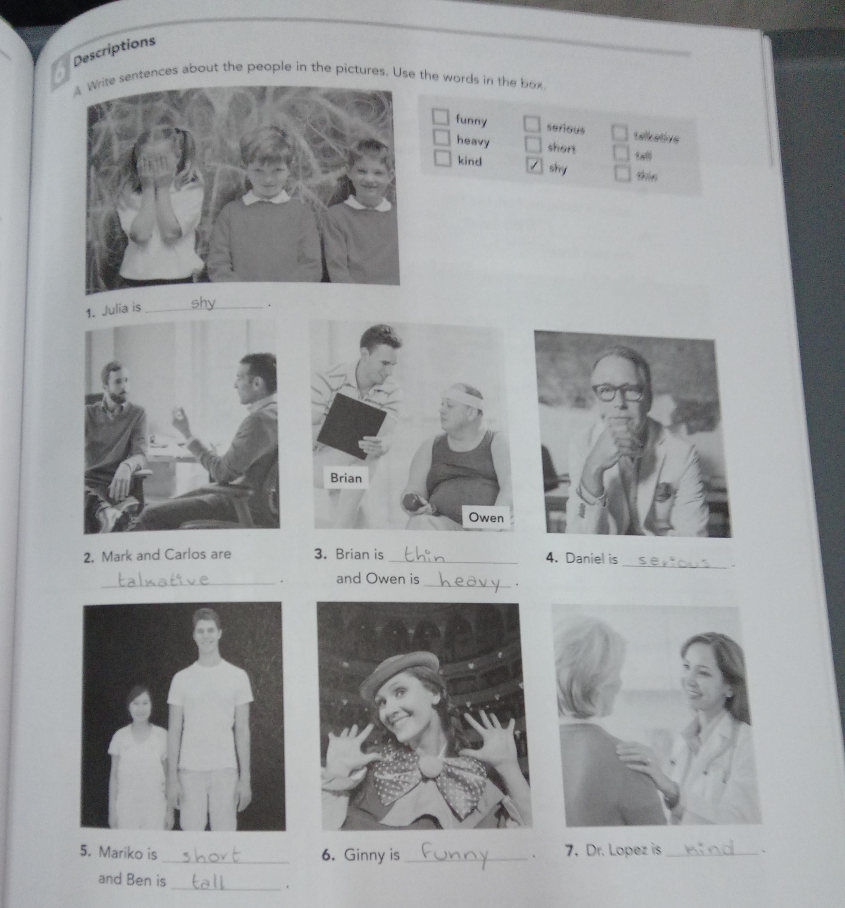
Vocabulary practice: Descriptions
Workbook pg 17 ex 6A
Write sentences about the people in the pictures. Use the words in the box.

Slide 8
Grammar practice: Yes-No questions with be
QUESTIONS
ANSWERS
Be | subject | complement
Yes, | Subject | Be.
No. | Subject | Be not.
Am | I | shy ? talkative ? funny ?
Is | He
 | She
 | It
Are | You
are | We
 | They
Yes, | I | am,is are
 | He
 | She
 | It
No, |  | am not. is not. are not.
 | You
are | We
 | They

Slide 9
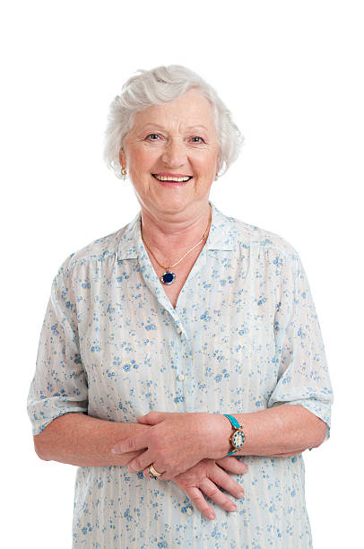
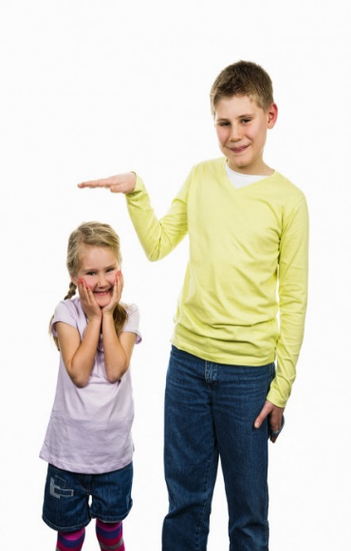
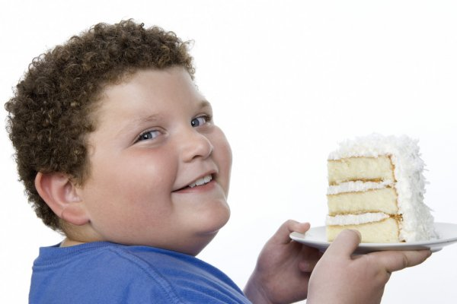
Speaking practice: “Yes no questions”
Answer the following yes/no questions
Is she young?
No, she is not
Is she tall?
No, she is not.
Is he thin?
No, he is not.
Are they thin?
Yes, they are.
Is he tall?
Yes, he is.
Is he handsome?
Yes, he is.

Slide 10
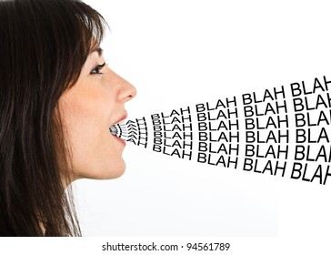
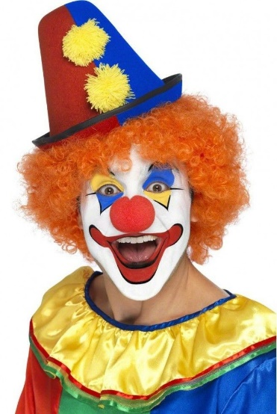
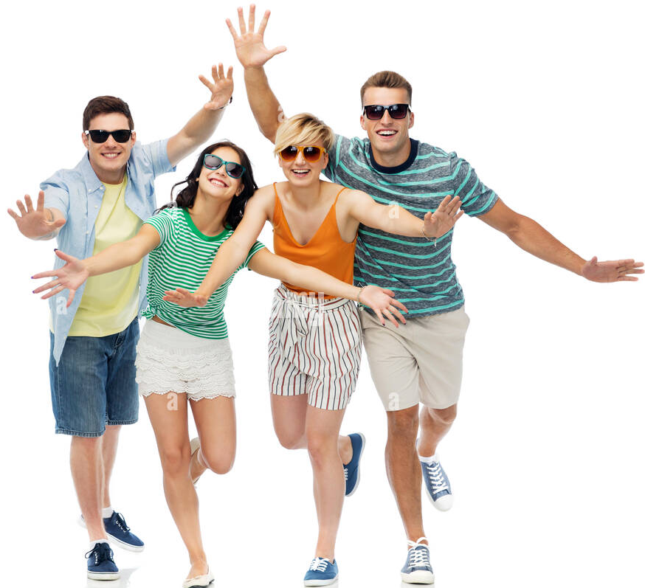
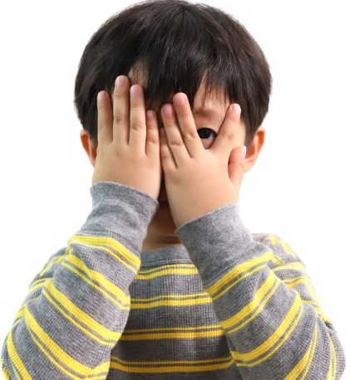
Speaking practice: “Yes no questions”
Answer the following yes/no questions
Is she serious?
No, she is not.
Is he shy?
No, he is not.
Is she short?
Yes, she is.
Are they friendly?
Yes, they are.
Is she kind?
Yes, she is.
Is he talkative?
No, he is not.

Slide 11
Vocabulary practice: Descriptions
Workbook pg 17 ex 6B
Answer the following questions.

Slide 12
Grammar practice: Wh questions with be
QUESTIONS
ANSWERS
What | Am | I | like ?
 | Is | He
 |  | She
 |  | It
 | Are | You
 | are | We
 |  | They
I | am
He | is
She
It
You | are
We
They

Slide 13
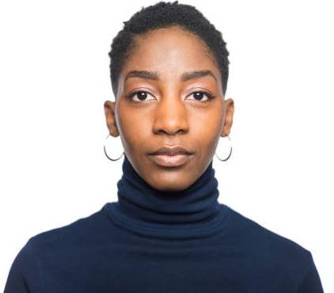
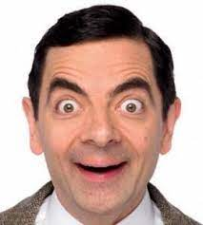
Grammar practice: Wh questions with be
Look at the following questions, They are used to ask about a person´s personality.
Ask a question to your partner about another classmate´s personality.
What´s Mary like?
What is Peter like?

Slide 14
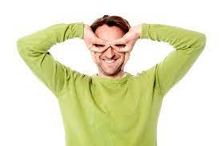
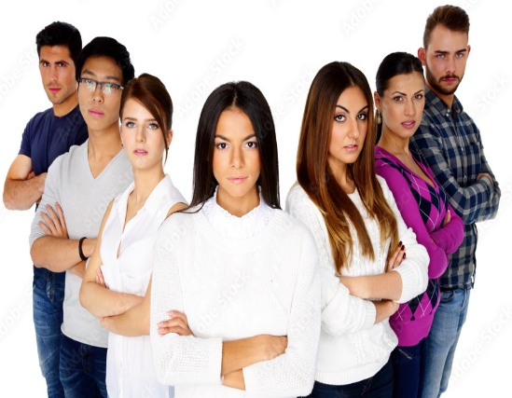
Grammar practice: “Wh questions”
Write wh questions then give an answer according to the picture.
Adam
Louis
Lily
What´s Louis like?
He is serious.
What’s Lily like?
She is talkative.
What’s Adam like?
He is kind.
Mark
What’s Mark like?
He is funny.
What’s are they like?
They are serious.
What’s are they like?
They are friendly.

Slide 15
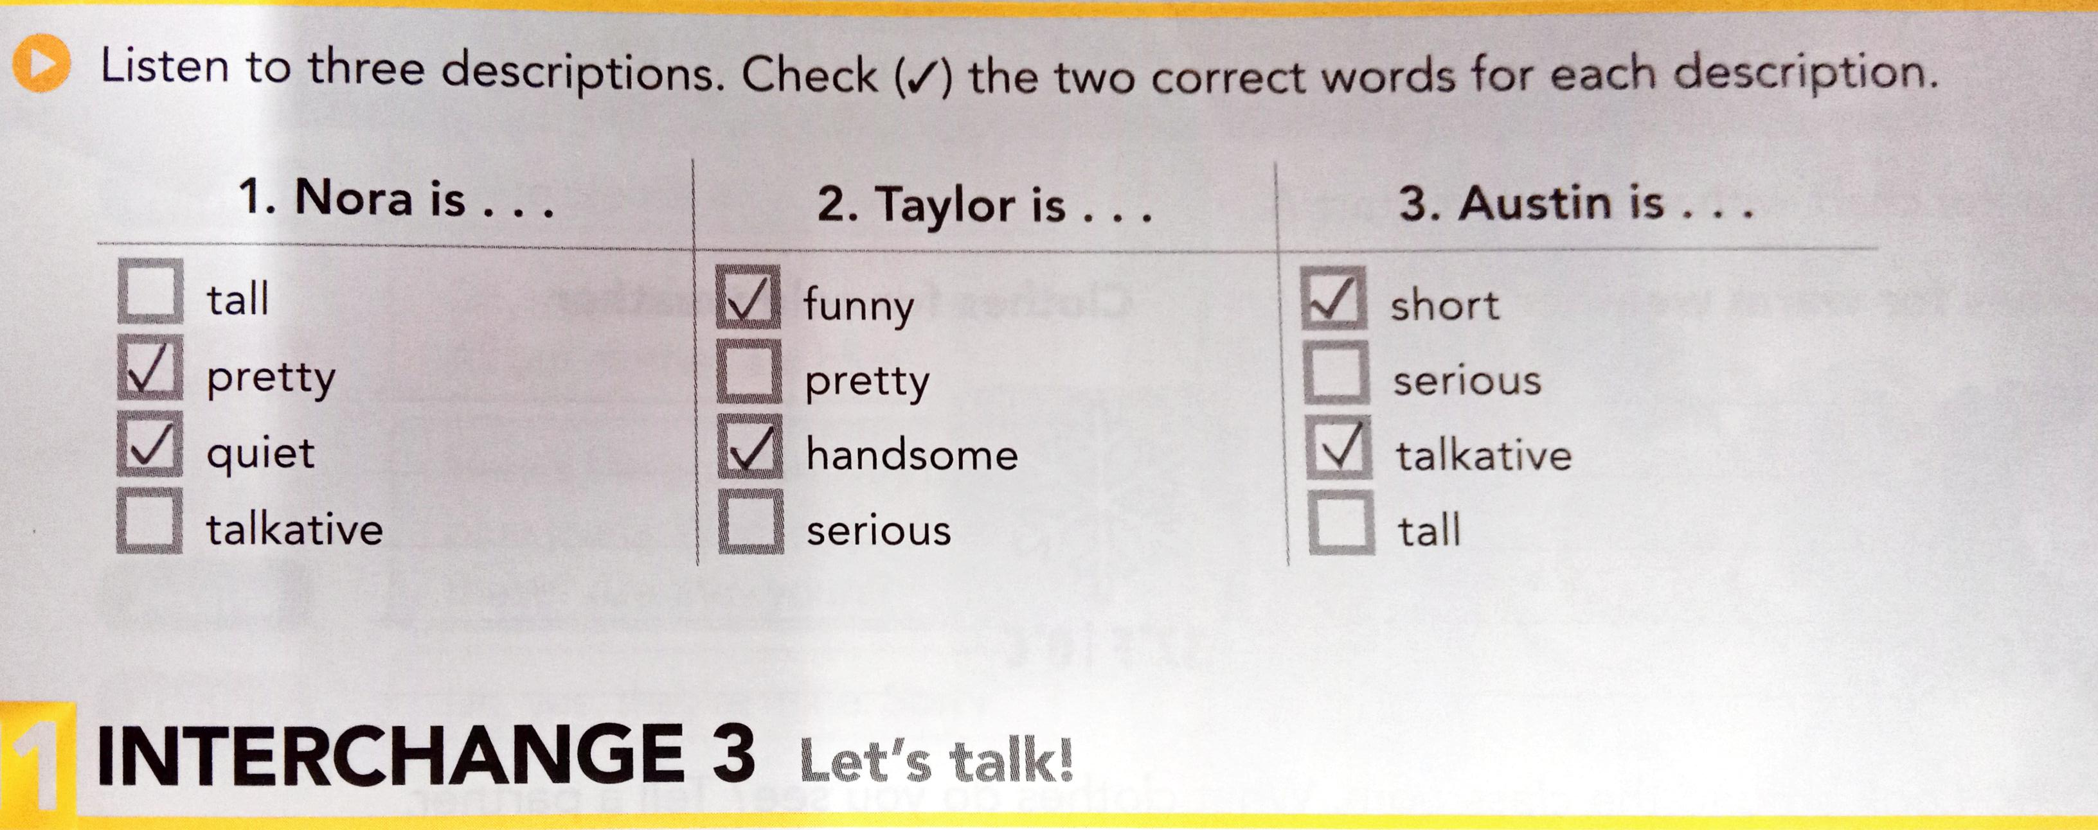
Listening practice. “Wow! Who´s that?
Student´sbook pg 21 ex10
A. Listen to three descriptions. Check the two correct words for each description

Slide 16
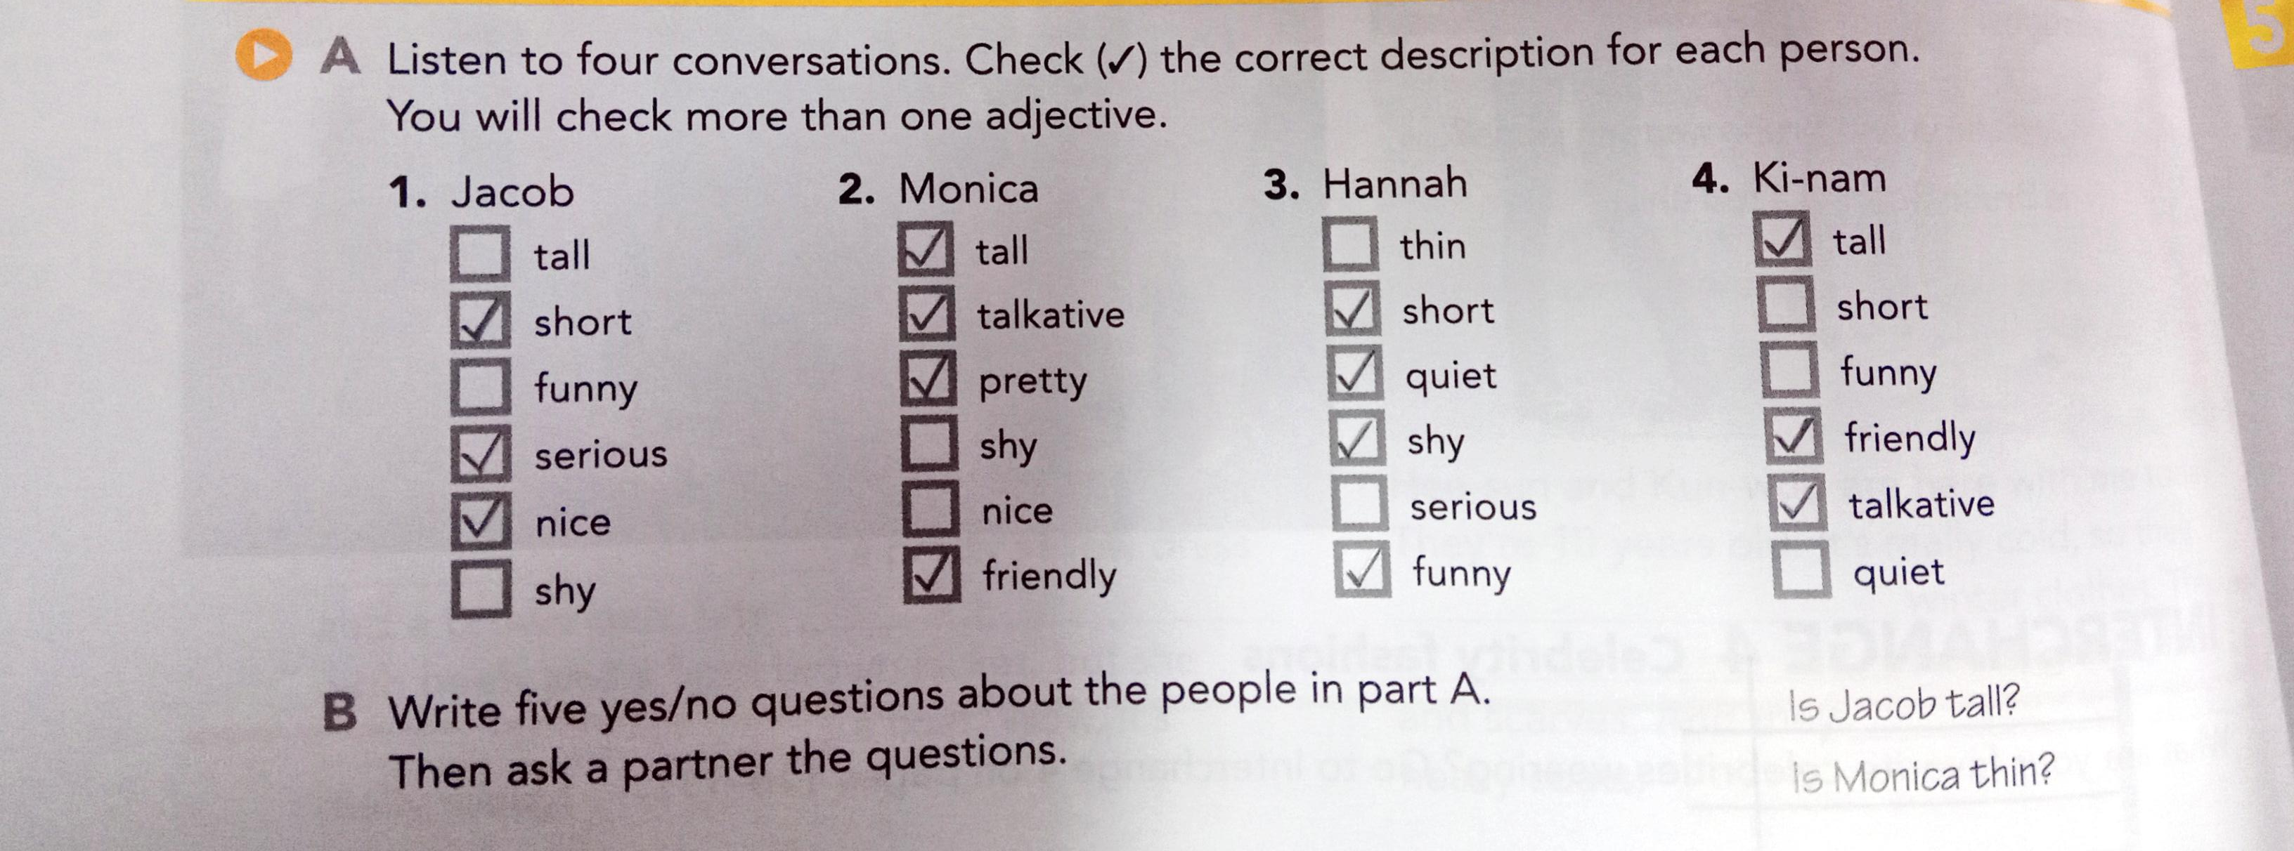
Listening practice. “Where´s your friend Jacob?
Student´sbook pg 28 ex2
A. Listen to four conversations. Check the correct description for each person. You will check more than one adjective.
B. Write three yes/no questions about the people in part A. Then ask a partner the questions.
1. Is Jacob funny? / No, he is not.
2. Is Hannah shy? / Yes, she is.
3. Is Ki-nam tall? / Yes, she is.

Slide 17
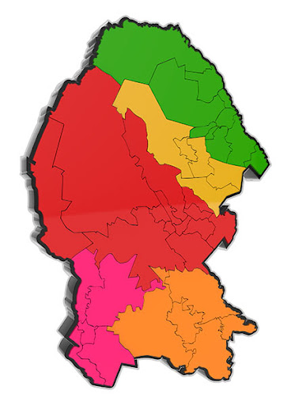
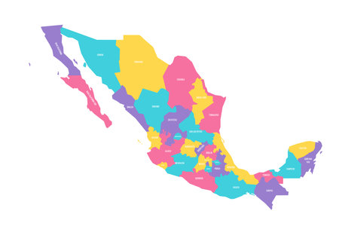
Vocabulary: Adjectives to describe places(cities)
What is your City like?
What is Mexico like?

Slide 18
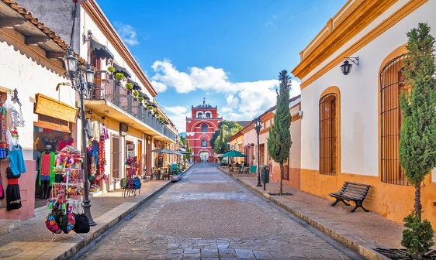
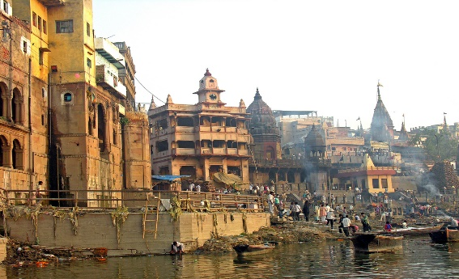
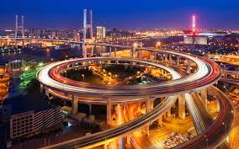
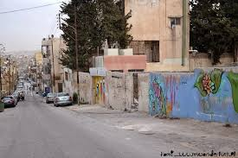
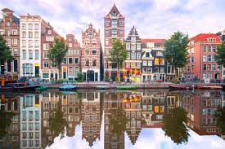
Vocabulary: Adjectives to describe places(cities)
small / big
old / modern
ugly / beautiful

Slide 19
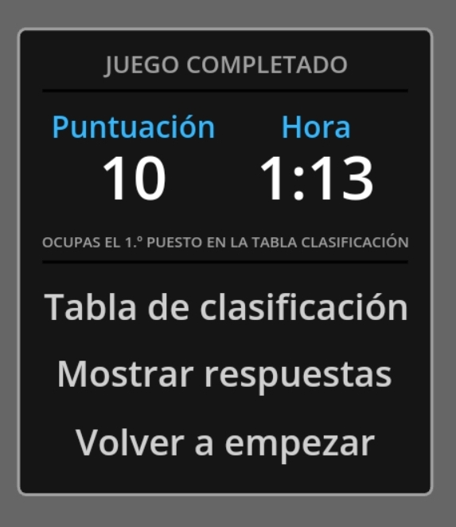
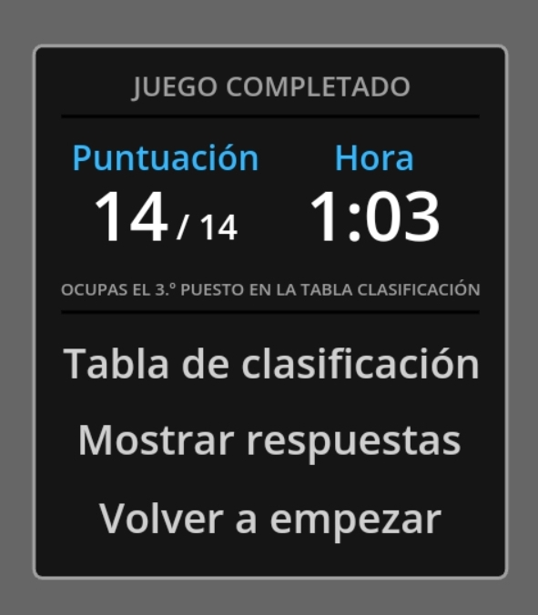
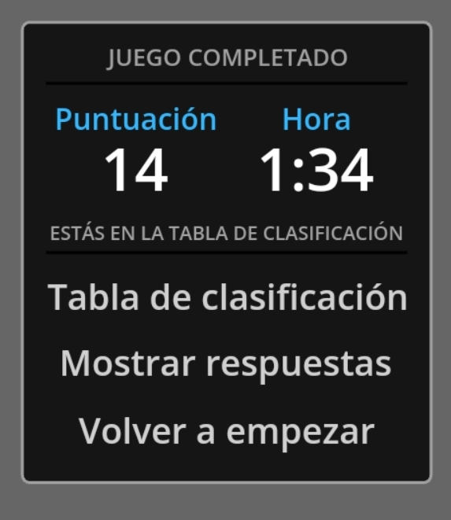
Online practice: Vocabulary “adjectives to describe people”
Practice plural spelling rules with the following online activities.
Print screen with your score and insert here
https://wordwall.net/es/resource/2848738
https://wordwall.net/es/resource/34854464
Print screen with your score and insert here
https://wordwall.net/es/resource/22125544
Print screen with your score and insert here

Slide 20
Grammar practice: Wh questions.
Look at the following questions. The first question is to ask about adjectives that describe physical appearance, The second question is to ask about personality.
What does she look like?
To ask about physical appearance
What´s he like?
To ask about personality

Slide 21
Grammar practice: Wh questions.
Answer the following questions.
What is she like? | What do they look like? | What does he look like?
She is talkative. | They are thin. | He is handsome.
What is he like? | What does she look like? | What are they like?
He is shy. | She is short. | They are friendly.

Slide 22
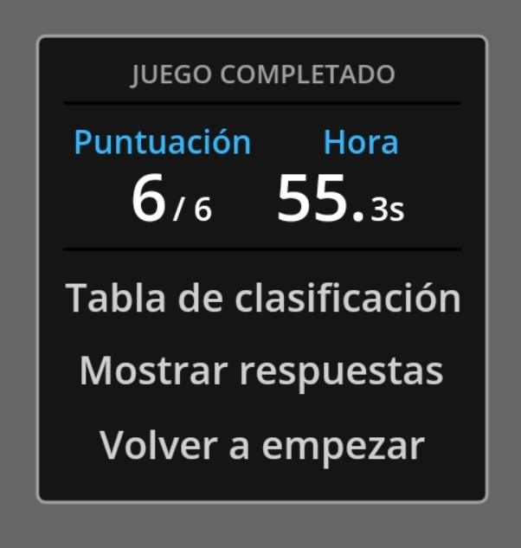
Online practice: Wh questions
Practice plural spelling rules with the following online activities.
Print screen with your score and insert here
https://wordwall.net/es/resource/13596798

