Slide 1
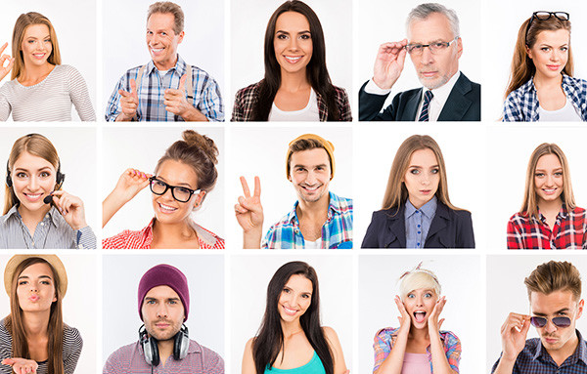
Unit 3
Lesson 2
DESCRIBING PEOPLE
Lesson objective:
Use adjectives to describe people (personality and physical appearance)
Ask and respond to yes/no and wh questions with be

Slide 2
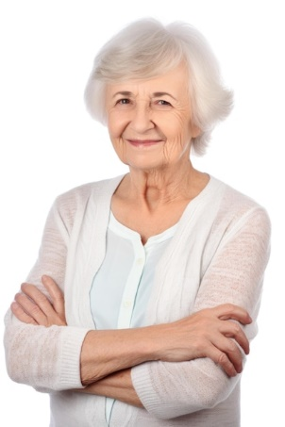
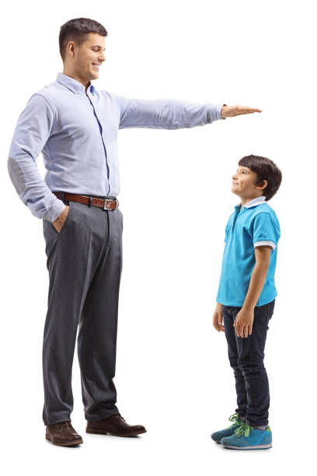
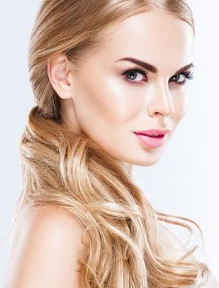
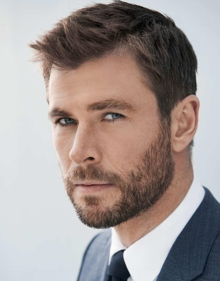
Vocabulary, Adjectives of physical apearance
Adjectives are words used to decribe the appearance or personality of a person
What do they look like?
Old
young
heavy
thin
pretty
handsome
Tall
short
Good looking

Slide 3
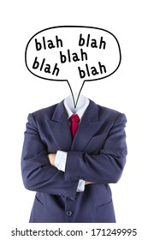
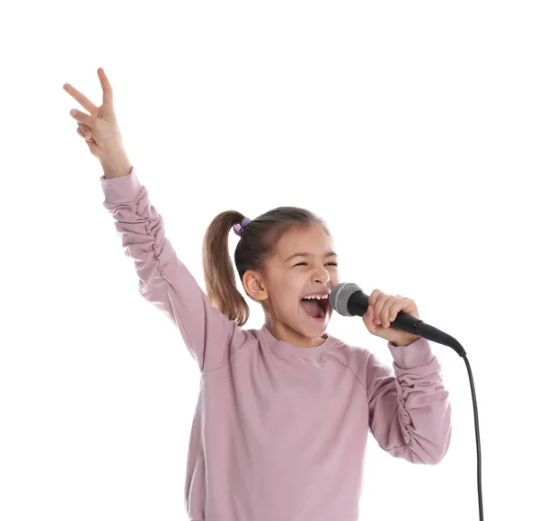
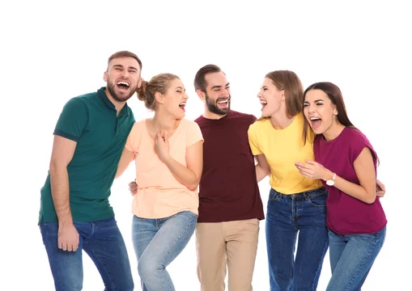
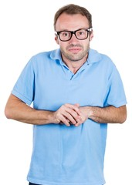
Vocabulary, adjectives of “personality”
Adjectives are words used to decribe the appearance or personality of a person
What are they like?
talkative
serious
kind
shy
funny
friendly

Slide 4
Vocabulary practice: What are they like?
Student´s book pg 21 ex 9A
Listen and practice

Slide 5
Vocabulary practice: What are they like?
Student´s book pg 21 ex 9B
Complete the chart with the Word from part A. Add two more words to each list.
Personality | Appearance
Serious | pretty
Quiet | handsome
Funny | short
Talkative | tall
shy | heavy
Friendly | thin
kind | Good looking

Slide 6
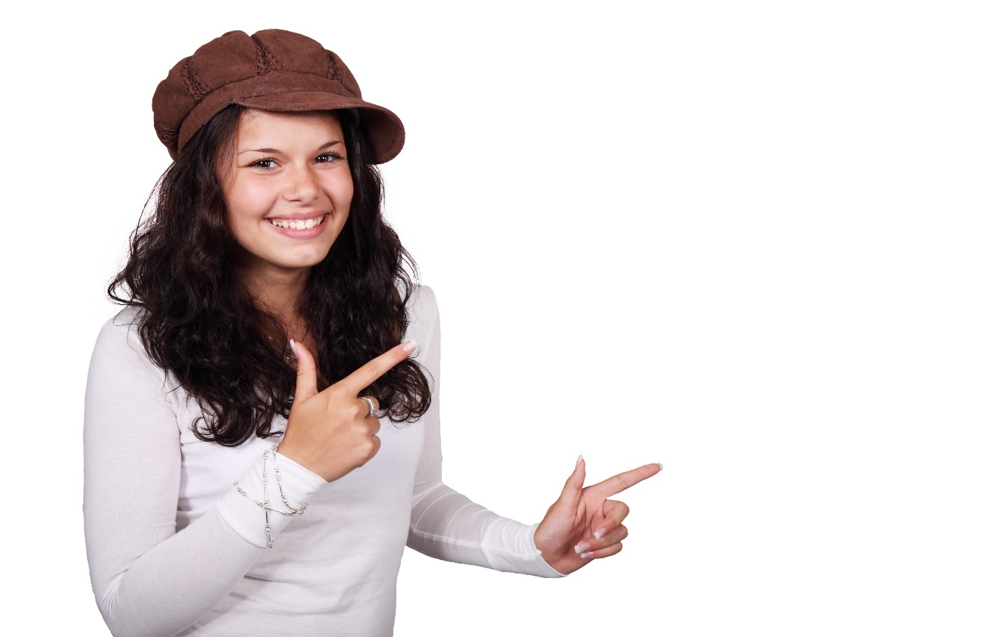
Speaking practice: What are you like?
Student´s book pg 21 ex 9C
Describe your appearance and personality, to a partner.
I am…
Personality | Appearance
serious | pretty
talkative | thin

Slide 7
Vocabulary practice: Descriptions
Workbook pg 17 ex 6A
Write sentences about the people in the pictures. Use the words in the box.
shy | kind
thin | heavy
short | tall
funny | serious
talkative
thin
talkative
heavy
serious
short
funny
Kind
tall

Slide 8
Grammar practice: Yes-No questions with be
QUESTIONS
ANSWERS
Be | subject | complement
Yes, | Subject | Be.
No. | Subject | Be not.
Am | I | shy ? talkative ? funny ?
Is | He
 | She
 | It
Are | You
are | We
 | They
Yes, | I | am,is are
 | He
 | She
 | It
No, |  | am not. is not. are not.
 | You
are | We
 | They

Slide 9
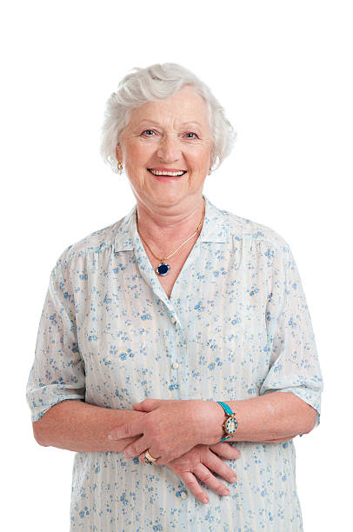
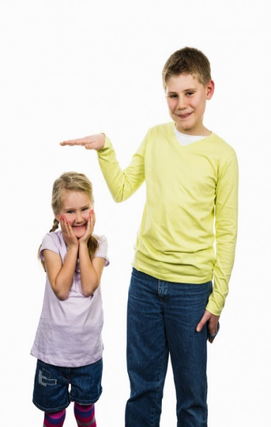
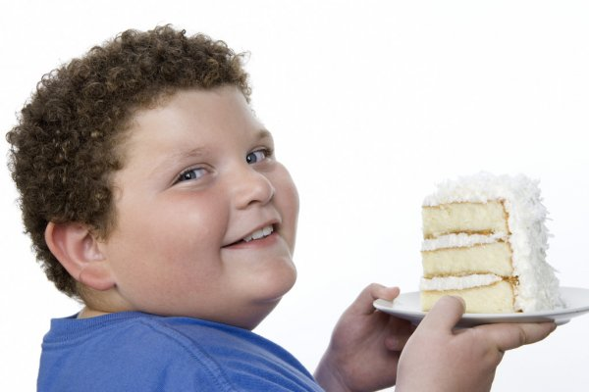
Speaking practice: “Yes no questions”
Answer the following yes/no questions
Is she young?
Yes, she is
Is she tall?
No, she´s not
Is he thin?
No, he´s bot
Are they thin?
Yes, they´re
Is he tall?
Yes , he is
Is he handsome?
Yes , he is

Slide 10
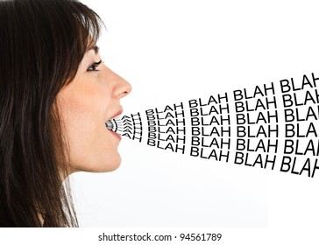
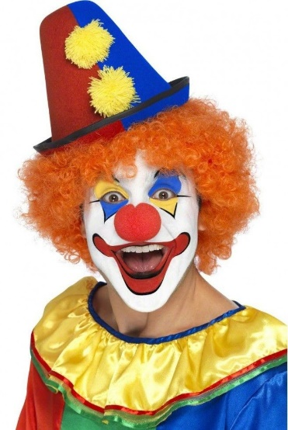
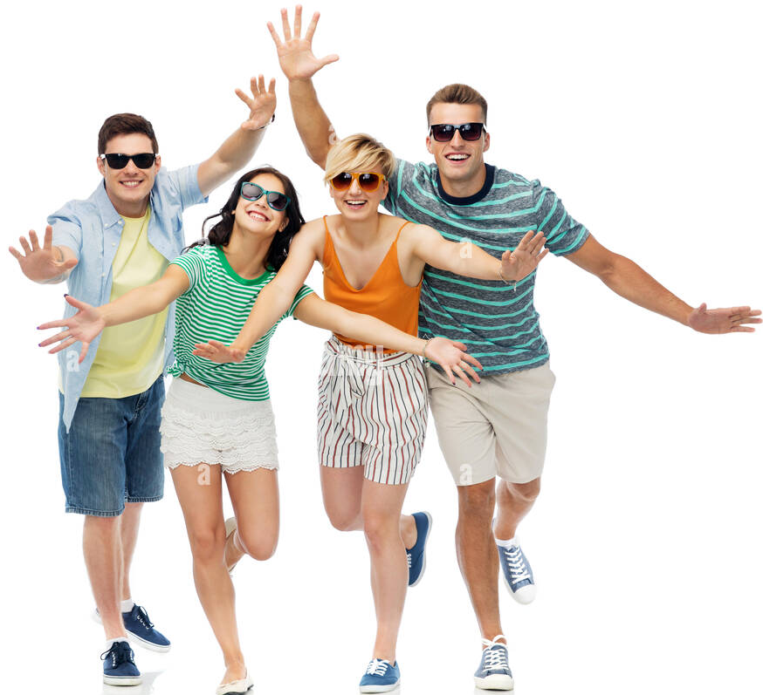
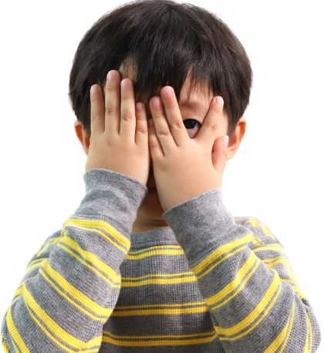
Speaking practice: “Yes no questions”
Answer the following yes/no questions
Is she serious?
No , she´s not
Is he shy?
No ,´he´s not
Is she short?
Yes , she is
Are they friendly?
Yes , they´re
Is she kind?
Yes , she is
Is he talkative?
No , he´s not

Slide 11
Vocabulary practice: Descriptions
Workbook pg 17 ex 6B
Answer the following questions.
No, she´s not
No , he´s not
No, she´s not
No , they´re not
No , she´s not
Yes , i´m
No , i´m not

Slide 12
Grammar practice: Wh questions with be
QUESTIONS
ANSWERS
What | Am | I | like ?
 | Is | He
 |  | She
 |  | It
 | Are | You
 | are | We
 |  | They
I | am
He | is
She
It
You | are
We
They

Slide 13
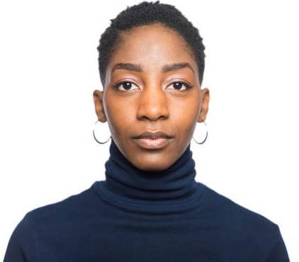
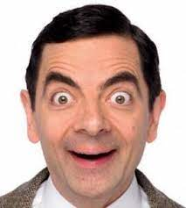
Grammar practice: Wh questions with be
Look at the following questions, They are used to ask about a person´s personality.
Ask a question to your partner about another classmate´s personality.
What´s Mary like?
She´s serious
What is Peter like?
He´s funny

Slide 14
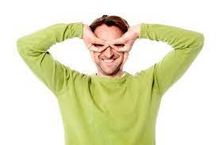
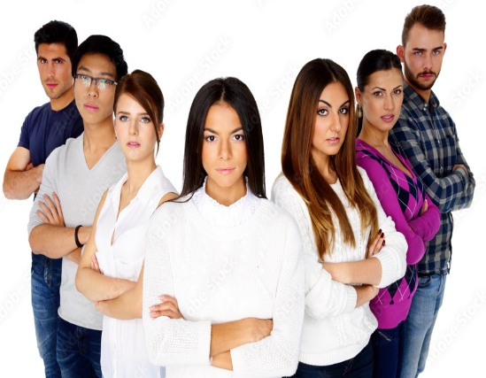
Grammar practice: “Wh questions”
Write wh questions then give an answer according to the picture.
Adam
Louis
Lily
What´s Louis like?
What´s Lily like?
She´s talkative
What´s Adam like?
He´s kind
Mark
What´s Mark like?
He´s funny
What´s are they like?
They´re serious
What´s are they?
They´re funny

Slide 15
Listening practice. “Wow! Who´s that?
Student´sbook pg 21 ex10
A. Listen to three descriptions. Check the two correct words for each description

Slide 16
Listening practice. “Where´s your friend Jacob?
Student´sbook pg 28 ex2
A. Listen to four conversations. Check the correct description for each person. You will check more than one adjective.
B. Write three yes/no questions about the people in part A. Then ask a partner the questions.
1.Is Monica tall? No, she´s not
2.Is Jacob short? Yes , he is
3.Is Hannah funny? Yes, she is

Slide 17
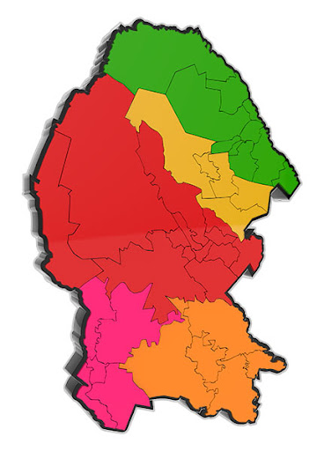
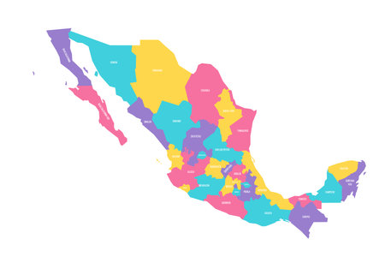
Vocabulary: Adjectives to describe places(cities)
What is your City like?
Is big
Is modern
Is ugly
What is Mexico like?
Is big
Is modern
Is beautiful

Slide 18
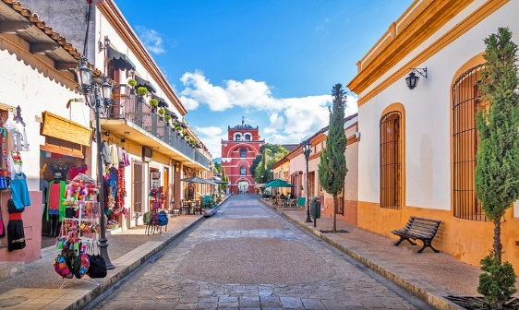
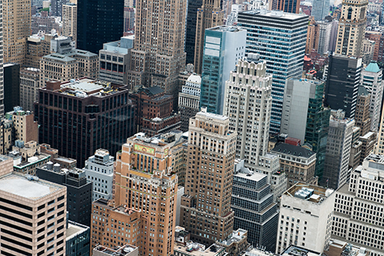
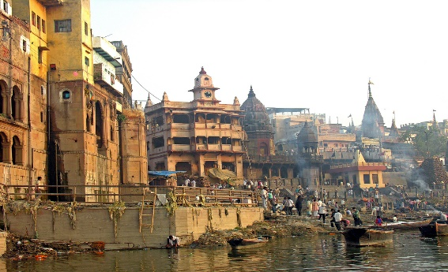
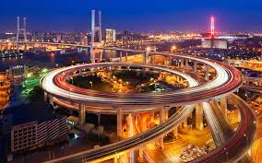
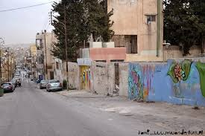
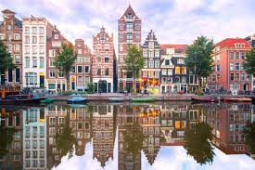
Vocabulary: Adjectives to describe places(cities)
small / big
old / modern
ugly / beautiful

Slide 19
Online practice: Vocabulary “adjectives to describe people”
https://wordwall.net/es/resource/2848738
Practice plural spelling rules with the following online activities.
Print screen with your score and insert here
https://wordwall.net/es/resource/34854464
Print screen with your score and insert here
https://wordwall.net/es/resource/22125544
Print screen with your score and insert here

Slide 20
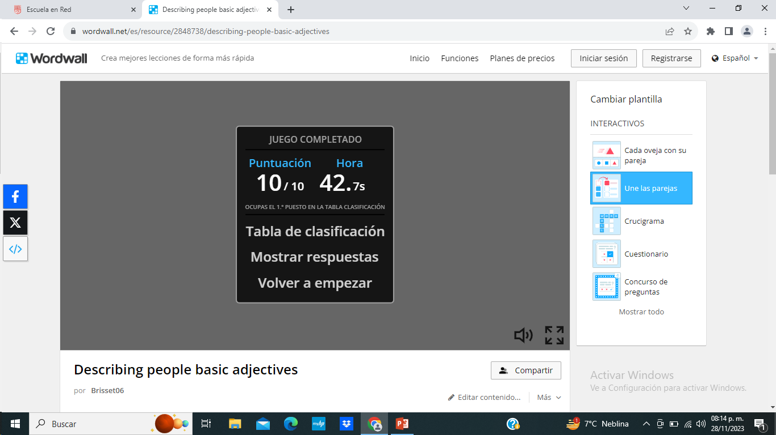
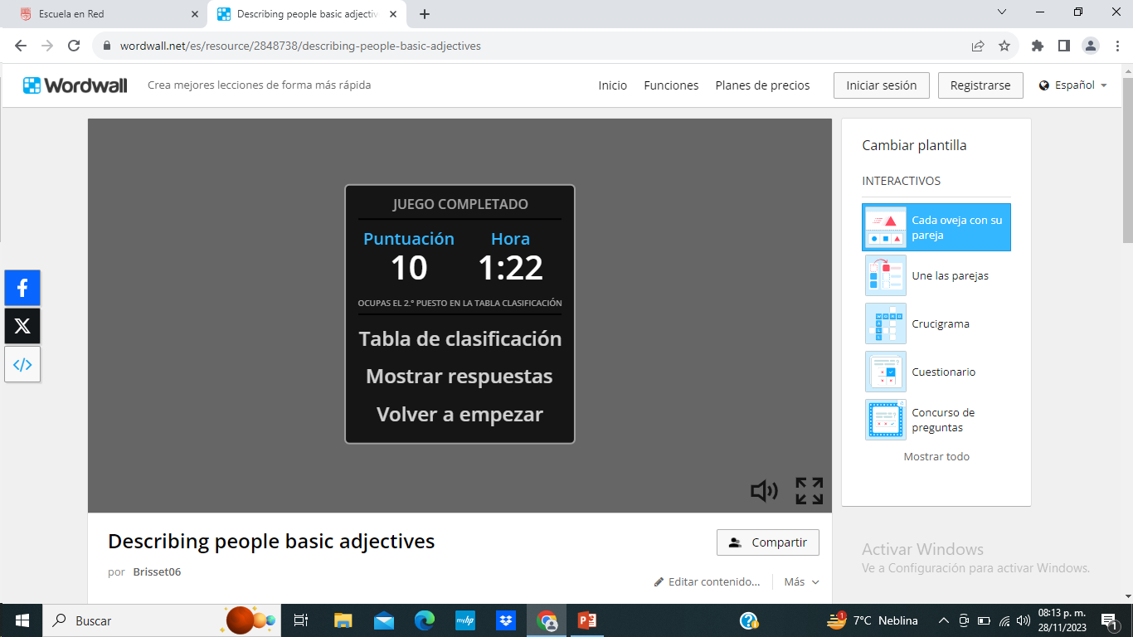
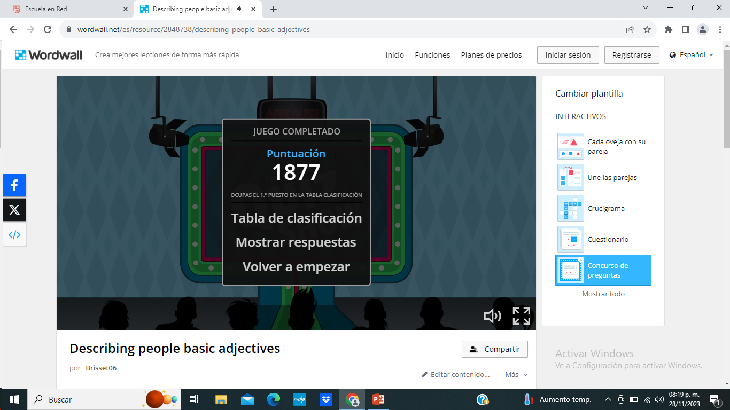
Primer link

Slide 21
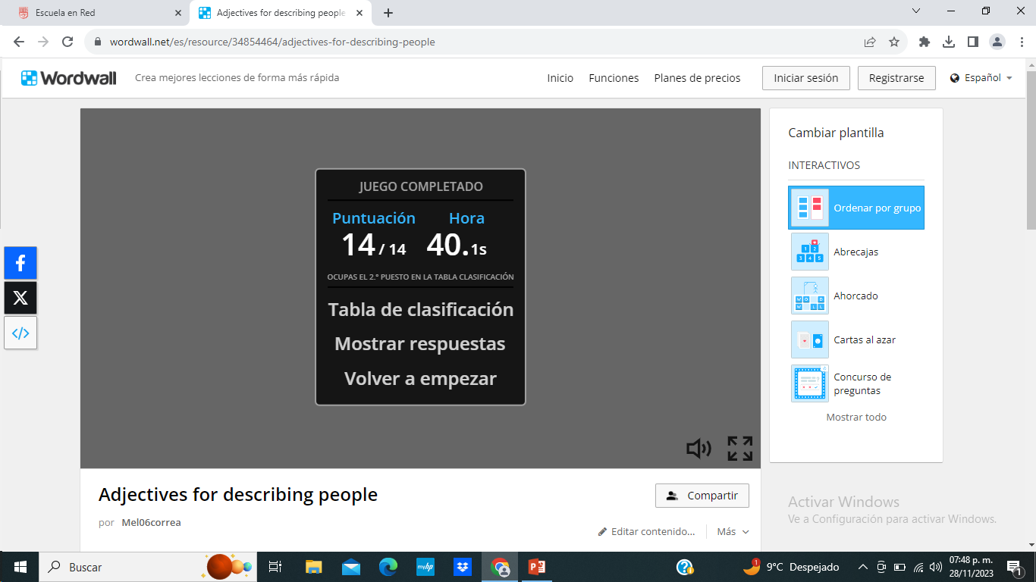
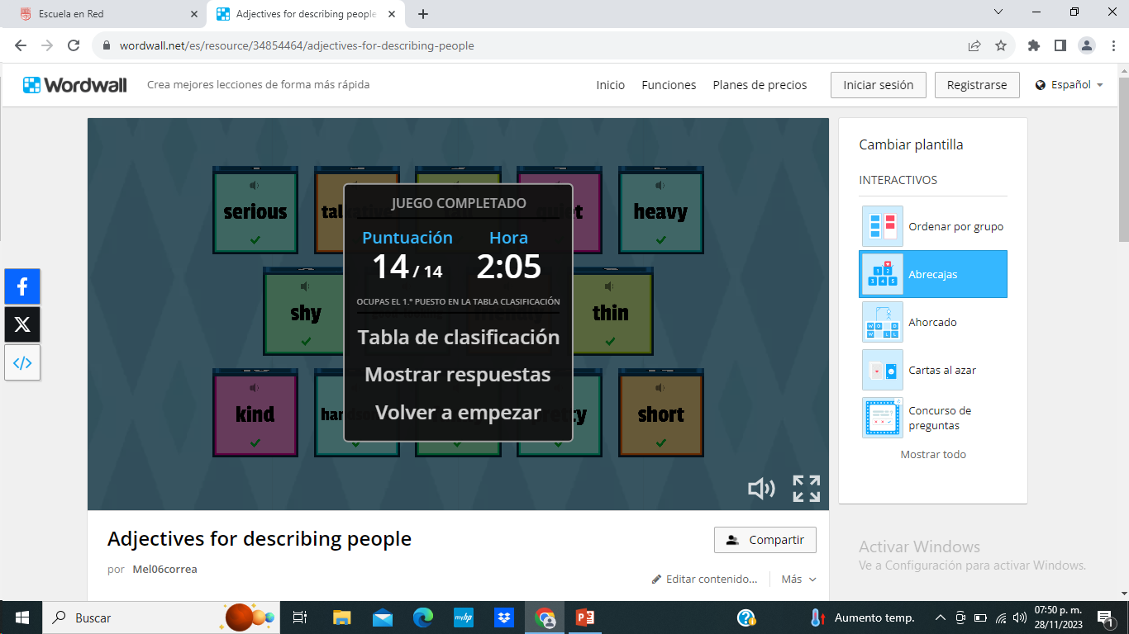
Segundo link

Slide 22
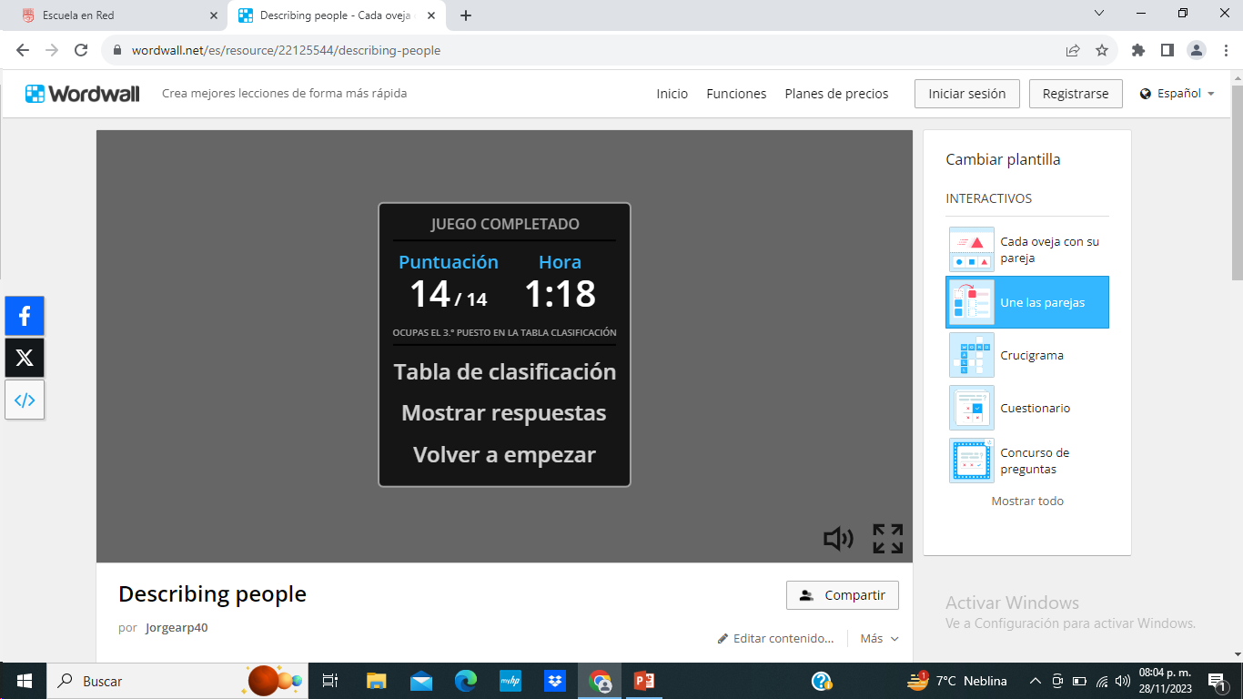
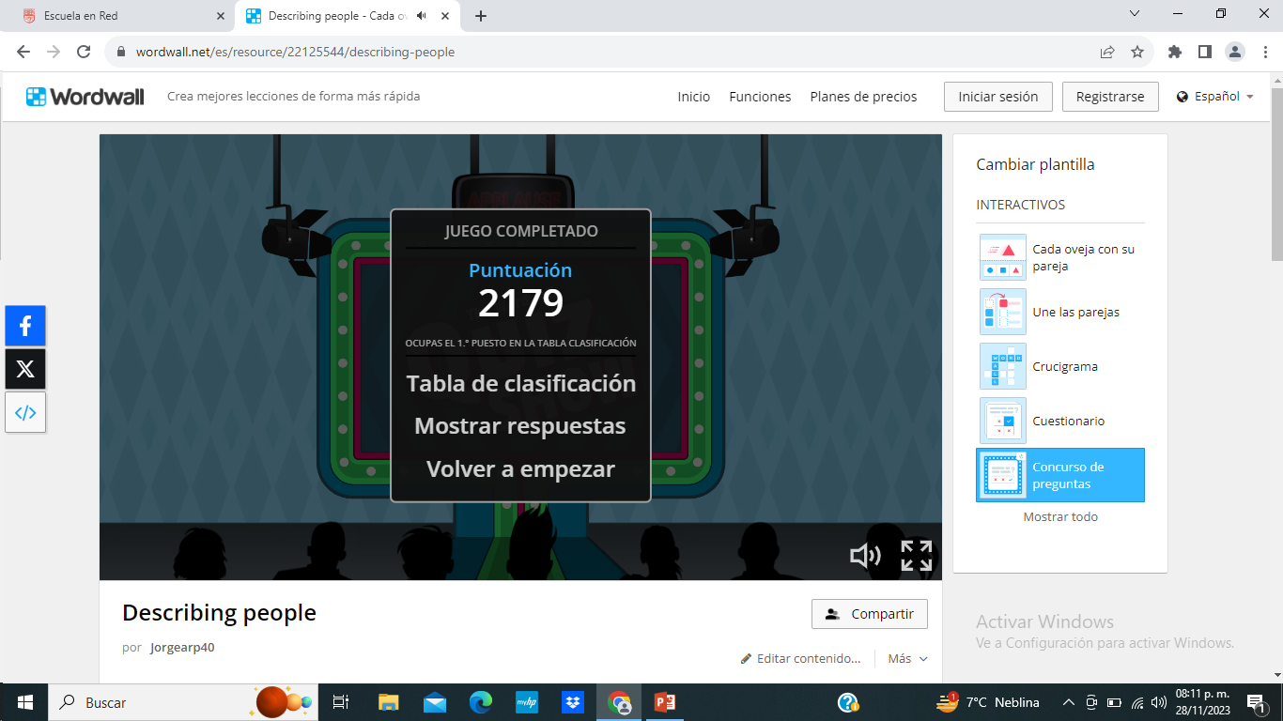
Tercer link

Slide 23
Grammar practice: Wh questions.
Look at the following questions. The first question is to ask about adjectives that describe physical appearance, The second question is to ask about personality.
What does she look like?
To ask about physical appearance
What´s he like?
To ask about personality

Slide 24
Grammar practice: Wh questions.
Answer the following questions.
What is she like? | What do they look like? | What does he look like?
She´s talkative | They´re thin | He´s handsome
What is he like? | What does she look like? | What are they like?
He´s shy | She´s short | They´re funny

Slide 25
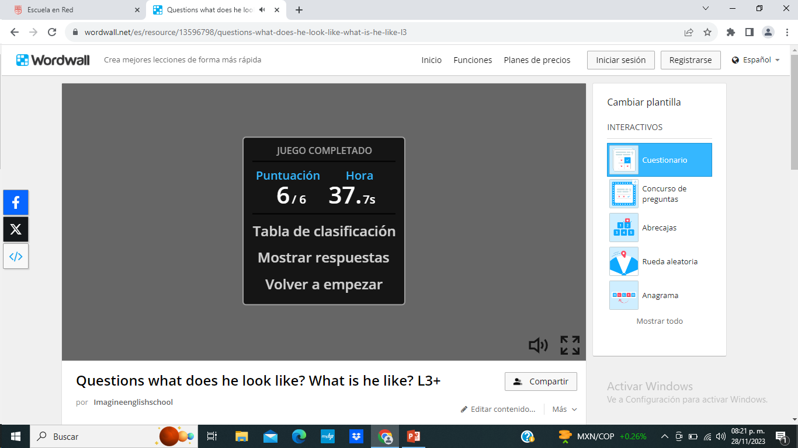
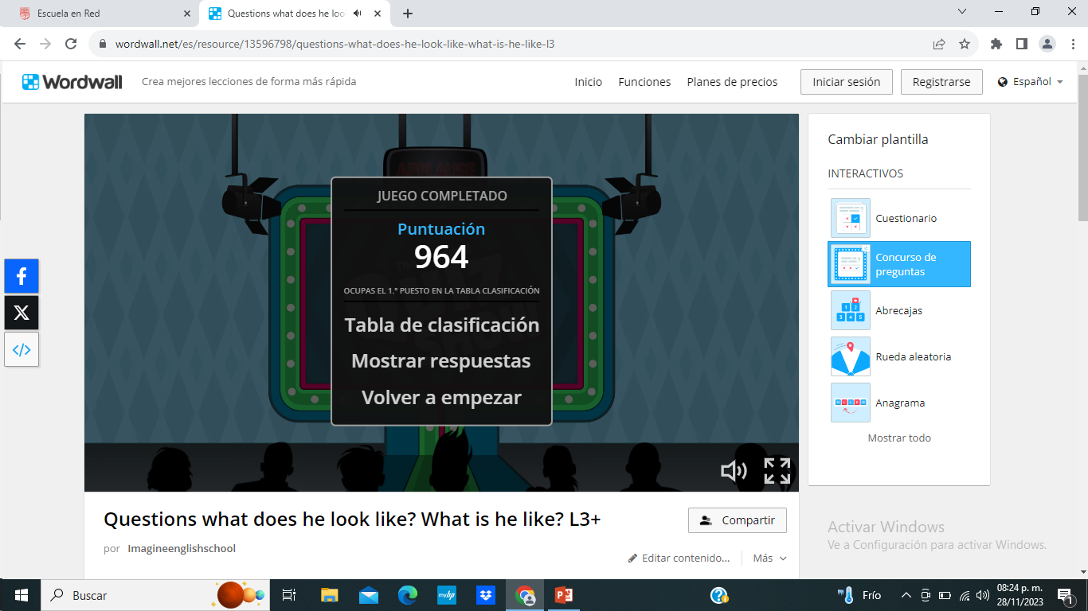
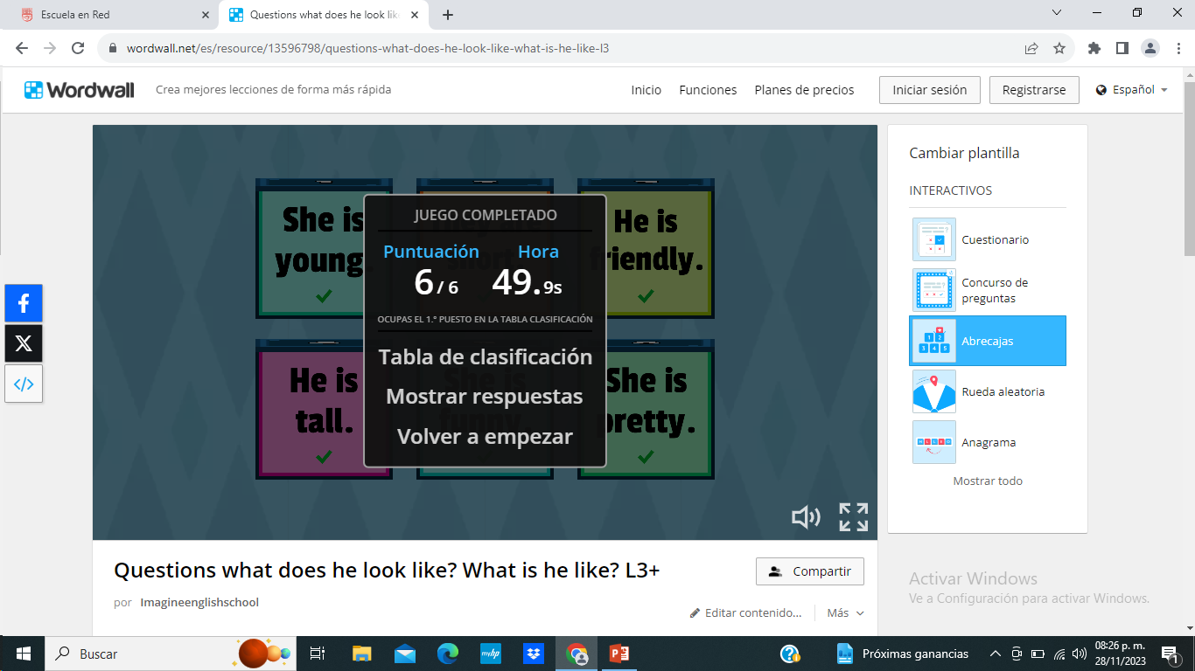
Online practice: Wh questions
Practice plural spelling rules with the following online activities.
Print screen with your score and insert here
https://wordwall.net/es/resource/13596798

