Slide 1
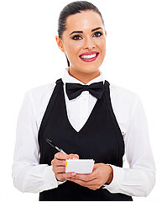
UNIT 3
Lesson 4
What would you like to order?
LESSON OBJECTIVE:
Use would and will to order food at a restaurant.

Slide 2
GRAMMAR FOCUS “Would and Will for requests”
GRAMMAR FOCUS “Would and Will for requests”
Student´s book pg 19
Studentbook pg 19
We use modals would and will for requests:
Me gustaría ordenar…
Que te gustaría ordenar/pedir
Informal
Que tipo de sopa le gustaría ordenar
Formal
Que le gustaría ordenar para tomar
Quisiera ordenar algo más
Desear o querer

Slide 3
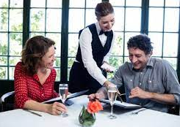
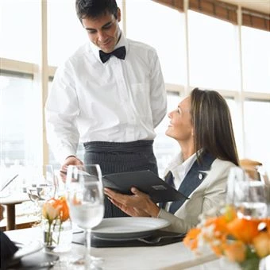
GRAMMAR FOCUS “Would and Will for requests”
GRAMMAR FOCUS “Would and Will for requests”
Student´s book pg 19
Studentbook pg 19
Modal would is used to :
offer something to someone in a more polite manner.
Would you like some soup?
What kind of soup would you like?
Would you like to order?
What would you like to drink? What would you like to eat? What would you like to shop?
say that we want something in a more polite manner.
I´d like a veggie Burger
I´d like the onion soup.
I´d like to drink tea

Slide 4
Grammar Practice
Complete this conversation with would like or would like to
1.- I´m thisty. I__would like to _______ a glass of wáter, please.
2.- __Would __ you __ like_______to__ drink something?
3.- __Would____ you ___like___ chocolate or vanilla ice-cream?
4.- What pizza combo would_ you ___like_____to___ order?
5.-___Would___ you _like_______ a Cesar or a Green salad?
6.-What ____would ___ you ____like___to____ drink?
7.-I ___wolud like___________ a veggie burger.
8.-I ____wolud like____to____ eat a slice of chocolate cake.

Slide 5
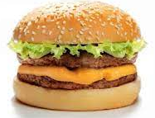
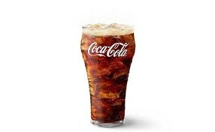
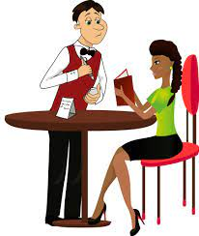
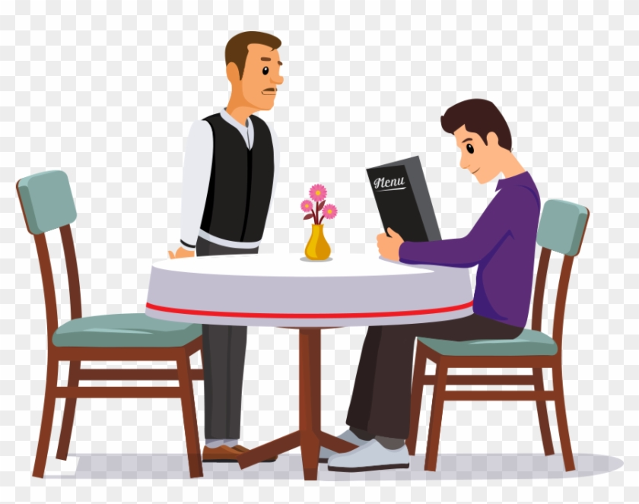
GRAMMAR FOCUS “Would and Will for requests”
GRAMMAR FOCUS “Would and Will for requests”
Studentbook pg 19
Student´s book pg 19
Modal will have is used to :
express our decision about something, is to say what we want in a less polite manner.
I´ll have a veggie Burger.
I´ll have the onion soup.
I´ll have a coffee.
Grammar Practice
Complete the conversations with I will have / I´ll have
What would you like to order?
What would you like to drink?
_I”ll have a burger__
__I”ll have a soda

Slide 6
Listening Practice “May I take your order”
Student´s book pg 18 ex 6
A. Listen and practice, circle the modals in this ocnversation.
B. Listen to the server talk to the next customer.
What does she order? I like the chicken , salad, and large orange juice

Slide 7
Grammar Practice
Complete this conversation with Would (´d) or Will. (´ll)
1.- A:What___would _you like to __ order?
B:I_”ll__ have the fried chiken.
A:__Would _you like ____ rice or potatoes?
B:I’d_ like potatoes.
A:What kind of potatoes _would you like _?
B: I ‘d_ like the mashed potatoes.
A:__Would you like___ a beverage?
B: Yes, please. I____”ll____ have a lemonade.

Slide 8
Grammar Practice
Student´s book pg 19 ex 7
Complete this conversation with Would or Will.
would
will
Would
would
would
will
like
like
would
would
will

Slide 9
Grammar Practice
Workbook pg 16 ex 5
Use one or more words to complete this conversation between a server and a customer.
Would yo like
I would
anything
I would
please
thanks
be

Slide 10
Grammar Practice
Student´s book pg 84 ex2
Complete this conversation with Would, I´d or I´ll.
I will
Would
I will
Would
Would
I’d

Slide 11
Grammar Practice
Workbook pg 17 ex 6
Choose the correct responses
No, thanks
I’d like soup, please
Vainilla, please
I”ll have pepperoni
That’ll be all,thanks

Slide 12
Listening Practice “Working late”
Student´s book pg 20 ex 9
A. Steven and Sarah are working late. Listen as their boss asks what they would like to dinner. What do they order? Fill in the blanks.
Soshes
Small
peppers
Vinegret
italia
Cream
Ice tea
Suggar
lemond
chocolate cake
Pay blueberry
B. Listen to their conversation after the food arrives.
Write the two ítems that are missing from the order
Steven | Sarah
Cream | Blue Berry pay

Slide 13
Listening Practice “In a restaurant”
Student´s book pg 28 Ex 2
A. Listen to six requests in a restaurant. Check the best response.

Slide 14
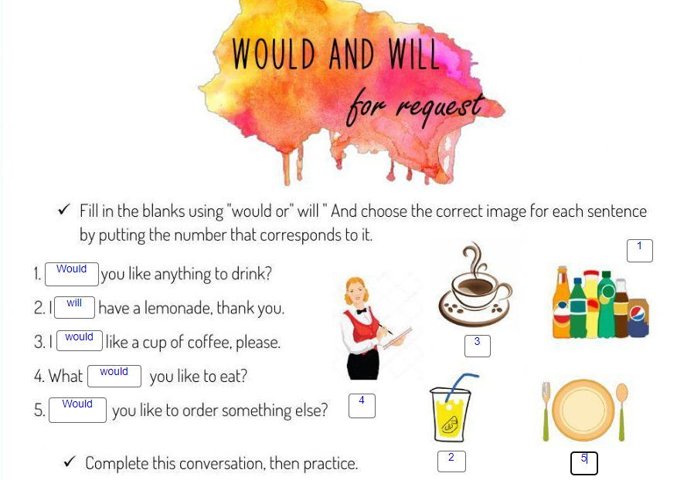
Grammar Practice “In a restaurant”
Click on the following link to practice Would like and Will have.
https://es.liveworksheets.com/worksheets/en/English_language/Modal_verbs/Would_and_will_for_requests._ir1305484xy

Slide 15
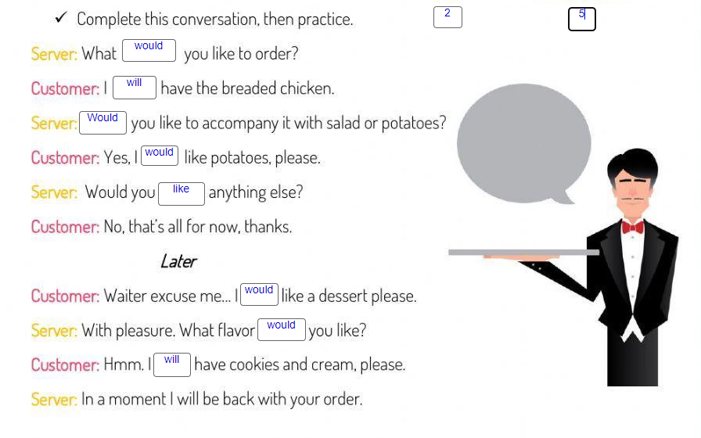

Slide 16
Speaking Practice “At a coffee shop”
Student´s book pg19 Ex 8
Role play a conversation using modals to requets in a coffee shop
Student A: You are a customer at a coffee shop. Order what you want for lunch.
Student B: You are the server. Take your customer´s order.

