Slide 1
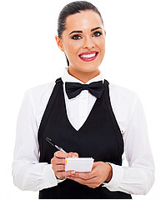
UNIT 3
Lesson 4
What would you like to order?
LESSON OBJECTIVE:
Use would and will to order food at a restaurant.

Slide 2
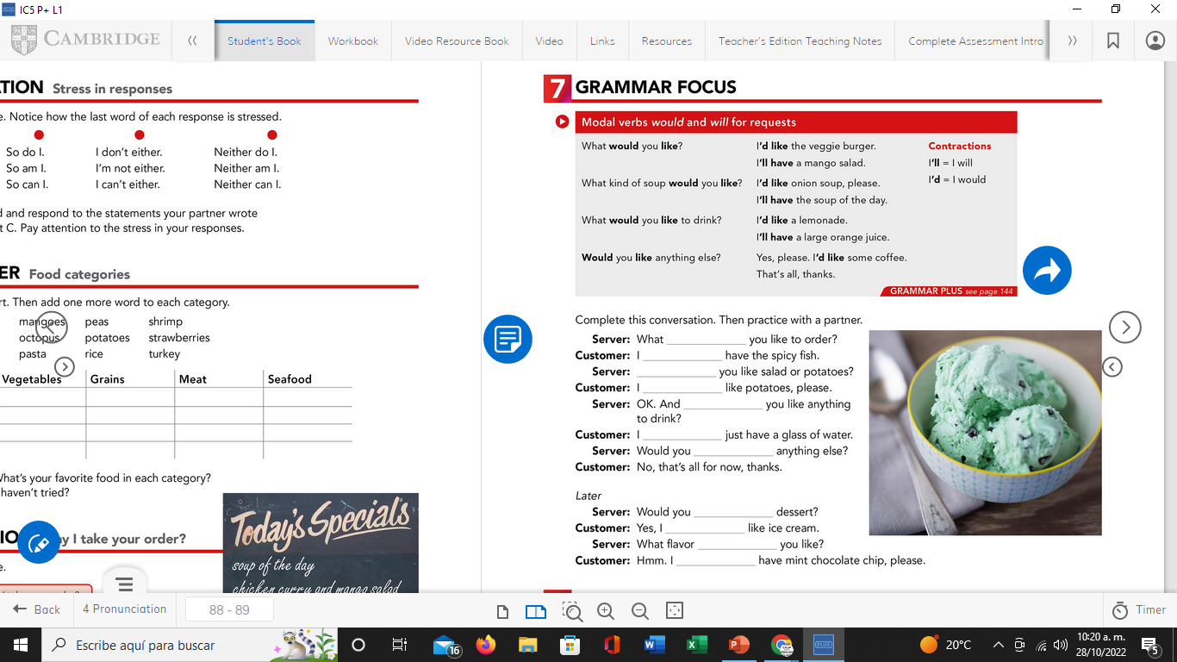

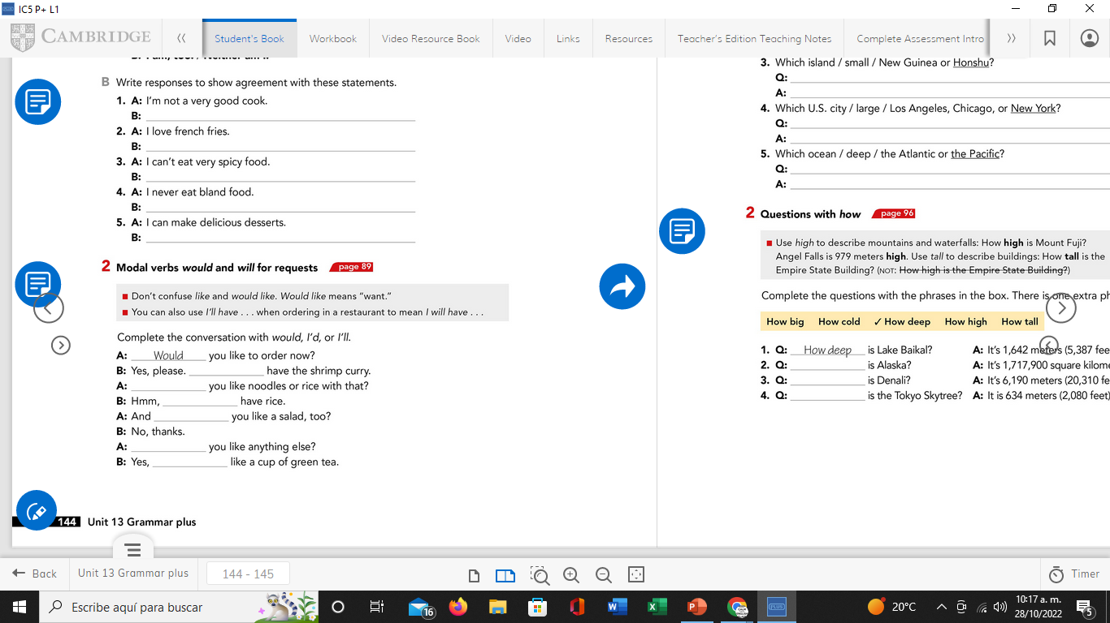
GRAMMAR FOCUS “Would and Will for requests”
GRAMMAR FOCUS “Would and Will for requests”
Student´s book pg 19
Studentbook pg 19
We use modals would and will for requests:

Slide 3
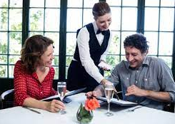
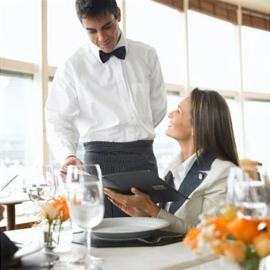
GRAMMAR FOCUS “Would and Will for requests”
GRAMMAR FOCUS “Would and Will for requests”
Student´s book pg 19
Studentbook pg 19
Modal would is used to :
offer something to someone in a more polite manner.
Would you like some soup?
What kind of soup would you like?
Would you like to order?
What would you like to drink?
say that we want something in a more polite manner.
I´d like a veggie Burger
I´d like the onion soup.
I´d like to drink tea

Slide 4
Grammar Practice
Complete this conversation with would like or would like to
1.- I´m thisty. I would like a glass of wáter, please.
2.- Would you like drink something?
3.- Would you like chocolate or vanilla ice-cream?
4.- What pizza combo Would you like to order?
5.-_Would you like to a Cesar or a Green salad?
6.-What would you like to drink?
7.-I would like a veggie burger.
8.-I would like to eat a slice of chocolate cake.

Slide 5
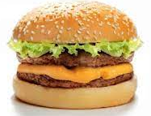
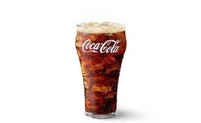
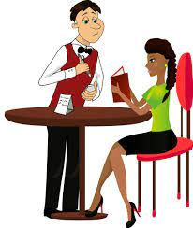
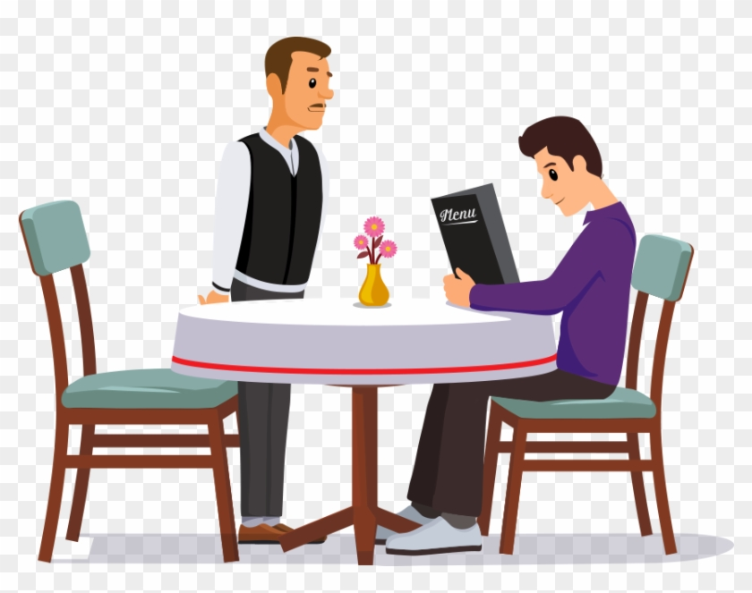
GRAMMAR FOCUS “Would and Will for requests”
GRAMMAR FOCUS “Would and Will for requests”
Studentbook pg 19
Student´s book pg 19
Modal will have is used to :
express our decision about something, is to say what we want in a less polite manner.
I´ll have a veggie Burger.
I´ll have the onion soup.
I´ll have a coffee.
Grammar Practice
Complete the conversations with I will have / I´ll have
What would you like to order?
What would you like to drink?
_______________
_____________

Slide 6
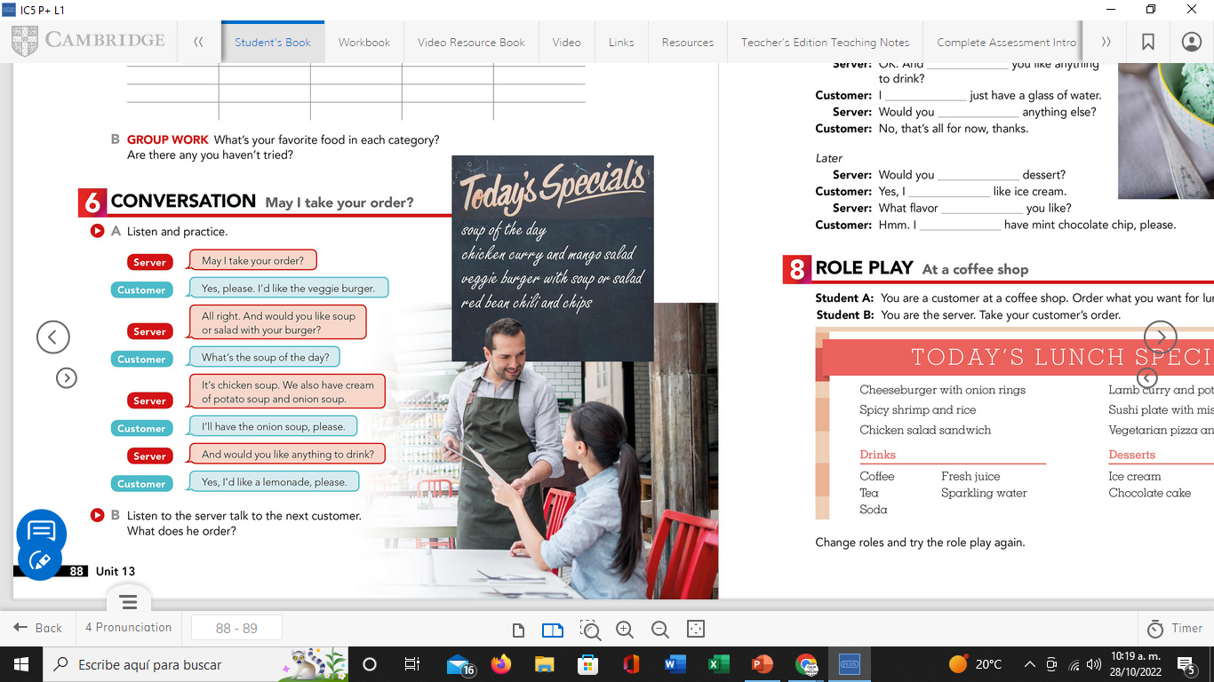

Listening Practice “May I take your order”
Student´s book pg 18 ex 6
A. Listen and practice, circle the modals in this ocnversation.
B. Listen to the server talk to the next customer.
What does she order?
Chicken curry and salad.

Slide 7
Grammar Practice
Complete this conversation with Would (´d) or Will. (´ll)
1.- A:What would you like to order?
B:I´ll have the fried chiken.
A:Would you like rice or potatoes?
B:I´d like potatoes.
A:What kind of potatoes would you like?
B: I´d like the mashed potatoes.
A:Would you like a beverage?
B: Yes, please. I´ll have a lemonade.

Slide 8
Grammar Practice
Student´s book pg 19 ex 7
Complete this conversation with Would or Will.
would
´ll
Would
´d
Would
´ll
like
like
´d
would
´ll

Slide 9
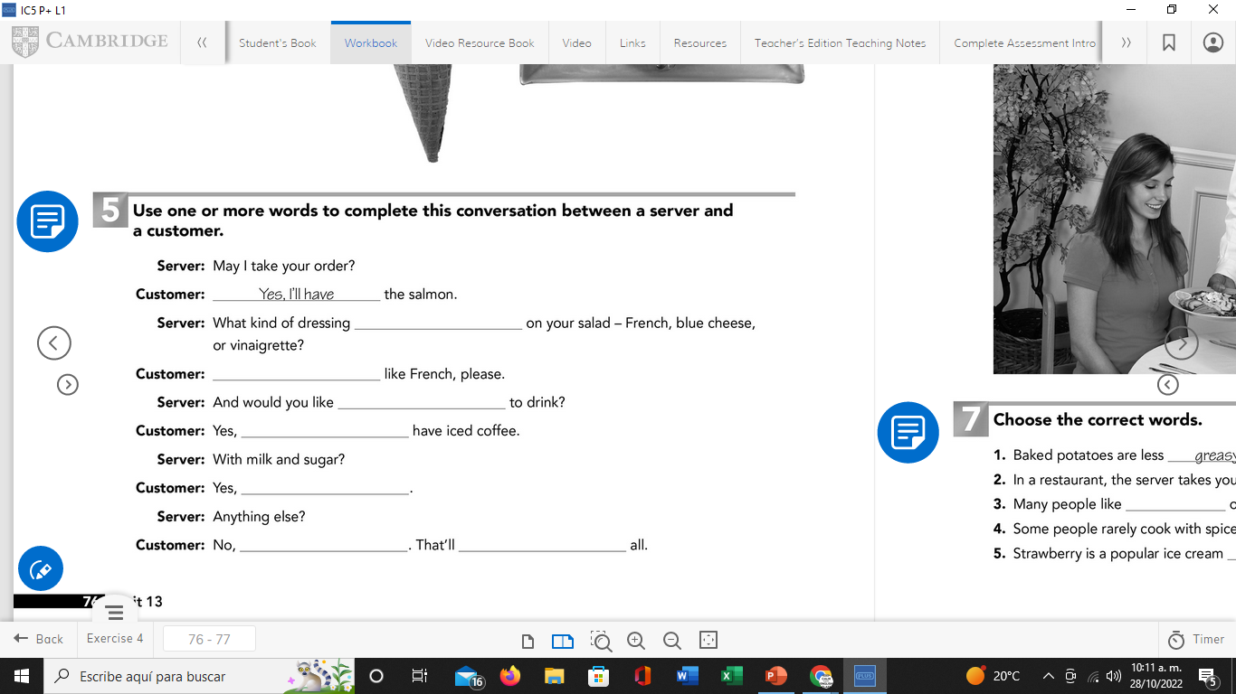
Grammar Practice
Workbook pg 16 ex 5
Use one or more words to complete this conversation between a server and a customer.
would you like
I´d
anything
I´ll
please
thanks
for now

Slide 10
Grammar Practice
Student´s book pg 84 ex2
Complete this conversation with Would, I´d or I´ll.
I will
Would
I will
Would
Would
I´d

Slide 11
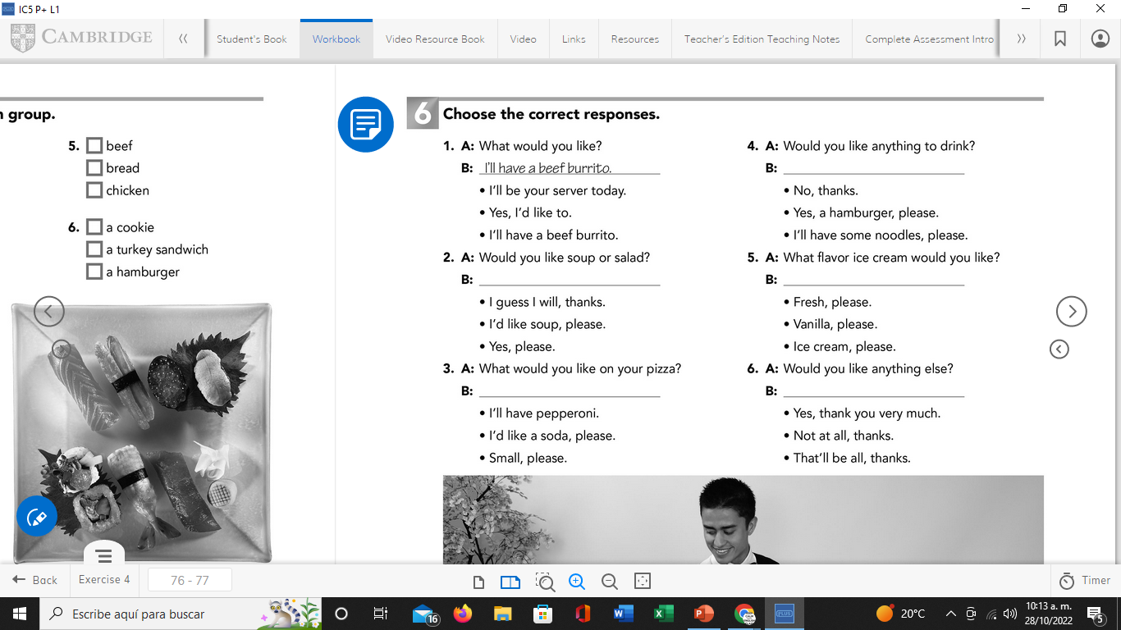
Grammar Practice
Workbook pg 17 ex 6
Choose the correct responses
No, thanks.
I’d like soup, please.
Vainilla, please.
I’ll have pepperoni.
That’ll be all, thanks.

Slide 12
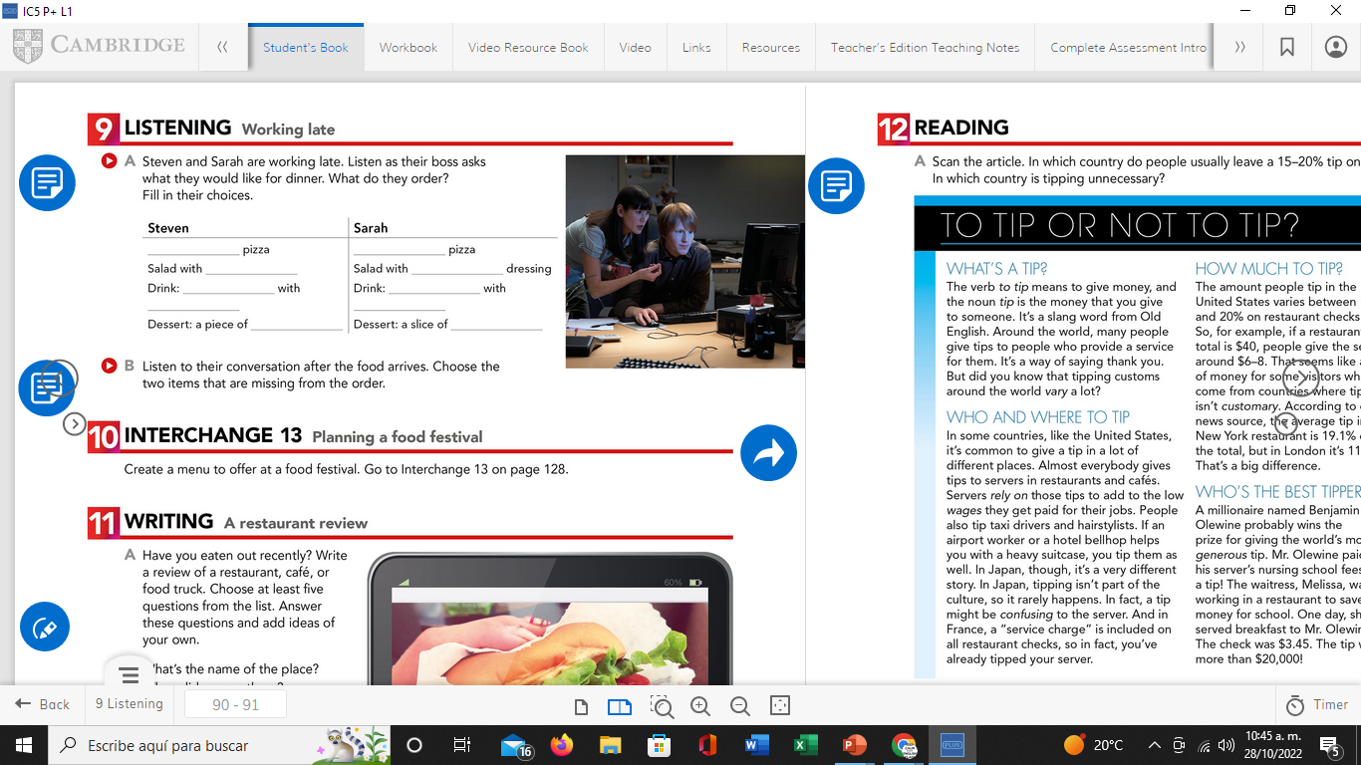
Listening Practice “Working late”
Student´s book pg 20 ex 9
A. Steven and Sarah are working late. Listen as their boss asks what they would like to dinner. What do they order? Fill in the blanks.
Small sausage
Small pepperoni
vinaigrette
vinaigrette
coffe
Ice tea
cream
lemon
Chocolate cake
Blueberries pay
B. Listen to their conversation after the food arrives.
Write the two ítems that are missing from the order
Steven | Sarah
cream | Blueberrie

Slide 13
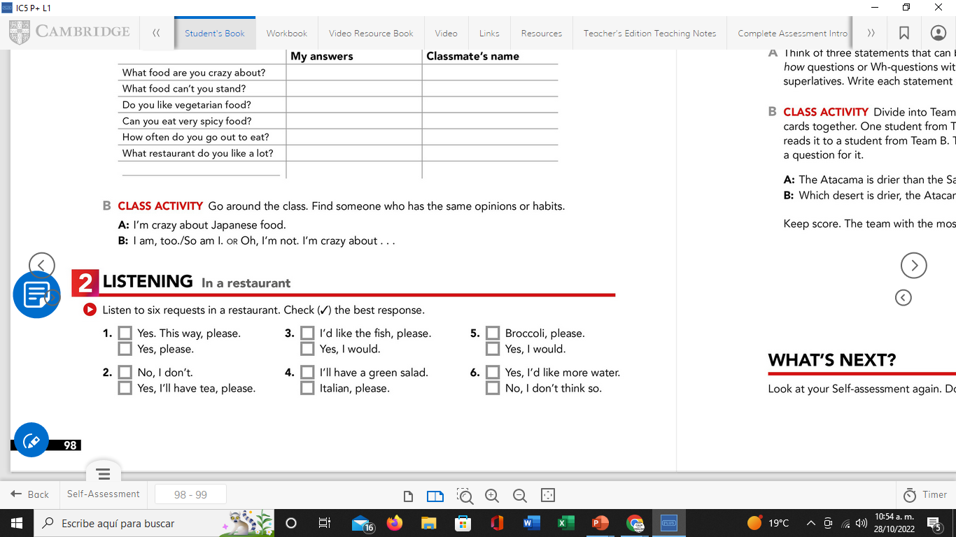






Listening Practice “In a restaurant”
Student´s book pg 28 Ex 2
A. Listen to six requests in a restaurant. Check the best response.

Slide 14
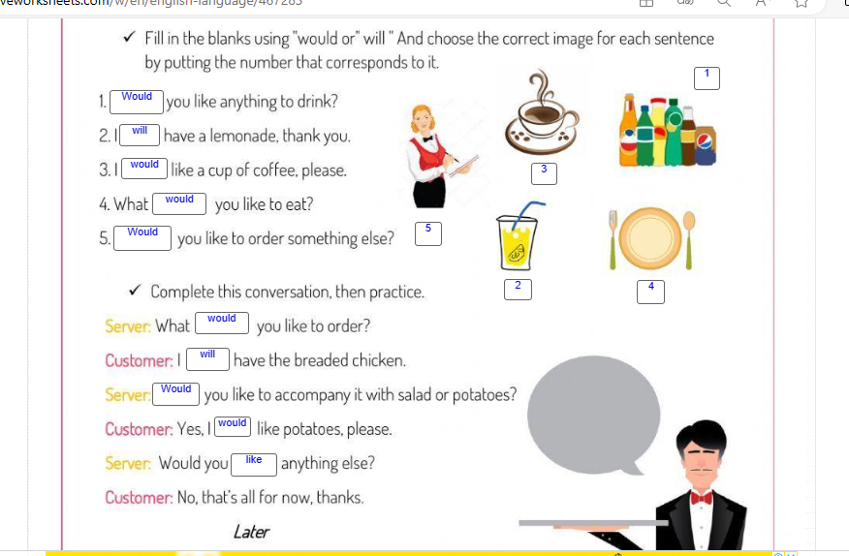
Grammar Practice “In a restaurant”
Click on the following link to practice Would like and Will have.
https://es.liveworksheets.com/worksheets/en/English_language/Modal_verbs/Would_and_will_for_requests._ir1305484xy

Slide 15
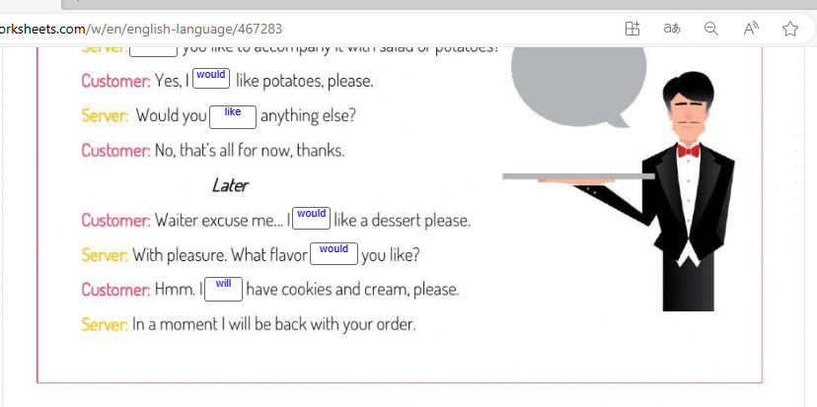

Slide 16
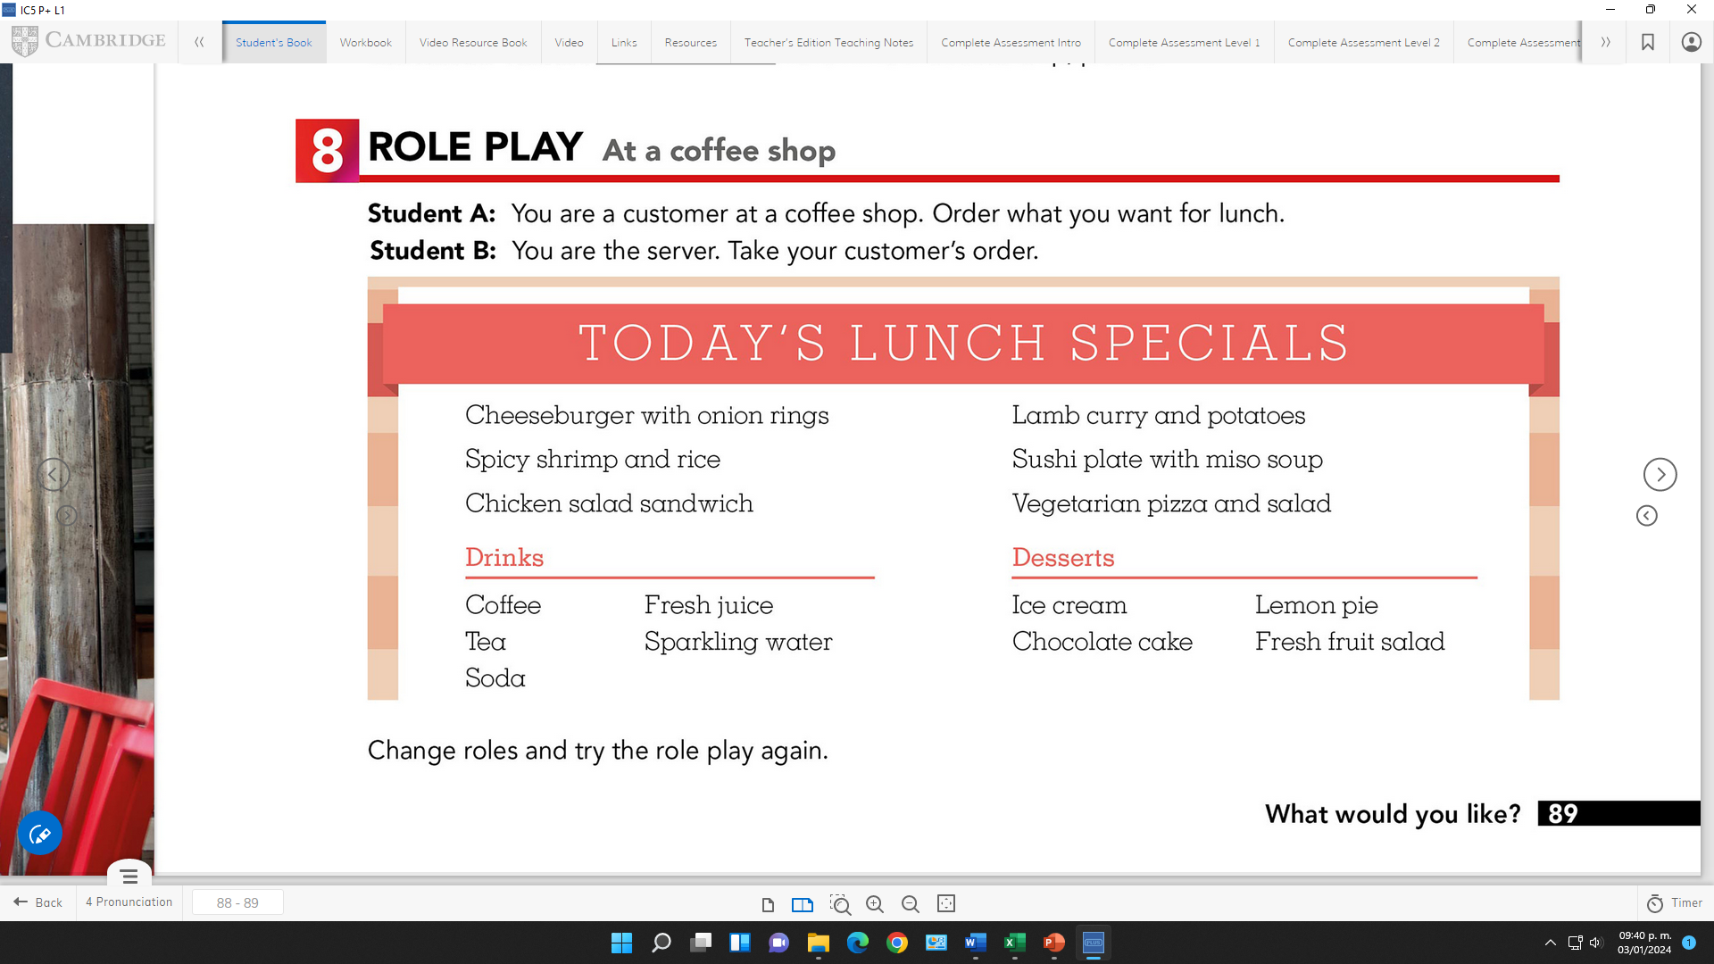
Speaking Practice “At a coffee shop”
Student´s book pg19 Ex 8
Role play a conversation using modals to requets in a coffee shop
Student A: You are a customer at a coffee shop. Order what you want for lunch.
Student B: You are the server. Take your customer´s order.

Slide 17
Student A: Would you like to order now?
Student B: Yes, please. I’ll have the Chicken salad sandwuch.
Student A: Would you like fried or roasted chicken?
Student B: I’d like roast chicken.
Studen A: Would you like anything to drink?
Student B: Yes, I’d like more fresh juice.
Student A: Would you like anything else?
Student B: That’ll be all, thanks.

