Slide 2
Escuela Normal de Educación Preescolar School year 2023-2024 English A1.1 STARTING BASIC COMMUNICATION
Term I
Number of hours/ Credits: 4/ 4.75
Class schedule: Tuesday 11:00 A.M. – 12:30 P.M. and Friday 9:15 A.M. – 10:45 A.M.
Teacher: Maria Elena Meza Aguado

Slide 3
Purpose
The English Language Course for Escuelas Normales is designed to develop students’ ability to communicate effectively in English contexts that will be important for them. As future teachers in a society where English is increasingly important for engaging successfully with professional and social activities, it is essential that all students develop a good level of proficiency in English.

Slide 4
English is growing in importance for accessing information, making useful contacts, understanding other cultures and participating in cultural activities.
As UNESCO has said: Linguistic competencies are fundamental for the empowerment of the individual in democratic and plural societies, as they condition school achievement, promote access to other cultures and encourage openness to cultural exchanges (UNESCO 2007:13). English is particularly important for students because of its role in multinational communicative settings (Hyland 2011).

Slide 5
The course has three main objectives:
Develop their ability to use English in personal and social communications, to develop relationships, complete transactions and meet everyday needs.
Increase their engagement with cultural and intercultural activities in English, in order to develop a better understanding of their own culture as well as other cultures around the world.
Develop their ability to teach in a school environment where English is an important aspect of the school’s approach. Schools are expected to use English increasingly for various teaching and learning activities, and future teachers need to be confident in using English in the school environment.

Slide 7
Course Progression
Previous and subsequent courses

Slide 8
BASIC
INDEPENDANT
PROFICIENT

Slide 9
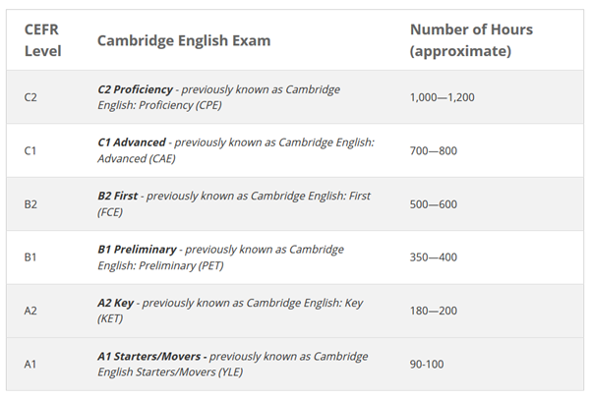
How long does it take to learn English?

Slide 10
CEFR
Common
European
Framework of
Reference

Slide 11
Course Description
The English language course is based on the communicative approach to language learning in line with the Common European Framework of Reference form the Council of Europe. More specifically, there are five main principles of language learning that underpin this curriculum:
Focus on meaningful communication
Teach authentic English.
Students learn most effectively through doing.
Students learn best when motivated and engaged
Differentiate the teaching according to different interests and needs among each group of students.

Slide 12
Competences of the degree profile developed by the course
GENERIC
Use critical and creative thought for solving problems and taking decisions.
Learn in an autonomous way and demonstrate initiative for self-regulation and strengthen her /his personal development.
Cooperate to bring about innovative projects having a social impact.
Act within an ethical way by interiorizing social rules and principles needed for a better coexistence.
Use ICT as well as other languages for understanding, explaining and offering alternative solutions to the problems encountered.

Slide 13
Competences of the degree profile developed by the course
SUBJECT-SPECIFIC
Describe ways of living from different cultures to appreciate their diversity.
Use language to establish harmonious and responsible relationships when exercising citizenship.
Reflect on one´s own learning process to act consciously in communicative exchanges.
Understand and produce texts to participate in a variety of everyday and concrete situations.
Exchange basic information about personal and professional experiences.
Recognize cultural differences when participating in brief and common exchanges.

Slide 14
Course purpose
Learning UNIT 1
BOOK Unit 2:
Identifying and discuss personal and classroom objects using the articles a/an, plurals, this/these, and it/they.
Discussing the location of items using yes/no and where questions with be, the article the, and prepositions of place.
Identifying the owner of something
Thanking someone
Expressing pleasure, disbelief and disappointment
Thinking before responding
Agreeing
Realizing something
BOOK Unit 1:
Saying hello and make introductions using my, your, his, and her
Saying good-bye and exchange contact information using subject pronouns and the verb be
Checking and confirming information
Getting someone’s attention
Thanking someone
Expressing surprise
Apologizing
Giving an opinion

Slide 15
Course purpose
Learning UNIT 3
Learning UNIT 2
BOOK Unit 13:
Discussing work and free-time clothes and colors using possessive adjectives, possessive pronouns, and possessives with names.
Discussing the weather and what people are wearing using the present continuous and conjunctions
Talking about preferences
Making a contrast and a suggestion
Getting someone’s attention
Asking about a problem
Expressing distress and pleasure
Agreeing with a suggestion
BOOK Unit 3:
Discussing cities, countries, nationalities, and languages using yes/no questions with be.
Discussing people´s appearances, personalities, and ages using Wh-questions with be.
Getting someone’s attention
Introducing a different topic and an explanation or idea
Expressing surprise

Slide 16
Structure (Contents and learning unit)
PERIOD | BOOK UNITS | CONTENTS | LEARNING EVIDENCES
1 | 1: What’s your name? | Alphabet; greetings and leave- takings; names and titles of address; numbers 0 0–10, phone numbers, and email address | #1 Personal information cards. Introduce themselves and ask questions using the personal card Ss created.
 | 2: Where are my keys? | Possessions, classroom objects, personal items, and locations in a room. | #2 My favorite things. Create a book cover with drawings, pictures and photos of the favorite things.
2 | 3: Where are you from? | Cities and countries; adjectives of personality and appearance; numbers 11–103 and ages. | #3 Where are you from?. A map and the partner’s picture to describe a hometown and the people in the photo.
3 | 4: Is this coat yours? | Clothing, colors, weather and seasons. | #4 Fashion Show. Perform your fashion show. Describe the clothes and colors the models wear.

Slide 18
 | weeks | month | days
 | 1 | August | 28-01 | Introduction, Diagnosis
 | 2 | September | 04-08
 | 3 |  | 11-15
 | 4 |  | 18-22
 | 5 |  | 25-29 | Projects and Tests I
 | 6 | October | 02-06 | Revision I
 | 7 |  | 09-13 | 9,10, 11 y 12 Immersion en J de N, Institutional evaluation I
 | 8 |  | 16-20
 | 9 |  | 23-27
 | 10 |  | 30-03 | 02 holiday,
 | 11 | November | 06-10 | Projects and Tests II
 | 12 |  | 13-17 | Revision II
 | 13 |  | 20-24 | 20 holiday, Institutional evaluation II
 | 14 |  | 27-01
 | 15 | December | 04-08 | 5,6,7 y 8 Immersion en J de N
 | 16 |  | 11-15 | Projects and Tests III
 |  |  | 18-22 | Christmas Holidays
 |  |  | 25-29
 | 17 | January | 01-05 | 03 back to School
 | 18 |  | 08-12 | Revision III
 | 19 |  | 15-19 | 3rd Institutional evaluation
 | 20 |  | 22-26 | Final and Global Grading
Evaluation and teaching practice dates

Slide 19
Assessment Criteria
EVALUATION OF EACH LEARNING UNIT (1-3)
Classwork / Homework | 40%
Project(s) | 20%
Platform progress (Cambridge One) | 20%
Exam | 20%
EVALUATION OF THE SEMESTER
AVERAGE OF LEARNING UNITS | 50%
FINAL EVIDENCE (INTERVIEW) | 50%

Slide 20
The Cambridge platform must be completed entirely. You must work on the exercises until you obtain a 100 in your scores in order to obtain the total points of the platform (20%) .
https://www.cambridgelms.org/main/p/splash

Slide 21
Formato que debe ser firmado por el alumno en la plataforma de Escuela en red.

Slide 22
Global Evaluation
50%
50%
Average of Learning Units 1-3
Final Evidence
(Speaking)

Slide 23
NOTA IMPORTANTE
El estudiante acreditará el nivel de inglés una vez que evidencie el desarrollo de las habilidades propias del nivel que cursa, con base en el CEFR, mediante una entrevista realizada al final del ciclo escolar y en la cual deberá lograr un resultado no menor a 8 (equivalencia numérica).
En caso de que el estudiante no logre el desarrollo de las habilidades lingüísticas necesarias para avanzar al siguiente nivel de inglés, se le evaluará con base en el desempeño que tuvo durante el semestre para fines de acreditación del curso, no obstante, tendrá que repetir el nivel.

Slide 24
Course policies
Course Materials: Failure to bring the book and notebook to class results in losing points per day.
Homework: There will be regular homework tasks, as well as homework related to textbook material. It is the students’ responsibility to find out the homework assigned, when absent for any reason.
Late homework: It is the students’ responsibility to turn in homework assignments on time. In case a student presents homework assignments or projects after the stablished due date the maximum grade will be of an 8.

Slide 25
Course policies
Grading: Your course grade will depend on the performance on tests, speeches, and participation. Satisfactory participation means completing the tasks assigned in class and interacting with your classmates in English at all times. Therefore, if a student is not in class during a task, he or she will lose points automatically. Quizzes, tests or project speeches cannot be made up unless the student has a note by ENEP.
Policies about being late and/or absent.
In accordance to ENEP ‘s policies, you must attend 85% of class time hours.

Slide 26
Treat each other with KINDNESS, DIGNITY AND RESPECT
Neat
Tolerant
Participative
BE….
Respectful
Honest
Patient
Receptive
Confident
Positive
INTERESTED
CONCENTRATE AND HAVE FUN!

Slide 27
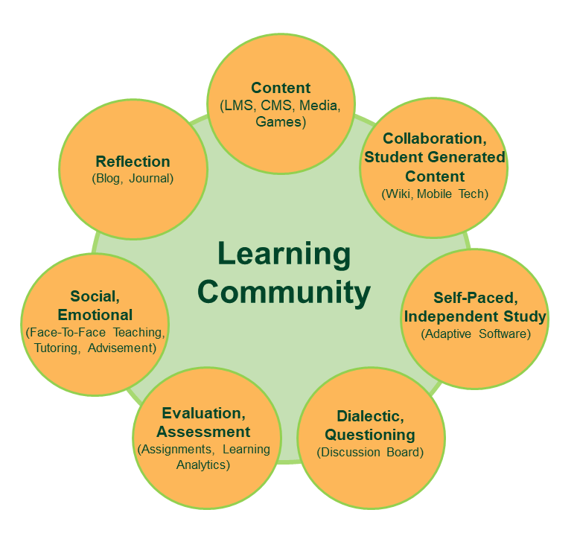
TEACHER’S ROLE
A facilitator/guide who develops and promotes

Slide 28
STUDENT’S ROLE (Mentimeter)

Slide 29
If you really want to improve your English, please remember:
The more you use the language, the faster you will learn.
YOU CAN DO IT!

Slide 32
Additional online references and resources
Learning English. http://www.bbc.co.uk/learningenglish
Teaching adults. https://www.teachingenglish.org.uk/teaching-adults
Adult learners. https://elt.oup.com/learning_resources/courses/adultlearners/?cc=mx&selLanguage=en
Learning English. https://www.cambridgeenglish.org/learning-english/
Teacher’s corner. https://americanenglish.state.gov/teachers-corner
Classroom resources. Pearson. https://www.pearsonelt.com/professional-development/resources.html
Teaching adults. Oxford. https://elt.oup.com/teachersclub/courses/teachingadults/?cc=mx&selLanguage=en
For teachers. BBC. http://www.bbc.co.uk/worldservice/learningenglish/teach/
Onestop English. http://www.onestopenglish.com/
The digital teacher. https://thedigitalteacher.com/
https://visuwords.com/
https://www.eslvideo.com/
https://es.lyricstraining.com/
https://www.busuu.com/es
http://intermediatelow.blogspot.com/
https://www.englishclub.com/
http://www.topics-mag.com/
http://www.readableblog.com/
https://dictionary.cambridge.org/es/
http://www.bbc.co.uk/learningenglish
https://www.tefl.net/
http://www.elllo.org/

