Slide 1
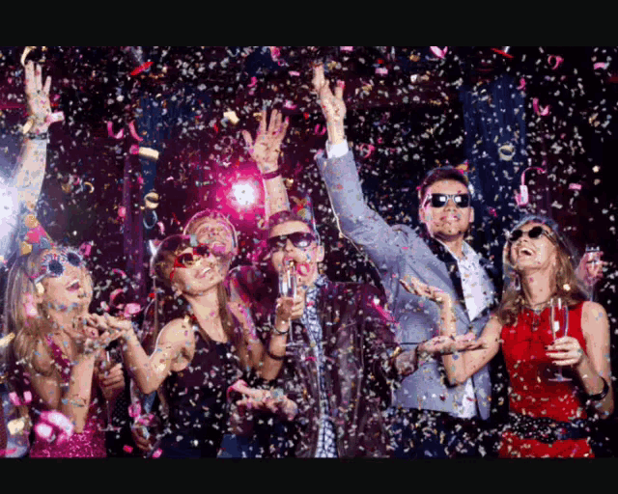
Time to celebrate!
Unit 4

Slide 2
What are some public holidays in Mexico? (* =not official)
1 Jan Tue New Year's Day
4 Feb Mon Constitution Day
18 Mar Mon Benito Juarez Day
18 Apr Thu Holy Thursday *
19 Apr Fri Good Friday *
1 May Wed Labor Day
5 May Sun Anniversary of the Battle of Puebla*
16 Sep Mon Independence Day
12 Oct Sat Day of the Race
2 Nov Sat All Souls' Day *
18 Nov Mon Revolution Day
12 Dec Thu Lady of Guadalupe Day *
25 Dec Wed Christmas Day

Slide 3
There are ways to celebrate your favorite holiday or festival or special occasions.
What is your favorite special occasion?
Why is it your favorite occasion? What makes it so special for you?
What do you do on that occasion? Use

Slide 4
Unscramble game
1. parade
2. flowers
3. decorations
4. wedding
5. presents
6. gifts
7. fireworks
8. relatives
9. meal
10. costumes
11. customs
12. bride
13. groom
14. skeleton
15. trick or treat
16. messy
17. get engaged
18. look forward to

Slide 5
LISTENING. Time for Carnival
Ex A. Three facts:
Carnival is ___ _______ ______or________________in_________ in late____________ or _____________March.
Carnival lasts_______ ______________days.
People ________________Carnival____ _______Brazil, but the_____ _________party is _____ ________ ______ ____________.
Hotels _______ _____ really _____________.
There are___________ ______________ all over the ________. For the parade, people __________on the _____________and practice the _________ _________ for _________ as ________ of a ___________.

Slide 6
Listen. You will hear three people discuss their favorite day of the year.
Perspectives
Holidays
______________________________________________________
Things he or she does on that day
_______________________________________________________________________________________

Slide 7
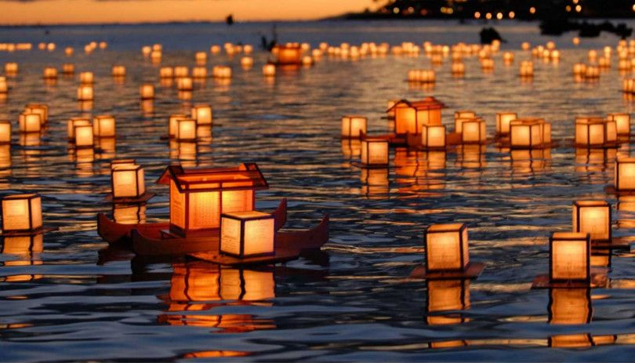
Grammar focus 1: Relative clause of time
Student’s Day is a day when…
The relative clause of time is formed with WHEN, which refers to the noun phrase (e.g. the days, the month, the season, the time) that comes before it.
e.g.
Obon is an annual event when Japanese people commemorate their ancestors.

Slide 8
Grammar focus 2: Adverbial clauses of time
When women get married, they usually wear a brightly colored sari.
Before two people get married, they plan the wedding.
adverbial clause main clause
(Adverb+subject+verb)
An adverbial clause is subordinate. It cannot occur on its own and is always attached to a main clause.
Before they marry, couples send invitations.
Couples send invitations before they marry.

Slide 9
What happens when people get married in your country?
When a couple gets married…
Before a couple gets married…
After a couple gets married…

Slide 10
Where do weddings normally take place?
Is there a ceremony or a reception?
How are they different?
Do the bride and groom wear special clothes?
Who gives gifts?
Do guests give speeches at the reception?

