Slide 1
UNIT 9
THAT’S ENTERTAINMENT!
Learning Objective:
Discuss popular entertainment using participles and adjectives.
Discuss movies and famous names using relative clauses.

Slide 2
UNIT 9 Cycle 2
LEARNING OBJECTIVES:
By the end of Unit 9, the students must be able to answer the following questions:
What is the last movie you’ve seen? What did you like/dislike about it?
What new movie would you most like to see? Why?
Did you ever see the movie “Nosotros los Nobles”? How did you like it? Why?
What kinds of movies are you interested in?
What’s your favorite Mexican movie? Why do you like it?
What’s your favorite movie/TV show/book? Tell me about it. (Use relative clauses.)
Who is your favorite actor/actress/director/author? Tell me about him/her. (Use relative clauses.)
Ask me about my taste in books and movies. or Ask [classmate] about his/her taste in books and movies.

Slide 3
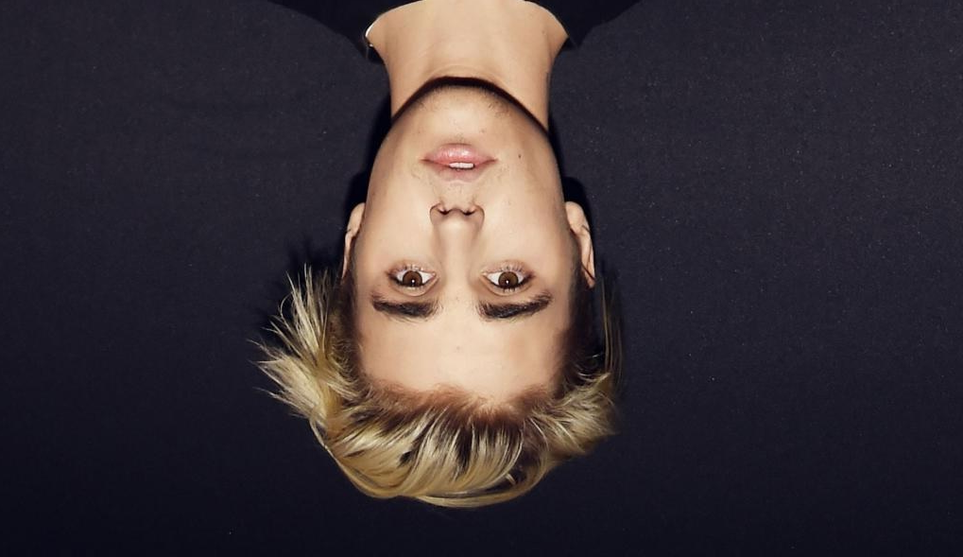
Guess who my person is!
She’s an actress and a singer
who was discovered by Disney in a nationwide casting call,
who has a mother who is of part Italian ancestry, and a father who is of Mexican descent and
that released a first solo album "Stars Dance" and the lead single "Come & Get It" from the album.
He’s a Canadian pop singer
who got his big start thanks to his YouTube covers,
who has become one of the world's biggest pop stars,
that released an album which includes the singles "Sorry", "Love Yourself", and "Company“ and
who was arrested for being reckless.
Answers
Answers

Slide 4
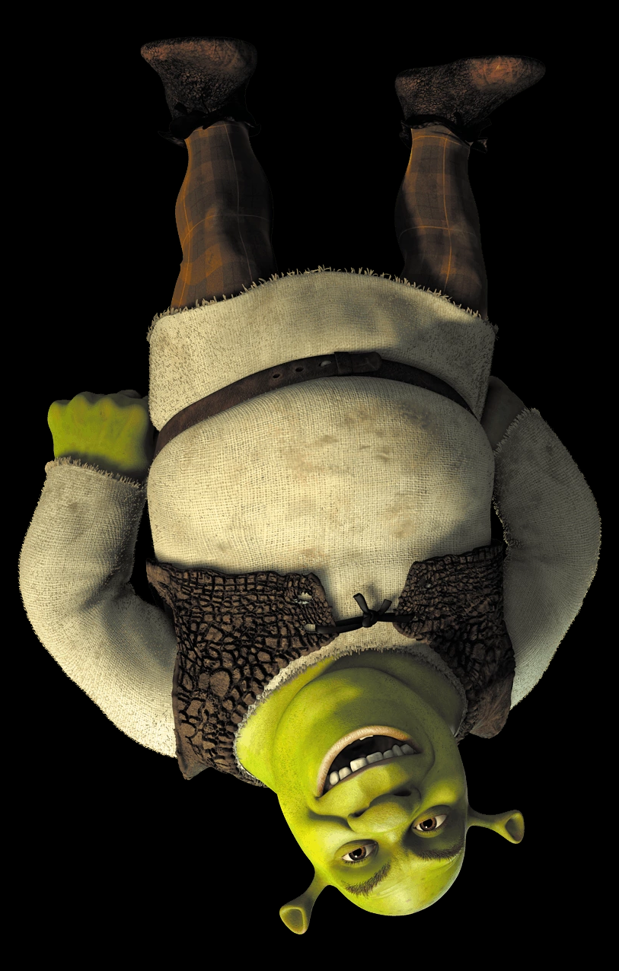
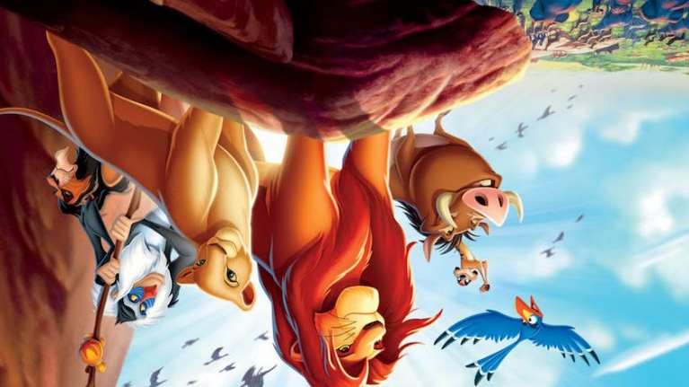
Guess what my movie is!
It’s an animated movie
which contains fairytale creatures,
that deals with adult content and
which makes people laugh.
It’s an animated movie
which was produced by Disney,
which makes people cry,
that has a mix of comedy, romance, and tragedy and
which has the "Can you feel the Love Tonight" in its soundtrack.
Answers
Answers

Slide 5
WRITING PRACTICE 1. Guess who my person is and what my movie is!
This exercise will be considered as part of the PROYECT grade.
Your turn!!
Write a description for a famous person and another one for a well known movie, using relative pronouns ON A WORD FILE to turn in. Write the name of the person or thing you are describing plus other three choices. Indicate which is the correct one, as in a trivia game.

