Slide 1
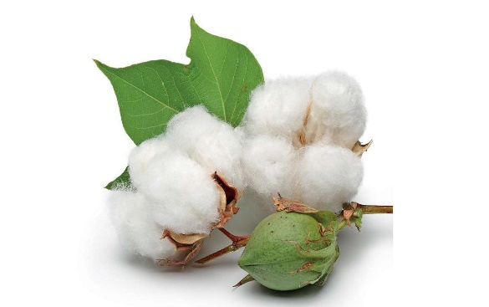
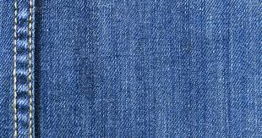
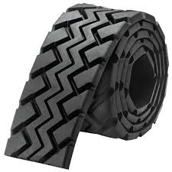
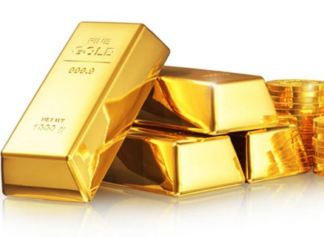
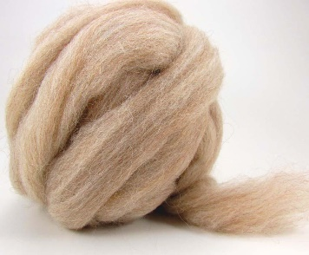
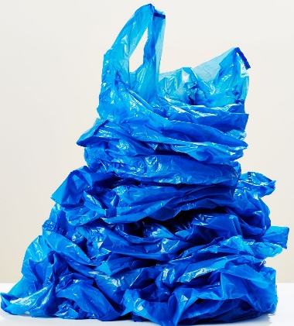
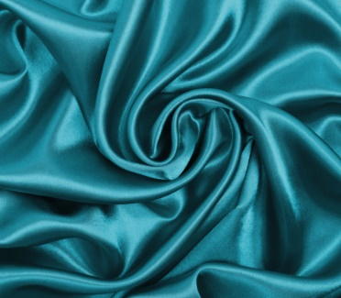
VOCABULARY “Materials”
What are the things made of ? Listen to the different materials.
COTTON
LEATHER
DENIM
RUBBER
GOLD
WOOL
SILVER
PLASTIC
SILK

Slide 2
Important:
material is placed before the thing
a gold bracelet

Slide 4
Note:
Investigate the unknown words

Slide 5
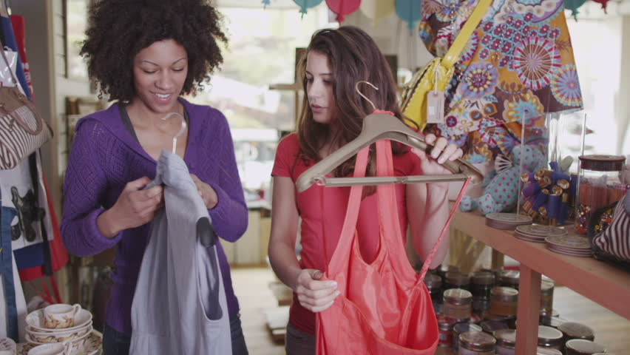
Preferences
How to ask fo a preference | How to answer with a preference
Which dress do you prefer? | I prefer the red one
Which one do you like more? | I like the red one more
Which one do you like better? | I like the red one better

Slide 6
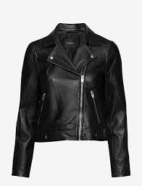
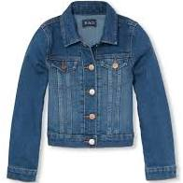
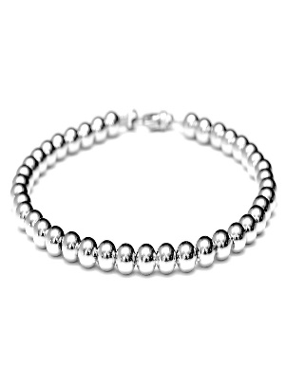
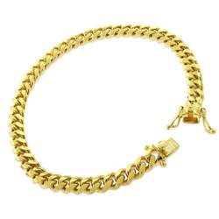
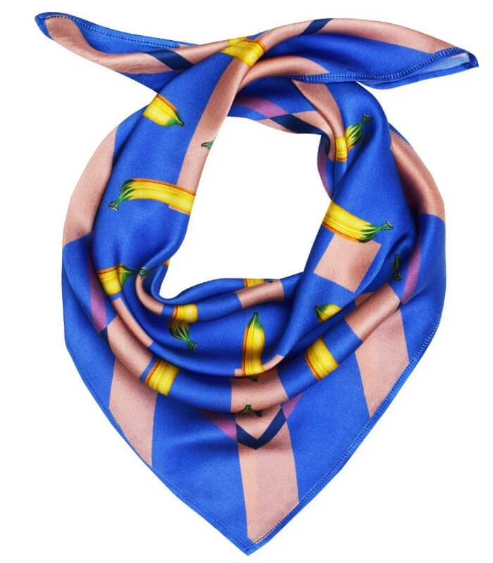
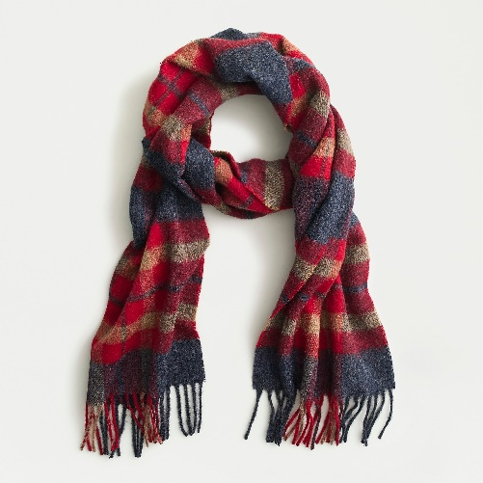
Write your answer to the following questions then record your voice with your preference.
Which jacket do you prefer?
_________________
Which bracelet do you like more?
_________________
Which bracelet do you like better?
_________________

