Slide 1
Lend a hand.
UNIT 3.
Students will discuss favors, borrowing and lending using modals, if clauses, and gerunds. Students will be able to leave messages using indirect requests.

Slide 2
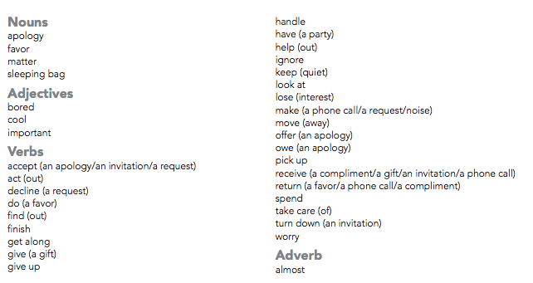
Language Summary
Vocabulary

Slide 3
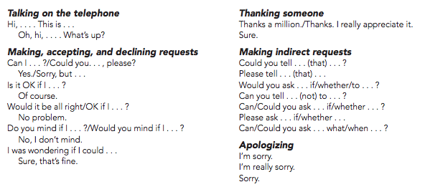
Language Summary
Expressions

Slide 4
Lend or Borrow…
Could you do me a favor?
Borrow or Lend…
You borrow something from somebody. In other words, you take something from someone for a limited time.
You lend something to somebody. In other words, you give something to someone for a limited time.

Slide 5
ACTIVITY 1. Annoying Favors People Ask
COULD YOU…
babysit my kids on the weekend?
watch my stuff for a few minutes?
let me use your credit card?
drive me to the airport?
let me use your passcode to download a movie or song?
help me move to me new apartment?
come with me to my niece’s school concert?
let me stay at your place for a couple of weeks?
donate to my favorite charity?
co-sign a bank loan for me?
Upload a Word Document sharing your answers to the following questions:
Which of these favors would bother you the most? Which would bother you the least?
What are three other favors that you dislike being asked?
Imagine that a close friend asked you each of these favors. What would you say?

Slide 6
Requests with modals, if clauses, and gerunds. STRUCTURES
1. Requests with if clauses and the present tense
Is it OK if . . . ? and Do you mind if . . . ? Are followed by the present tense:
Is it OK if I borrow your phone?
Do you mind if I use your CD burner?
2. Requests with if clauses and the past tense
Would it be OK if . . . ? and Would you mind if . . . ? are followed by the past tense:
Would it be OK if I picked it up on Friday?
Would you mind if I borrowed your new digital camera?
Note: Would you mind is answered with “no” if the request is granted. “Yes” means the person denies the request.
3. Requests with gerunds (-ing)
Would you mind (without if) is followed by a gerund:
Would you mind letting me use your laptop?
4. Requests with if clauses and modals
Wonder + if is followed by a modal:
I wonder if I could borrow some money.
I was wondering if you would mind letting me use your car.
Note: wonder + if is not a question

Slide 7
Requests with modals, if clauses, and gerunds. From FORMAL to INFORMAL
Less Formal
Can I borrow your truck, please?
Could you lend me your truck, please?
Is it OK if I use your credit card?
Do you mind if I use your credit card?
Would it be all right if I used your credit card?
Would you mind if I borrowed your truck?
Would you mind helping me on Sunday?
I was wondering if you could help me move.
More Formal

Slide 8
ACTIVITY 2. Formal and Informal Requests
Watch the following video (it is an oldie but still works for our purpose!). As you listen to the dialogues, identify the structure used as someone is asking for a favor.
https://www.youtube.com/watch?v=4rBAUtBmLlQ
Upload a Word Document with your answers to the following:
A) In the next slide you will find several prompts. By using 5 of them, write formal and informal requests.
B) In the last slide, you will find an applied grammar exercise. Complete it and share with me your answers.

Slide 9
ACTIVITY 3. Formal vs Informal
You want to enter to a friend’s bathroom.
It’s a hot day; you want your classmate to open the door.
You need money, ask your partner if she can lend you some money.
It’s freezing cold and your partner has an extra coat, ask her if you can use it.
You have an exam but you forgot your pen, ask if you can borrow one.
Your uncle asks you to drive him to the airport.
You ran out of T-shirts; ask your friend if she can give you one.
You lost your cell phone, ask your boss if you can use hers/his.

Slide 10
Activity 4. Requests with modals, if clauses, and gerunds.
Read the situations. Then complete the requests. Share your answers in a Word Document.
You want to borrow a friend’s underwater camera for a diving trip.
A: I was wondering if _________________________________________.
B: Sure. That’s fine. Just please be careful with it.
You want to use your roommate’s computer.
A: Is it OK ____________________________________________________?
B: You can use it, but please don’t drink near it.
Your neighbor has a car. You need a ride to class.
A: Would you mind ___________________________________________?
B: I’d be glad to. What time should I pick you up?
You want your brother to help you move on Saturday.
A: Can you __________________________________________________?
B: I’m sorry. I’m busy all weekend.
You would like a second piece of your aunt’s cherry pie.
A: Would it be all right ________________________________________?
B: Yes, of course! Just pass me your plate.
You want to borrow your cousin’s red sweater.
A: Could you _________________________________________________?
B: Sorry. I don’t like it when other people wear my clothes.

