Slide 1
ESCUELA NORMAL DE EDUCACION PREESCOLAR
INGLES A1.1 1° AÑO EVIDENCIA GLOBAL
TEACHER: MAYELA ALEJANDRA DEL CARMEN GAONA GARCIA
Aim: Give students practice in content of the plan o the semester
Preparation:
Student will work individually in the Cambridgelms platform.
Students are guided by the teacher to open an account at https://www.cambridgelms.org/
Students are provided with a code to create their account.
Students are provided with a classcode and guided to join the class managed by the teacher.
Students will practice and reinforce the content of the units 1-6 of the plan of the semester.
Teacher will suppervise the practice of the student.
Student must obtain at least the 80% of score on each activity of the unit, and the 100% of completition of each unit activities.
Student must hand out the report of their practice. (report can be a screenshot of their advance)
Students will insert the screenshot of their report in this file.
Due date February 12th 2021
Materials: Student account at https://www.cambridgelms.org/, the student code, the class code.

Slide 2
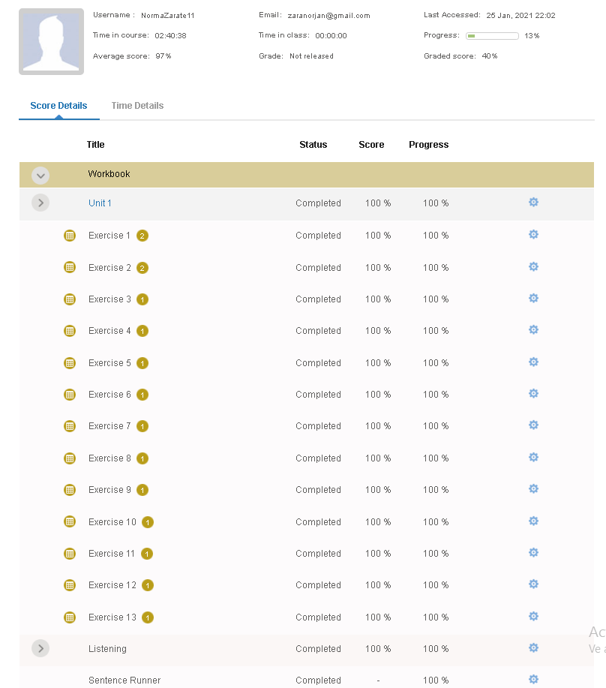
General requirement format | Points | Total points
Advance of units 1-6 Student must obtain at least the 80% of score on each activity of the unit 100% of completition of each unit activities.
Don´t forget to include a coversheet with your name and the teacher´s name. Include an introduction with the aim of this activity. Remind to read carefully the requirements of the rubric and include all of them in your presentation. | Total | 50%
Print your screen of detailed report
You can include as many screens as posible to hand out a complete report of your 6 units
There are 3 excercices which are not scored, but you must complete them in orter to get the 100 completition

Slide 3
Attach here your detailed report.

