Slide 1
SESSION 1 REVIEW PRESENT TENSES What’s happening? Friday March 19th

Slide 2
OBJECTIVE OF THE UNIT
Describe routines and talk about what is happening right now.

Slide 3
Verbs

Slide 5
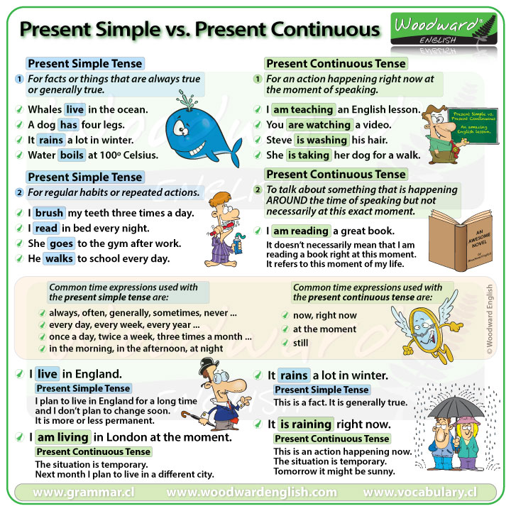

Slide 8
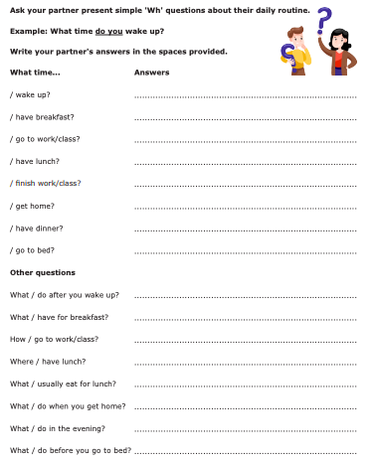
DESIGN A DETAILED HEALTHY DAILY SCHEDULE FOR A PRESCHOOL STUDENT.
PRESENT IT TO THE CLASS.

Slide 9
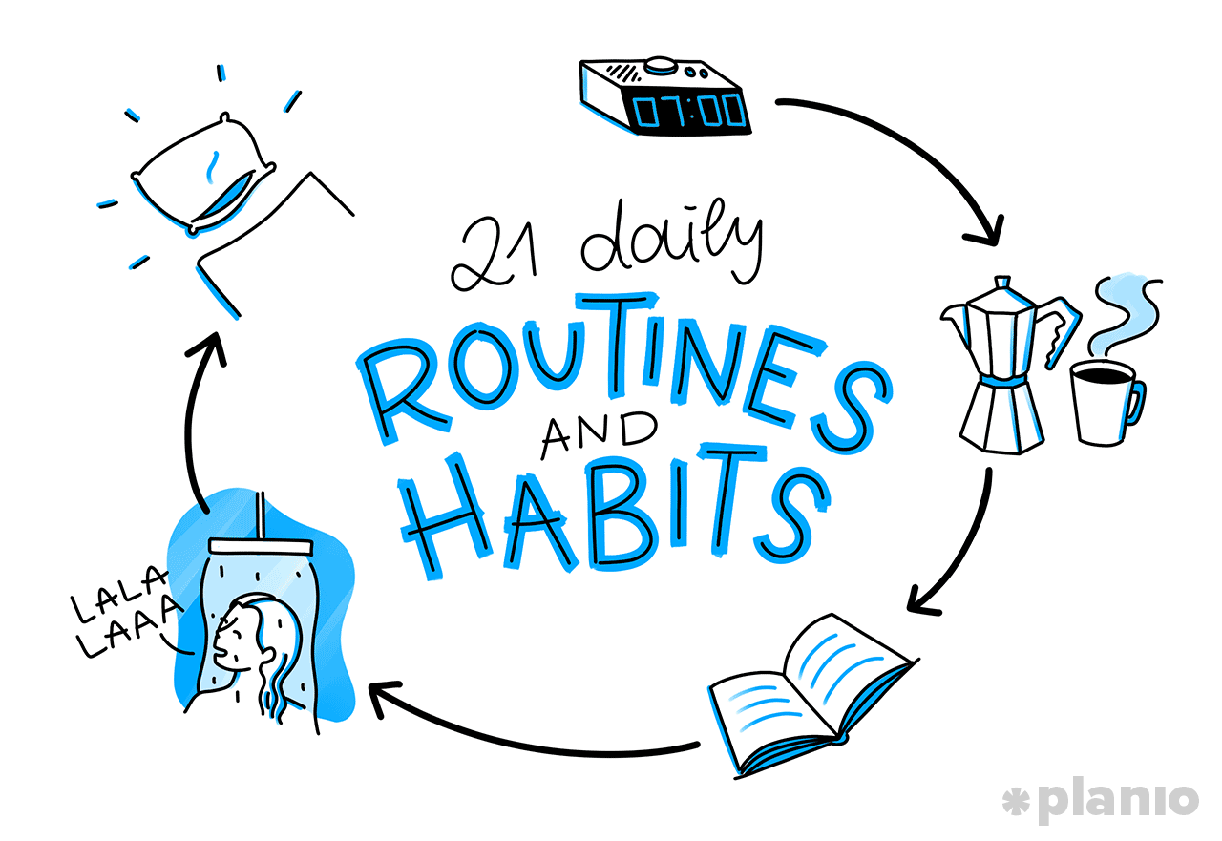
SESSION 2 REVIEW PRESENT SIMPLE Wednesday March 24th

Slide 10
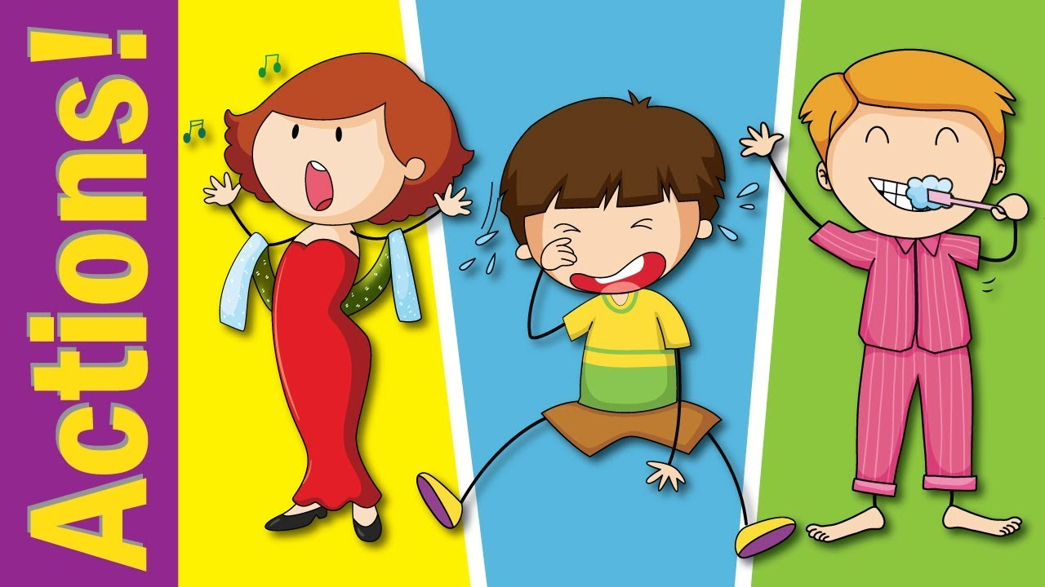

Slide 15
Let’s play!

Slide 16
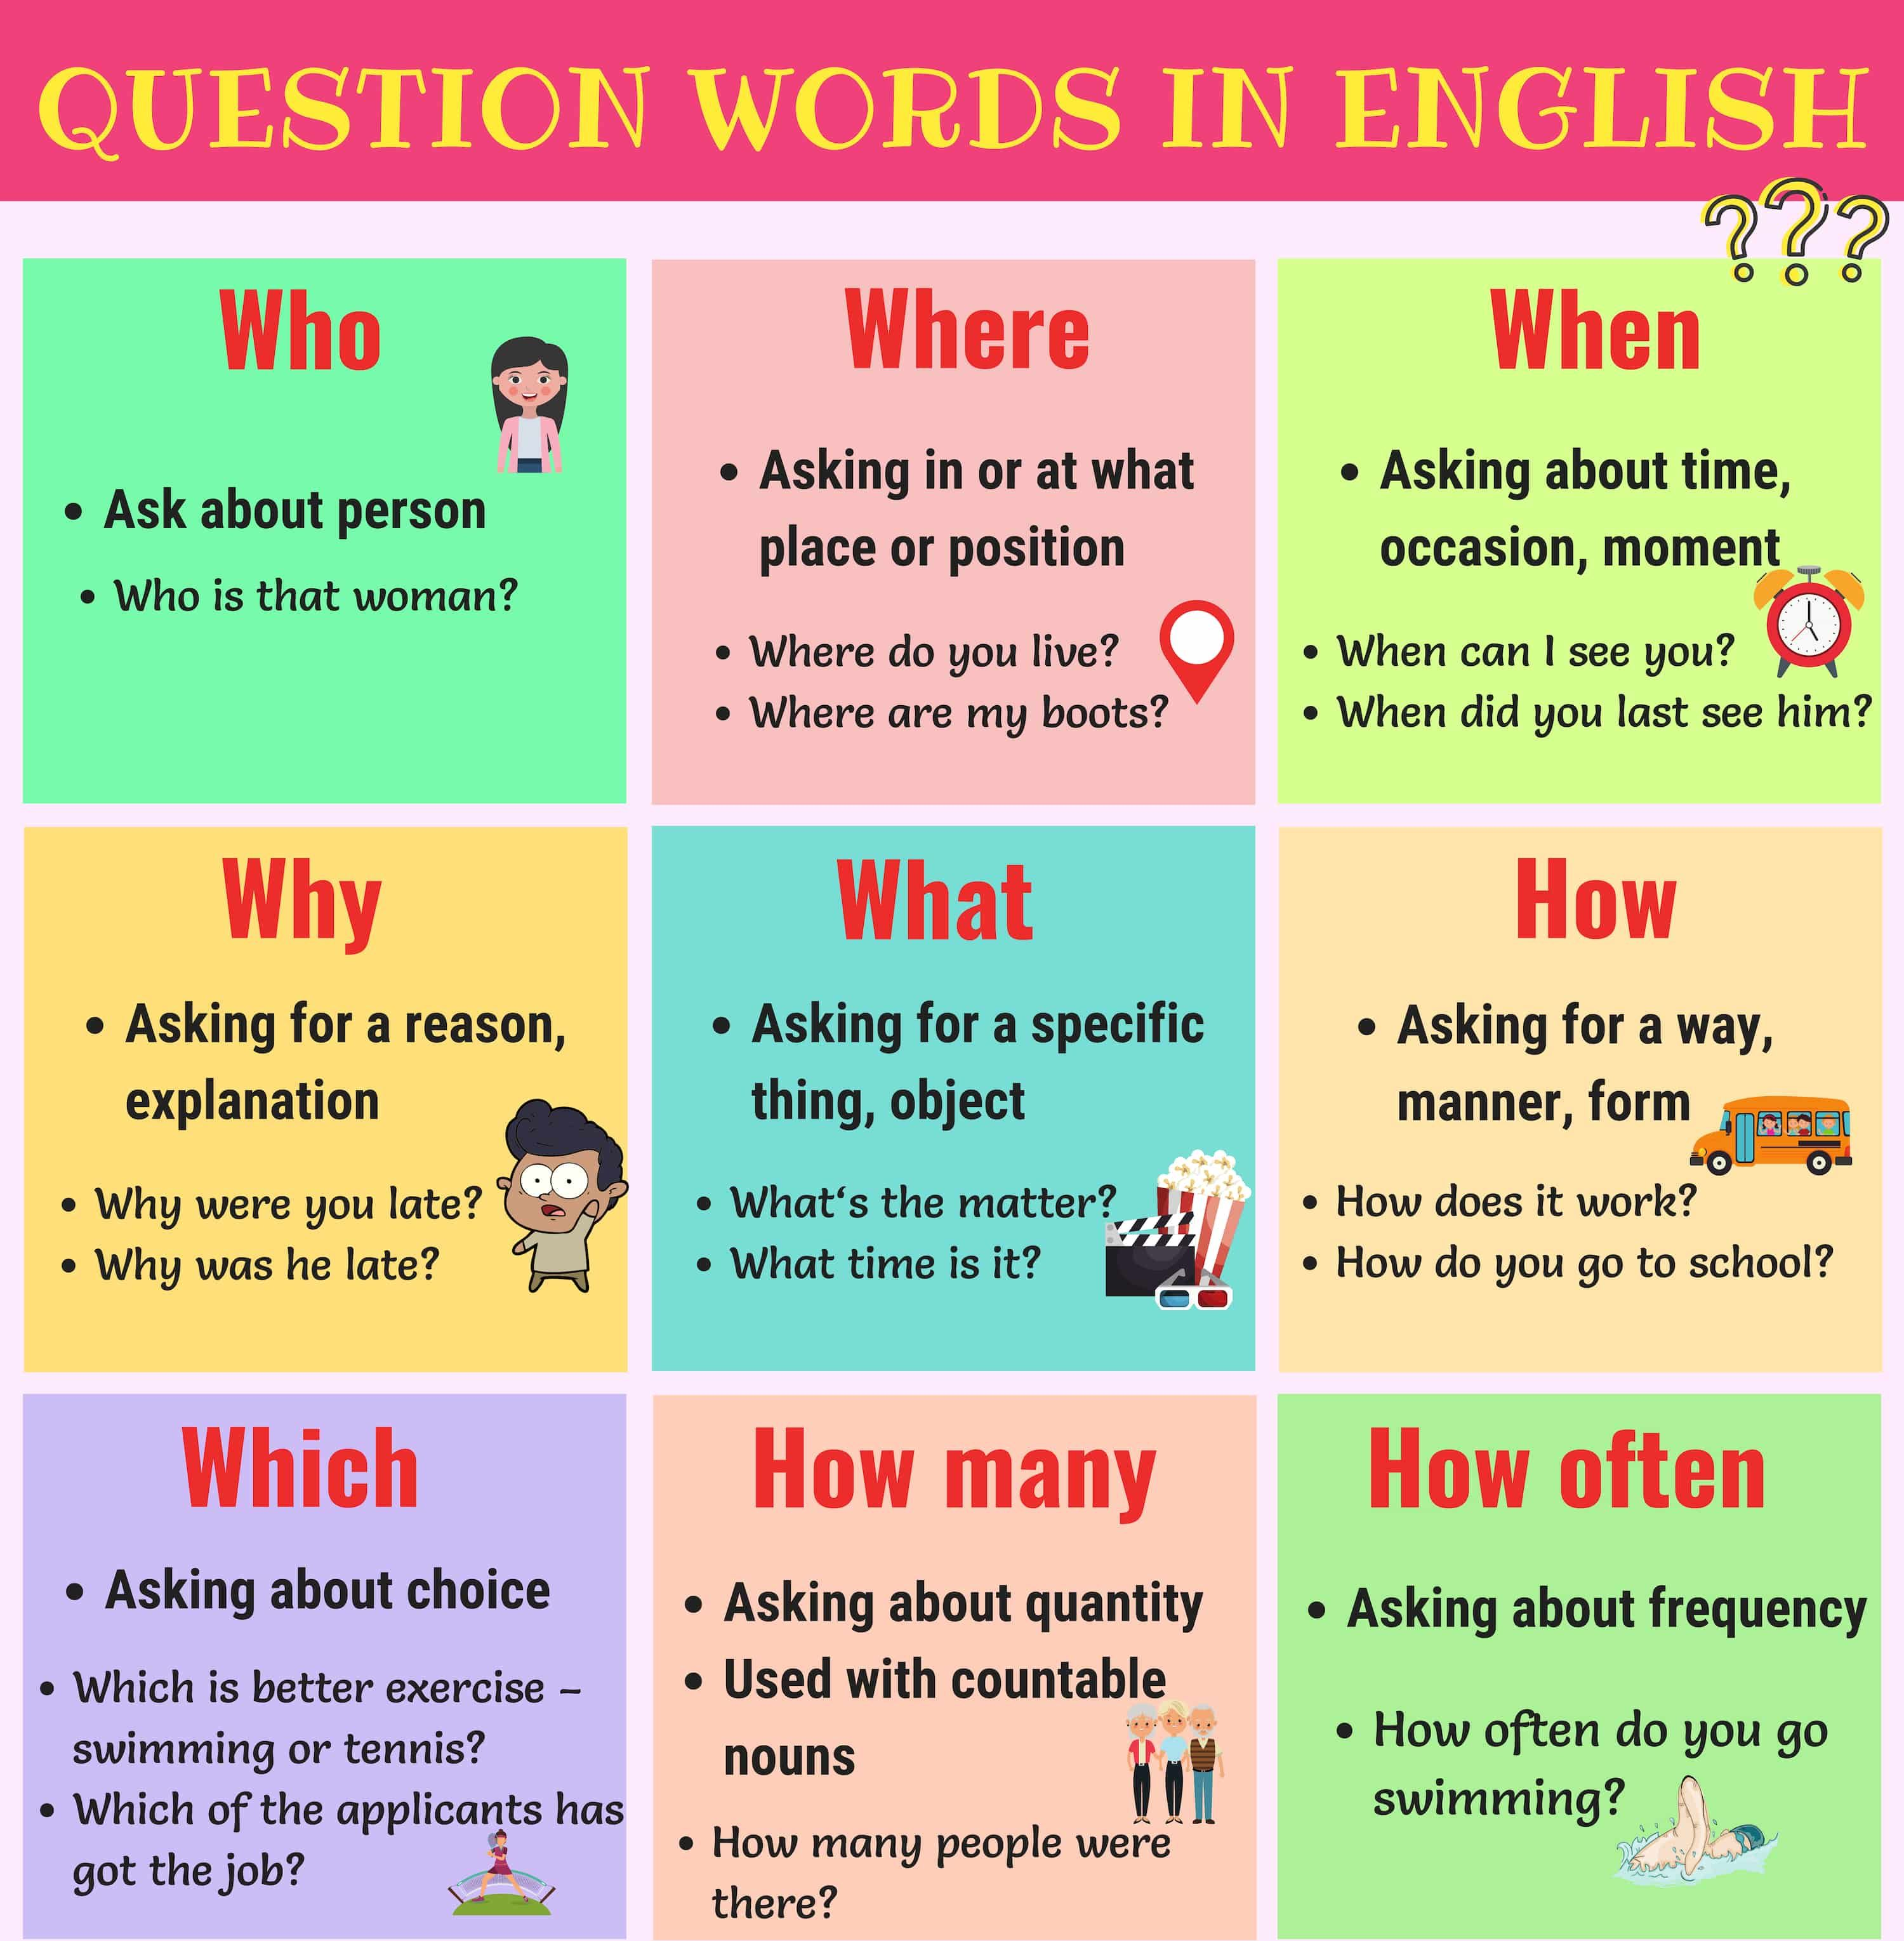

Slide 17
What’s your name?
Where do you live?
Do you live with your family?
Do you study or do you work?
What kind of music do you listen to?
Where do you usually go on weekends?
What time do you normally wake up?
What do you do to relax?
What do you drink in the morning?
Where do you like to go on holiday?
What do you usually eat for breakfast?
How often do you chat online?
What do you watch on TV?
What do you do in your free time?
Where do you usually have dinner?
What type of books do you read?
What sports do you like or play?
What websites do you usually use?
What time do you usually go to bed

Slide 18
PRESENT CONTINUOUS

Slide 21
WH-

Slide 22
Find the mistake and say the sentence correctly.
Jane is watch a cartoon now.
Maggie sleeping on the sofa right now.
Your sister are playing with her baby now.
He’s swiming in the lake now.
I amn’t going to the market at the moment.
She doesn’t speaking Chinese now.
Kerry is run in the park now.
Where you going today?
Is your sister dance right now?
Robert and Jim eating dinner now.

Slide 23
Let’s play!

Slide 24
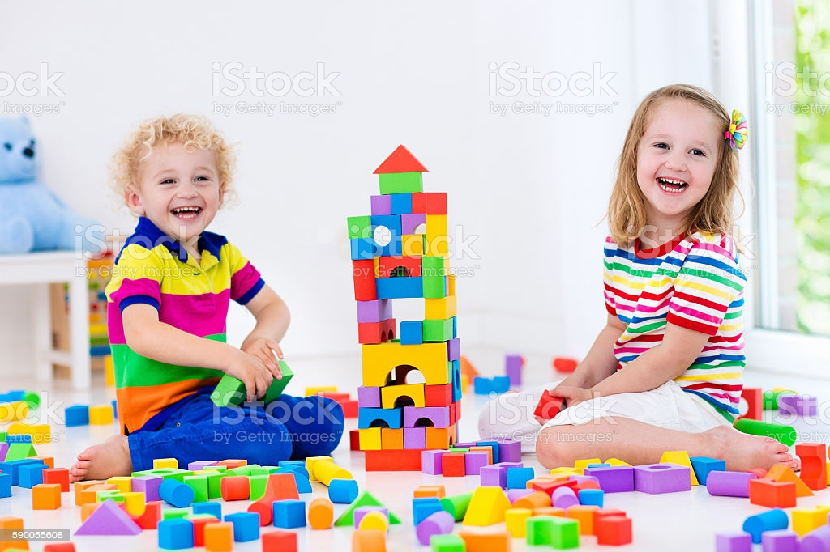
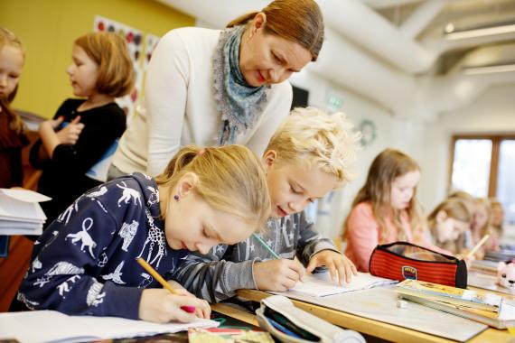
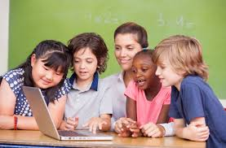

Slide 25
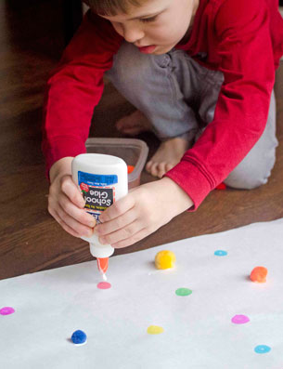
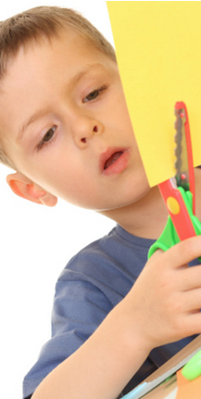
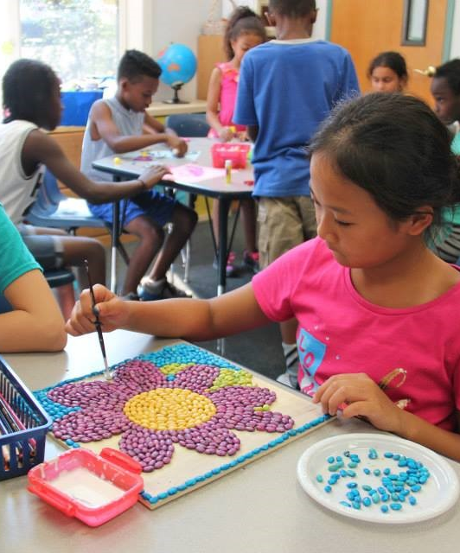

Slide 26
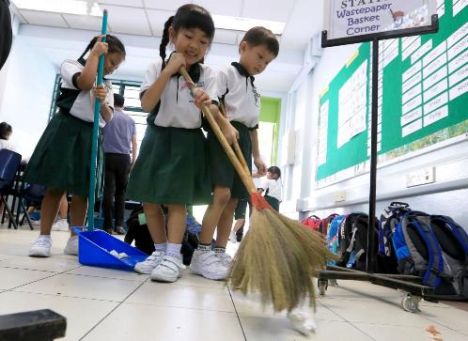
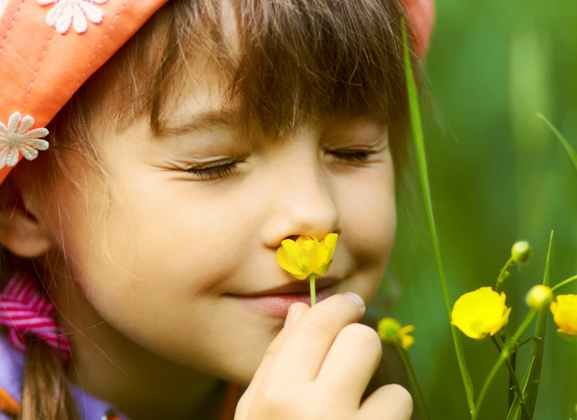
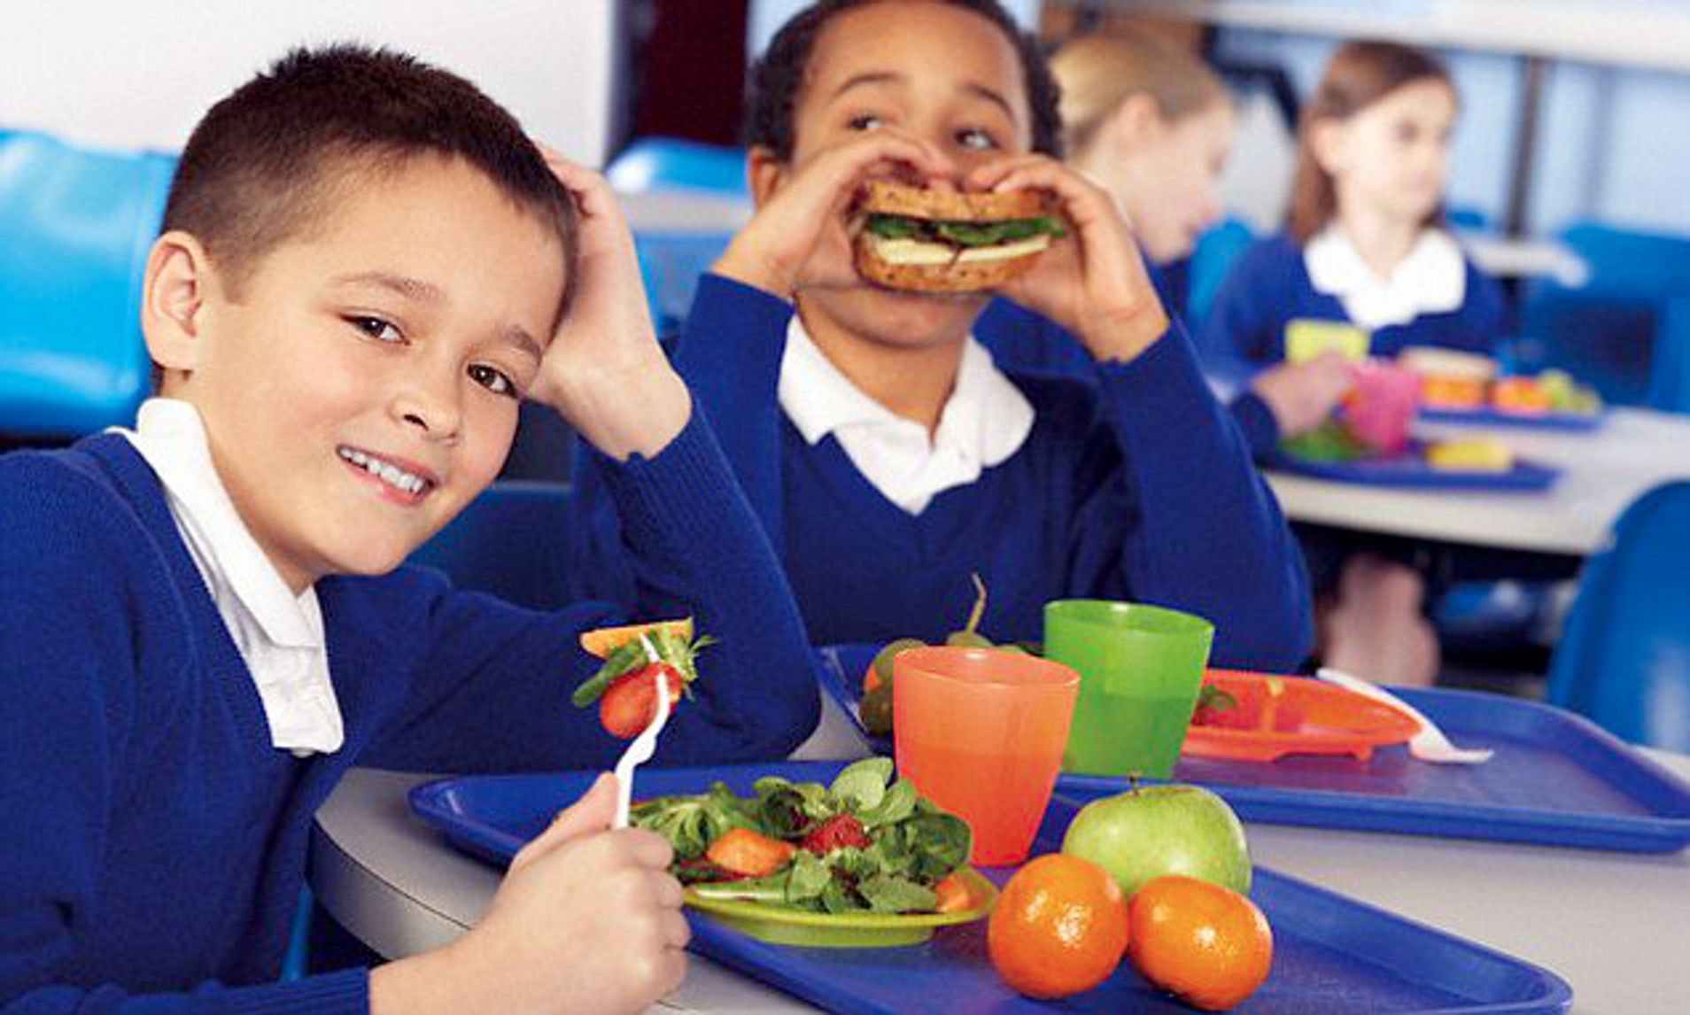
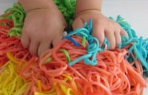

Slide 28
