Slide 1
Introduce your self
1.- What is your name?
2.- What is your last name?
3.- Can you spell your first/ last name?
4. Where are you from?
5. How old are you?
6. What´s your e-mail address?

Slide 2
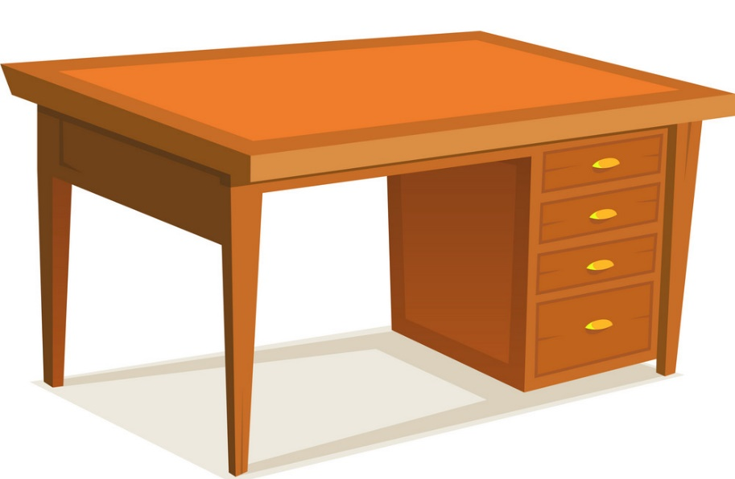
Teacher will point out a picture and ask the ss. Ss will answer using the vocabulary of the unit
1.-What is this?
2.- What are these?

Slide 3
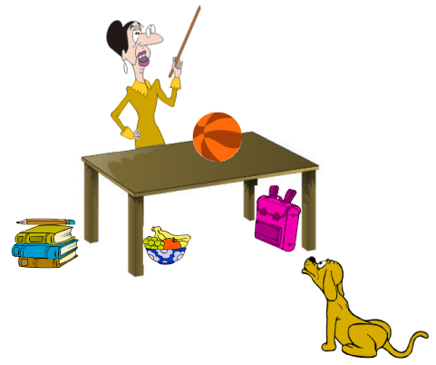
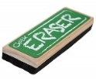
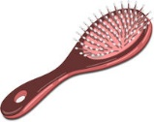
Teacher will ask the ss about the locations of things in the pictures.
1.- Where is the backpack?
2.- Where are the keys?
3.- Where is the laptop?
4.- Where are the glasses?
5.- Where is the umbrela?
6.- Where is the teacher?

Slide 4
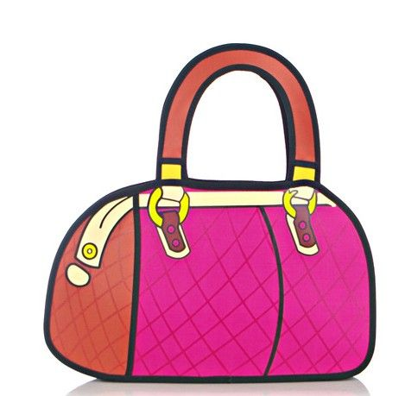
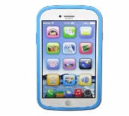
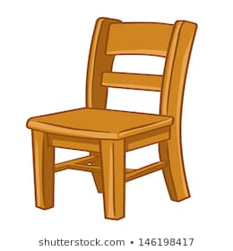
Teacher will ask the ss about the locations of things in the pictures.
1.- Is the cellphone in the purse?
2.- Are the books on the backpack?
3.- Is the laptop under the table?
4.- Where are the glasses?
5.- Are the glasses on the chair?

Slide 5
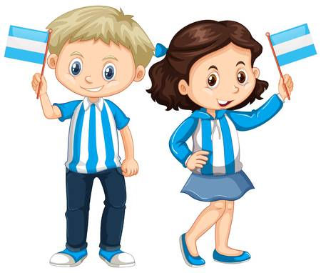
Teacher will point out a picture and ask the ss about nationalities and language, ss will answer using vocabulary of unit.
1.- Where is Joao from?
2.- Are Paty and Alan Mexican? Where are they from?
3.- Is their first language portuguese?
4.- Where is Chao from?
5.- Are Luciana and Giovanni from Canada? Where are they from?
6.- Is their first language english?
7.- Where are Luciana and Giovanni from?
8.- Is Mark from Italy? Where is he from?
9.- Is his first language italian?
Luciana and Giovanni
Alan and Paty
Mark
Joao
Chao

Slide 6
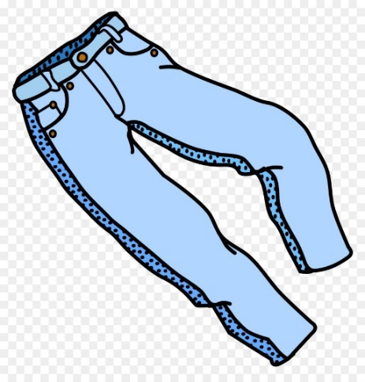
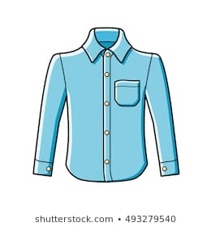
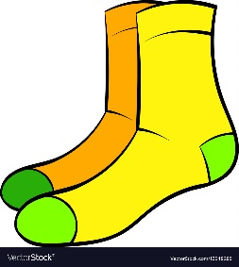
Teacher will point out a picture, ss will answer using clothing vocabulary
1.- What is this?
2.- What are these?
Variant: Teacher will ask ss to name five pictures of clothing vocabulary

Slide 7
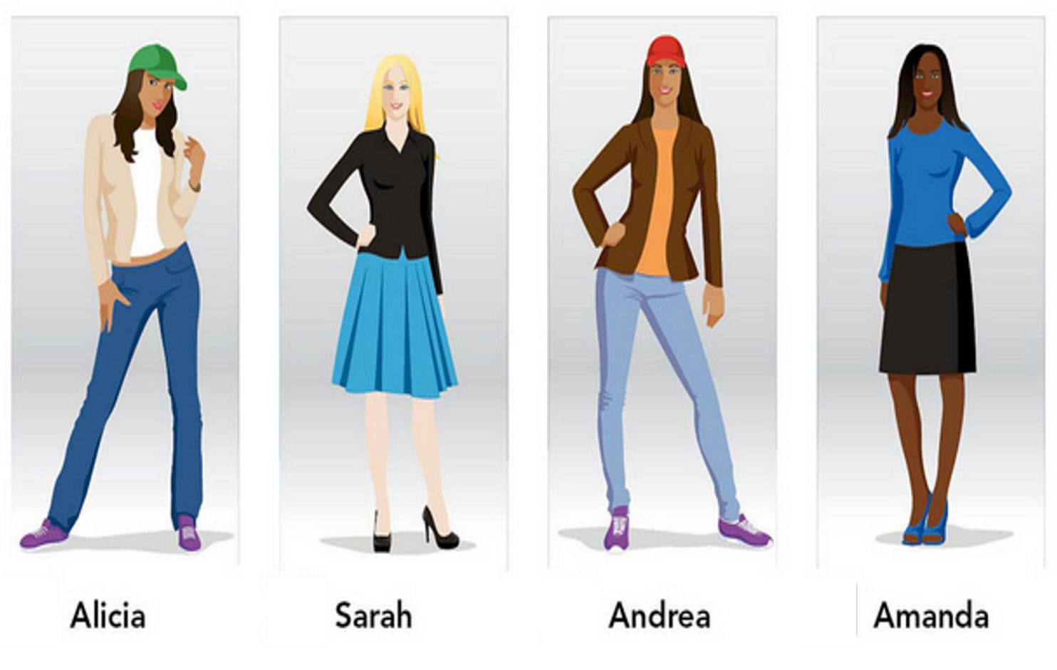
Teacher will ask the students about the pictures using clothing vocabulary
1.- What is Alicia wearing?
2.-What is Sarah wearing?
3.-What is Andrea wearing?
4.-What is Amanda wearing?
5.- Is Alicia wearing a black skirt?
6.- Is Sarah wearing blue higheels?
7.- Is Andrea wearing a purple blouse?
8.- Is Amanda wearing a blue skirt?

Slide 8
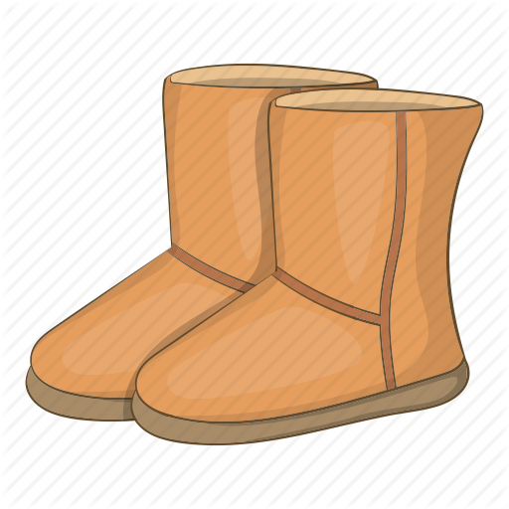
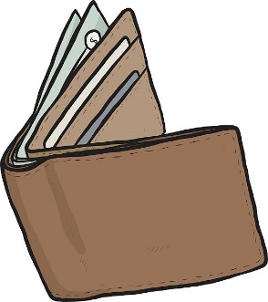
Teacher will ask the students about the pictures using possessives
1.- Whose gloves are these? They are mine
2.- Are these Janet´s boots?
3.-Whose laptop is this?
4.-Are these Mary´s glasses?
5.-Whose eraser is this?
6.-Are these Kathy´s keys?
7.-Whose wallet is this?
8.-Is this Tom´s wallet?
Example
Erick
Paul
Mary
Tom
Kathy
Janet

Slide 9
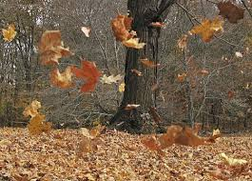
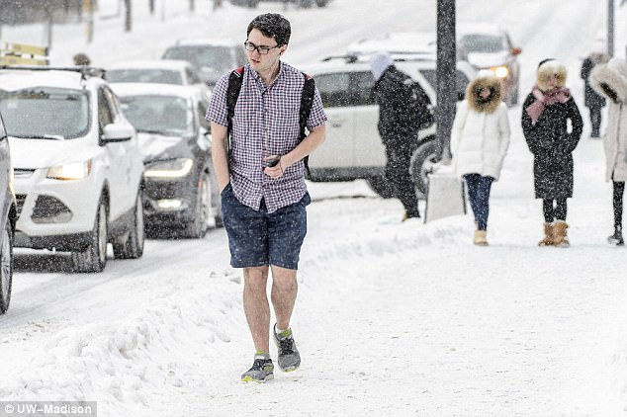
Teacher will ask the students about the pictures using weather vocabulary
1.- How is the weather in Toronto? Is it warm?
2.- How is the weather in Florida? Is it cold?
3.- How is the weather in Rio de Janeiro? Is it hot?
4.- How is the weather in Mexico? Is it cold?
Variant: Teacher will ask the ss to describe one of the pictures using vocabulary of seasons and weather.
New York
Toronto

Slide 10
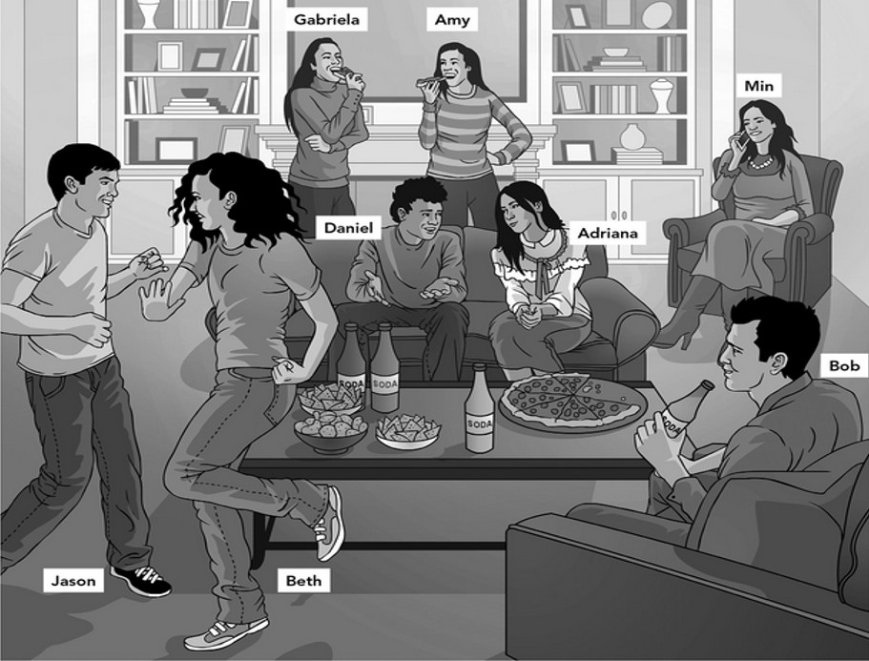
What is Gabriela doing?
Is Amy dancing?
Is Bob drinking soda?
Are Daniel and Adriana eating pizza?

Slide 11
What time is it?
1.-
3.-
2.-
4.-

Slide 12
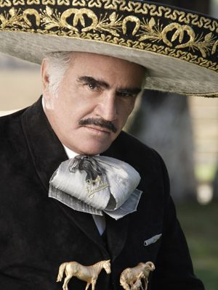
“Vicente Fernandez”
Who is that?
What is his name?
How old is he?
What is he like ?
Where is he from?
What is his first language?

Slide 13
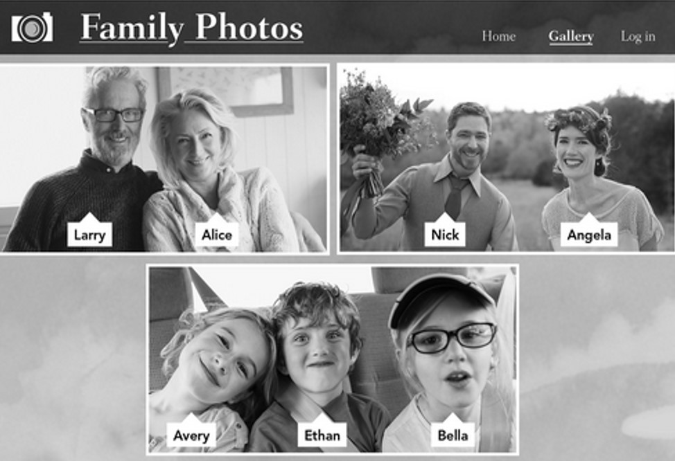
Talk about this family

Slide 14
Answer the following questions
Do you get up early on sundays?
Does your mother eat breakfast at 9:00 o´clock?
Do you take a taxi to school?
What time do you get up?
What time does your fathes have dinner?
Do you play videogames at night?
Do you eat dinner with your family?
Do you stay at home on weekends?

Slide 15
Answer the following questions
Do you live in an appartment?
Does your house have a yard?
Do you have your own bedroom?
Describe Tony´s apartment (use there is, there are, there isn´t, there aren´t any)

Slide 16
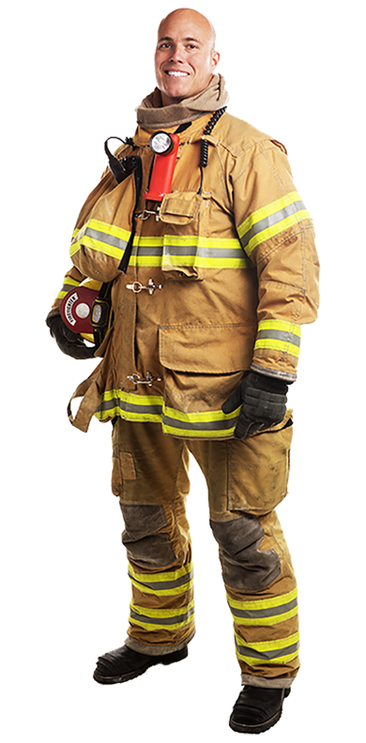
Answer the following questions
A: Does your father work?
A: What does he do?
A: Where does he work?
A: How does he like his job?
A: What´s his job like?
A: What time does he go to work?
A: What time does he finish work?

Slide 17
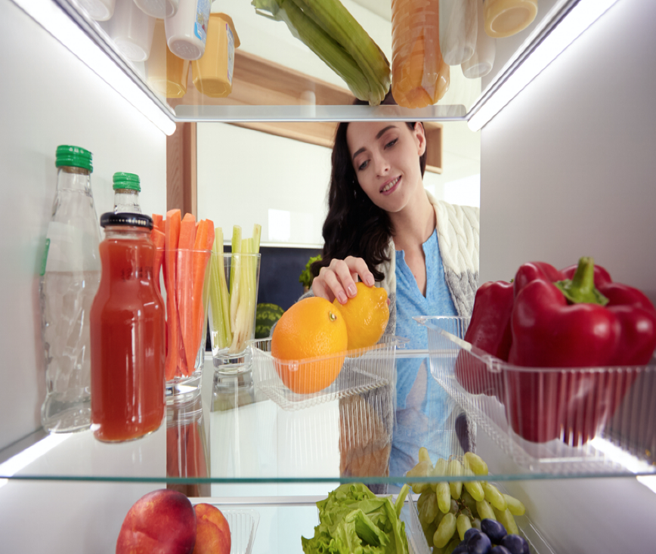
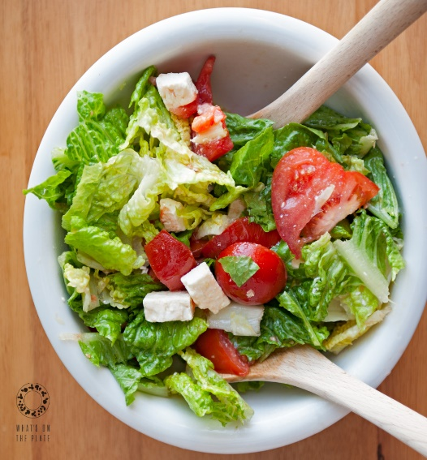
Answer the following questions
A: Do you like onions?
A: Does your mother need any tomatoes for the salad?
A: Do you usually have a big breakfast?
A: Do you often have snacks in the afternoon?
A: Does your father usually eat in his office?
A: What´s a typical dish in mexico?
What´s in your refrigerator?
What do you need to prepare a Ceasar salad?

