Slide 1
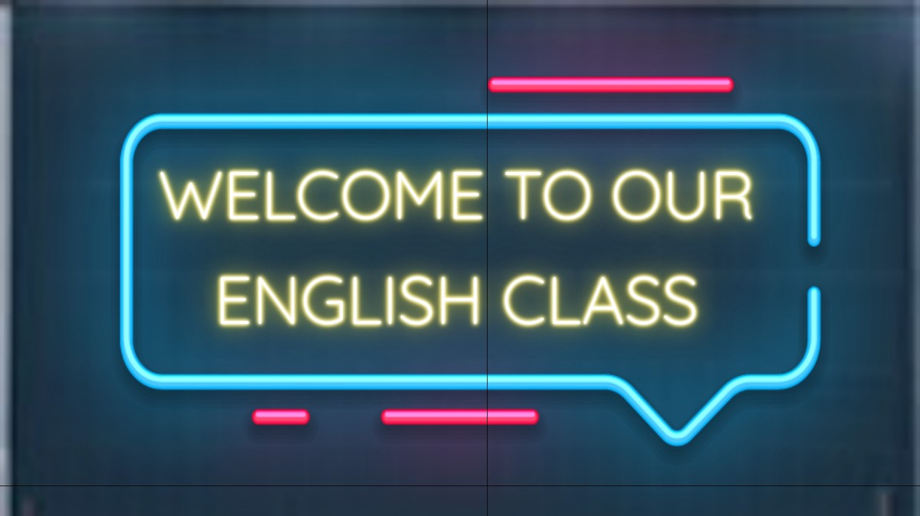
ENGLISH A2.2
UNIT 1 – CYCLE 2
IT`S A REALLY NICE CITY!
SEPTEMBER 10TH

Slide 2
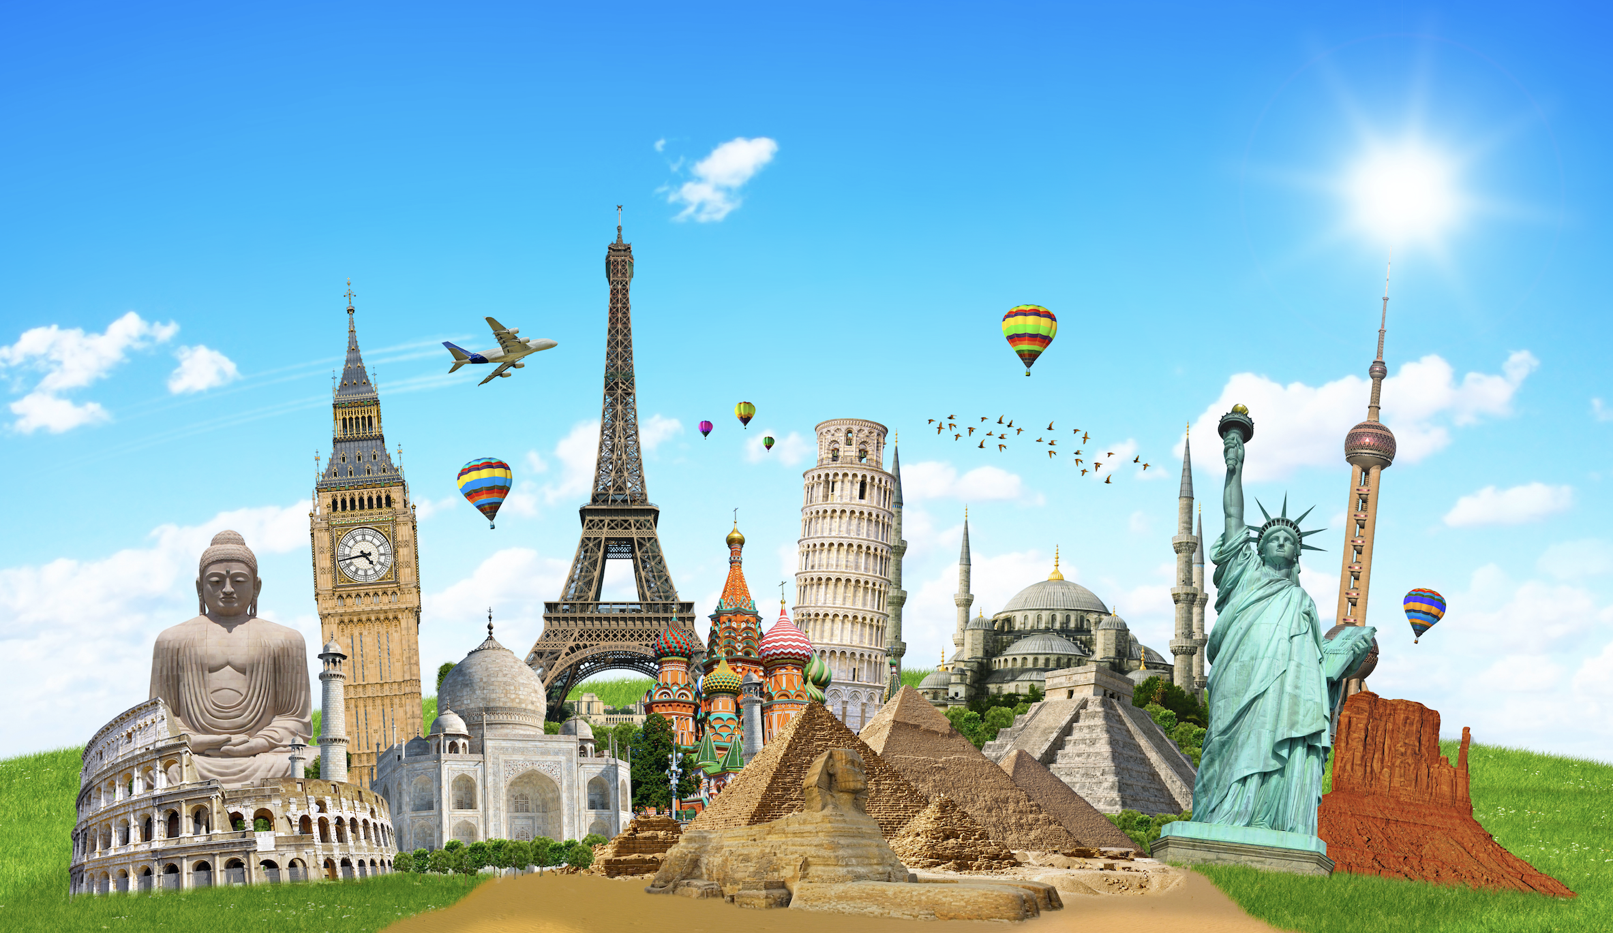
LANDMARKS - TEAM WORK
GOOGLE SLIDES – FIND INFORMATION ABOUT
Burj Khalifa
Leaning Tower of Pisa
Opera House
Eiffel Tower
Machu Picchu
Basil’s Cathedral
Empire State Building
Big Ben
Chichén-Itzá
ONE SLIDE - INCLUDE LOCATION, DESCRIPTION (3 SENTENCES) AND PICTURE.

Slide 4
conversation
1. What city are they talking about?
2. What’s the Museum of Anthropology like?
3. What are the Diego Rivera murals like?
4. How many kinds of street food does Claudia recommend?

Slide 5
conversation

Slide 6
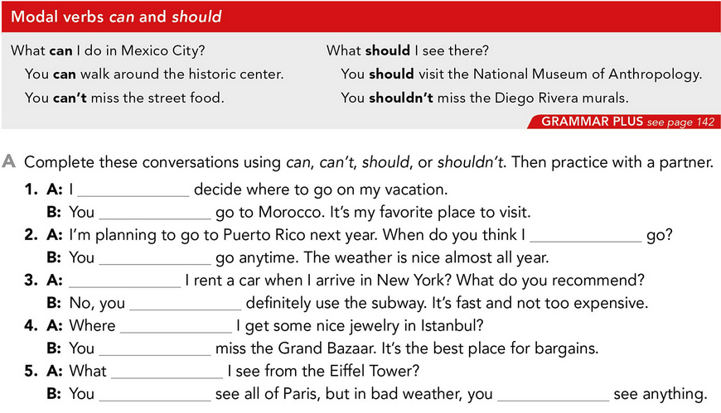

Slide 11
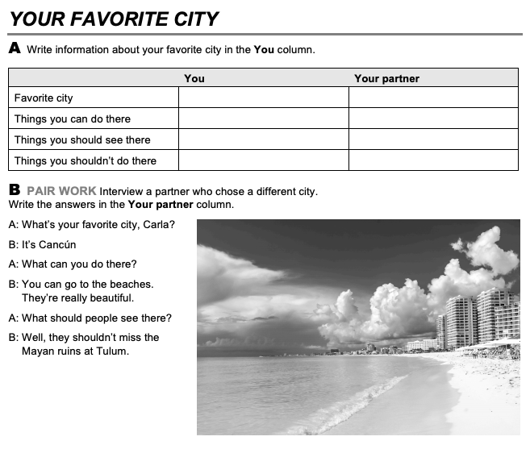

Slide 13
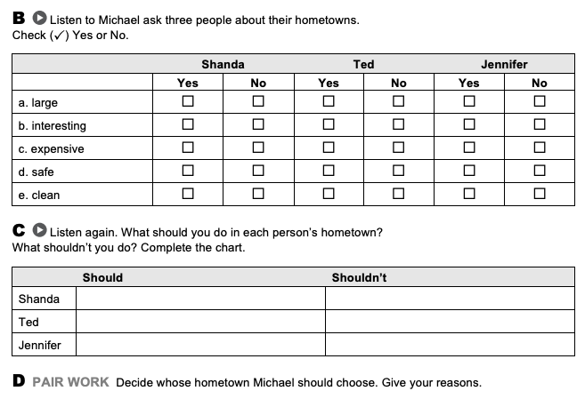

Slide 14
PROJECT UNIT 1
IT’S A REALLY NICE CITY!
THE PROJECT WILL BE DONE IN TEAMS OF 3 PEOPLE.
WORK IN YOUR PROJECT ON MONDAY.
TASK:
Choose one place you want to go on vacation.
Do some research and write sentences describing the place, What’s it like? (use adjectives, adverbs and conjunctions.
Answer the following questions: What can you do there? What should you see there? What things you shouldn’t do there? What’s the weather like? What’s the best time of year to visit? What things can you buy? What special food can you eat? Etcetera.
Design a presentation and tell your classmates why they should visit the place. Try to convince them to go there! You will present on Thursday.
PRODUCTS: Document in Escuela en Red/Presentation/Speaking performance

