Slide 1
UNIT 4
LESSON 6
Lesson objectives:
Identify the difference between possessive adjectives and possessive pronouns

Slide 2
https://www.youtube.com/watch?v=ZT7B4enrn50

Slide 3
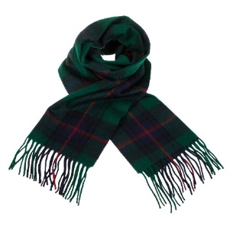
Possessive pronouns and possessive pronouns can be easily confused terms as both refer to possession.
A possessive adjective is an adjective that indicates the possession.
It indicates the ownership of the noun it follows.
Their main function is describing to whom something belongs to.
They are followed by a noun.
Possessive Adjective
Whose scarf is this?
It´s my scarf
Possessive pronouns indicate possession or ownership.
They indicate to whom or what something belongs to.
The main purpose of using possessive pronouns in a sentence is to avoid repetition.
They are not followed by a noun.
Whose scarf is this?
Possessive Pronoun
It´s mine

Slide 4
Discovery learning “Conversation”
Listening practice. Listen to the conversation and practice possessive pronouns
They are not mine
Whose shoes are these?
They are not mine
Ups!. they are mine

Slide 5
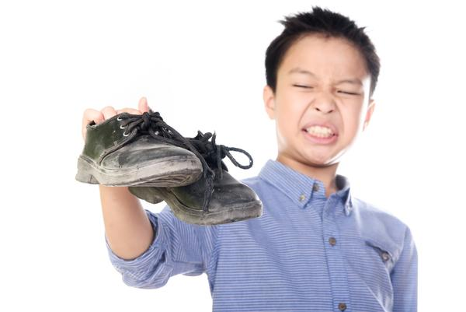
Discovery learning “Conversation”
Listening practice. Listen to the conversation and practice possessive pronouns
Roger, Are these your shoes?
No, they are not mine.
My shoes are clean

Slide 6
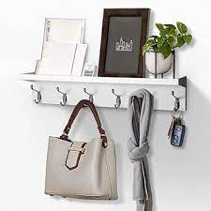
Discovery learning “Conversation”
Listening practice. Listen to the conversation and practice possessive pronouns
No,____________.
_______ purse is purple.
Maybe it´s Rosy´s.
______ purse is gray.
Is this Mary´s purse?

Slide 7
Whose dress is this?
Listening practice. Listen to the conversation and practice possessive adjectives and possessive pronouns.
Jenny: Whose dress is this ? Alex, Is it yours?
Alex: No it´s not mine. My dress is blue
Jenny: Mmh. My dress is red. Maybe it´s Mary´s
Alex: Oh! You´re right. It´s hers.

Slide 8
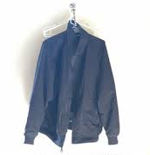
Whose jacket is this?
Role-play a conversation se possessive adjectives and possessive pronouns
A:
B:
A:
B:

Slide 9
Listening practice. Listen to the conversation and practice possessive adjectives and possessive pronouns.
Studentbook pg. 23 ex 4.

Slide 10
Writing practice
Practice on studentbook pg 24 ex A.
Insert here your practice

Slide 11
Writing practice
Practice on studentbook pg 135 ex 1.
Insert here your practice

Slide 12
Writing practice
Practice on workbook pg 21 ex B.
Insert here your practice

