Slide 1



Slide 2

Escuela Normal de Educación Preescolar
English A2.2.2
Building confidence in communication
Term II
Number of hours/ Credits: 6/ 6.75
Teacher: Cristina A. Alvarado Chavarría

Slide 3
Course purpose
The English Language Course for Escuelas Normales is designed to develop students’ ability to communicate effectively in English contexts that will be important for them. As future teachers in a society where English is increasingly important for engaging successfully with professional and social activities, it is essential that all students develop a good level of proficiency in English.

Slide 4
English is growing in importance for accessing information, making useful contacts, understanding other cultures and participating in cultural activities.
As UNESCO has said: Linguistic competencies are fundamental for the empowerment of the individual in democratic and plural societies, as they condition school achievement, promote access to other cultures and encourage openness to cultural exchanges (UNESCO 2007:13). English is particularly important for students because of its role in multinational communicative settings (Hyland 2011).

Slide 5
The course has three main objectives:
Develop their ability to use English in personal and social communications, to develop relationships, complete transactions and meet everyday needs.
Increase their engagement with cultural and intercultural activities in English, in order to develop a better understanding of their own culture as well as other cultures around the world.
Develop their ability to teach in a school environment where English is an important aspect of the school’s approach. Schools are expected to use English increasingly for various teaching and learning activities, and future teachers need to be confident in using English in the school environment.

Slide 6
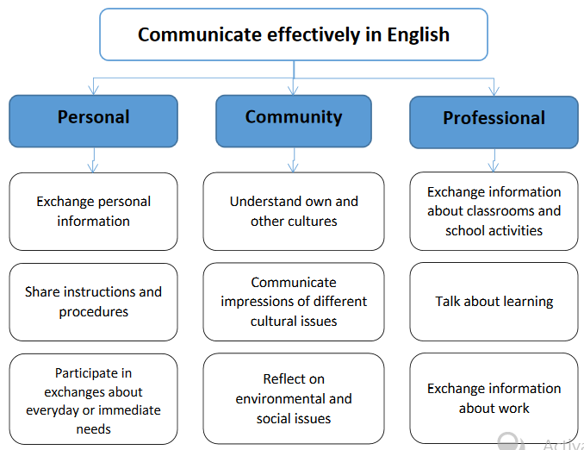

Slide 7
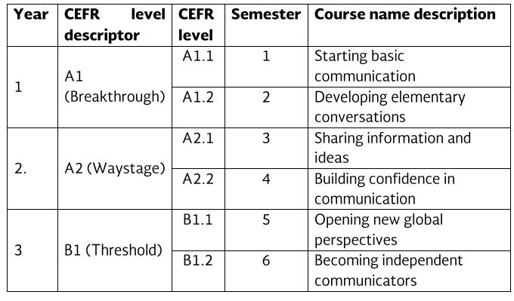
Course Progression

Slide 8
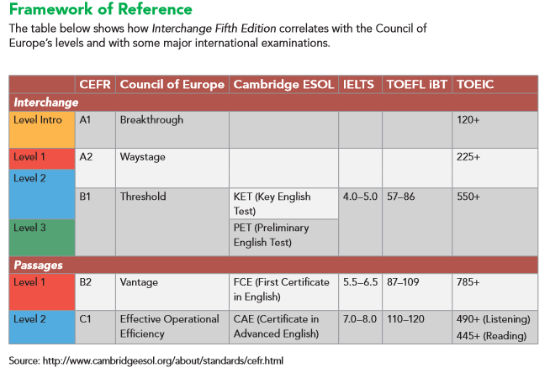

Slide 9
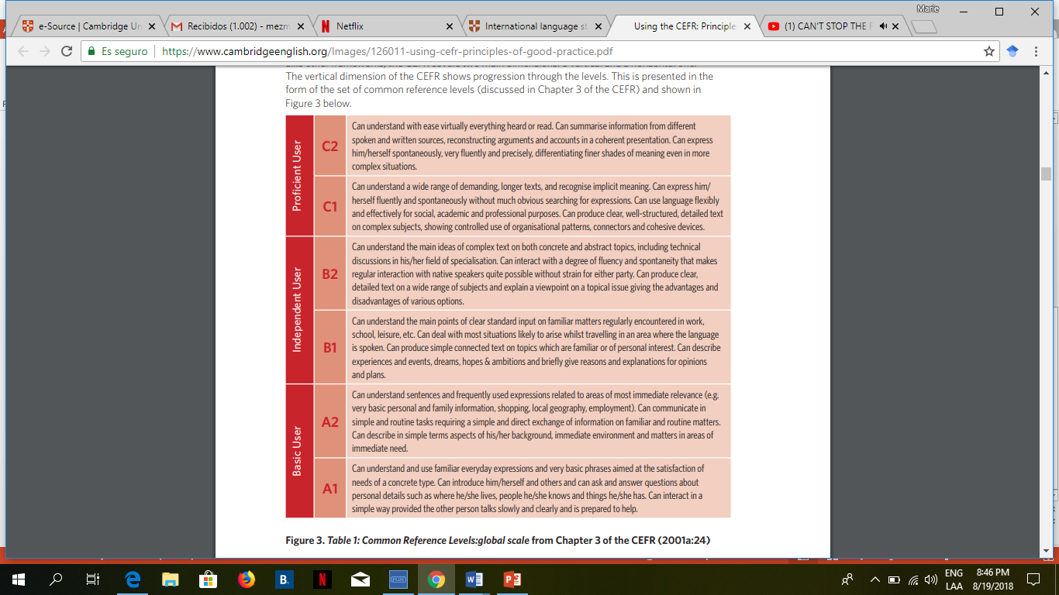

Slide 10
Course Description
The English language course is based on the communicative approach to language learning in line with the Common European Framework of Reference form the Council of Europe. More specifically, there are five main principles of language learning that underpin this curriculum:
Focus on meaningful communication
Teach authentic English.
Students learn most effectively through doing.
Students learn best when motivated and engaged
Differentiate the teaching according to different interests and needs among each group of students.

Slide 11
Competences of the degree profile developed by the course
GENERIC
Use critical and creative thought for solving problems and taking decisions.
Learn in an autonomous way and demonstrate initiative for self-regulation and strengthen her /his personal development.
Cooperate to bring about innovative projects having a social impact.
Act within an ethical way by interiorizing social rules and principles needed for a better coexistence.
Use ICT as well as other languages for understanding, explaining and offering alternative solutions to the problems encountered.

Slide 12
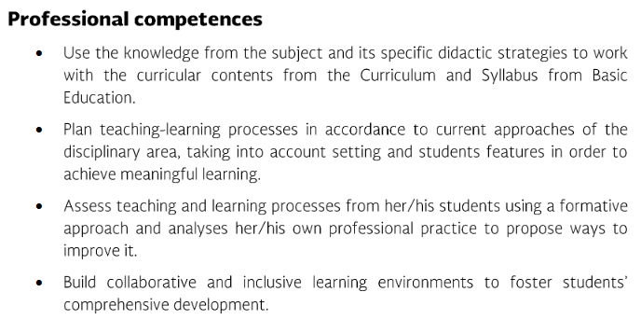
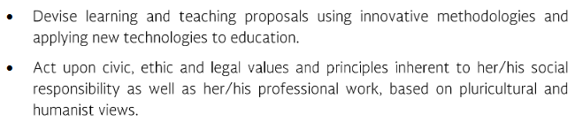

Slide 13
Competences of the degree profile developed by the course
SUBJECT-SPECIFIC
Describe ways of living from different cultures to appreciate their diversity.
Use language to establish harmonious and responsible relationships when exercising citizenship.
Reflect on one´s own learning process to act consciously in communicative exchanges.
Understand and produce texts to participate in a variety of everyday and concrete situations.
Exchange basic information about personal and professional experiences.
Recognize cultural differences when participating in brief and common exchanges.

Slide 14
Course structure
PERIOD | BOOK UNITS | CONTENTS | LEARNING EVIDENCES
1 | Book Unit 5: What are you doing later? | Invitations and excuses; free-time activities; telephone messages | PROJECT – UNIT 1
 | Book Unit 6: How have you changed? | Life changes; plans and goals for the future | PROJECT – UNIT 2
2 | Book Unit 7: Good memories | People; childhood; memories | #1 WISH YOU WERE HERE! Design and write an online post about a vacation to send someone
 | Book Unit 8: Life in the city | Transportation; transportation problems; city services | PROJECT – UNIT 3
3 | Book Unit 9: Making changes | Houses and apartments; lifestyle changes; wishes | #1 WHAT SHOULD I WEAR? Create a catalog or website to sell clothing.
 | Book Unit 10: Have you ever tried it? | Food; recipes; cooking instructions; cooking methods | PROJECT - UNIT 2

Slide 15
weeks | month | days
3 | February | 14-18 | Framework
4 |  | 21-25
5 | March | 28-04
6 |  | 07-11 | 1st Institutional evaluation
7 |  | 14-18 | 1st Internship
8 |  | 21-25 | 1st Internship
9 | April | 28-01
10 |  | 04-08
 |  | 11-15 18-22 | Spring break
11 |  | 25-29
12 | May | 02-06 | 2nd Institutional evaluation
13 |  | 09-13
14 |  | 16-20 | 2nd Internship
15 |  | 23-27 | 2nd Internship
16 | June | 30-03
17 |  | 06-10
18 |  | 13-17
19 |  | 20-24 | 3rd Institutional evaluation
20 | July | 27-01 | Final evaluation/speaking evaluation
21 |  | 04-08 | Exam Profesional
22 |  | 11-15 | GLOBAL grading
A2.2
2nd grade
EVALUATION and INTERNSHIP dates

Slide 16
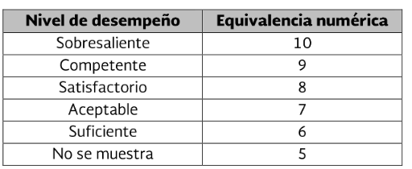
Assessment Criteria
EVALUATION OF EACH LEARNING UNIT (1-3)
Exam | 20%
Project(s) | 20%
Classwork / Homework. All activities in escuela en red and video live sessions | 40%
English Platform progress (Cambridge LMS. ELL’s) | 20%
EVALUATION OF THE SEMESTER
AVERAGE OF LEARNING UNITS | 50%
FINAL EVIDENCE (INTERVIEW) | 50%

Slide 17
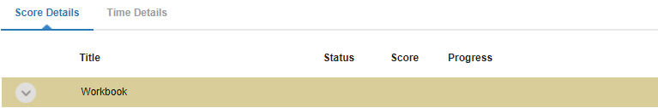
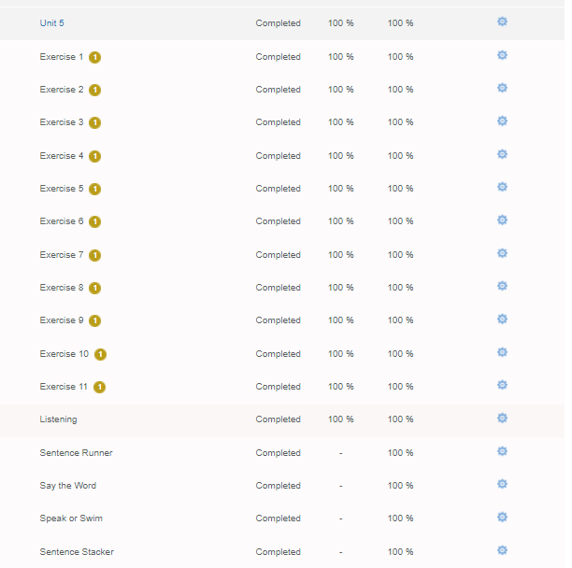
The Cambridge platform must be completed entirely. You must work on the exercises until you obtain a 100 in your scores in order to obtain the total points of the platform (20%) .
https://www.cambridgelms.org/main/p/splash

Slide 18


Global Evaluation
NOTE:
In case the student fails (5 or lower grade) the Final Evidence, he/she will automatically fail the Global Evaluation. Therefore, he/she will have to take a regularization exam.
In order for the student to have (two) opportunities to regularize his/her status, he/she must attend at least 85% of class hours in the semester.
50%
50%
Average of Learning Units 1-3
Final Evidence
(Speaking)

Slide 19
NOTA IMPORTANTE
El estudiante acreditará el curso cuando obtenga como mínimo en la evaluación global del nivel de desempeño, su equivalencia numérica de 6.
El estudiante acreditará el nivel de inglés una vez que evidencie el desarrollo de las habilidades propias del nivel que cursa, con base en el CEFR, mediante una entrevista realizada al final del ciclo escolar y en la cual deberá lograr un resultado no menor a 8 (equivalencia numérica).
En caso de que el estudiante no logre el desarrollo de las habilidades lingüísticas necesarias para avanzar al siguiente nivel de inglés, se le evaluará con base en el desempeño que tuvo durante el semestre para fines de acreditación del curso, no obstante, tendrá que repetir el nivel.

Slide 20

Sit on a proper place to work. (table, chair, silence for concentration).
Have your English materials with you.
Connect 5 minutes before class begins.
Be neat in personal presentation. The class will always be recorded as evidence of work and as material you could review.
Check ESCUELA EN RED messages and activities often, to plan ahead and organize your time.

Slide 21
Course policies
Course Materials: Failure to bring the book to class results in losing points per day.
Homework: There will be regular online homework tasks, as well as homework related to textbook material. It is the students’ responsibility to find out the homework assigned, when absent for any reason.
Late homework: It is the students’ responsibility to turn in homework assignments on time. In case a student presents homework assignments or projects after the stablished due date, the maximum grade will be of a 7.
Grading: Your course grade will depend on performance on tests, speeches, and participation. Satisfactory participation means completing the tasks assigned in class and interacting with your classmates in English at all times. Quizzes, tests, speeches, and other presentations cannot be made up unless the student has an excuse absence by ENEP. This means that if a student is not in class during a task, he or she will receive a grade of 0 for the missing work.

Slide 22
Policies about being late and/or absent.
In accordance to ENEP ‘s policies, you must attend 85% of class time hours.
Class participation grade will be affected if you:
Arrive late or leave early.
Miss class.
Sleep during a class.
Read anything during class which is not related to class activities.
Speak Spanish in class.
Disrespect teacher or classmates during the class.
Please turn off cell phones during class!
Cell phones should be turned off in class; no texting may be done in class. In addition, students may not use electronic devices with earphones in class nor may they do recreational activities on computers. Electronic dictionaries may be used in class but not during tests.

Slide 23

Treat each other with KINDNESS, DIGNITY AND RESPECT
Respectful
Honest
Patient
Neat
Tolerant
Participative
BE….
Receptive
Confident
Positive
INTERESTED
CONCENTRATE
AND
HAVE FUN!

Slide 24

Cultural notes:
If you are late for some reason, please come in quietly and sit down. Do not disrupt the class saying hello, greeting classmates, etc.
Please do not attempt to negotiate with the instructor. It is very rude and disrespectful to negotiate grades, minutes, etc.
The only way to learn when you are misunderstanding is by asking questions.
You may call me Miss, teacher, Miss Mary
I look forward to a very good session.
Thank you for your interest in learning English!
If you really want to improve your English, please remember:
The more you use English, the faster you will learn.
YOU CAN DO IT!

Slide 25
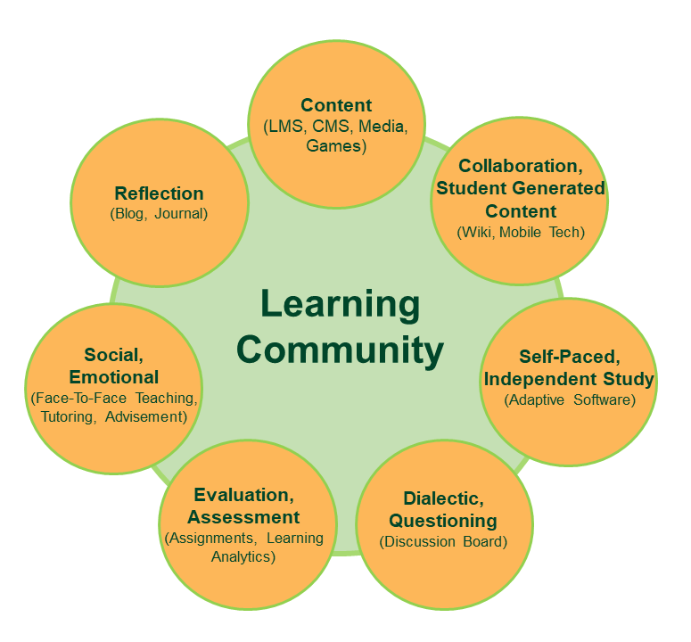
TEACHER’S ROLE
A facilitator/guide who develops and promotes

Slide 26

STUDENT’S ROLE (Mentimeter)

Slide 27


Slide 28
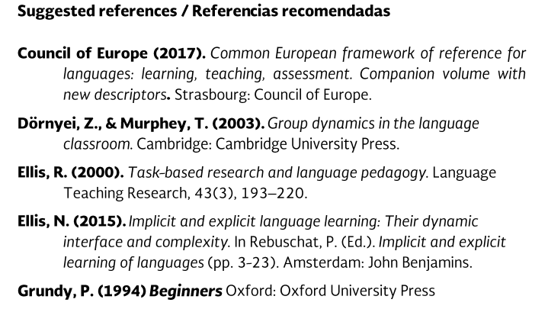
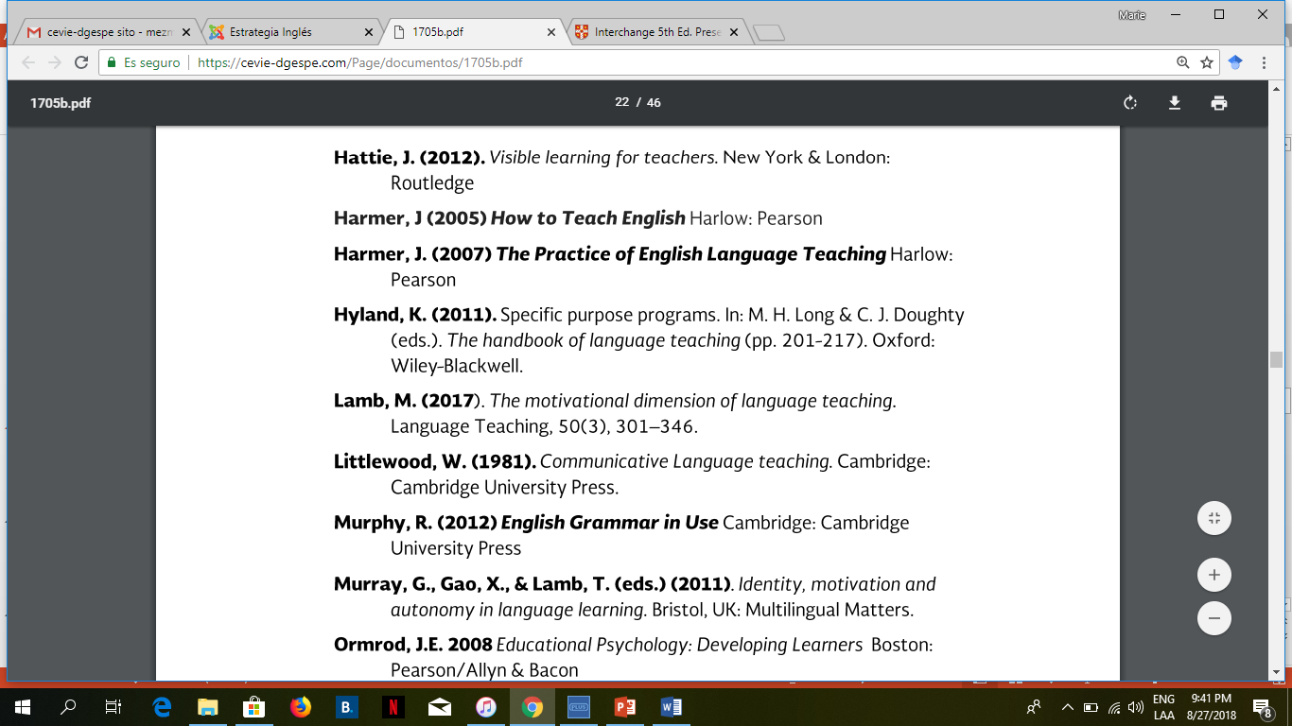
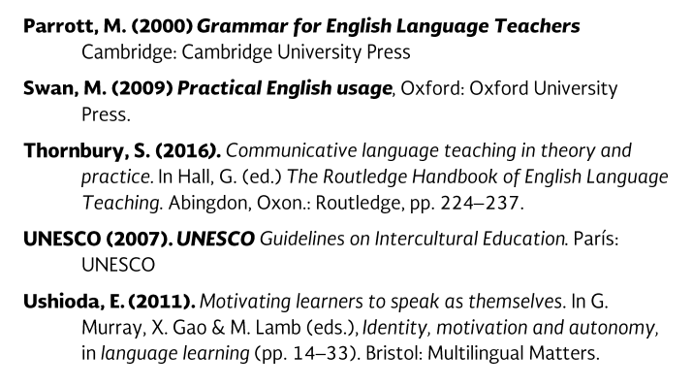

Slide 29
Additional online references and resources
Learning English. http://www.bbc.co.uk/learningenglish
Teaching adults. https://www.teachingenglish.org.uk/teaching-adults
Adult learners. https://elt.oup.com/learning_resources/courses/adultlearners/?cc=mx&selLanguage=en
Learning English. https://www.cambridgeenglish.org/learning-english/
Teacher’s corner. https://americanenglish.state.gov/teachers-corner
Classroom resources. Pearson. https://www.pearsonelt.com/professional-development/resources.html
Teaching adults. Oxford. https://elt.oup.com/teachersclub/courses/teachingadults/?cc=mx&selLanguage=en
For teachers. BBC. http://www.bbc.co.uk/worldservice/learningenglish/teach/
Onestop English. http://www.onestopenglish.com/
The digital teacher. https://thedigitalteacher.com/
https://visuwords.com/
https://www.eslvideo.com/
https://es.lyricstraining.com/
https://www.busuu.com/es
http://intermediatelow.blogspot.com/
https://www.englishclub.com/
http://www.topics-mag.com/
http://www.readableblog.com/
https://dictionary.cambridge.org/es/
http://www.bbc.co.uk/learningenglish
https://www.tefl.net/
http://www.elllo.org/

