Slide 1
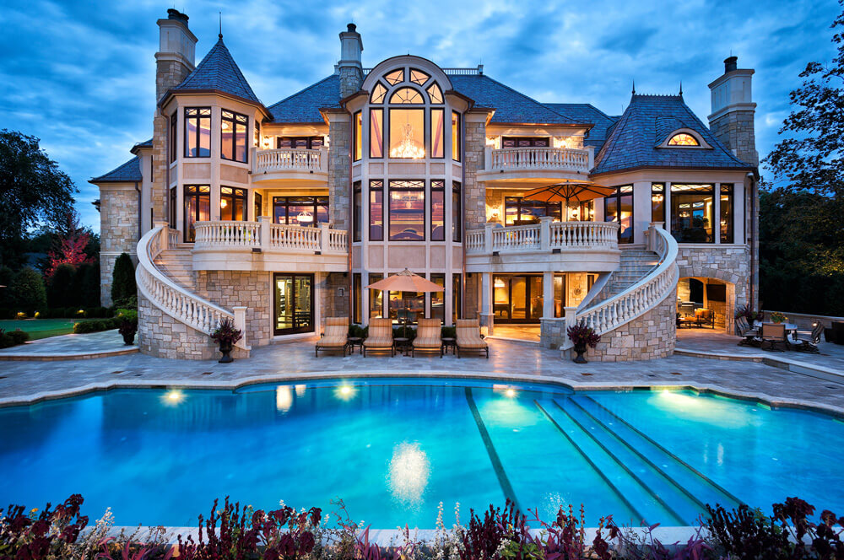
UNIT 7
Lesson 2.1
Does it have a nice view?
LESSON OBJECTIVES
Practice affirmative, negative, Yes/No and Wh questions in simple present tense

Slide 2
Grammar focus “simple present tense”
Practice simple present tense. Studentbook pg 45
Practice simple present tense. Studentbook pg 138

Slide 3
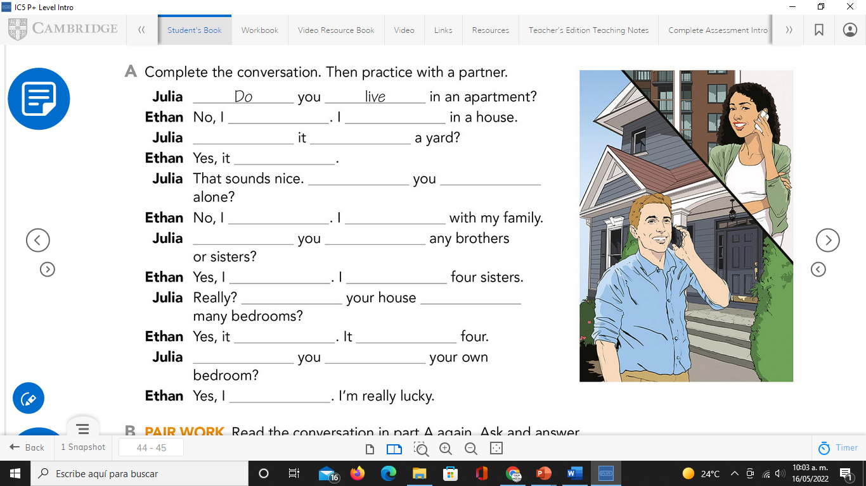
Grammar focus “simple present tense”
Practice simple present tense. Studentbook pg 45
Complete the conversation. Then practice with a partner

Slide 4
Grammar focus “simple present tense”
Practice simple present tense. Workbook pg 38
Complete the conversation with the correct words in parentheses.

Slide 5
Grammar focus “simple present tense”
Practice simple present tense. Studentbook pg 38
Answer these questions with your own information. Use short answers
What furniture do they have?. Workbook pg 39
Answer the questions about the picture. Use short answers

Slide 6
What furniture do they have?. Workbook pg 39
Answer the questions about the picture. Use short answers

Slide 7
Speaking practice “simple present tense”
Practice simple present tense. Workbook pg 38
Complete the conversation. Use the sentences in the box. Then role play the conversation with a partner

Slide 8
Speaking practice “simple present tense”
Practice simple present tense.
Studentbook pg 44
Do you live downtown?
Listen and repeat.
Role play the conversation with a partner

