Slide 1
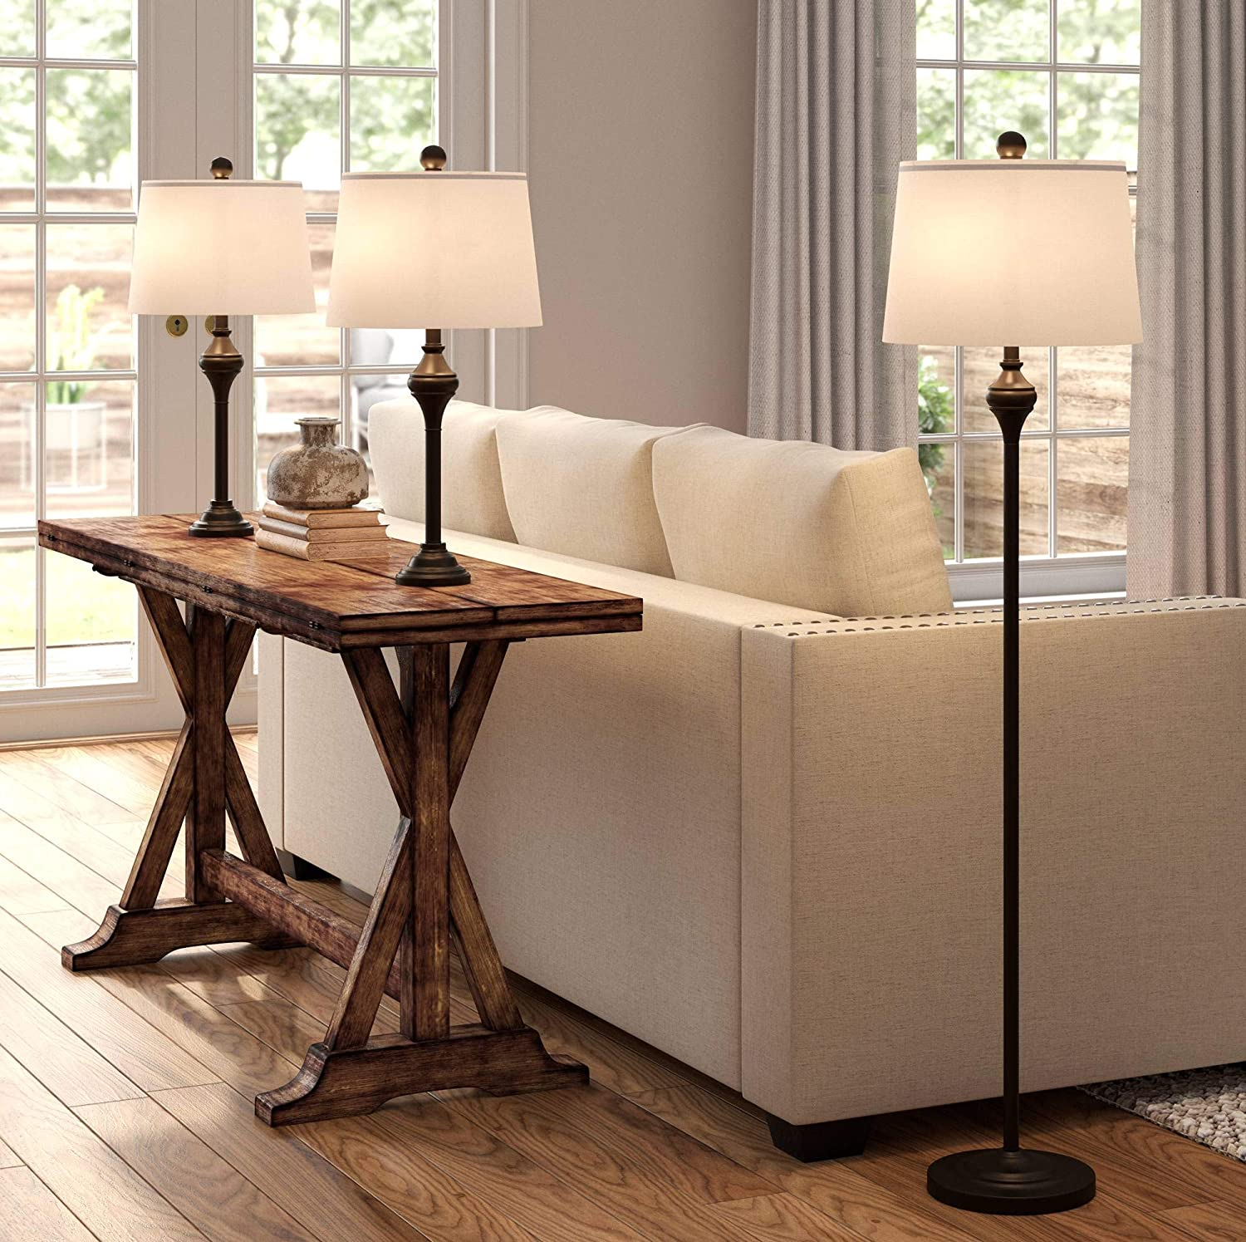
UNIT 7
LESSON 3
There are some lamps in my livingroom
UNIT OBJECTIVES
Use there is, a,an /there are, some, any to describe houses and apartments.

Slide 2
LESSON 3
Grammar focus “there is / there are”
Watch the next video to learn and practice the use of there is / there are.
https://www.youtube.com/watch?v=EKLD4Arn_bs

Slide 3
GRAMMAR FOCUS “THERE IS / THERE ARE”
Look at the picture practice statements with there is there are.

Slide 4
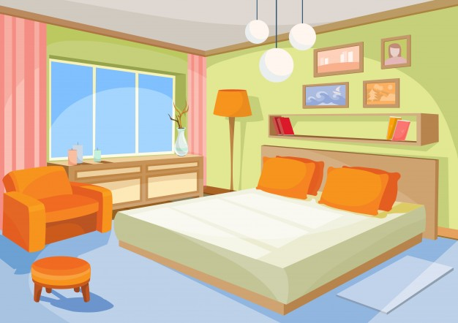
GRAMMAR FOCUS “THERE IS / THERE ARE”
Look at the picture practice statements with there is there are.
Write down 6 sentences using : There is , there are
1.
2.
3.
4.
5.
6.

Slide 5
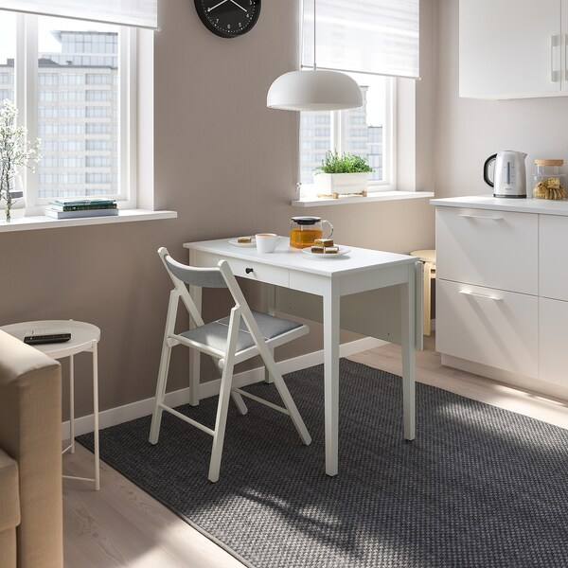
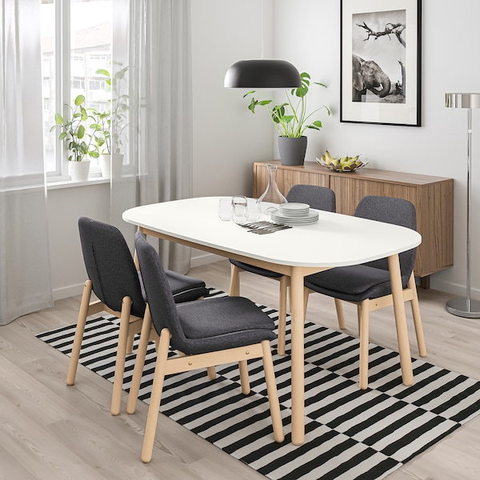
GRAMMAR FOCUS “THERE IS / THERE ARE”
The choice between the phrases there is and there are at the beginning of a sentence is determined by the noun that follows it.
Use there is when the noun is singular (“There is a chair”).
Use there are when the noun is plural (“There are three chairs”).
Contraction
There´s = There is
AFFIRMATIVE statements
Singular | There is a chair
Plural | There are some chairs There are four chairs

Slide 6
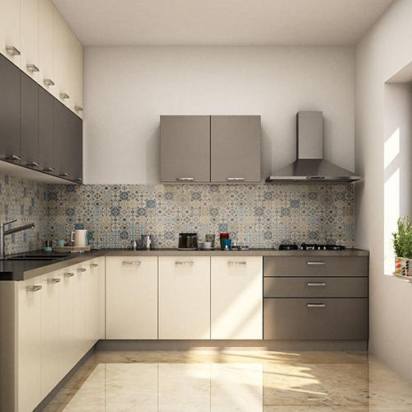
GRAMMAR FOCUS “THERE ISN´T / THERE AREN´T”
Use there isn´t when the noun is singular (“There isn´t a chair”).
Also can use there´s no when the noun is singular (“There´s no chair”).
Use there aren´t any when the noun is plural (“There aren´t any chairs”).
Use there are no when the noun is plural (“There are no chairs”).
Contraction
There is no = There isn´t =There´s no
NEGATIVE statements
Singular | There isn´t a table There is no table
Plural | There aren´t any chairs There are no chairs

Slide 7
GRAMMAR FOCUS “THERE Isn´t / THERE Aren´t”
Look at the picture .
Complete with: There isn’t a/an / There aren’t any
_____________ pictures
_____________ a TV
_____________ courtains
_____________ an armchair
_____________ a coffee table
_____________ clothes in the bed
_____________ laptop

Slide 8
GRAMMAR FOCUS “THERE Isn´t / THERE Aren´t”
Look at the picture .
Write 5 statements using : There isn’t a/an, there´s no /there are no, there aren´t any
1.
2.
3.
4.
5.

Slide 9
GRAMMAR PRACTICE
Look at the picture of Ann´s apartment. Complete the sentences.
Studentbook pg 47

Slide 10
GRAMMAR PRACTICE
Click on the following link to practice There is/There are
https://wordwall.net/es/resource/11947290
Insert here your results
Click on the following link to practice There is/There are, There isn´t /There aren´t
https://wordwall.net/es/resource/11947509
Insert here your results

