Slide 1
Learning unit 1 project
THIS IS ME!

Slide 2
STEP 1 . PLAN
Get to know your classmates. Use these questions and write five more.
What’s your name?
What do people call you?
Where are you from?
What’s your last name?
How do you spell it?

Slide 3
STEP 2 . interview
Interview one of your classmates and write the answers to the questions.

Slide 4
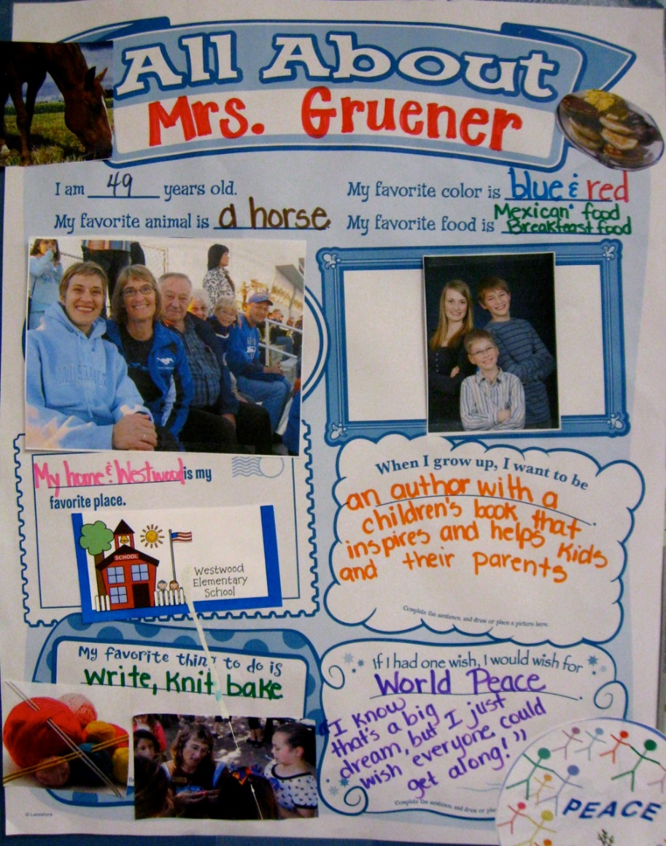
Step 3. poster
Make a poster with your classmate’s information.
Use magazines, pictures, and your own words to describe your partner.
PASTE A PICTURE OF YOUR POSTER HERE!

Slide 5

Step 4. presentation
Introduce your partner to the class.
Show your poster.

Slide 6
rubric

Slide 7

LEARNING UNIT 1 TEST
MONDAY, SEPTEMBER 26TH, 2022

