Slide 1
LEARNING UNIT 2 PROJECT IN HONOR OF…
DUE DATE: FRIDAY, NOVEMBER 11TH

Slide 2
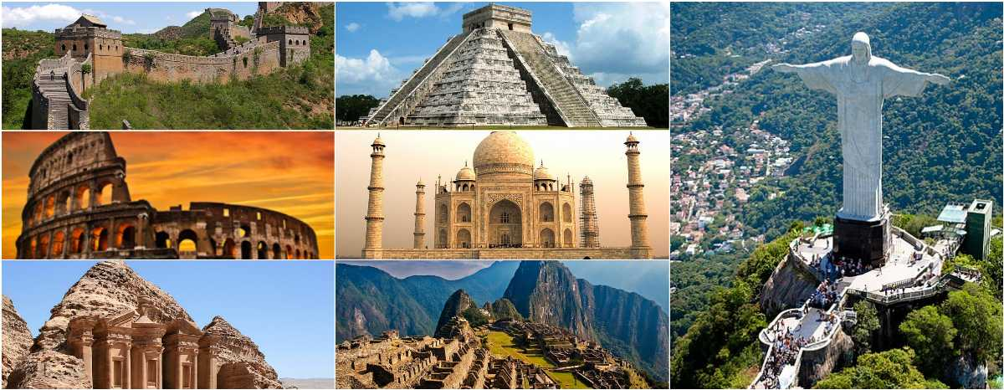

Slide 3
GUIDELINES
OBJECTIVES
To discuss landmarks, monuments and works of art.
To discuss cities and countries around the world.
To use the passive voice to talk about cities, countries, and landmarks or monuments.
4 TEAMS OF THREE STUDENTS
1 TEAM OF FOUR STUDENTS
THURSDAY, NOV. 10TH – PREPARATION ACTIVITIES AND MONUMENT
FRIDAY, NOV. 11TH – PRESENTATION

Slide 4
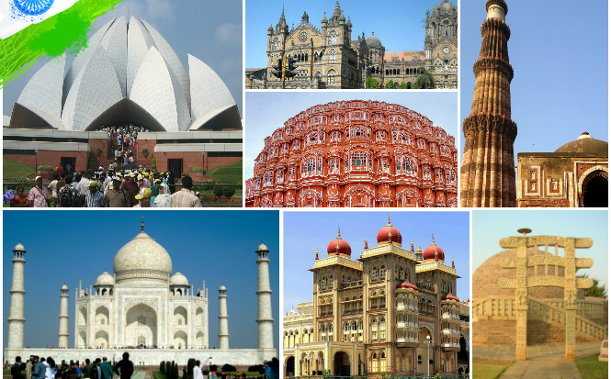
PREPARATION ACTIVITY 1

Slide 5
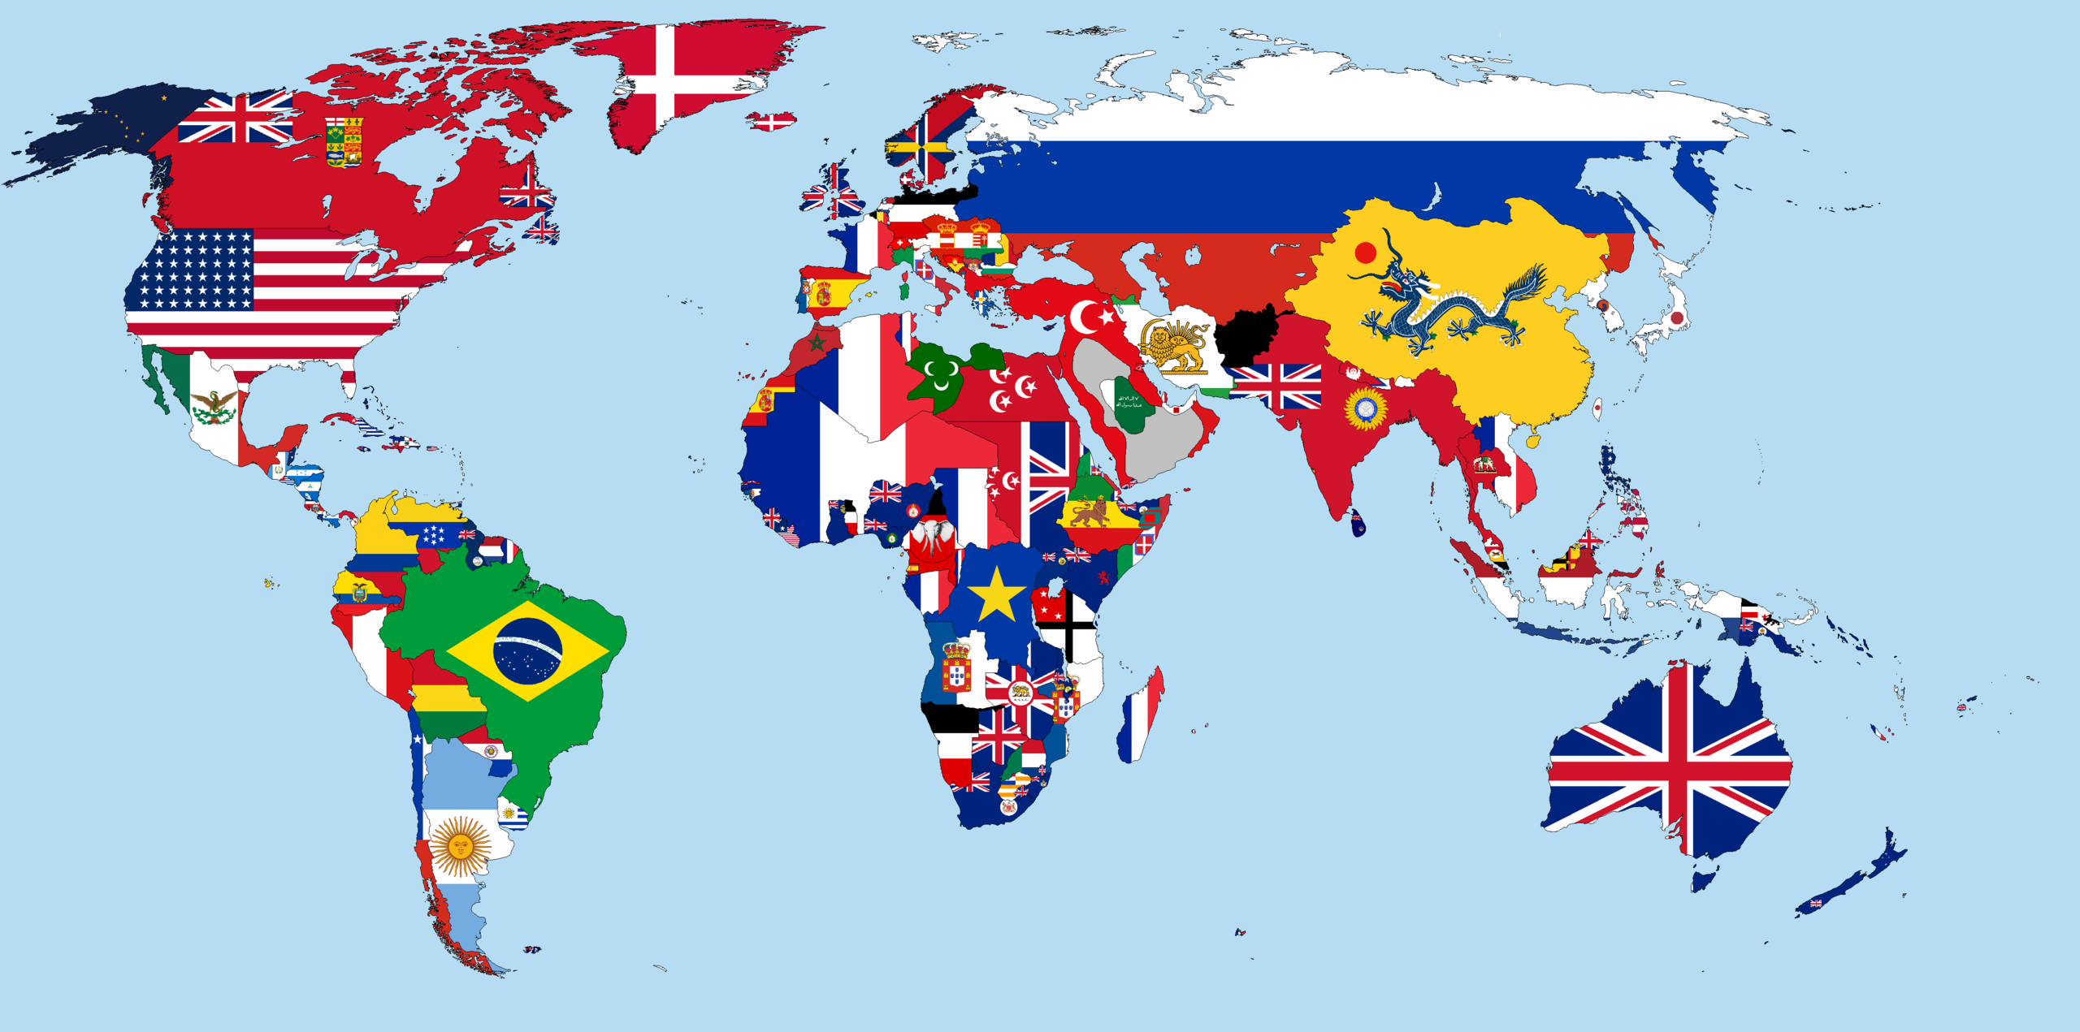
PREPARATION ACTIVITY 2
Choose a city from the world.
Imagine you are city planners.
Find information about the city you chose and write a review. Include:
Location
Size
Population
Main attractions and activities
Shopping
Design a monument for the city. Answer the following questions:
Where will it be located?
Who or what will the monument honor? Why?
How big/tall will it be?
What will it be made of?

Slide 6
PREPARATION ACTIVITY 3
Build your monument using the recycled materials you brought to class.

Slide 7
PROJECT PRESENTATION
PREPARATION ACTIVITIES (15%)
CLASSWORK – Chart / City review / Monument design
PRODUCTS (15%)
Monument
GRAMMAR AND VOCABULARY (30%)
Use of vocabulary from the unit (check vocabulary log)
Use of grammar structures from the unit (passive voice with simple past and simple present)
SPEAKING PERFORMANCE (40%)
Fluency
Coherence
Pronunciation
Intonation

