Slide 1
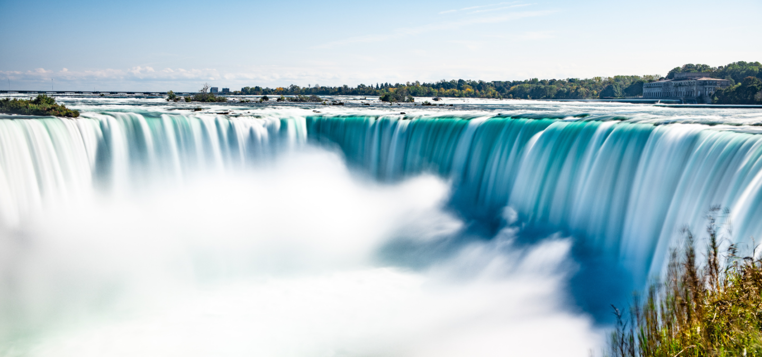
UNIT 4
Lesson 1
Natural landscapes
LESSON OBJECTIVE:
Learn and use landscapes vocabulary.

Slide 2
VOCABULARY “Natural landscapes”
Watch the following video learn the vocabulary of natural landscapes.
https://www.youtube.com/watch?v=7Y1fL0GyyJs

Slide 3
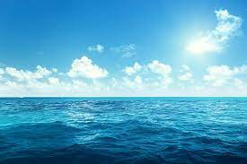
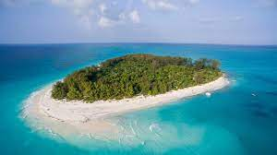
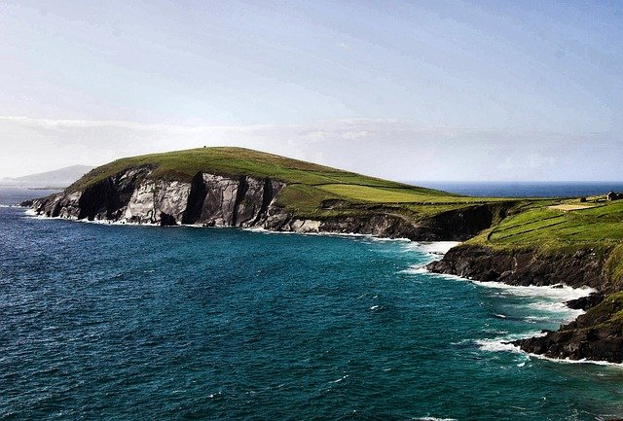
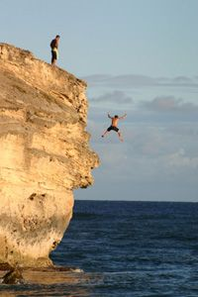
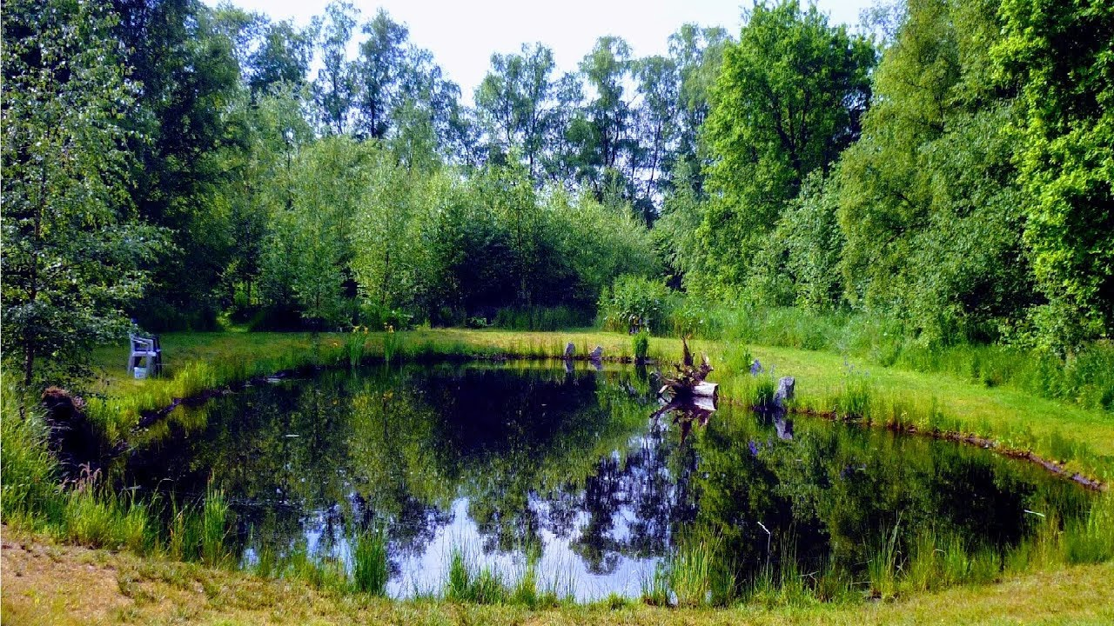
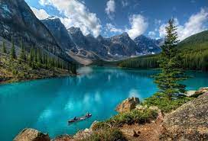
SPEAKING PRACTICE VOCABULARY “Natural landscapes”
Look at the picture, say the word you see.
(Variant https://wordwall.net/es/resource/16923535/landscapes-u2 )

Slide 4
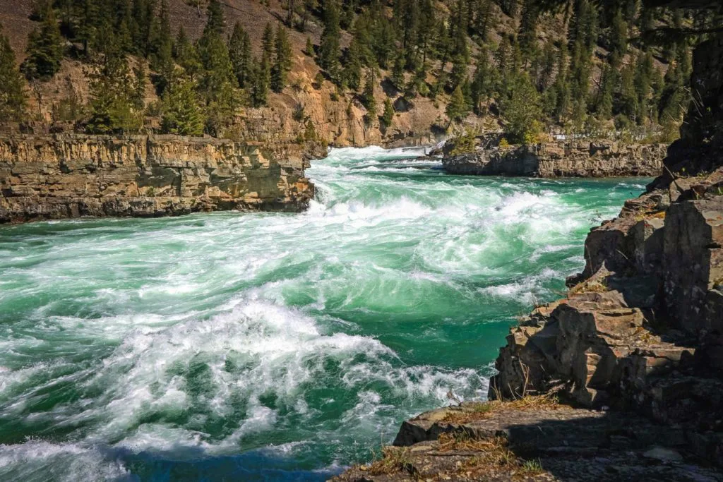
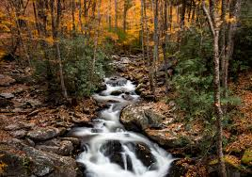
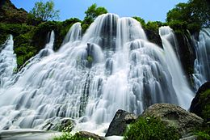
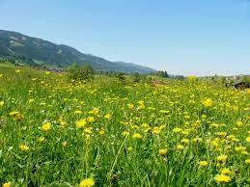
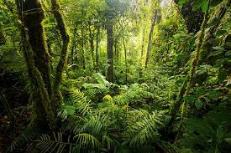
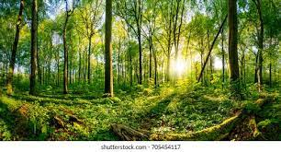
SPEAKING PRACTICE VOCABULARY “Natural landscapes”
Look at the picture, say the word you see.

Slide 5
VOCABULARY “Natural landscapes”
Draw or insert a pocture to the following definitions.
Hills
Rounded area of land that is higher tan the land around it. It´s not as high as the mountain.
Mountain
a raised part of the earth's surface, much higher and larger than a hill
Valley
an area of low land between hills or mountains, often with a river running through it:
Canyon
a large valley with very steep sides and usually a river flowing along the bottom

Slide 6
Vocabulary Practice

Slide 7
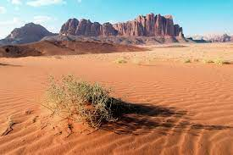
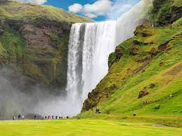
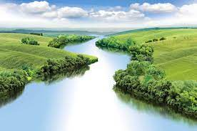
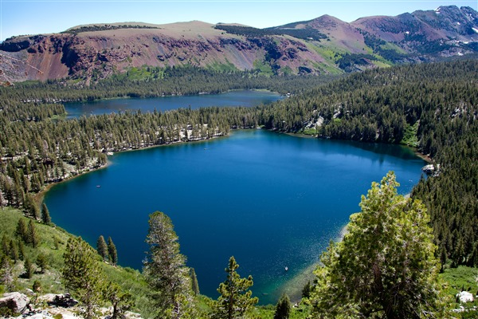
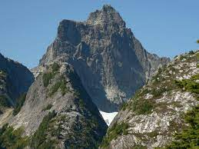
Vocabulary Practice
Do you know a famous __________ ? (give an example of each place)
Desert
Waterfall
River
Lake
Mountain

Slide 8
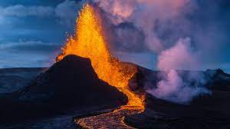
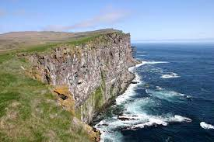
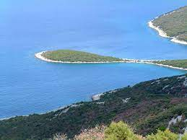
Vocabulary Practice
Do you know a famous __________ ? (give an example of each place)
Volcano
Cliff
Stream
Peninsula

Slide 9
Vocabulary Practice
Workbook pg 19 ex 1 A

Slide 10
Vocabulary Practice
Click on the following links, practice vocabulary then share the results of your practice
https://es.liveworksheets.com/ks17325yg
Insert here your results
https://wordwall.net/es/resource/29741399/ciencias-sociales/landscapes
Insert here your results
https://wordwall.net/es/resource/19884576/landscapes
Insert here your results

Slide 11
Vocabulary Practice
Click on the following links, practice vocabulary then share the results of your practice
https://wordwall.net/es/resource/3548281/landscapes
Insert here your results
https://wordwall.net/es/resource/7630020/landscapes
Insert here your results

Slide 12
Vocabulary Practice
Studentbook pg 22

Slide 13
Vocabulary Practice

Slide 14
Vocabulary Practice
Workbook pg 19 ex 1 B

Slide 15
Listening/Reading Practice
Click on the following link, practice listening, Reading and vocabulary then share the results of your practice
https://www.liveworksheets.com/worksheets/en/English_as_a_Second_Language_(ESL)/Listening_and_reading/US_natural_beauty_ub1783165iy
Insert here your results

