Slide 1
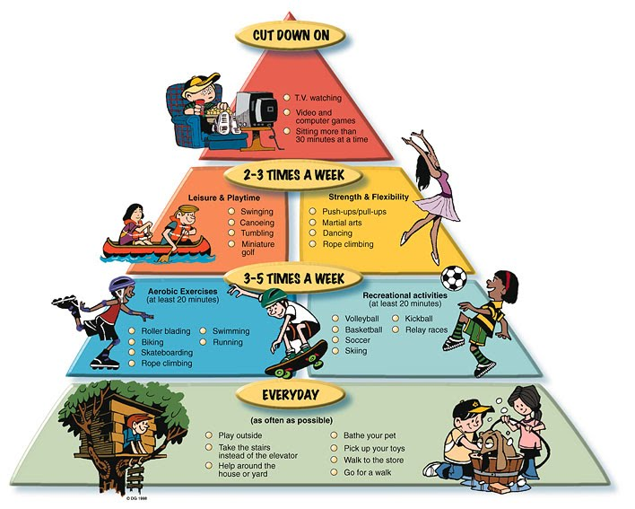
UNIT 5
Lesson 1
Activation pyramid
LESSON OBJECTIVE:
Learn and use activation activities vocabulary.

Slide 2
Vocabulary Practice “Activation activities”

Slide 3
Vocabulary Practice “Activation activities”
Find 10 of the many family recreational activities hidden below in the seek-n-find.
Hidden words
Jog
Skipping
Volleyball
Jump rope
Soccer
Dance
Softball
Stair climbing
Skating
swim

Slide 4
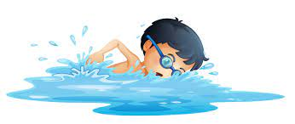
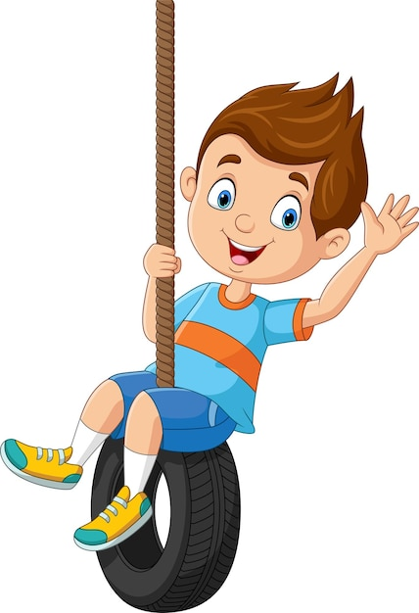
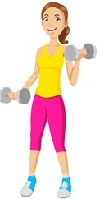
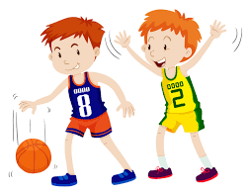
Vocabulary Practice “Activation activities”
Match the piuctures in the correct category.
Sedentary activities | Leisure actvivities | Strenght /flexibility activities
Aerobic excercises | Recreational activities | Daily activities
swiming
doing the laundry
swinging
lifting weights
texting
playing basketball

Slide 5
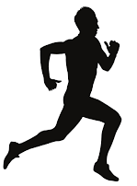
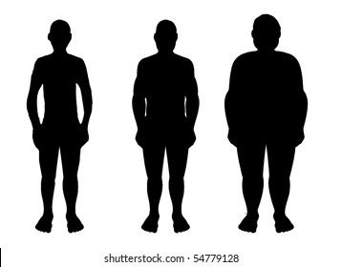
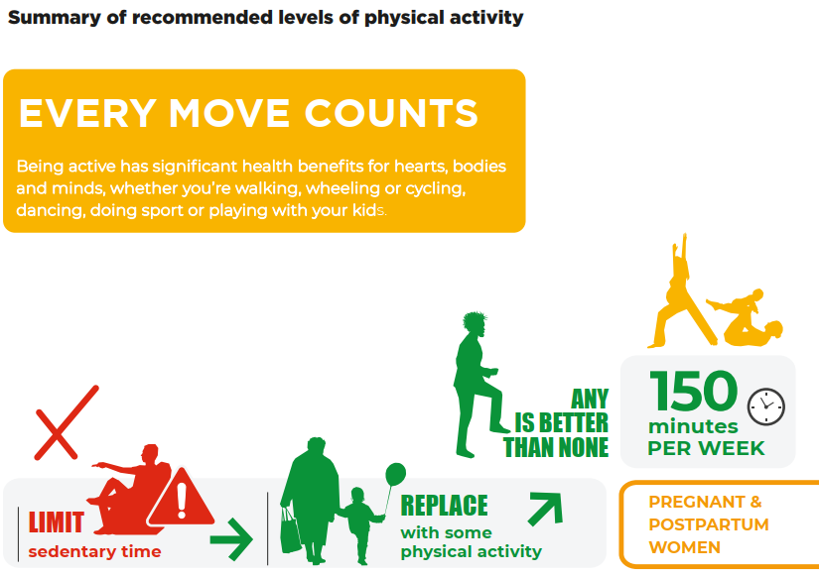
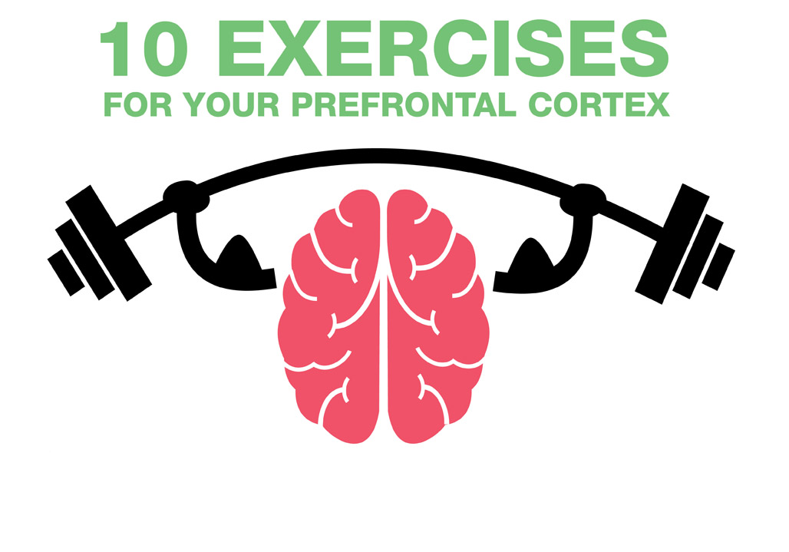
Reading Practice
“Physical Activities”
Read the following article about physical activities.
WHO (World health organization)
defines physical activity as any bodily movement (including during the leisure time)produced by skeletal muscles that requires energy expenditure.
Current global estimates, show one in four adults and 81% of adolescents do not do enough physical activity.
As countries develop, levels of sedentary behaviors and inactivity grow, which have negative impacts on health systems and quality of life.
Popular ways to be active include walking, cycling, sports, active recreation, etc. Both moderate- and vigorous-intensity physical activity improve mental health, quality of life and well-being.
WHO recommend:
To be physically active several times a day in a variety of ways.
Do at least an average of 60 minutes per day of moderate-to-vigorous intensity, mostly aerobic, physical activity, those that strengthen muscle and bone, at least 3 days a week.
Limit the amount of time spent being sedentary, limit the screen time (tube, computer, cellphone).
Replace sedentary time with physical activity of any intensity
It means that today´s people is less fit- and more overweight-than the previous generations.

Slide 6
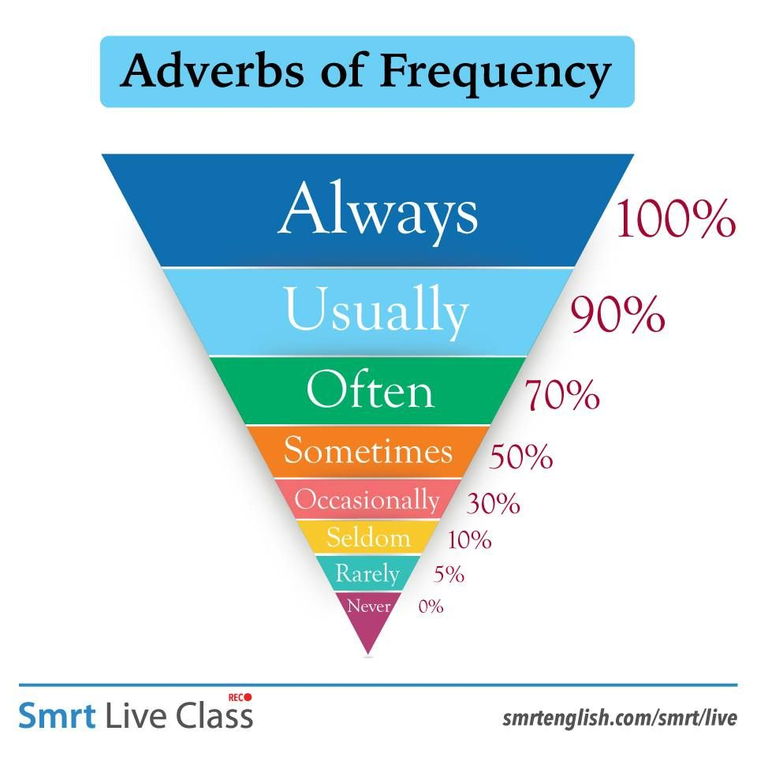
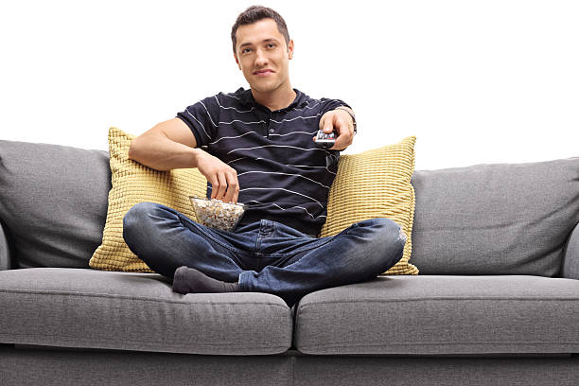
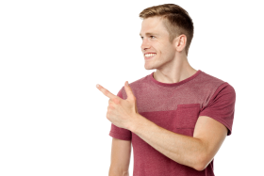
Grammar “Adverbs of frequency”
Adverbs of frequency describe how often an action happens, they are often used to indicate routine or repeated activities.
Adverbs of frequency are often used with the present simple tense. If a sentence has only one verb, place the adverb of frequency in the middle of the sentence after the subject but before the verb.
How often……?
Adverbs of frequency
I usually watch TV at night
So, you´re a coach potatoe

Slide 7
Grammar “Adverbs of frequency”
Write three statements using adverbs of frequency to talk about the activities you do .

Slide 8
Grammar Practice
Studentbook pg 27 ex6
Write about how often do you do these leisure activities. Use the frequency adverbs in the in the box
Variant: click on the following link to practice https://www.liveworksheets.com/dn2954658uz

Slide 9
Grammar Practice
Click on the following link to watch and listen four conversations.
Follow the conversation and fill in the blanks
Conversation 2
Man: What do you _______ have for dinner? Woman: I try to eat healthy, so I _______ cook vegetables. Man: Really. What kind of stuff do you make? Woman: _________ I make soups. ___________ I make stir-fry. Man: Stir-fry! That”s not very healthy. Woman: I know, but don't eat not eat it ___________.
Conversation 3
Woman: Do you take the bus to work? Man: No, I__________take the bus. I _________ drive. Woman: Yeah, it's so much easier to drive. Man: Do you drive to work? Woman: Actually, I ________ drive. I _______walk to work. I live near the office. Man: Lucky you!
Conversation 4
Man: Do you ever go to the movies? Woman: I _________ do. It is too expensive. Do you? Man: No, not _______. I _________ rent DVDs. Woman: Really. I _________ do that. I __________ stream movies. Man: Nice. Do you have fast Internet? Woman: Yeah, ___________ it is fast, but __________ it’s slow.
https://player.vimeo.com/video/251286273
Conversation 1
Man: What do you do on the weekend? Woman: I ________ stay home, but _________ I go out. Man: Oh, where do you go? Woman: ________ I go to the beach. ___________ I go to the park. Man: I ______ go there too. Do you ever go to the lake? Woman: No, very __________. It is too far from house.

Slide 10
VOCABULARY “Activity pyramid”
Watch the following video learn the.
https://www.youtube.com/watch?v=IwNUeg5RMMo

Slide 11
Vocabulary Practice
Complete your Activity Pyramid(Follow the example chart.)
Cut down /limit
Sedentary
activities
2 or more times a week using machines, functional training, free weights
Leisure
activities
Strength
& flexibility
20 minutes everyday. Continuous physical activities that increase the heart rate.
Aerobic excercises & recreational activities
As much as possible
Daily activities

