Slide 1

UNIT 5
Lesson 3
What are you doing tonight?
LESSON OBJECTIVE:
Learn to use the present continuous and the be going to as future.

Slide 2
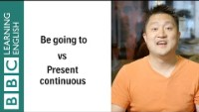
GRAMMAR “Future plans with present continuous and going to”
Watch the following video to learn about the use of the present continuous and the going to for future
https://www.youtube.com/watch?v=K7jtbc8jYGc

Slide 3
GRAMMAR “Future plans with present continuous and going to”
We can talk about future events by using either: the present continuous, or be going to
There are, however, some differences between the two forms.
PRESENT CONTINUOUS The present continuous tense is mainly used to talk about personal arrangements and fixed plans to do at a specific time in the future . | BE GOING TO Be going to is used to express the future when we intend to do something or have decided to do something but did not arrange it. It is just an intention.
I am getting a new job. (It is already decided / arranged. Here the focus is on the arrangement.) | I am going to get a new job. (I intend to get a job.)
I am seeing Peter tomorrow night. (Here the emphasis is on the arrangement that already exists.) | I am going to see Peter this week. (Here the emphasis is on the intentions of the speaker.)

Slide 4
GRAMMAR “Future plans with present continuous and going to”
PRESENT CONTINUOUS | BE GOING TO
The windows are dirty. I’m cleaning them this afternoon. ( I've decided to clean them.) | The windows are dirty. I'm going to clean them later. ( I've decided to clean them ,but I haven't arranged to clean them.)
What are you doing this evening? (A question about arrangements) | What are you going to do this evening? (A question about the intentions of the listener)
 | We also use 'going to' to talk about events that are outside people’s control or to make predictions.
 | It's so cloudy! I think it's going to rain Prices are going to fall. Watch out! you are going to break the glass

Slide 5
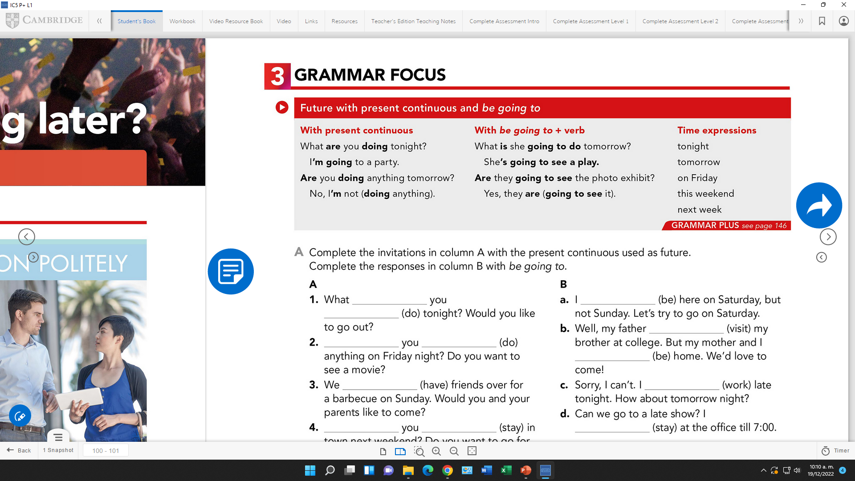
GRAMMAR “Future plans with present continuous and going to”
studentbook pg 31
PRESENT CONTINUOUS The present continuous tense is mainly used to talk about personal arrangements and fixed plans to do at a specific time in the future . | BE GOING TO Be going to is used to express the future when we intend to do something or have decided to do something but did not arrange it. It is just an intention.
Time expressions for future | Tonight Tomorrow On Friday/Saturday/Monday/… This weekend/ This month/ This year Next week/next month /next year
Learn more future structures at:
https://youtu.be/79Yxp84s0KI

Slide 6

Video Practice “Cheryl and Marie try to make plans for the weekend”
Watch the following video to practice the future plans with present continuous and the going to.
https://youtu.be/fkkDZWnIQNs
.

Slide 7
Video Practice “Cheryl and Marie try to make plans for the weekend”
Watch the video one more time and complete the conversation.
Marie: _____________this weekend? Do you want to go shopping with me?
Cheryl: That sounds great. When do you want to go?
Marie: How about Saturday morning?
Cheryl: ____________breakfast for some friends at 9:00. Then __________laundry from 11:00 to noon.
Marie: Saturday afternoon?
Cheryl: __________an art class from 1:00 to 3:00.
Marie: How about 3:30?
Cheryl: No, I’_________ with a friend from 3:00 to 4:00. Then __________to the movies at 5:00 with my sister.
Marie: Sunday morning?
Cheryl: __________my parents until 10:00. Then ___________a friend at the art museum until 1:00. Marie: Sunday afternoon?
Cheryl: __________to a baseball game with Bob at 1:00. How about late afternoon?
Marie: Around 5:00?
Cheryl: Great.
Bob: Hey. Do you want to play basketball tomorrow?
Paul: OK.

Slide 8
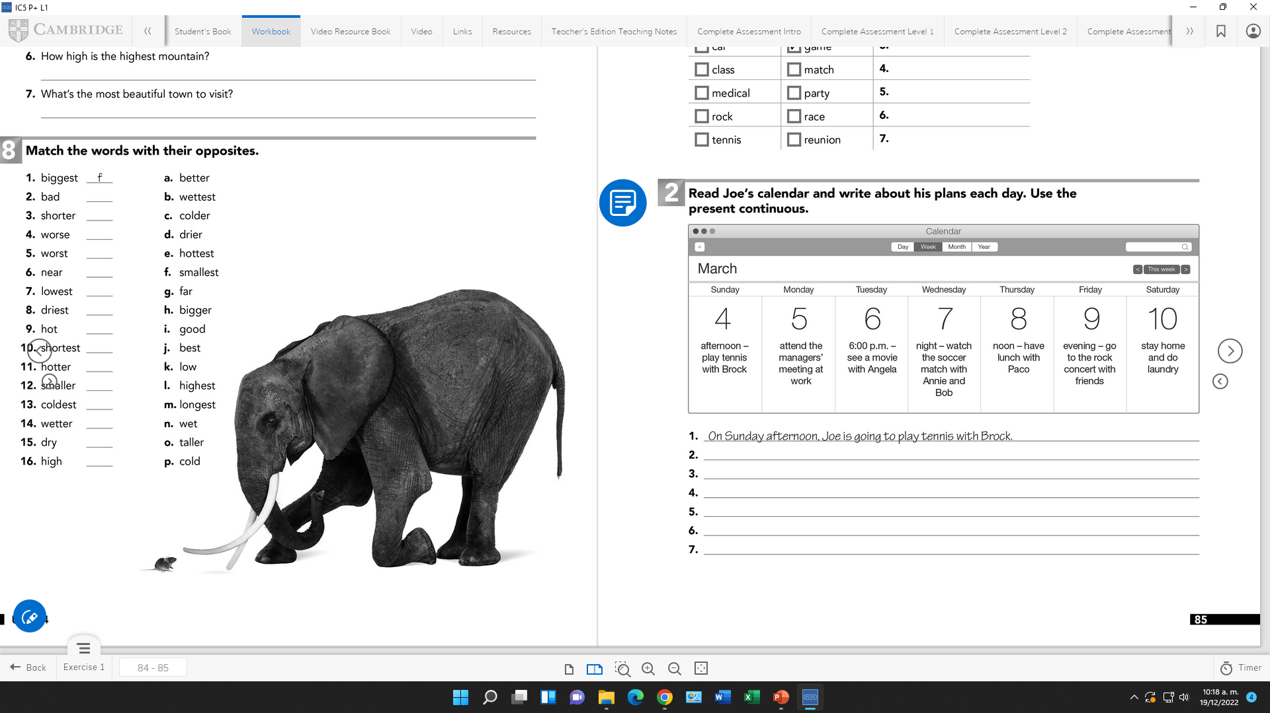
Grammar Practice
Workbook pg 25
1.- Joe is playing tennis with brook this saturday afternoon.
2.-
3.-
4.-
5.-
6.-
7.-

Slide 9
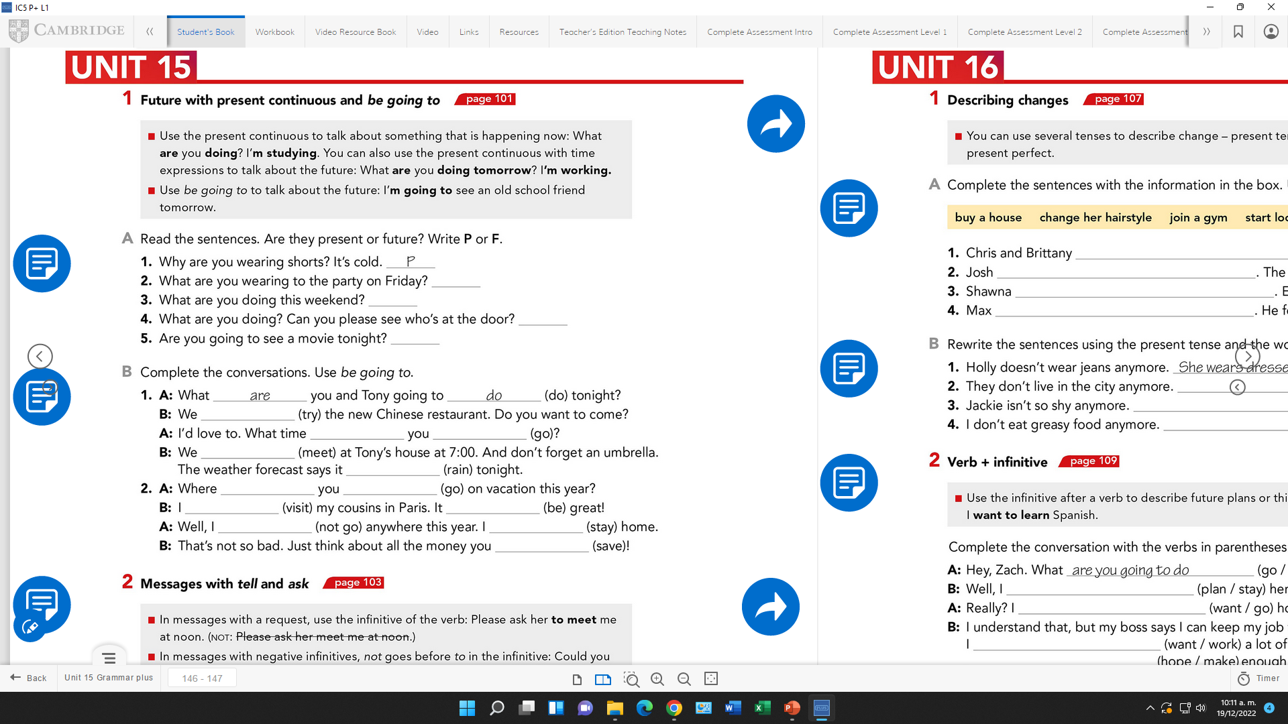
Grammar Practice
Studentbook pg 86

Slide 10
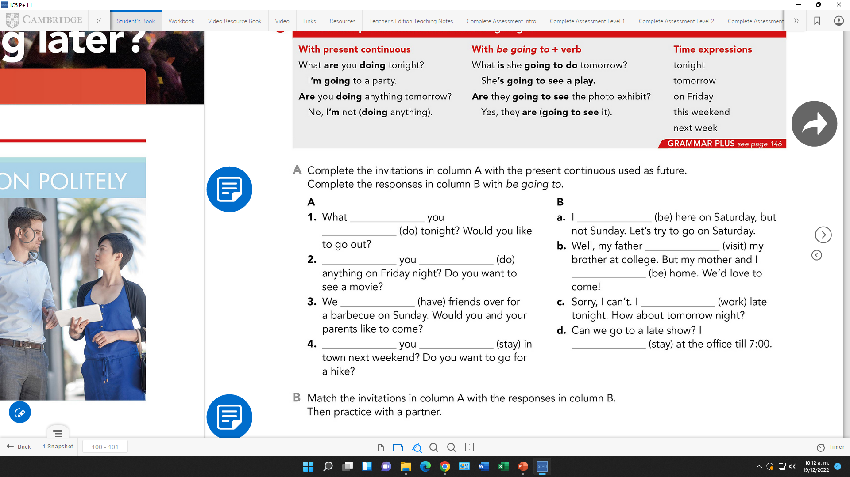
Grammar Practice
Studentbook pg 31

Slide 11
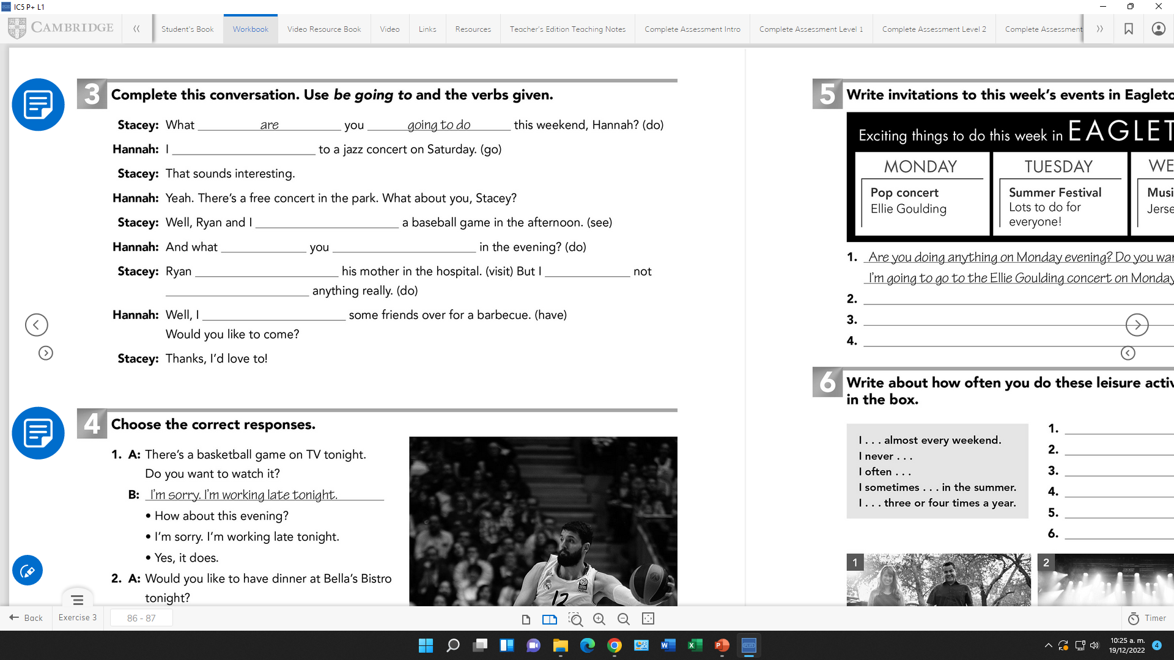
Grammar Practice
Workbook pg 26 ex 3

Slide 12
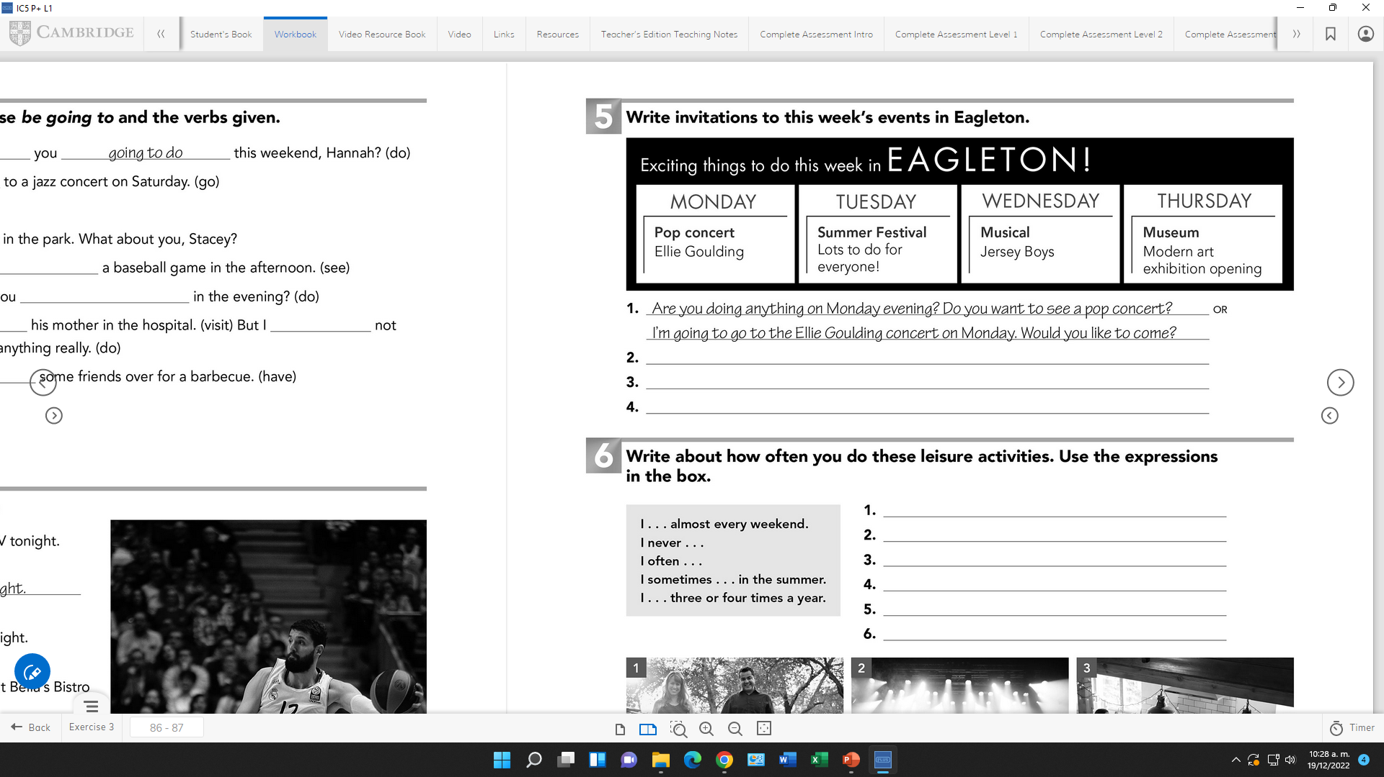
Grammar Practice
Workbook pg 27 ex 5

Slide 13
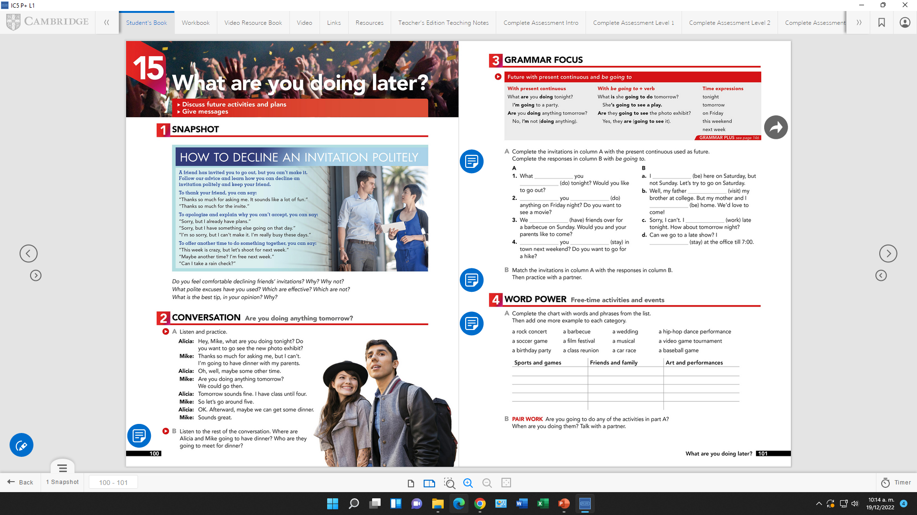

Speaking Practice
studentbook pg 32 ex5
Extrapractice/ Role play “Accept or refuse”
List of activities to talk about.
Student A: Choose an activity from the list and invite your partner to go with you.
Be ready to say where and when the activity is.
Student B: Your partner invites you out. Accept the invitation and ask for more information or decline the invitation and give an excuse why you canpt go.
Example:
A(invite): So, are you doing anything on ………..?
Would you like to ………….?
B(accept): Ok, That sounds fun. Where is it?
B(refuse): Oh, I´m sorry, I can´t. I ………….

