Slide 1



Slide 2

https://www.youtube.com/watch?v=FH3akqBwYfo

Slide 3

Escuela Normal de Educación Preescolar
English A2.2
Building Confidence in Communication
Teacher: MAYELA ALEJANDRA DEL CARMEN GAONA GARCIA
Term II
Number of hours/ Credits: 6/ 6.75
Class schedule: Monday 9:15 A.M. – 10:45 A.M. Tuesday 7:45 A.M. – 9:15 A.M. Thrusday 11:00 A.M. – 12:30 P.M.
Term: February-June 2024

Slide 4
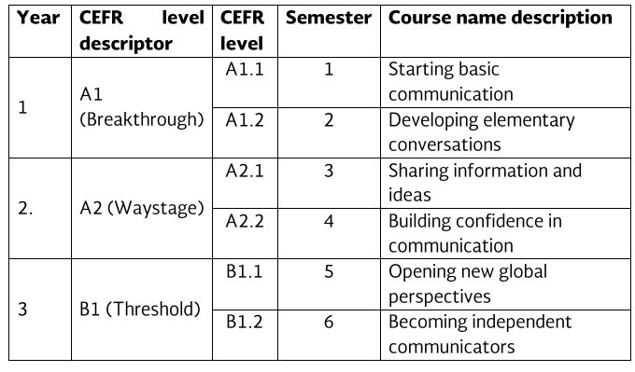
Course Progression

Slide 5
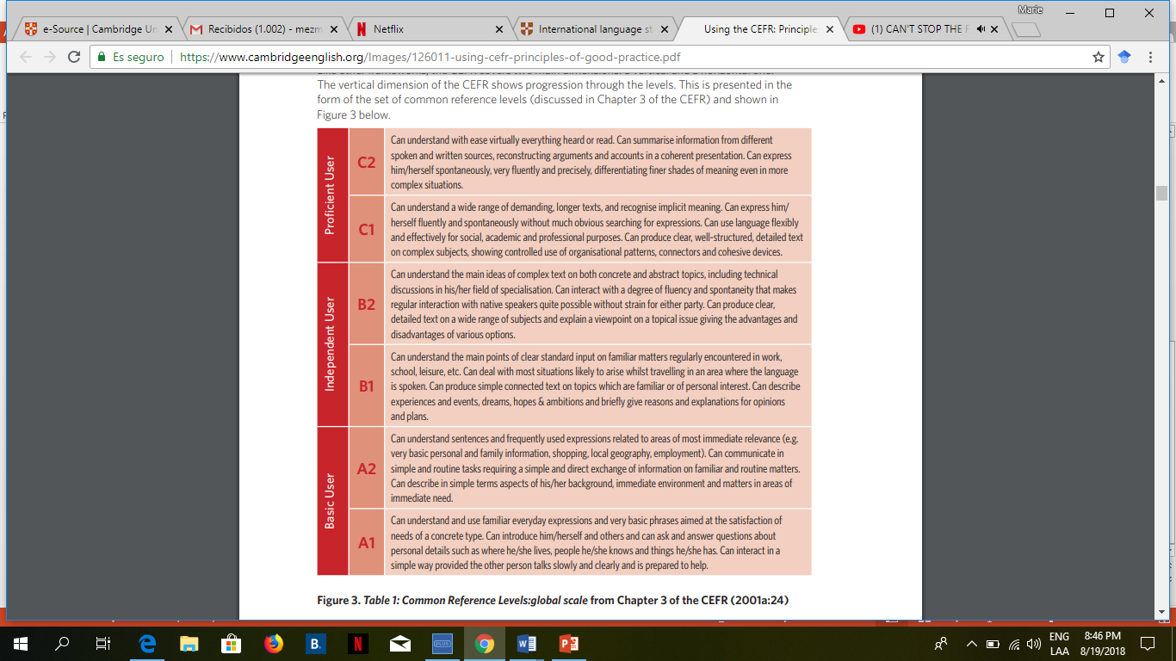

Slide 6
This course has three main objectives:
The students will develop their ability to use English in personal and social communications, to develop relationships, complete transactions and carry out every day needs.
The students will increase their engagement with cultural and intercultural activities in English, in order to develop a better understanding of their own cultures as well as other cultures around the world.
The students will develop their ability to teach in a school environment where English is an important aspect of the school´s approach.

Slide 7
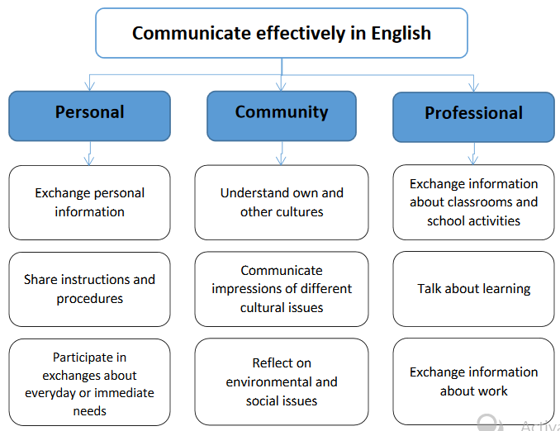

Slide 8
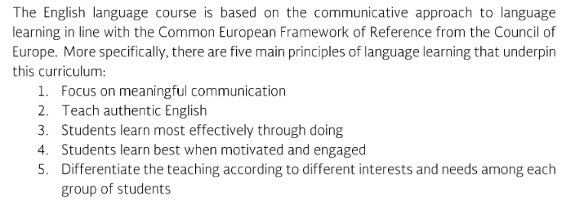
Course Description

Slide 9
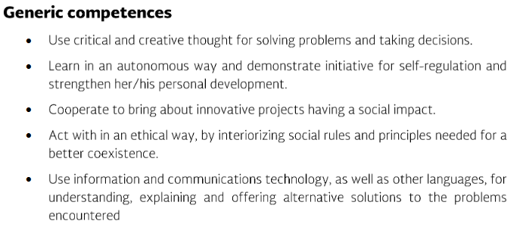
Competences of the degree profile developed by the course

Slide 10
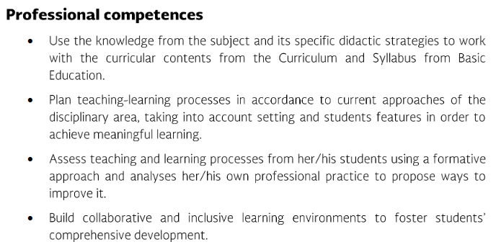
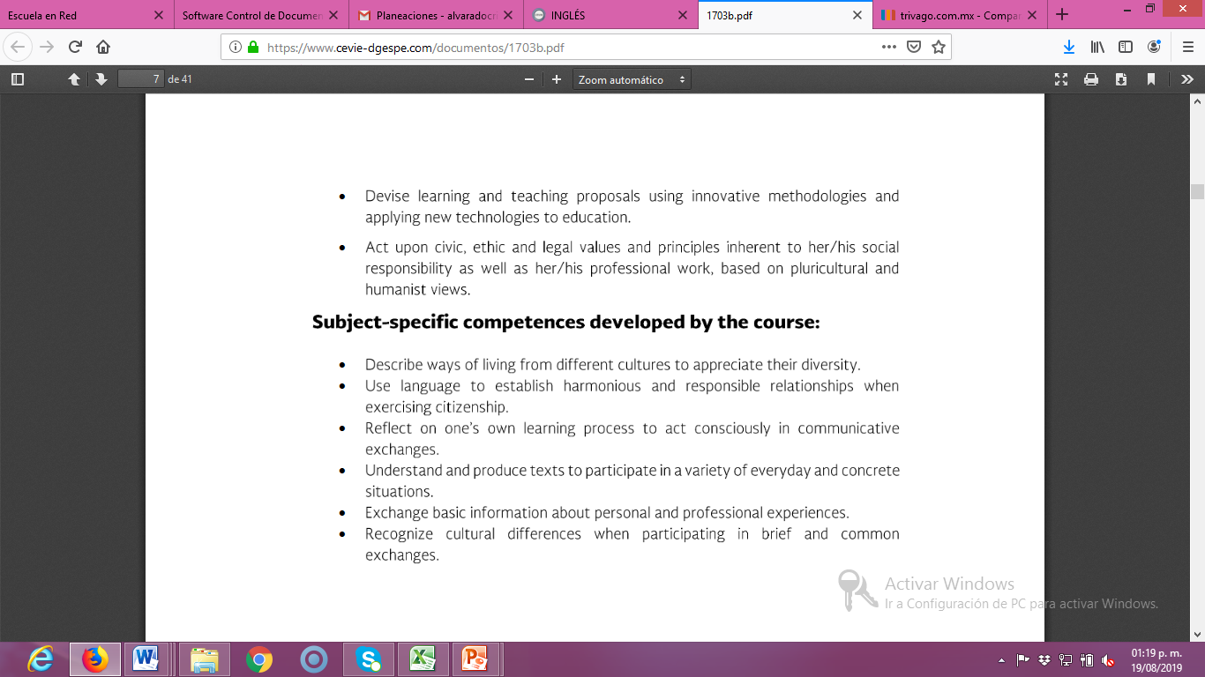

Slide 12
Course structure
PERIOD​ | BOOK UNITS​ | CONTENTS​ | LEARNINGEVIDENCES​
1​ | BOOK UNIT 4: It’s the coldest city! ​ ​ | TOPICS: World geography and facts; countries GRAMMAR: Comparative and superlative forms of adjectives; questions: how far, how big, how high, how deep, how long, how hot, and how cold | ​ ​ Project: My city is prettier tan yours!”
2​ | BOOK UNIT 7: Good memories ​​ | ​TOPICS: People, childhood, memories GRAMMAR: Use of past tense of be, regular-irregular verbs and the used to for habitual actions | ​ Project “A life in paintings The life of..(a famous person)”
3​ | BOOK UNIT 8: Life in the city | TOPICS: Transportation; transportation problems; city services. GRAMMAR: Expressions of quantity with count and noncount nouns: too many, too much, fewer, less, more, not enough; indirect questions from Wh- questions | ​Project “Rate a destination city”

Slide 13

Course purpose
Learning UNIT 1
Learning UNIT 2
Learning UNIT 3
BOOK Unit 4:
Describe countries.
Making comparisons. Expressing opinions about temperatures, distances, and measurements.
Ask and answer questions
with how far, how big, how high, how deep, how long, how hot, and how cold.
BOOK Unit 7:
Introduce yourself,
Exchange personal information(birth date, place of birth)
Talking about childhood memories
Ask about someone´s childhood.
using the past tense
Talk about habitual actions in the past with used to.
BOOK Unit 8:
Talking about transportation and transportation problems; Evaluate city services; asking for and giving information.
Use expressions of quantity with count and noncount nouns: too many, too much, fewer, less, more, not enough. Make indirect questions from Wh- questions.

Slide 14
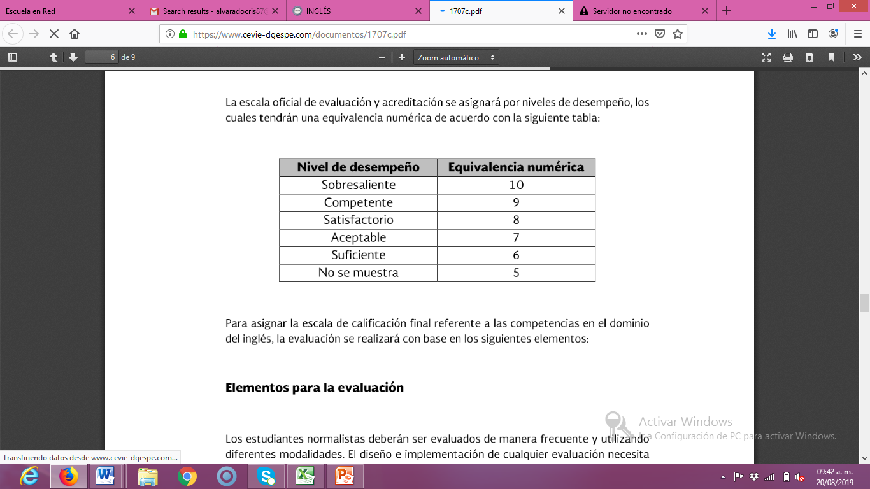
Assessment Criteria
EVALUATION OF EACH LEARNING UNIT (1-3)
Classwork / Homework (Activities in classroom and in Escuela en Red; Attendance, punctuality, attitude, participation and respect) | 35%
Project(s) | 30%
Platform progress (Cambridge One) | 10%
Exam | 25%
EVALUATION OF THE SEMESTER
AVERAGE OF LEARNING UNITS | 50%
FINAL EVIDENCE (INTERVIEW) | 50%

Slide 15
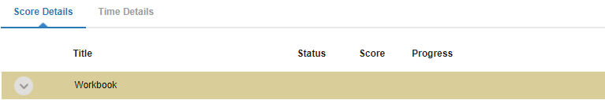
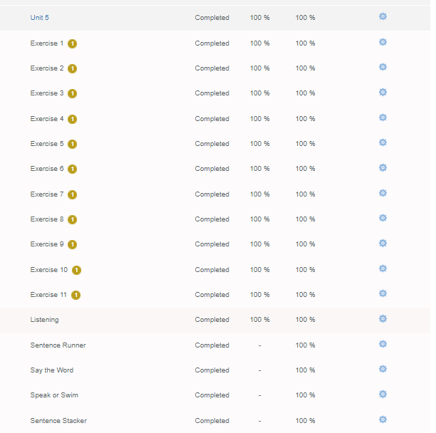
The Cambridge platform must be completed entirely. You must work on the exercises until you obtain a 100 in your scores in order to obtain the total points of the platform (10%) .
https://www.cambridgelms.org/main/p/splash

Slide 16


Global Evaluation
50%
50%
Average of learning units 1-3
Final Evidence
(Speaking)

Slide 17
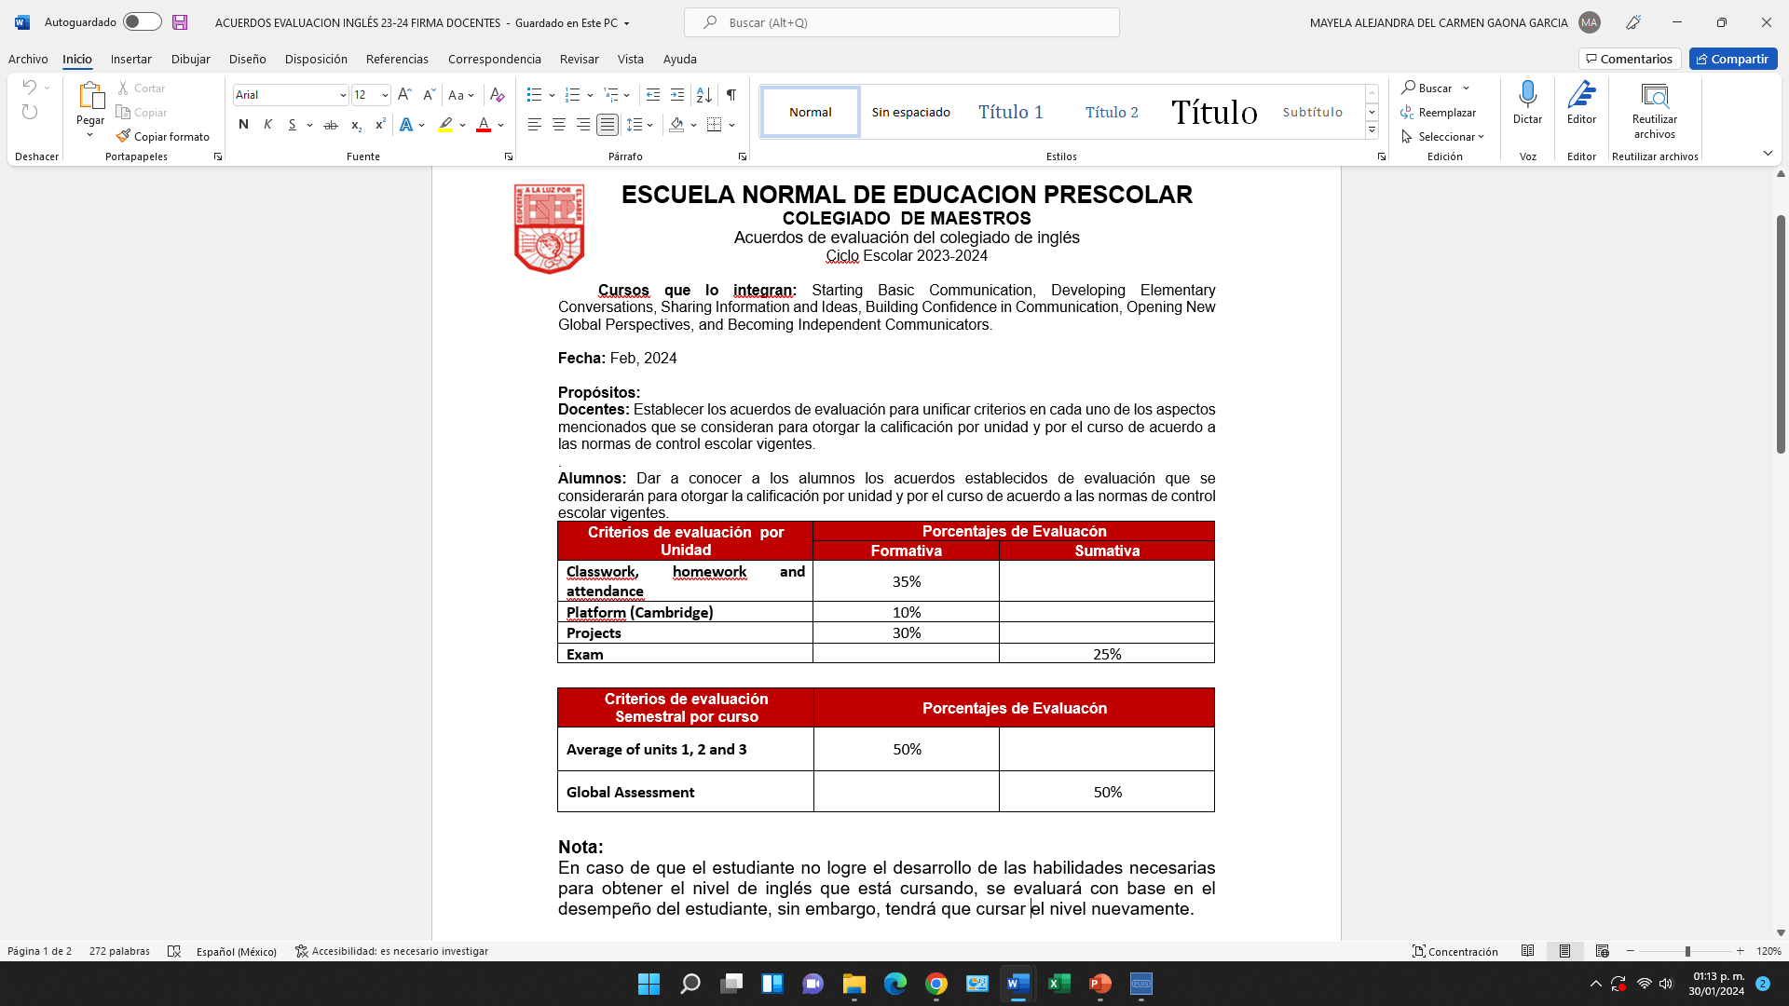
Formato que debe ser firmado por el alumno en la plataforma de Escuela en red.

Slide 18
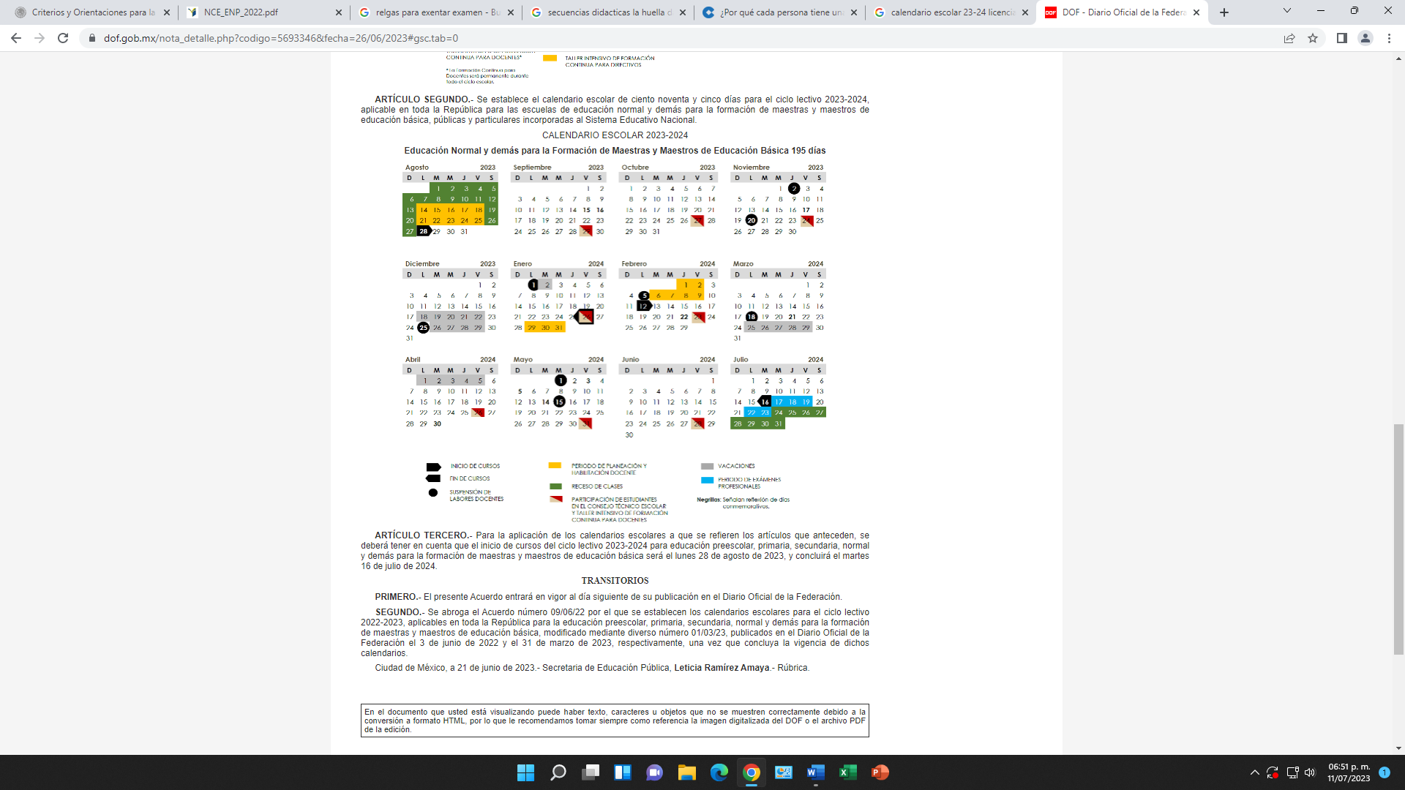

Slide 19
ESCUELA NORMAL DE EDUCACIÓN PREESCOLAR
Calendarización de jornadas de práctica y evaluaciones de unidad del semestre PAR
CICLO ESCOLAR: 2023-2024

Slide 20
 | weeks | month | days
 | 1 | February | 12-16 | Introduction
 | 2 |  | 19-23
 | 3 | March | 26-01 | 1st LEARNING EVIDENCE AND QUIZ
 | 4 |  | 04-08
 | 5 |  | 11-15 | Upload 1st Institutional evaluation
 | 6 |  | 18-22 | 18 HOLIDAY
 |  |  | 25-29 | EASTER HOLIDAYS
 |  | April | 01-05 | EASTER HOLIDAYS
 | 7 |  | 08-12 | 2nd LEARNING EVIDENCE AND QUIZ
 | 8 |  | 15-19
 | 9 |  | 22-26 | Upload 2nd Institutional evaluation
 | 10 | May | 29-03 | 01 HOLIDAY, Practice week
 | 11 |  | 06-10 | Practice week
 | 12 |  | 13-17 | 15 HOLIDAY
 | 13 |  | 20-24
 | 14 |  | 27-31 | Practice week
 | 15 | June | 03-07 | Practice week
 | 16 |  | 10-14 | 3rd LEARNING EVIDENCE AND QUIZ
 | 17 |  | 17-21
 | 18 |  | 24-28 | Upload Upload Final and Global Grading
Evaluation and teaching practice dates

Slide 21



Course rules
Bring materials.
Be on time.
Participate in class raising your hand
(Don´t hesitate to aks questions on things you don´t understand).
Listen and follow directions.
Check always your inbox for any announcement from your teacher.
Submit homework on time.
Do not eat in class.
Class participation grade will be affected if you:
Arrive late or miss the class.
Sleep during a class.
Read or do anything during class which is not related to class activities.
Disrespect teacher or classmates during the class.

Slide 22



Course
Material: Bring complete material (books, notebook, others) to every session. Compulsory.
Work: Study and review the lesson everyday at home. It is your responsibility to turn in homework assignments on time. Homework, classwork, assignments or projects turned in after the established due date (*NO more than one week after), will be accepted if the students submits an exculpatory evidence signed by the Academic Vice-Principal, the maximum passing grade will be 6.
Attendance: The student must attend 85% of class time hours in accordance with “Normas de Control Escolar”. Arriving to class 5 minutes after the class schedule, results in a time delay, and 10 minutes after, results in an absence. Leaving classroom early counts as an absence too. It's the students responsibility to find out the homework assigned when absent.
Behavior: Eating and performing activities not related to the English class (cell phones, leaving the classroom, buying and selling) is not permitted in the classroom.
Grading: The course grade will depend on tests’, speeches and class and homework participation’s performance. This means that if a student is not in class for this work, he or she will receive a grade of 0 for the missed work.
Class participation grade will be affected if you do not follow the rules.

Slide 23
Course
Participations, homework, projects and exams (written and oral) are mandatory elements of the evaluation criteria in this course, as they testify the effectiveness of teaching and learning.
Exams will be held according to the unit calendar. They will be carried out in person at the institution and at times strictly included within the school calendar. In the event that, the student does not take the exam, they must submit an exculpatory evidence signed by the Academic Vice-Principal, which endorses taking the exam at a later immediate date.
The student will pass the subject when he obtains a performance level of 6 in the global evaluation.
The student who demonstrates to have acquired the knowledge and skills for each of the three semester units, through participation (speaking in English at all times), homework and classwork completion, excellent performance in projects, unit exams grades of 95 or over, in addition to 0 absences, may be exempted from taking the Final evaluation exam at the teacher's discretion.
If the student does not show knowledge and skills through the unit, he/she will obtain a failing grade of 5 (five) in the unit, which means: course not accredited.

Slide 24

All students at all ages are capable to learn a second language.
Respect is a key to a healthy learning environment.
Learning depends on the attitude, the passion for, the time and concentration quality spent on the language practice.
Connecting words and ideas helps language acquisition.
Technology use is very helpful.
Don´t be afraid of making mistakes
Success comes in a can not a can´t

Slide 25
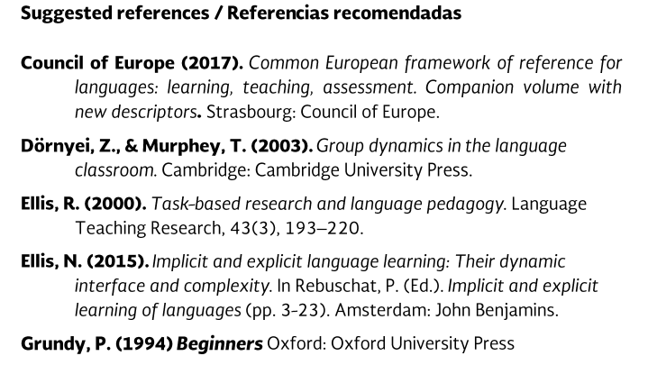
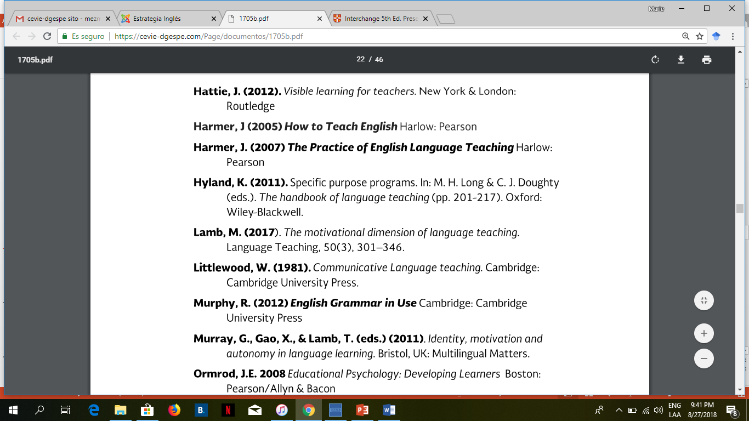
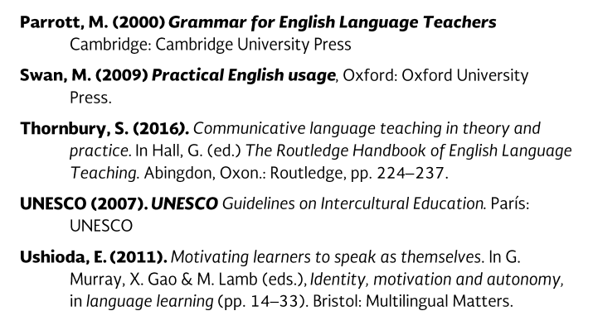

Slide 26
Additional online references and resources
Learning English. http://www.bbc.co.uk/learningenglish
Teaching adults. https://www.teachingenglish.org.uk/teaching-adults
Adult learners. https://elt.oup.com/learning_resources/courses/adultlearners/?cc=mx&selLanguage=en
Learning English. https://www.cambridgeenglish.org/learning-english/
Teacher’s corner. https://americanenglish.state.gov/teachers-corner
Classroom resources. Pearson. https://www.pearsonelt.com/professional-development/resources.html
Teaching adults. Oxford. https://elt.oup.com/teachersclub/courses/teachingadults/?cc=mx&selLanguage=en
For teachers. BBC. http://www.bbc.co.uk/worldservice/learningenglish/teach/
Onestop English. http://www.onestopenglish.com/
The digital teacher. https://thedigitalteacher.com/
https://visuwords.com/
https://www.eslvideo.com/
https://es.lyricstraining.com/
https://www.busuu.com/es
http://intermediatelow.blogspot.com/
https://www.englishclub.com/
http://www.topics-mag.com/
http://www.readableblog.com/
https://dictionary.cambridge.org/es/
http://www.bbc.co.uk/learningenglish
https://www.tefl.net/
http://www.elllo.org/

Slide 27


