Slide 1
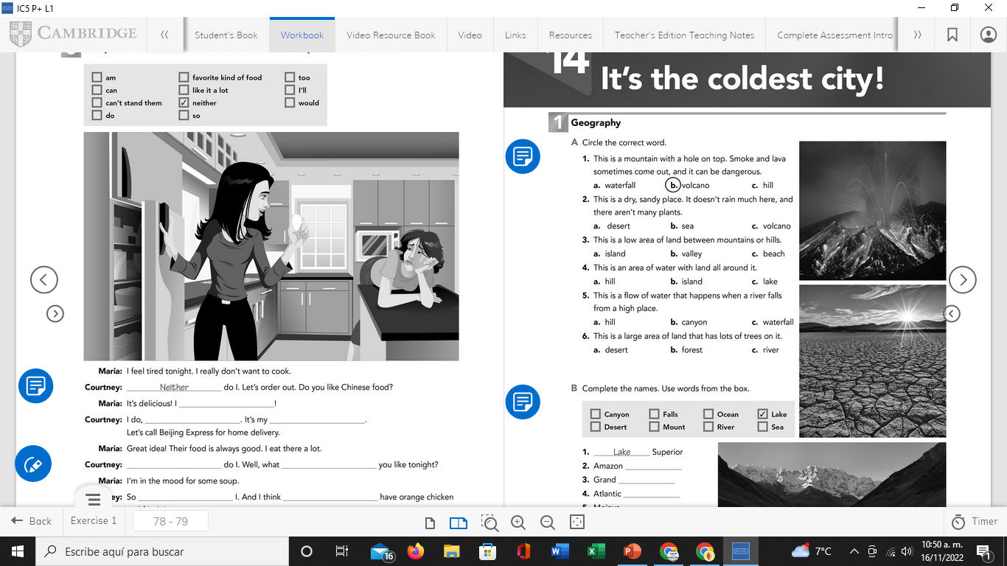
Vocabulary Practice
Workbook pg 19 ex 1 A

Slide 2
Vocabulary Practice
Match each sentence with the correct word
1. It´s hot and dry, some cacti plants are found here.
2. Taiwan and Puerto Rico are examples of this
3. The ones called Niagara are very famous.
4. Have a smaller watershed than rivers.
5. It´s smaller than a mountain.
6. The one in Panama is very famous.
7. There´s one in Mexico. It´s called Yucatán.
peninsula
falls
hill
island
desert
stream
canal

Slide 3
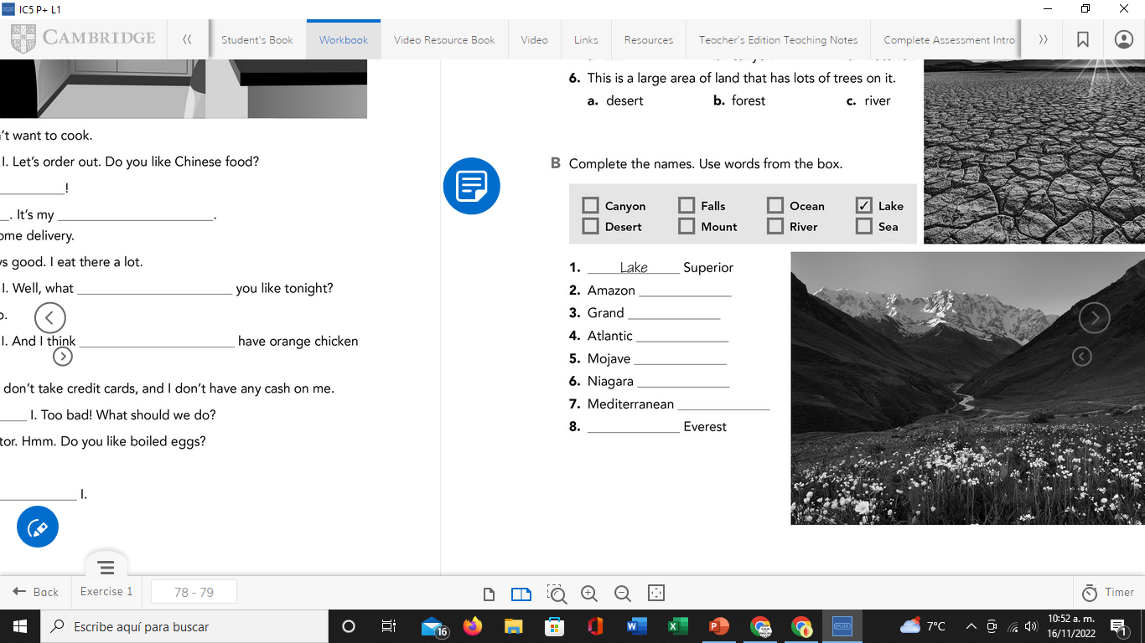
Vocabulary Practice
Workbook pg 19 ex 1 B
River
canyon
ocean
desert
falls
sea
Mount

Slide 4
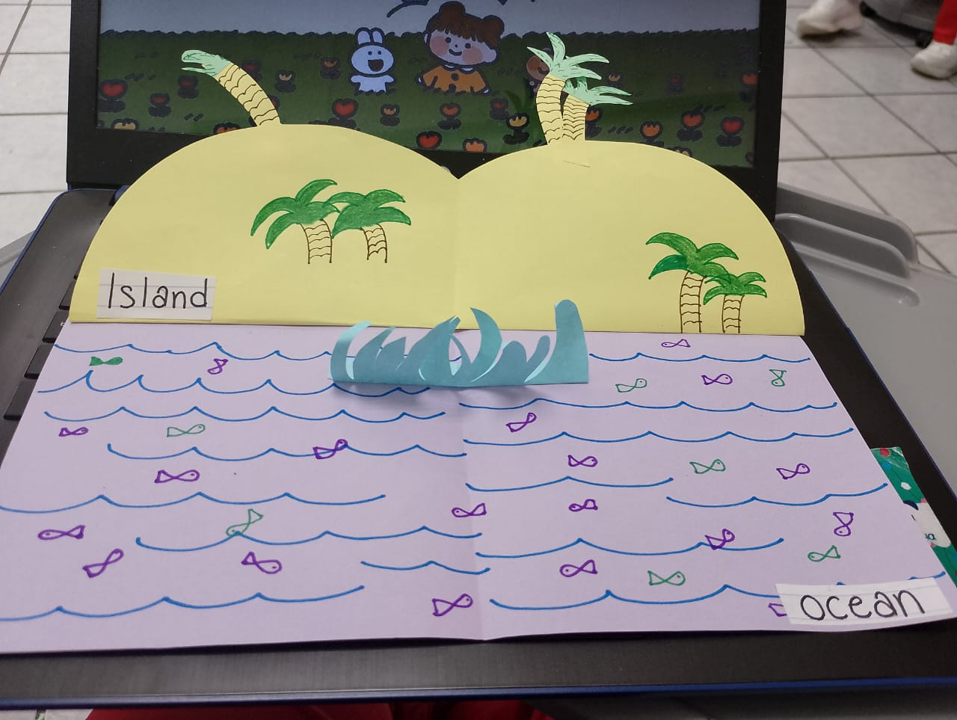
Listening/Reading Practice
Click on the following link, practice listening, Reading and vocabulary then share the results of your practice
https://www.liveworksheets.com/worksheets/en/English_as_a_Second_Language_(ESL)/Listening_and_reading/US_natural_beauty_ub1783165iy
Insert here your results

