Slide 1
UNIT 6
Lesson 4
Lesson objectives:
Learn and use affirmative simple present statements
Know some irregular verbs and its use in simple present tense.

Slide 2
Warm up simple present tense
Studentbook practice pg 38 ex 5
Workbook practice pg 32 Ex3

Slide 3
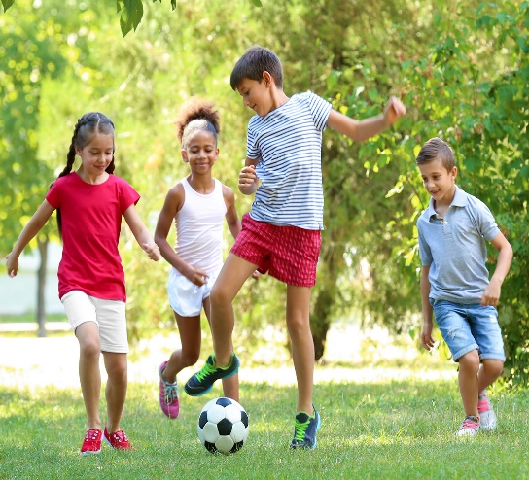
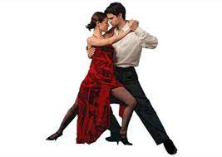
Listening activity.
Listen simple present statements and match with the correct picture
Audio | Picture #
 | 2
 | 1
 | 5
 | 3
 | 4
3
1
4
2
5

Slide 4
Listening activity.
Listen simple present statements and WRITE the missing verb.
Audio | STATEMENT
 | The baby cries all night
 | My mother calls my dad all day.
 | I wash my hands before meals.
 | Pablo drinks Green tea.
 | My daughter reads everynight.

Slide 5
Simple present tense with “Irregular verbs”
Irregular verbs change for the third person
have
do
go
I
You
We
They
have a bike
do the homework
go to school
has
does
goes
He
She
it
has a bike
does the homework
goes to school

Slide 6
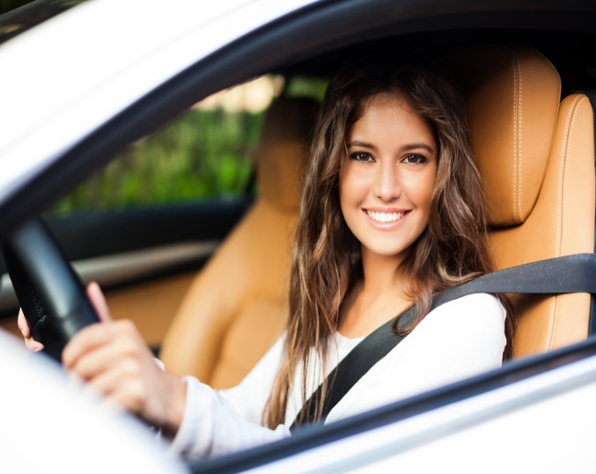
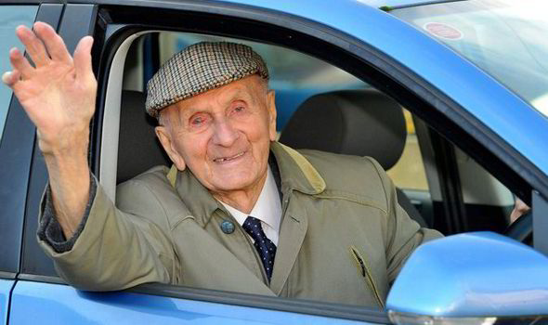
Simple present tense
Verb have/has denotes possession.
Have is used with pronouns I, You, We, They.
Has is used with pronouns he, she, it. In simple present affirmative statements changes its root form in the third person.
I have a White car
My grandfather has a blue car

Slide 7
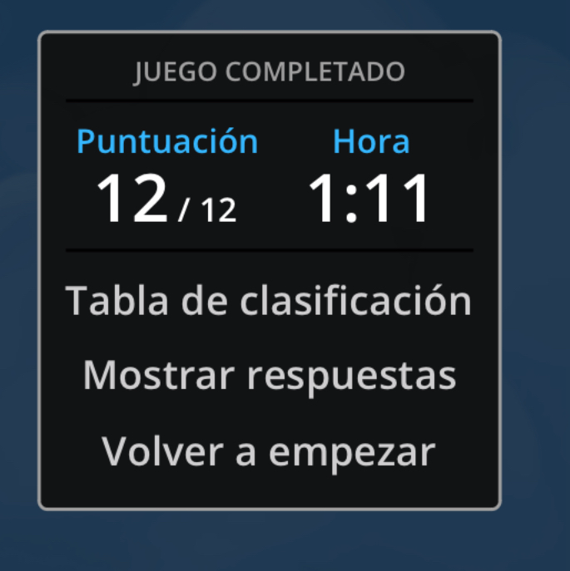
Practice simple present statements
Click on the following link to practice simple present tenses with irregular verb have / has then share your results
https://wordwall.net/es/resource/3991199
https://wordwall.net/es/resource/20704785
Click on the following link to practice simple present tenses with do/does share your results
https://wordwall.net/es/resource/15265556/do-does

Slide 8
Complete the following pharagraphs in simple present tense. Use the words in parentheses.
Workbook practice pg 38 Ex2

Slide 9
Workbook practice pg 32

Slide 10
Simple present speaking practice
Writing-Speaking activity
Write a short pharagraph about a member of your family, use simple present statements (affirmative and negative) follow the next video as example.
https://www.youtube.com/watch?v=xlDj5aH3Cco

