Slide 1
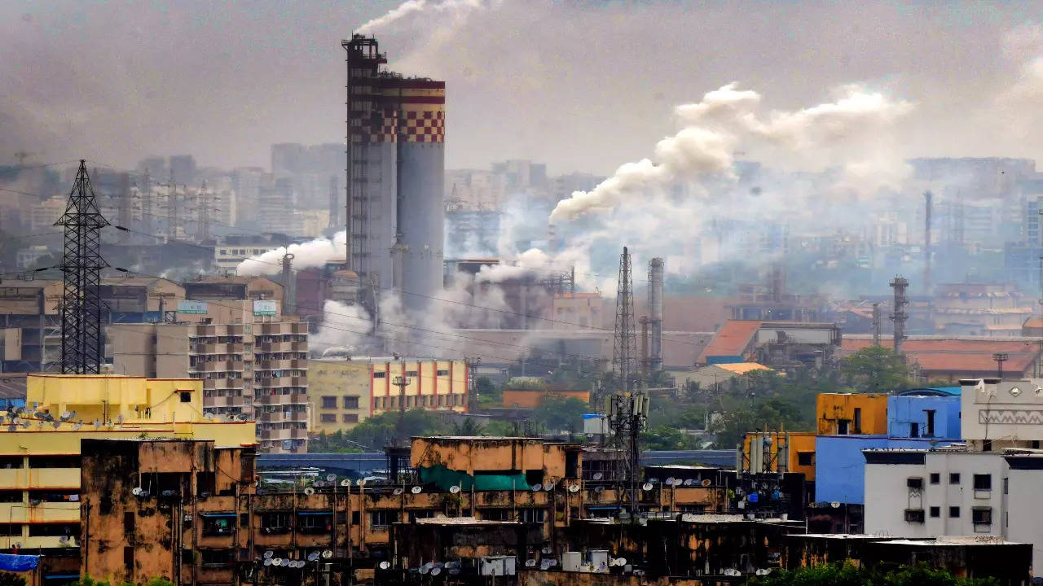
UNIT 2
Lesson 2
There is too much pollution in the city
LESSON OBJECTIVE:
Learn and practice quantity expressions

Slide 2
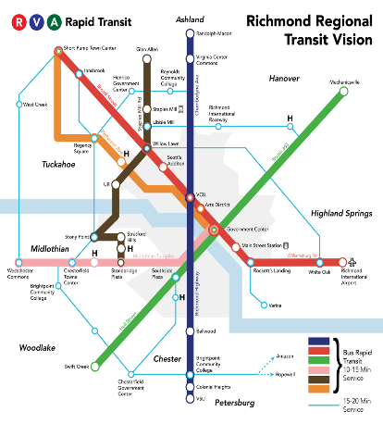
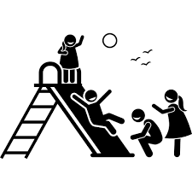
Warm up “Rate your city”
Student´s book pg 52 ex 5 A,B
A. Which of these services are available in your city or town? Discuss what is good and bad about each one.
recycling system Rate 3 | Wi-fi service Rate 2
transportation system Rate 3 | affordable housing Rate 1
green spaces Rate 3 | recreational facilities Rate 3
B. How would you rate the services where you live? Give each item a rating from 1 to 5.

Slide 3
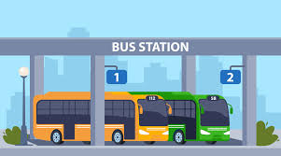
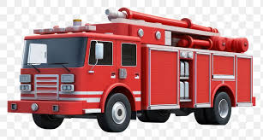
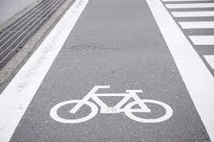
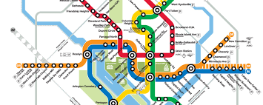
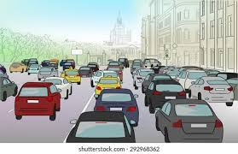
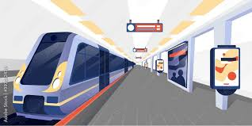
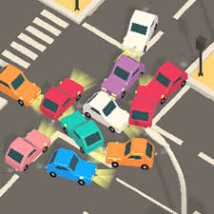
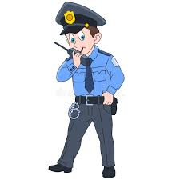
Warm up “Countable or uncountable?”
Look at the following words, discuss which are countable or noncountable.
bus station
fire truck
coffee shop
subway system
bicycle lane
noise
subway station
traffic
public transportation
traffic jam
police officer
library

Slide 4
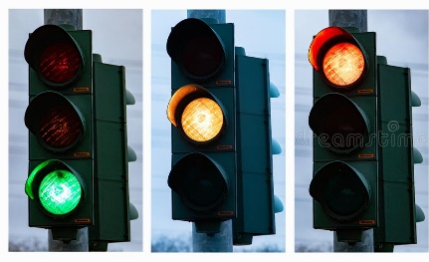
Grammar “Quantity expressions”
Student´s book pg 51 ex 3
An expression of quantity is a word or group of words that tells the amount of something.
Quantity expressions with count nouns | With count nouns
 | (-)There aren´t any traffictlights (There are no streetlights)
 | (-)There aren´t enough traffictlights (+)There are enough streetlights
 | (+)There are a few traffictlights
 | (+)There are some traffictlights
 | (+)There are many traffictlights
 | (+)There are a lot of traffictlights (There are a too many) streetlights
(0)
Any para negativo y preguntas, para lo que no se puede contar
(less than need)
(as necessary)
Enough = suficiente / las suficientes o las no suficientes
(small quantity)
A few = pocos
(average quantity)
Some = algunos
(more than need)
Many = mas de las necesarias / muchas
(large quantity)
A lot = demasiadas mas que many / too many puede usarse también

Slide 5
Rating my city
Listen to Sandra´s and Alan´s opinions about their city.
There should be fewer cars
There should be more Parks
There should be enough police officers
Debería de
menos
We need some places to go dancing
We need more parks
We don´t have enough green spaces
Necesitamos

Slide 6
Grammar Practice “Quantity expressions count nouns”
Mention some of your city problems. Use quantity expressions.
1.- There aren’t any waterfalls in Saltillo There aren’t enough taxi stands in Saltillo There are enough bus stations
2.-There are a few stop
3.- There are some new stand
4.- There are many traffic jams There ara a lot cars

Slide 7
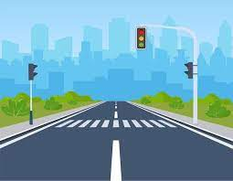
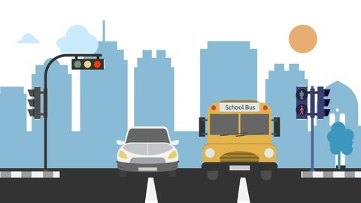
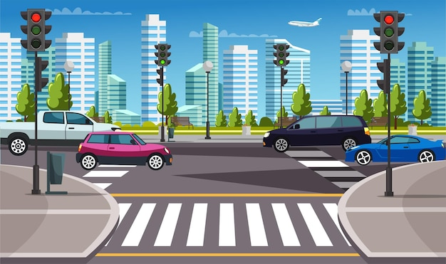
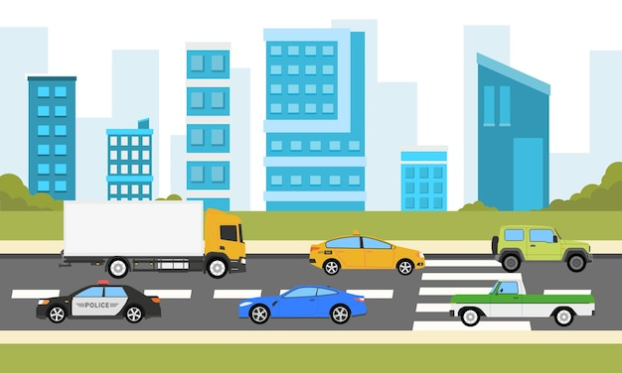
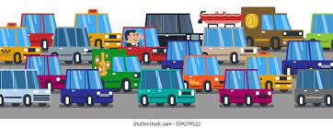
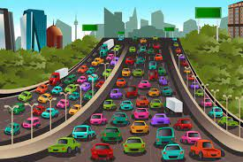
Grammar “Quantity expressions”
Student´s book pg 51 ex 3
An expression of quantity is a word or group of words that tells the amount of something.
Quantity expressions with non count nouns | With count nouns
 | (-)There isn’t any traffic (There is no traffic)
 | (-)There isn’t enough traffic (+)There is enough traffic
 | (+)There is a little traffic
 | (+)There is some traffic
 | (+)There is much traffic
 | (+) There is a lot of traffic There is too much traffic
(0)
(less than need)
(as necessary)
(small amount)
(average amount)
(more than need)
(large amount)

Slide 8
Rating my city
Listen to Sandra´s and Alan´s opinions about their city.
menos pero en incontable
There should be less pollution
There should be more security
There should be enough public transportation
We need some recycling system
We need more affordable housing
We don´t have enough parking

Slide 9
Grammar Practice “Quantity expressions noncount nouns”
Mention some of your city problems. Use quantity expressions.
1.-There should be less air pollution
2.-There should be more public transportation
3.-We need more Wi-fi service
4.-The city needs more security

Slide 10
Grammar “Quantity expressions”
Student´s book pg 51 ex 3
An expression of quantity is a word or group of words that tells the amount of something.
With count nouns | With noncount nouns
Count nouns have a plural form that usually ends in –s Eg. Are there any parking garages around here?
Non count nouns don´t have a plural form because you can´t separate and count them Is there any parking around here?

Slide 11
Speaking Practice “Survey”
What do you think about this things in your school? Give your opinión using quantity expressions
 | There should be more Wi-fi service
 | There aren’t any police officers
 | There is a little security There should be more security
 | We need more Green spaces
Wi-fi service
Police officers
Security
Green spaces

Slide 12
Speaking Practice “Survey”
Student´s book pg 15 ex 3
Are there enough parks?
A. What do you think about these things in your city or town? Complete the following survey.
Roads | We need more roads
Places to go shopping | There should be more places to go shopping
noise | There is too much noise
Playgrounds | The city needs more playgrounds
pollution | There should be less pollution
Transportation system | The city needs a good transportation system
Crime | There should be less crime There is too much crime

Slide 13
Grammar Practice “Pair work”
Student´s book pg 15 ex 3
B. In pairs, compare your opinions on the previous survey and suggest ways to make your city or town better. Then agree on three improvements. Follow the given example.

