Slide 1
UNIT 6
Lesson 5
Lesson objectives:
Learn and use simple present NEGATIVE statements.
Know that DO and DOES are auxiliars to make negative statements

Slide 2
Simple present NEGATIVE statements
Click on the following link to learn more about how to make negative statements in simple present tense.
https://www.youtube.com/watch?v=2hIkGW1uA0M

Slide 3
Simple present NEGATIVE statements
To make a negative sentence in English we normally use Don't or Doesn't with all verbs EXCEPT To Be and Modal verbs (can, might, should etc.).
You will see that we add don't between the subject and the verb. We use Don't when the subject is I, you, we or they
(+) (I, You, we, they) speak French. (-) (I, You, we, they) don't speak French.
When the subject is he, she or it, we add doesn't between the subject and the verb to make a negative sentence. NOTICE that the letter S at the end of the verb in the affirmative sentence (because it is in third person) disappears in the negative sentence.
(+) (He, She, It ) likes chocolate. (-) (He, She, It ) doesn't like chocolate.
Negative Contractions There is no difference in meaning though we normally use contractions in spoken English
Don't = Do not | I don't like meat = I do not like meat.
Doesn't = Does not | She doesn´t like meat = She does not like meat
Click on the following link to learn more about negative statements in simple present
https://www.grammar.cl/Present/Simple.htm

Slide 4
Simple present AFFIRMATIVE and NEGATIVE statements
 | (+) | (-)
I
You
We
They
like chocolate
don´t like chocolate
He
She
it
likes chocolate
doesn´t like chocolate

Slide 5
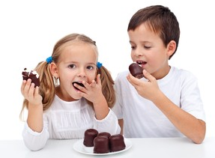
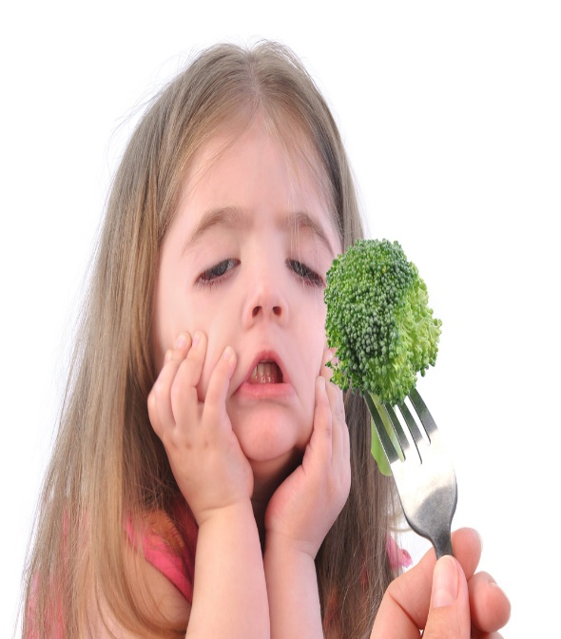
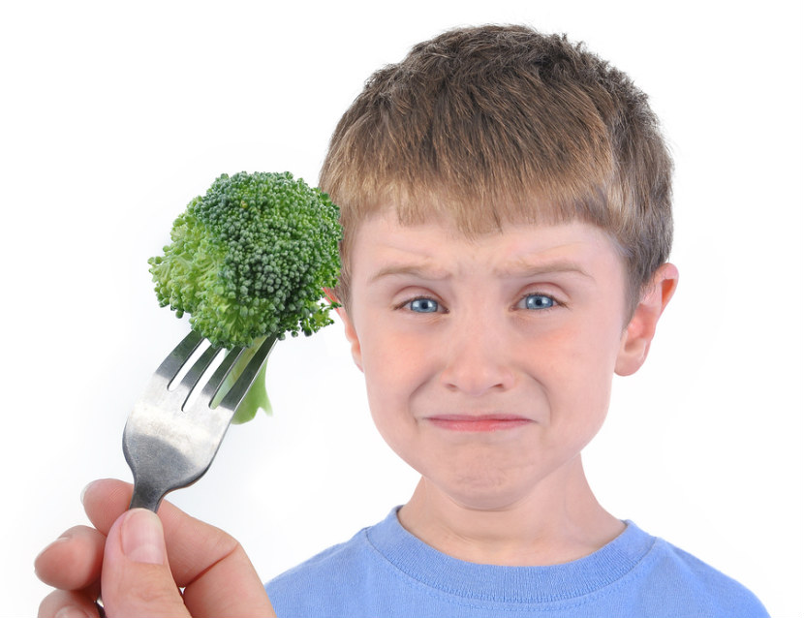
Simple present AFFIRMATIVE and NEGATIVE statements
(+) They like chocolate
(-) They don´t like brocolli

Slide 6
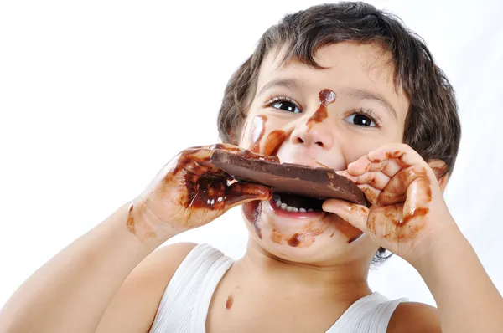
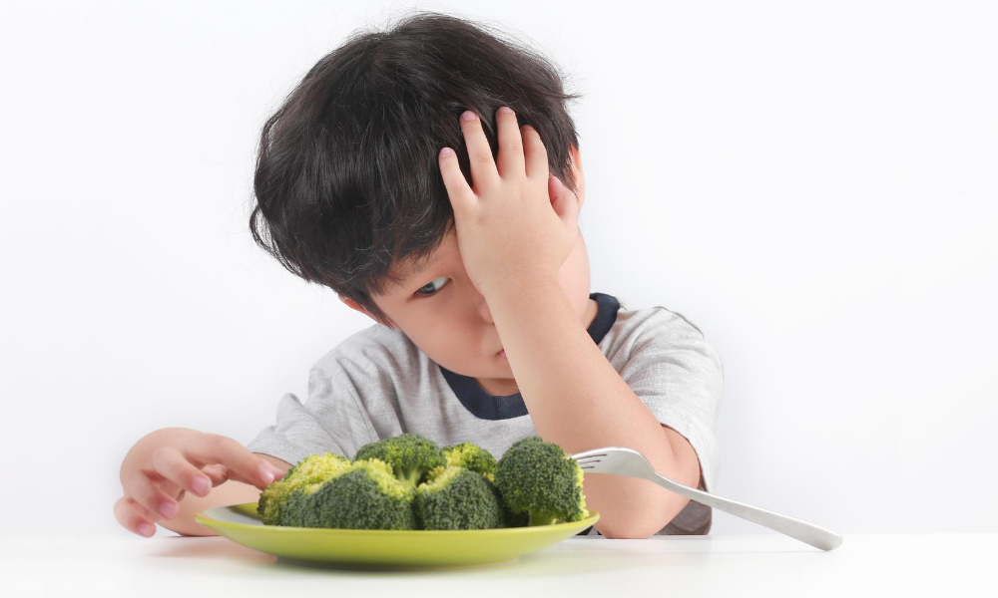
Simple present AFFIRMATIVE and NEGATIVE statements
(+) He likes chocolate
(-) He doesn´t like brocolli

Slide 7
Simple present NEGATIVE statements practice
Click on the follolwing link to practice simple present negative statements
https://www.youtube.com/watch?v=3Yv_8Tdv-qk

Slide 8
Fill in with (-) don´t or doesn´t
Mark´s mother | Doesn’t | like salad
Robert´s sister | Doesn’t | eat pizza
Ana and I | Don’t | take the bus everyday
Susan and Any | Don’t | sleep late
My grandfather | Doesn’t | dance very well
I | Don’t | read newspaper
My mother -in -law | Doesn’t | drink water

Slide 9
Simple present statements practrice. Studentbook pg 137
Remind:
Elena is talking about her family.
Complete the sentences with the correct form if the verb in parentheses
have
goes
walks
works
drives
uses
takes
has
doesn’t
don’t work
don’t need
ride

Slide 10
Simple present statements practrice. Studentbook pg 37
Tom Mitchel is talking about his family. Complete the sentences with the correct form of the verb
work
walk
works
drives
doesn’t
rides
live
takes
doesn’t
uses
don’t

Slide 11
Listening practice. Click on the following link to practice simple present tense.
Listen to Tod´s life once and recognize the affirmative and negative statements in simple present.
Then rewrite the statements talking about his life.
https://www.youtube.com/watch?v=5XgWwyqpVlA
Follow the firsts statements
Eg. He is a teacher, he Works in Japan, he works in a Univerity, he teaches English.
He lives in Japan, he lives in a small house, he doesn’t cook, he goes to work a seven, he haves a first class a 8:30, he goes hiking, he goes to montains, he doesn’t much free time, he doesn’t go hiking often

Slide 12
We don’t live in the suburbs.
We take the bus, the train, or the subway.
He goes to work before noon.
I don’t work far from here.
She doesn’t get up early on Sundays.

Slide 13
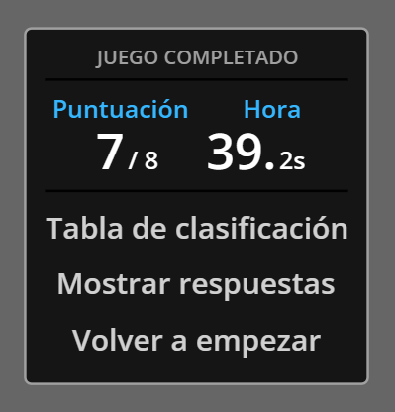
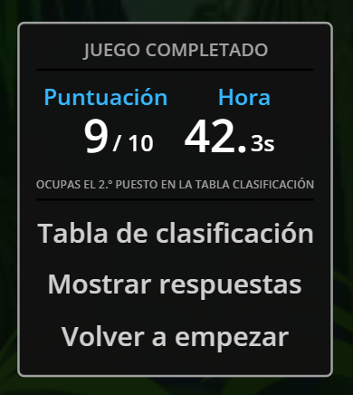
Practice negative statements in simple present tense. Then share your results.
https://wordwall.net/es/resource/25667891/english/present-simple-in-negative
Share your results
https://wordwall.net/es/resource/11378922
Share your results

