Slide 1
ESCUELA NORMAL DE EDUCACIÓN PREESCOLAR
English level A2.1
BUILDING CONFIDENE IN COMMUNICATION
Teacher: Mayela Alejandra del Carmen Gaona García
Student’s name: Eva Carolina Morón Pérez
LEARNING EVIDENCE UNIT 3
BOOK UNIT 8 LIFE IN THE CITY
PROJECT: “MY CITY ISSUES”
(Worth 30% of the grade)
LEARNING OUTCOMES:
Students will be able to practice the content of the unit (compound nouns, quantity expressions for countable and uncountable nouns)
SALTILLO, COAHUILA June 2024

Slide 2
Aim: Write a letter (paragraph of 10 lines min) explaining common problems the city has. Ss give personal opinions about possible solutions for those problems. Ss are encouraged use compound nouns to enumerate problems and expressions of quantity to describe those problems.
Materials: PDF. With the text of the article. (Add a picture of the problem or problems)
Plan: Individual Work.
Students are encouraged to develop an article through the practice of the target vocabulary, grammar, and language functions of unit 8 (Life in the city).
Prepare.
Students will write a short letter to explain common problems the city has. (10 lines min).
Students also give possible solutions to the exposed problems.
Use compound nouns. (5 at least)
Use expressions of quantity for countable and uncountable nouns (4 of each).
Be creative to edit your text and include pictures.
Upload your article in Escuela en red.

Slide 3
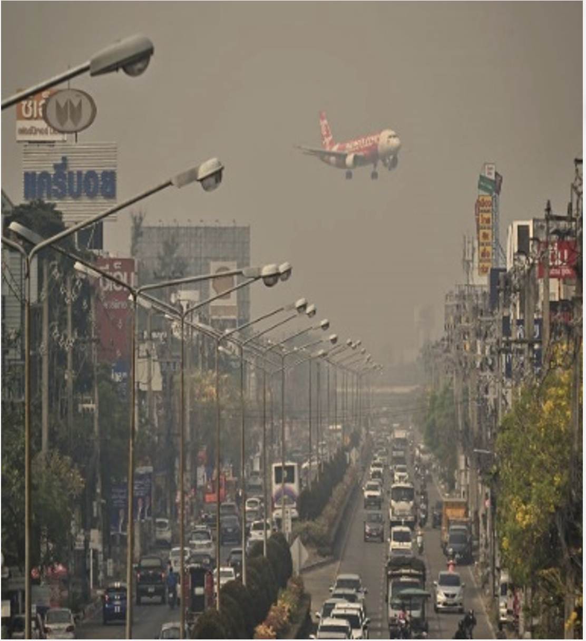
General Requirement | Example of the article (student´s book pg 96 ex 14)
Vocabulary Unit 4 Vocabulary of compound nouns (at least 5 words) | My City Issues! Life in this city needs to be improved. There are too many cars, and there is too much bad air, especially during the rush hour. The air pollution is terrible. This problem is particularly bad downtown in the business district. Too many people drive their cars to work. Also, the city doesn’t spend enough money on public transportation. There should be more buses and …..
Grammar and language functions Use quantity expression, countable nouns(at least 4) Use quantity expression, countable nouns(at least 4) Use modals to give suggestions.
Format Coversheet 10 lines min in PDF format Creativity Include self-assessment

Slide 4
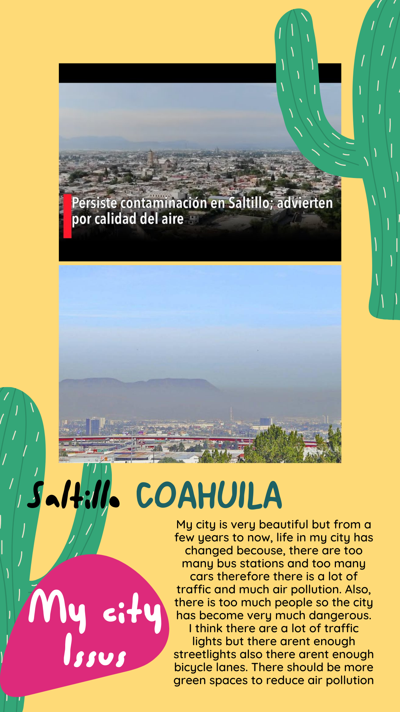

Slide 5
Present. Class activity.
Students share their letters in front of the class. Students are encouraged to be creative and realistic in their presentation.
Students Video record their performance.
Students place their letter, with their performance in class and a cover page on this instructions file. (make sure the video is in optimal conditions so it can be evaluated)
Complete the self-assessment at the end of this file
Save as a PDF file and upload on the ESCUELA EN RED project activity.
DESCRIPTORS.
Vocabulary (0-4 points)
4 Points: Excellent, use of diverse and accurate vocabulary (5 words on requirement and its descriptions).
3 Points: Good, use only some words of the vocabulary (3 words on requirement and its descriptions)
2 Points: Basic, use few words of the vocabulary, with some inaccuracies. (1 word on requirement and its descriptions)
1 Point: Limited use of vocabulary; struggles to express ideas, resulting in frequent inaccuracies. (just words with no descriptions)
Grammar (0-4 points)
4 Points: Exceptional command of grammar; consistently uses structures accurately. (8 structures on the requirement).
3 Points: Proficient in grammar; occasional minor errors. (6 structures)
2 Points: Basic grasp of grammar; noticeable errors, especially in more complex structures. (4 structures)
1 Point: Limited command of grammar; frequent errors that hinder understanding. (2 or less structures)

Slide 6
Fluency (0-4 points)
4 Points: Fluent and natural speech; maintains a steady pace with minimal hesitations.
3 Points: Generally fluent; occasional pauses or hesitations do not significantly impact communication.
2 Points: Hesitant speech; noticeable pauses and disruptions affecting overall fluency.
1 Point: Limited fluency; struggles to maintain a coherent flow, with frequent pauses.
Comprehension (0-4 points)
4 Points: Exceptional comprehension; accurately responds to questions and provides detailed information.
3 Points: Proficient comprehension; demonstrates a good understanding with minor lapses.
2 Points: Basic comprehension; grasps the main concepts but struggles with complexity.
1 Point: Limited comprehension; difficulty understanding and responding appropriately.
Pronunciation (0-4 points)
4 Points: Clear and accurate pronunciation; with no noticeable errors.
3 Points: Generally accurate pronunciation; minor errors that do not impede understanding.
2 Points: Understandable pronunciation; noticeable errors affecting overall clarity.
1 Point: Pronunciation difficulties significantly impact understanding.
Total Score (out of 20 points)

Slide 7
