Slide 1
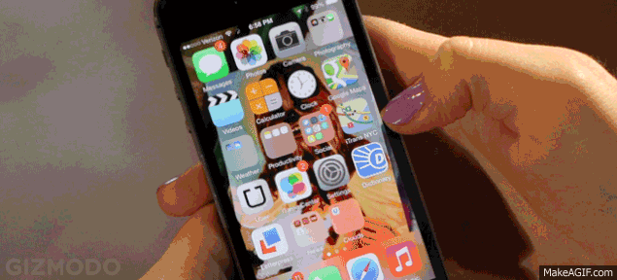
What do you use this for?
Unit 3

Slide 2
Snapshot
1. Is there an invention you couldn’t live without?
= I couldn’t live without________________.
2. How long have you had _______________?
3. If you could buy some new cool gadget, what would it be?
I would buy ______________.

Slide 3
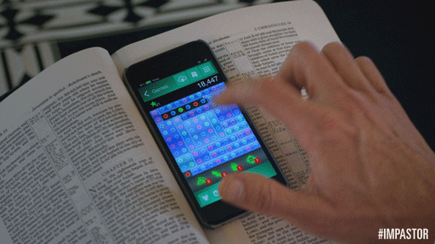
Perspectives
2. How do you use your cell phone?
Both _______ and I use our phones to__________
for___________
Neither _________ nor I use our phones to _________
for___________
She uses her phone to________, but I don’t.
for________
I use my phone to ____________, but she doesn’t
for____________

Slide 4
Grammar focus
We can describe how something is used with either an infinitive or a gerund. The meaning is the same.
Difference between the two forms:
With an adjective (to+verb)
I use my cell phone to send messages.
With a gerund (for+verb+-ing)
I use my cell phone for sending messages.

Slide 5
Information Gap Crossword
Describe uses and purposes of technology.
Write clues about the uses of the words listed to the left.
Example:
It is used to read books/for reading books.
It’s used
Pair up. One S from Group A and one S from Group B.
Take turns reading your clues aloud and guessing the words. Then write the words to complete the puzzle. Look at the model:
T: What’s the clue for 6 down? B S: It’s used for reading e-books. T: Is it an e-reader? B S: Yes, it is.

Slide 6
Conversation. What do I do now?
A)
Who has the problem?
What’s the first thing to do?
What should he try not to do?
Instructions.
___Be sure to up date it.
___Don’t forget to reset all your passwords.
___Install a good antivirus application.
___Try not to use public Wi-Fi networks.
B)
Justin needs help buying a new tablet computer.
Allie suggests they go to a store together.

Slide 8
Grammar focus

