Slide 2
Escuela Normal de Educación Preescolar English A1.2 English. Developing elementary conversations
Number of hours/ Credits: 6/ 6.75
Teacher: BRENDA BOLLAIN Y GOYTIA DE LA PEÑA

Slide 3
Course Purpose

Slide 4
This course has three main objectives:
The students will develop their ability to use English in personal and social communications, to develop relationships, complete transactions and meet every day needs.
The students will increase their engagement with cultural and intercultural activities in English, in order to develop a better understanding of their own culture as well as other cultures around the world
The students will develop their ability to teach in a school environment where English is an important aspect of the school approach. Schools are expected to use English increasingly for various teaching and learning activities, and future teachers need to be confident in using English in the school environment

Slide 6
Evaluation Calendar
EVALUATION | DATE
1ST EVALUATION | 16-20 MARCH
2ND EVALUATION | 11-14 MAY
3RD EVALUATION | 16-19 JUNE
GLOBAL EVALUATION | 22-26 JUNE
FINAL EVALUATION INTERVIEW | JUNE

Slide 7
Course Progression

Slide 10
Course Description

Slide 11
Competences of the degree profile developed by the course
Generic competences
Use critical and creative thought for solving problems and making decisions.
Learn in an autonomous way and demonstrate initiative for self-regulation and strengthen her/his personal development.
Cooperate to bring about innovative projects having a social impact.
Use information and communication technologies critically.
Apply his/her linguistic communicative skills in different contexts

Slide 12
Subject-specific competences
Describe ways of living from different cultures to appreciate their diversity.
Use language to stablish harmonious and responsible relationships when exercising citizenship.
Reflect on one’s own learning process to act consciously in communicative exchanges.
Understand and produce texts to participate in a variety of everyday and concrete situations.
Exchange basic information about personal and professional experiences.
Recognize cultural differences when participating in brief and common exchanges.

Slide 13
Course structure
PERIOD | BOOK UNITS | CONTENTS | LEARNING EVIDENCES
1 | Unit 7: Does it have a view? | Unit 7: Asking and describing houses and apartments, rooms and furniture. Use of simple present, and short answers, use of there is, there are, there is no, there isn´t a, there aren´t any, there are no. | Project 1 “What do you do at home?”
 | Unit 8: Where do you work? | Unit 8: Jobs and workplaces, describing workday routines, Use of simple present questions with wh, do and does.
2 | Unit 9 I always eat breakfast | Unit 9 Talking about basic foods, breakfast foods, meals, healthy and unhealthy food, giving opinion about food likes, dislikes, and eating habits. Use of count and noncount nouns, some and any, adverbs of frequency (Always, usually, often, sometimes, hardly ever, never) | Project 2 “What should I eat?”
 | Unit 10 What sports do you like? | Unit 10 Talking about sports, free time activities, abilities and talents. Use of simple present wh questions. Use of can for ability. Wh questions with can.
3 | Unit 11 I am going to have a party Unit 12 How do you feel? | Unit 11 Months and dates, birthdays, holidays, festivals and special days. Use of the future with going to, yes/no and wh questions with be going to, future time expressions Parts of the body; health problems and advice; medication | Project 3 : “Let´s have a party”

Slide 14
Assessment Criteria
EVALUATION OF EACH LEARNING UNIT (1-3)
Exam | 35%
Projects (3) | 20%
Participation | 15%
Homework | 10%
Portfolio | 10%
English Discoveries Platform | 10%
Attendance, punctuality, attitude, complete materials, respect, and classwork
EVALUATION OF THE SEMESTER
AVERAGE LEARNING UNITS | 50%
FINAL EVIDENCE (INTERVIEW) | 50%

Slide 15
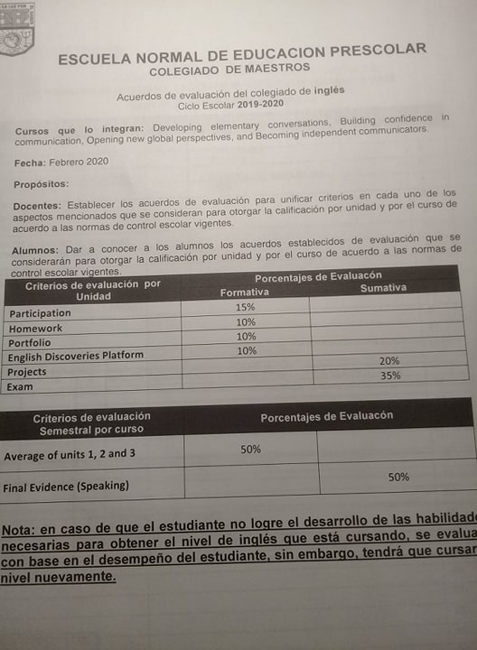

Slide 16
Global Evaluation
NOTE:
In case you fail one of the learning units, you will not be allowed to present the final evidence losing 50% of your global evaluation. In which case, you will have to present the extraordinary exam.
In order to have two opportunities to regularize your status you must attend 85% of class hours.
50%
50%
Average of learning units 1-3
Final Evidence
(Speaking)

Slide 17
NOTA IMPORTANTE
En caso de que el estudiante no logre el desarrollo de las habilidades necesarias para obtener el nivel de inglés que esté cursando, se evaluará con base en el desempeño del estudiante, sin embargo, tendrá que cursar nuevamente el nivel.
El estudiante acreditará el curso cuando obtenga como mínimo en la evaluación global del nivel de desempeño su equivalencia numérica de 6.
El estudiante acreditará el nivel una vez que evidencie el desarrollo de las habilidades propias del nivel de inglés con base en el CEFR mediante una entrevista realizada al final del ciclo escolar.

Slide 18
Course Policies
Course Materials: Failure to bring the book results in losing points per day.
Homework: There will be regular online homework tasks, as well as homework related to textbook material.
Late homework: It is your responsibility to turn in homework assignments on time. In case you present homework assignments or projects after the stablished due date, these will be graded
Grading: Your course grade will depend on performance on tests, speeches given, and participation. Satisfactory participation means completing the tasks assigned in class and interacting with your classmates in English at all times. Quizzes, tests, speeches, and other presentations cannot be made up unless the student has an excuse absence by ENEP. This means that if a student is not in class for this work, he or she will receive a grade of 0 for the missed work.

Slide 19
Class participation grade will be affected if you:
Arrive late or leave early.
Miss class.
Sleep during a class.
Read anything during class which is not related to class activities.
Speak Spanish in class.
Disrespect teacher or classmates during the class.
Please turn off cell phones during class!
Cell phones should be turned off in class; no texting may be done in class. In addition, students may not use electronic devices with earphones in class nor may they do recreational activities on computers.
Electronic dictionaries may be used in class but not during tests.
Policies about being late and being absent
In accordance to ENEP ‘s policies, you must attend 85% of class time hours.

Slide 20
Clasroom Rules
.
Do
Arrive on time
Speak english
Bring the material
Raise your hand before you speak
Respect and help others
Do your homework
Say “please” and “thank you”
Keep the room clean and tidy
Try your best!
X
Don´t
Eat in classroom
Use cellphone in class
Leave classroom without asking first
Talk when someone else is talking

Slide 22
Additional online references and resources
Learning English. http://www.bbc.co.uk/learningenglish
Teaching adults. https://www.teachingenglish.org.uk/teaching-adults
Adult learners. https://elt.oup.com/learning_resources/courses/adultlearners/?cc=mx&selLanguage=en
Learning English. https://www.cambridgeenglish.org/learning-english/
Teacher’s corner. https://americanenglish.state.gov/teachers-corner
Classroom resources. Pearson. https://www.pearsonelt.com/professional-development/resources.html
Teaching adults. Oxford. https://elt.oup.com/teachersclub/courses/teachingadults/?cc=mx&selLanguage=en
For teachers. BBC. http://www.bbc.co.uk/worldservice/learningenglish/teach/
Onestop English. http://www.onestopenglish.com/
The digital teacher. https://thedigitalteacher.com/
https://visuwords.com/
https://www.eslvideo.com/
https://es.lyricstraining.com/
https://www.busuu.com/es
http://intermediatelow.blogspot.com/
https://www.englishclub.com/
http://www.topics-mag.com/
http://www.readableblog.com/
https://dictionary.cambridge.org/es/
http://www.bbc.co.uk/learningenglish
https://www.tefl.net/
http://www.elllo.org/

Slide 23
Teacher Mayela Alejandra Gaona García

