Slide 3
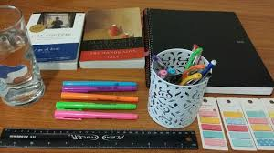
LA NETIQUETA. GUIA PARA TUS CLASES EN LINEA.
NETTIQUETE. GUIDE FOR ONLINE CLASSES.
Connect 5 minutes before the class starts / Conectarse 5 min antes de la clase
Have all your materials ready, camera on and microphone off, you will turn it on when teacher asks your participation (camera must be on all class) / Tener su material de clase listo, cámara encendida, micrófono apagado, solo encenderlo cuando se pida tu participación (La cámara debe estar activada durante toda la clase). EL CELULAR SE PUEDE UTILIZAR SOLAMENTE PARA FINES DE CLASE DURANTE LA SESION.
Have a good presentation, wear your uniform, sit in a quiet and appropriate place to do all activities (not in bed)/Estar Presentable con el uniforme escolar (o ropa en colores similares), sentado en un lugar tranquilo y adecuado para realizar las actividades (no en la cama).

Slide 4
No eating during class /No comer durante la clase
Participate during class raising your hand. Respect your classmates´participation without interrupting/Participar durante la clase levantando la mano y respetando la participación de los compañeros sin interrumpir.
If for some reason you are not able to join the class, send a message immediately to your teacher, get informed and do all the activities given that day/Si por algún motivo no puedes enlazarte a la clase, envía mensaje a tu maestro, infórmate y realiza todas las actividades que se siguieron en clase.

Slide 5
PENDING ACTIVITIES

Slide 6
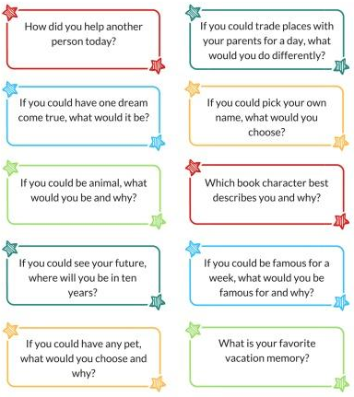
GETTING TO KNOW EACH OTHER

Slide 7
ESCUELA NORMAL DE EDUCACIÓN PREESCOLAR ENGLISH B1.2 UNIT 1: THAT’S MY KIND OF FRIEND! CALENDAR OF ACTIVITIES
WEEK | DAY | CLASS HOURS | ACTIVITIES ASSIGNED
Week 1 October 5th – 9th | Monday | Class hour 1 | Activity in Escuela en Red Vocabulary exercises
 |  | Class hour 2 | Activity in Escuela en Red Grammar exercises
 | Wednesday | Class hour 3 | Activity in Escuela en Red Listening and Reading
 |  | Class hour 4 | Activity in Escuela en Red Writing assignments
 | Friday | Class hour 5 | Zoom meeting
 |  | Class hour 6 | Assessment activity
Week 2 October 12th - 16th | Monday | Class hour 1 | EFS Platform Unit Lessons 1, 2 and 3
 |  | Class hour 2 | EFS Platform Unit Lessons 4, 5 and 6
 | Wednesday | Class hour 3 | EFS Platform Unit Lessons 7, 8 and 9
 |  | Class hour 4 | EFS Platform Unit Lessons 10 and 11
 | Friday | Class hour 5 | Zoom meeting
 |  | Class hour 6 | Assessment activity

Slide 8
ESCUELA NORMAL DE EDUCACIÓN PREESCOLAR ENGLISH B2+ ONLINE UNIT 2: WORKING 9 TO 5 CALENDAR OF ACTIVITIES
WEEK | DAY | CLASS HOURS | ACTIVITIES ASSIGNED
Week 3 October 19th – 23rd | Monday | Class hour 1 | Activity in Escuela en Red Vocabulary exercises
 |  | Class hour 2 | Activity in Escuela en Red Grammar exercises
 | Wednesday | Class hour 3 | Activity in Escuela en Red Listening and Reading
 |  | Class hour 4 | Activity in Escuela en Red Writing assignments
 | Friday | Class hour 5 | Zoom meeting
 |  | Class hour 6 | Assessment activity
Week 4 October 26th – 30th | Monday | Class hour 1 | EFS Platform Unit Lessons 1, 2 and 3
 |  | Class hour 2 | EFS Platform Unit Lessons 4, 5 and 6
 | Wednesday | Class hour 3 | EFS Platform Unit Lessons 7, 8 and 9
 |  | Class hour 4 | EFS Platform Unit Lessons 10 and 11
 | Friday | Class hour 5 | Zoom meeting
 |  | Class hour 6 | Unit test

Slide 9
THAT’S MY KIND OF FRIEND!
UNIT 1

Slide 10
OBJECTIVES
I can describe personalities and qualities.
I can ask about and express preferences.
I can talk about likes and dislikes.
I can use expressions to agree, disagree and complain.

Slide 11
SURVEY
https://es.surveymonkey.com/r/X8HSVVV

Slide 12
SNAPSHOT

Slide 13
VOCABULARY
Talk with a partner about the meaning of the following words: What does the word mean? Is it possitive or negative? Give an example of a famous person who has one or more characteristic from the list.
ADVENTUROUS | EGOTISTICAL | OUT GOING | STINGY
AGGRESSIVE | GENEROUS | QUIET | STUBBORN
COMPETITIVE | IMPATIENT | SELF-CONFIDENT | SUPPORTING
CONSIDERATE | INFLEXIBLE | SENSITIVE | TEMPERAMENTAL
CREATIVE | KIND | SERIOUS | UNRELIABLE
EASYGOING | MODEST | SOCIABLE

Slide 14
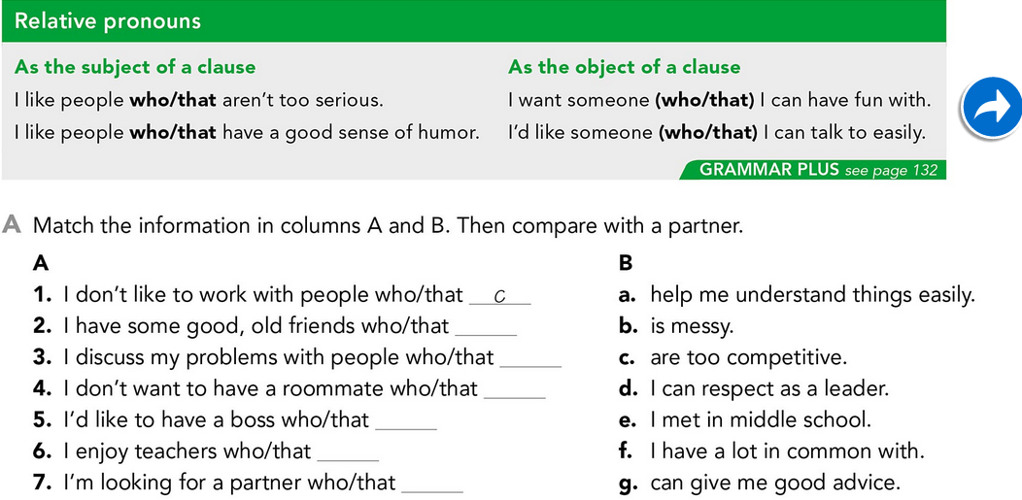
GRAMMAR

Slide 15
GRAMMAR

Slide 16
ESCUELA NORMAL DE EDUCACIÓN PREESCOLAR ENGLISH B1.2 UNIT 1: THAT’S MY KIND OF FRIEND! CALENDAR OF ACTIVITIES
WEEK | DAY | CLASS HOURS | ACTIVITIES ASSIGNED
Week 1 October 5th – 9th | Monday | Class hour 1 | Activity in Escuela en Red Vocabulary exercises
 |  | Class hour 2 | Activity in Escuela en Red Grammar exercises
 | Wednesday | Class hour 3 | Activity in Escuela en Red Listening and Reading
 |  | Class hour 4 | Activity in Escuela en Red Writing assignments
 | Friday | Class hour 5 | Zoom meeting
 |  | Class hour 6 | Assessment activity

Slide 18
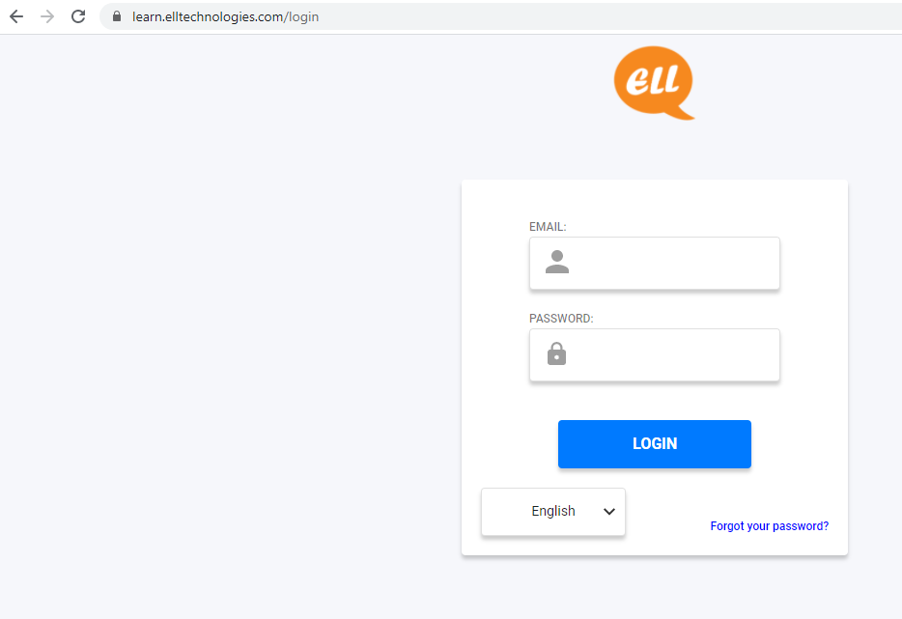
EFS LOG IN

Slide 19
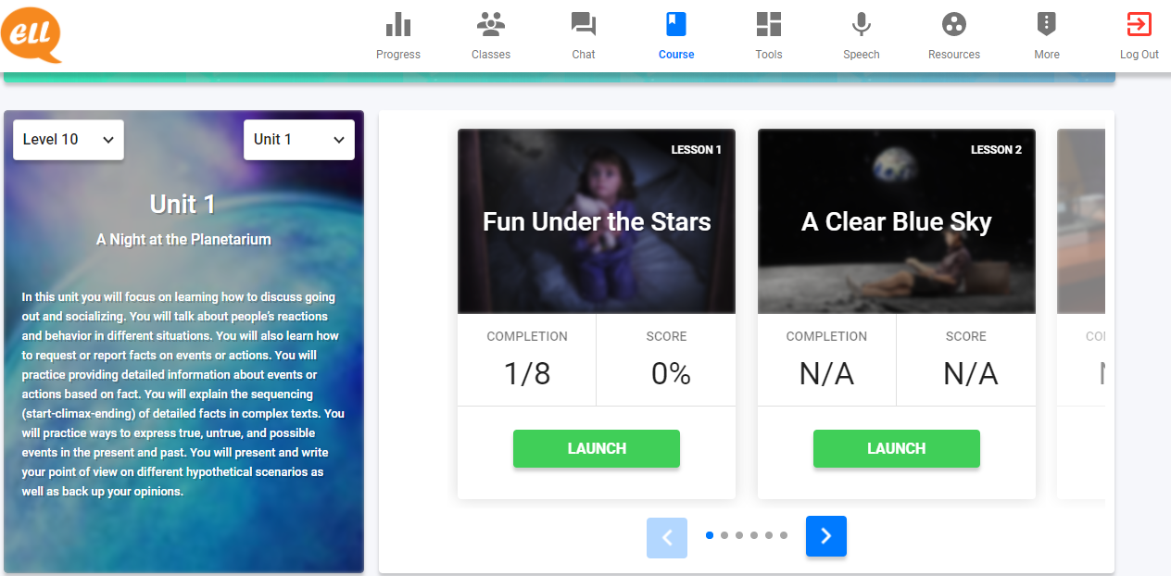
EFS UNITS AND LESSONS

Slide 20
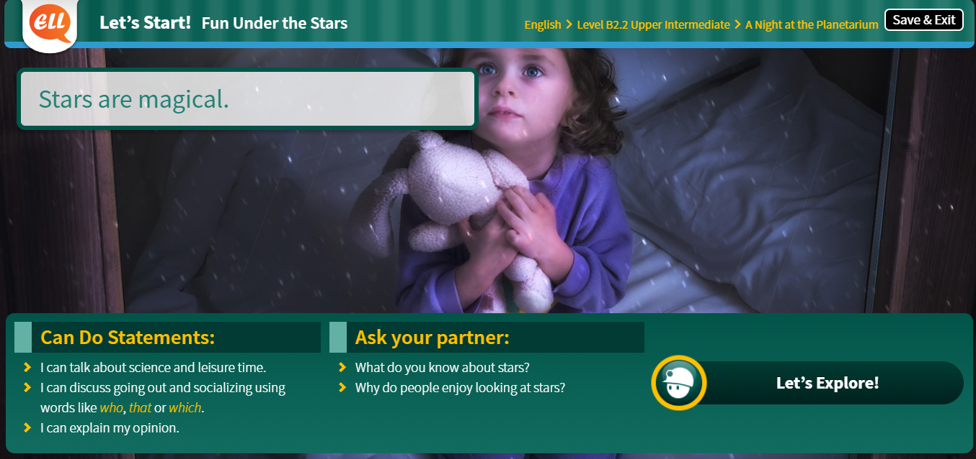
LET’S START! ONLINE SESSION

Slide 21
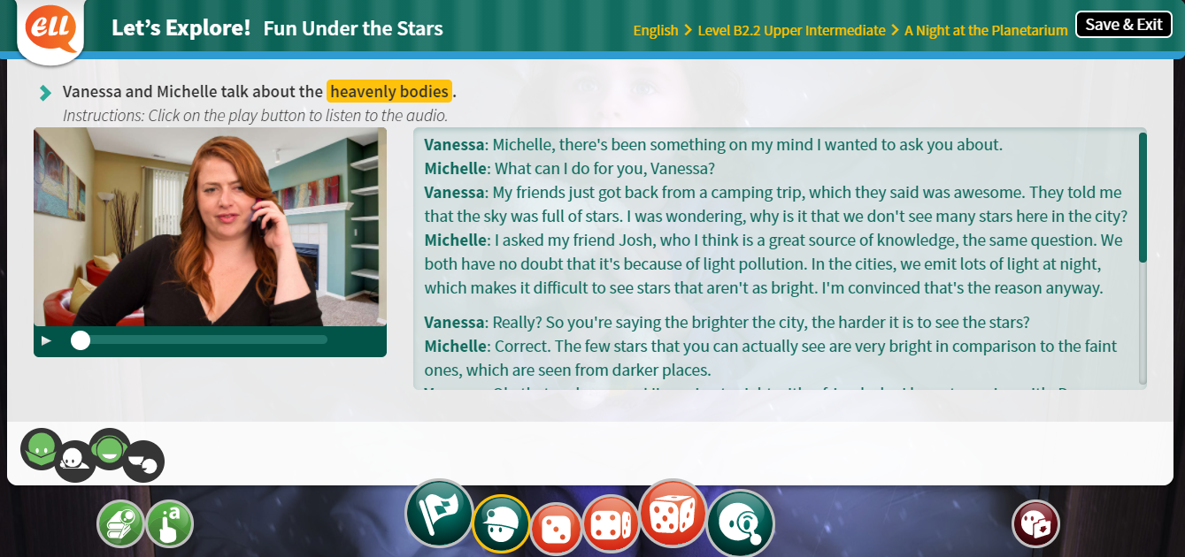
LET’S EXPLORE! ONLINE SESSION / AT HOME

Slide 22
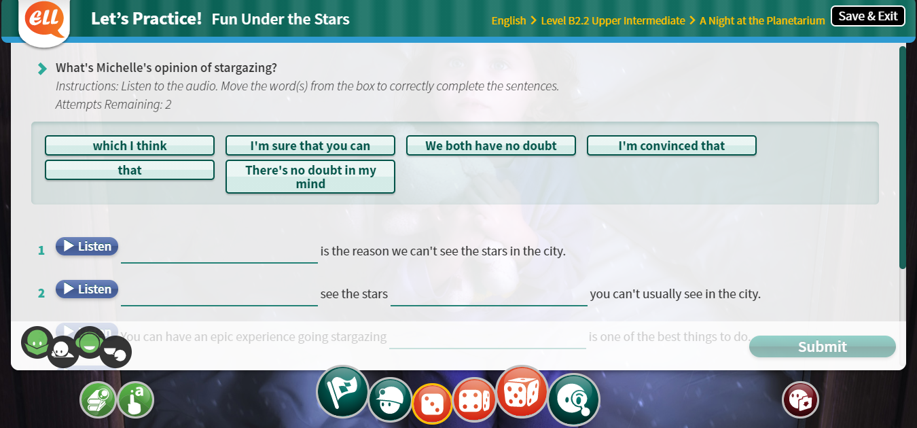
LET’S PRACTICE! AT HOME

Slide 23
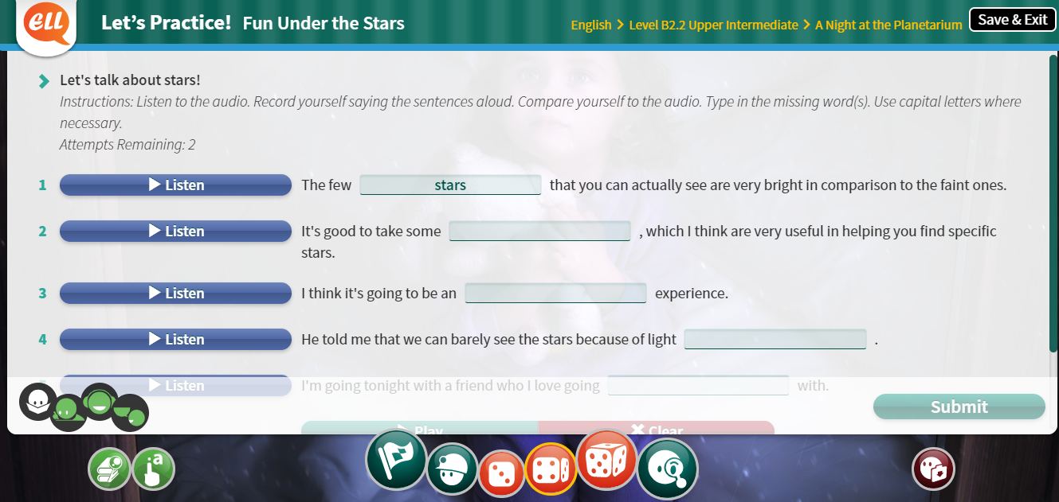
LET’S PRACTICE! (SPK) AT HOME

Slide 24
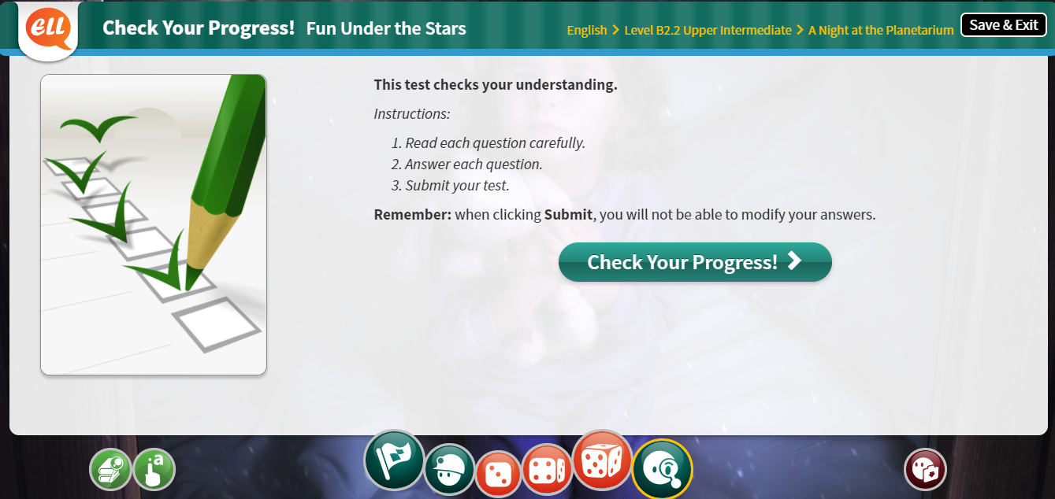
CHECK YOUR PROGRESS! AT HOME

Slide 25
TYPES OF EXERCISES

Slide 26
GRADING ACTIVITIES

Slide 27
GRADING ACTIVITIES

Slide 28
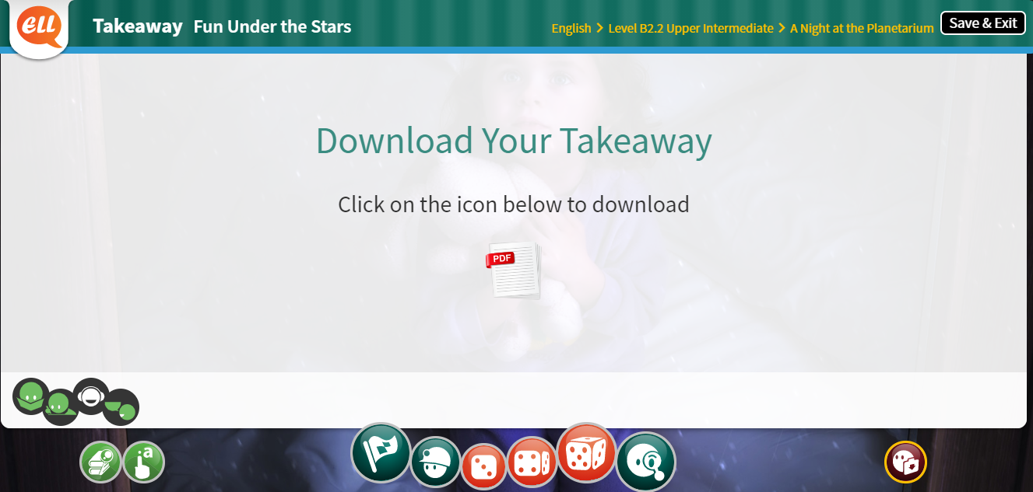
EXTRA RESOURCES LEARNING POINTS TARGET WORDS TAKEAWAY

Slide 29
