Slide 1
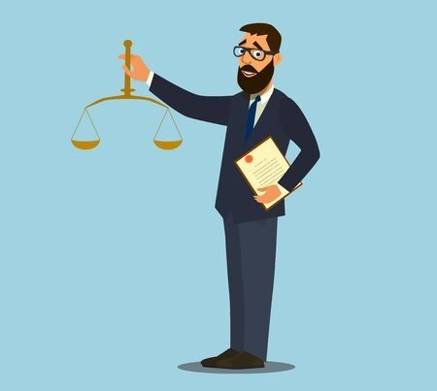
GRAMMAR “ SIMPLE PRESENT STATEMENTS AND QUESTIONS”
What do you do? I´m a lawyer
Where do you work? I work at the court
How do you like your job? (+) I like my job very much / (-) I don´t like my work very much
What does she do ? She´s a dancer
Where does she work? She works at a dance company
How does she like her job? She likes her work very much / She doesn´t like her job very much
Auxiliar | Pronoun
(+)Do | I , you , we, they
(-)Don´t | I , you , we, they
(+)Does | He, She, It
(-)Doesn´t | He, She, It
* Don´t add – “s, or es” ending to the verb when using auxiliar in questions or short answers. Examples:
How does she like her job?
Not: How does she likes her job
She doesn´t like her job very much
Not: She doesn´t likes her job very much
Use these auxiliars to make questions and give short answers

Slide 4
READING
Answer the following questions
1. What does Oliver do?
2. Where does he work?
3. How does Oliver like his job?
4. What does Lucy do?
5. Where does she work?
6. What is the hardest part of her job?

Slide 5
READING / WRITING
Read the following text.
Use the underline words as clues to make questions, and give answers.
Q: Where does he work? A: Tom works at a bank.
1. A:
2. A:
3. A:
4. A:
5. A:
Tom works at a bank. He starts work every day at 8:00 am. He finishes work every day at 6:00 pm. He lives very close to the bank, so he walks to work every day. He doesn´t have a car.
He has lunch at 12:00 noon.
Tom doesn´t like very much his job, because it is an stressful job. He talks to the customers all day long.

