Slide 1
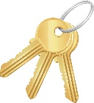
GRAMMAR “yes/no questions with be”
Singular
Is this your Tablet ?
Yes, it is
No, it´s not
Plural
Are these your keys ?
Yes, they are
No, they´re not

Slide 2
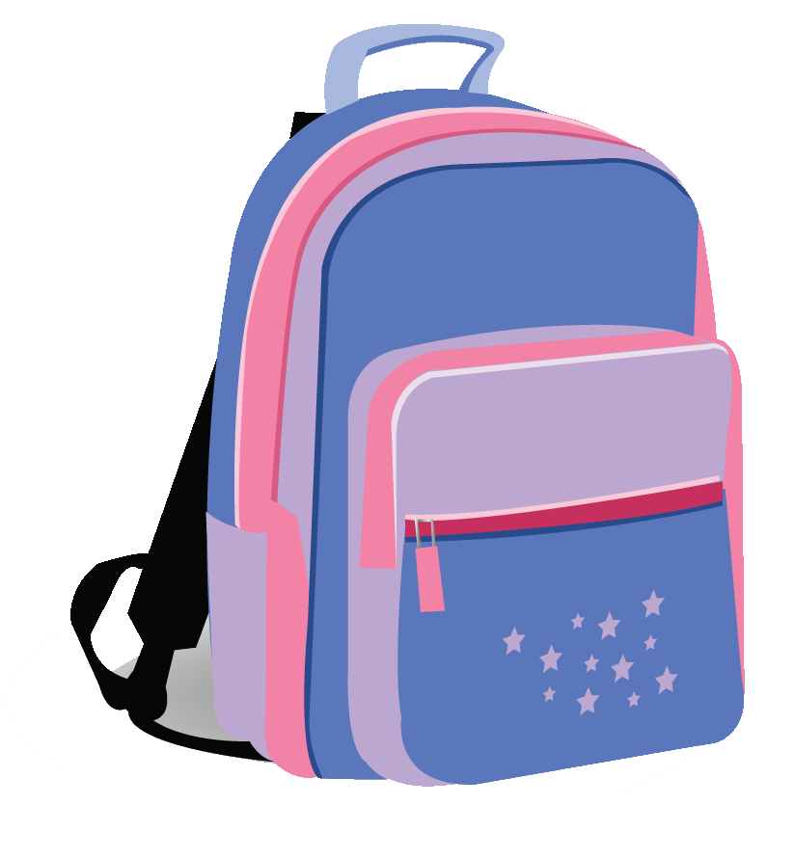
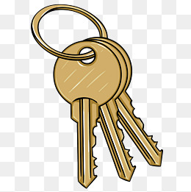
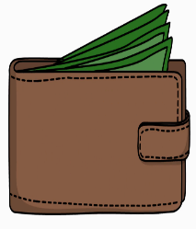
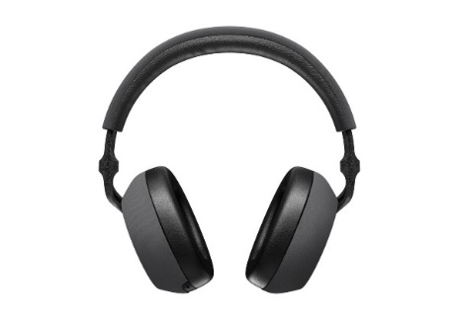
Complete the following questions with this, these, then give correct answers.
Complete las siguientes preguntas con this, these, luego dé las respuestas correctas.
Is this your backpack?
No, it´s not
______ your flashdrive?
No, __________
______ your keys?
Yes, __________
______ your wallet?
No, __________
______ your umbrella?
Yes, __________
_________ your glasses?
Yes, __________
______ your headphones?
No, __________

Slide 3
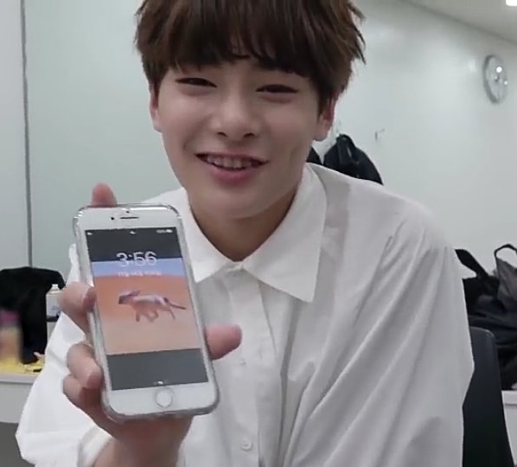
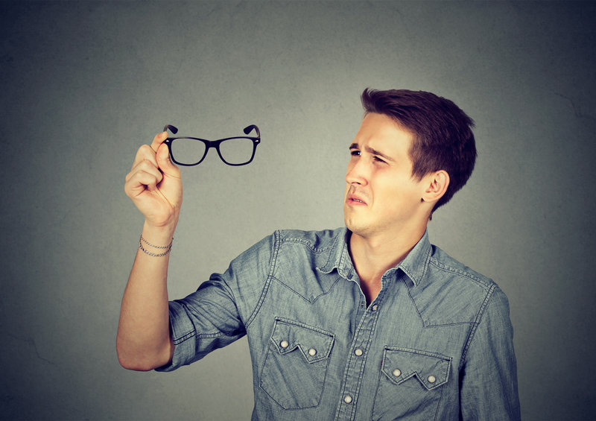
Complete the following conversations
Completa las siguientes conversaciones

Slide 4
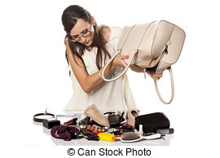
GRAMMAR “where questions with be”
Question Where refers to a place or position
La pregunta Where (donde) se refiere a un lugar o posición
Where´s my haibrush?
Singular
It´s in my purse
Plural
Where are my keys?
They´re in my purse

Slide 5
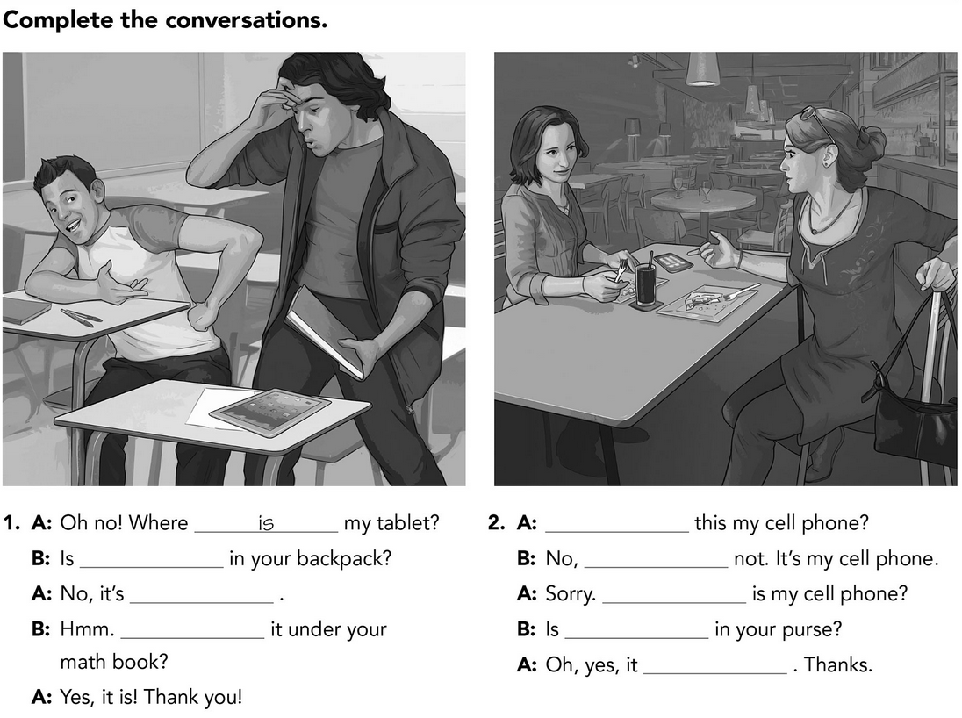
Practice where and yes/no question with be.

Slide 6
