Slide 1
UNIT 1
Lesson 6
“POSSESSIVE ADJECTIVES”
My
Your
Her
His
Learning objective:
Learn and use the possessive adjectives in short conversations.

Slide 2
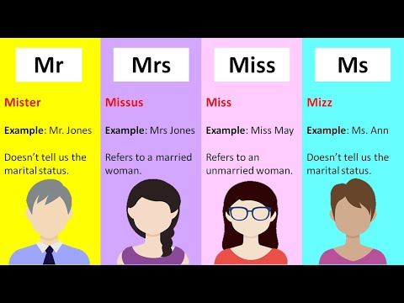
Titles
Use titles with FAMILY names NOT with FIRST names
Men | Woman
Mr. | Ms.
 | Mrs.
 | Miss.

Slide 3
GRAMMAR “Possessive adjectives”
We use possessive adjectives to express who owns (or ‘possesses’) something.
A possessive adjective is used in front of a noun (a thing).
For example: My computer, Your pen, his name, her nickname
Possessive adjectives | Spanish | Example
My | mi
Your | tu
His | su
Her | su
My name is Jhon
Your nickname is funny
His lastname is Rodríguez
Her first name is Sofia

Slide 4
https://wordwall.net/es/resource/3876268/his-or-her
https://wordwall.net/es/resource/2713151/angielski/my-your-his-her-exercice
https://wordwall.net/es/resource/1841700/my-his-her-your
https://wordwall.net/es/resource/3771149/his-her

Slide 5
GRAMMAR “Contraction of what is”:
2.

