Slide 1
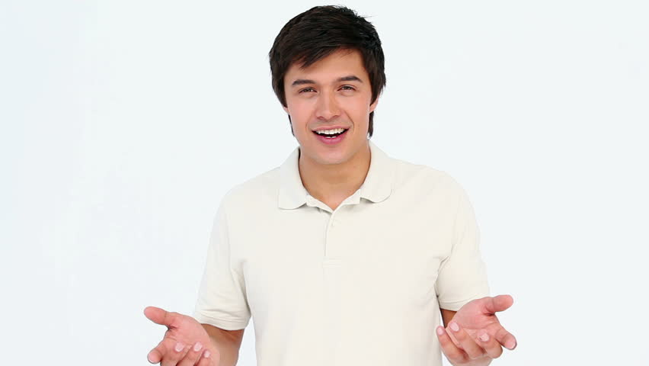
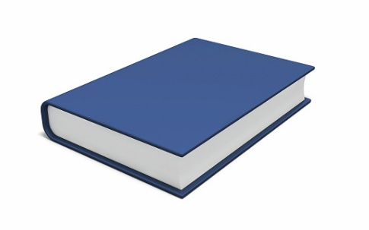
UNIT 2
Lesson 4
“Ask and answer yes/no questions”
Are these your books?
Is this your book ?
Learning objective:
Ask and answer yes/ no questions with be

Slide 2
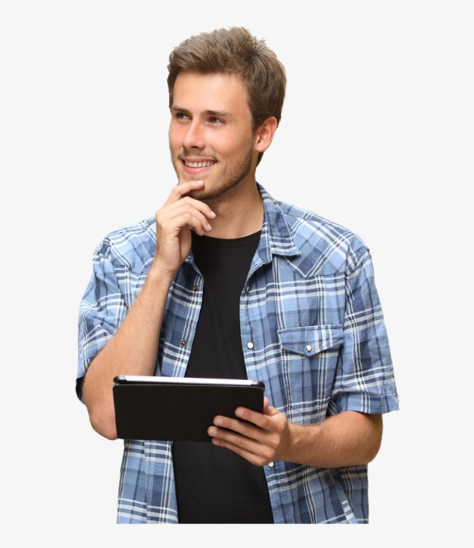
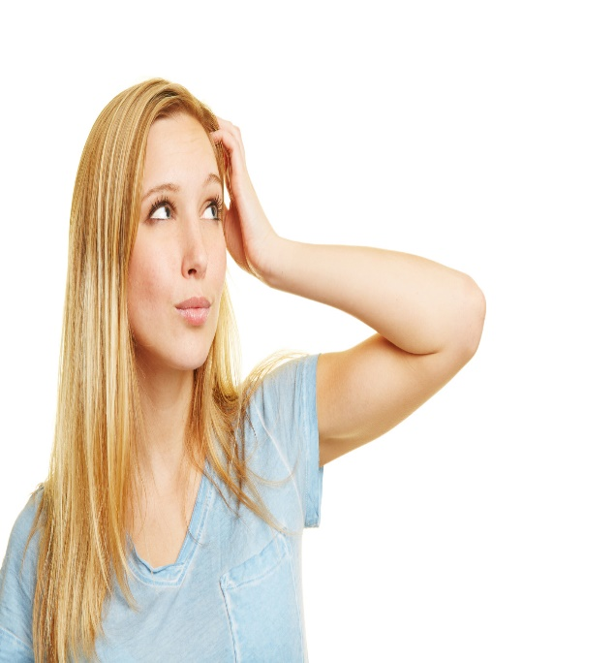
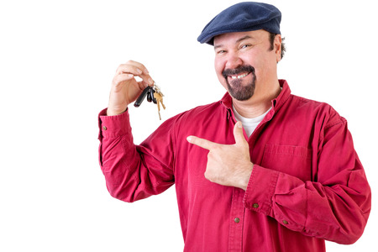
GRAMMAR “yes/no questions with be”
Singular
Is this your Tablet ?
Yes, it is
No, it´s not
Plural
Are these your keys ?
Yes, they are
No, they´re not

Slide 3
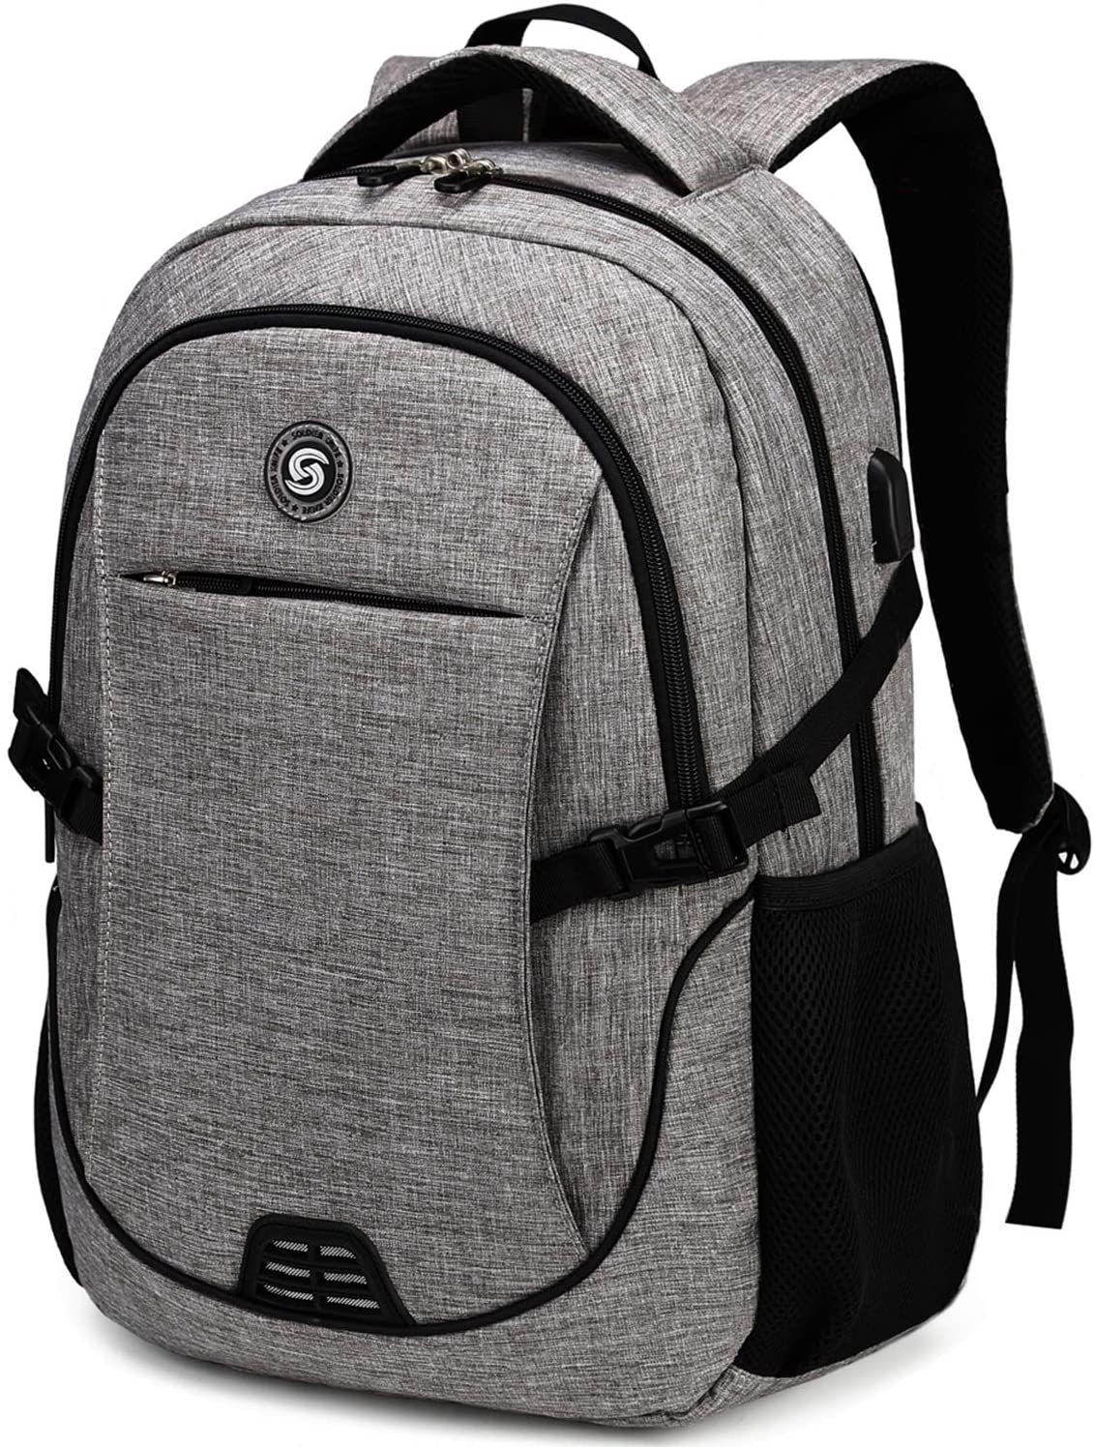
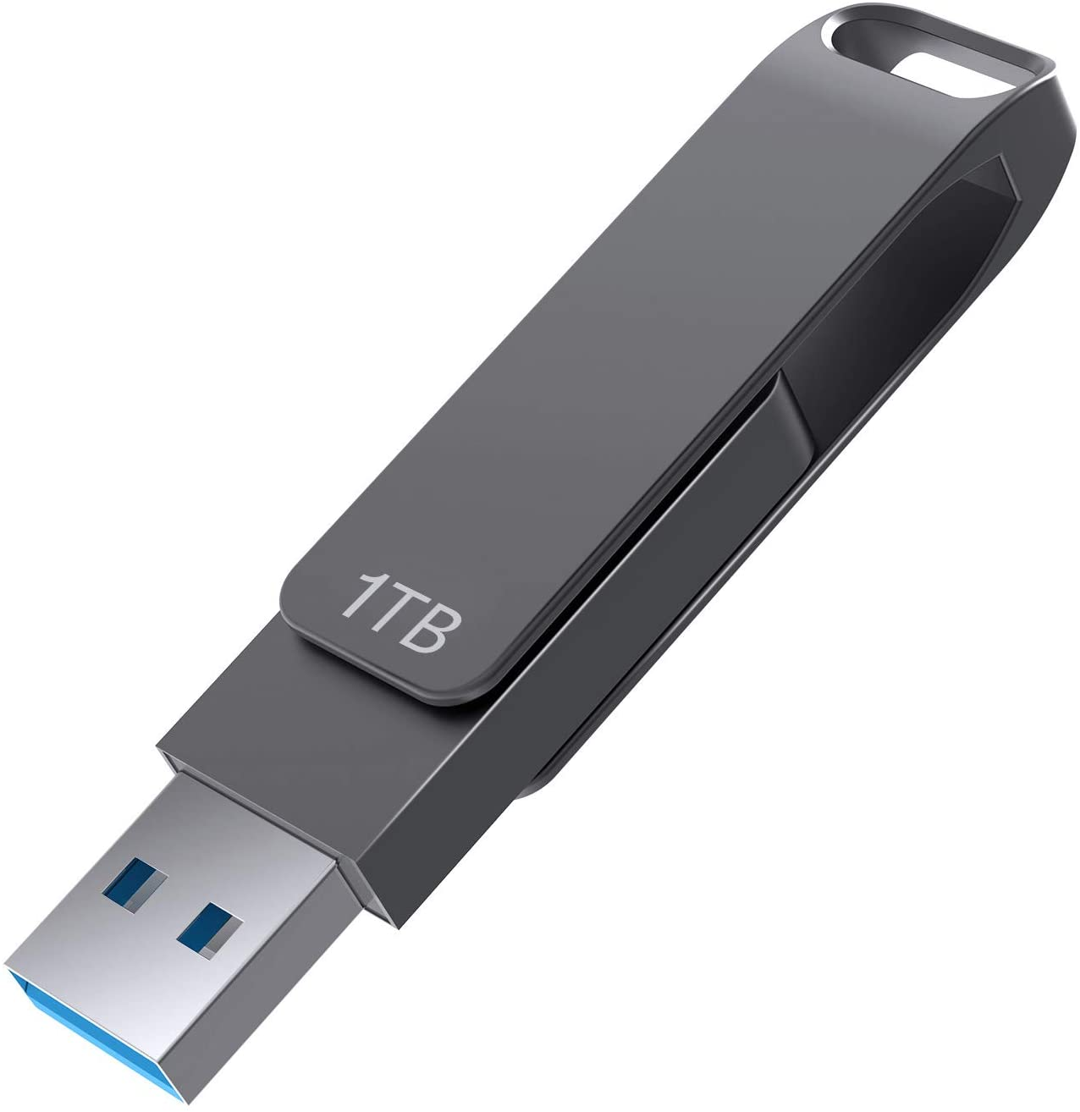
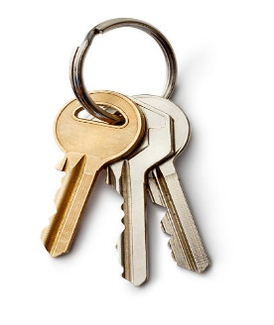
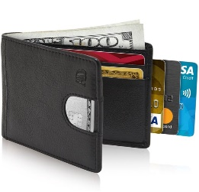
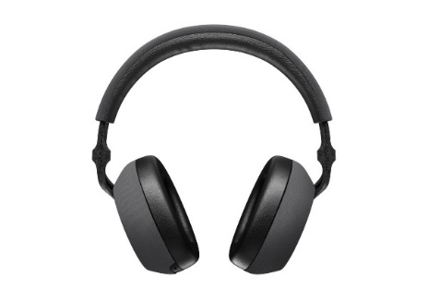
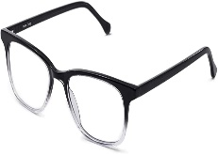
Complete the following questions with this, these, then give correct answers.
Complete las siguientes preguntas con this, these, luego dé las respuestas correctas.
Is this your backpack?
No, it´s not
______ your flashdrive?
No, __________
______ your keys?
Yes, __________
______ your wallet?
No, __________
______ your umbrella?
Yes, __________
_________ your glasses?
Yes, __________
______ your headphones?
No, __________

Slide 4
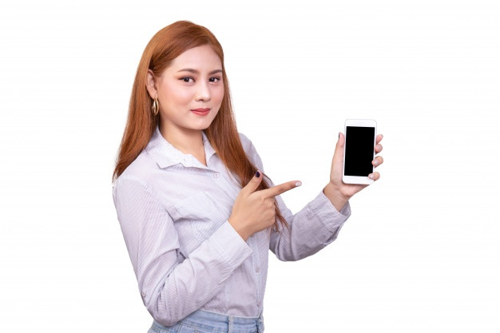
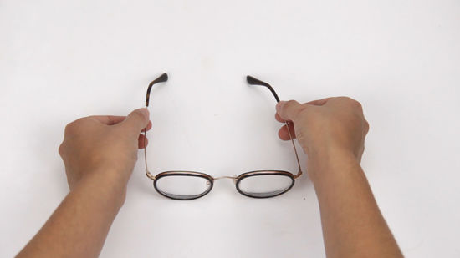
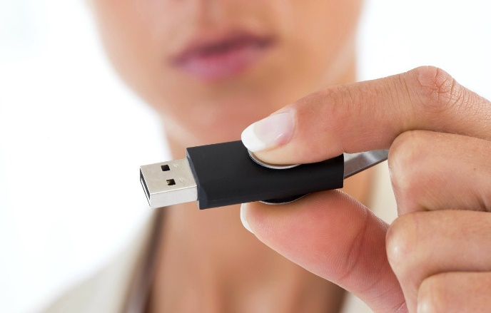
Correct the following conversations, they are not correct circle the error and give the correct
A: Is these your keys?
B: Yes, it´s not. Thank you!
A: Are this your cell pone?
B: No, they’re not
A: Is these your glasses?
B: No, it is.
A: Are this your flash drive?
B: Yes, they are. Thanks!

Slide 5
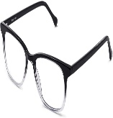
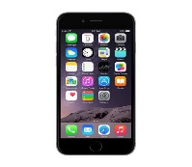
UNIT 2
Lesson 4
“Ask and answer Where questions with be”
Where is my cellphone?
Where are my glasses?
Learning objective:
Ask and answer wherw questions with be

Slide 6
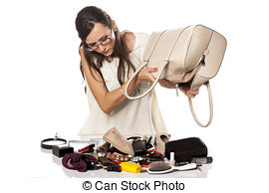
GRAMMAR “where questions with be”
Question Where refers to a place or position
La pregunta Where (donde) se refiere a un lugar o posición
Where´s my haibrush?
Singular
It´s in my purse
Plural
Where are my keys?
They´re in my purse

Slide 7
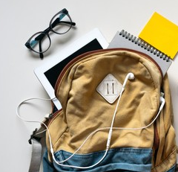
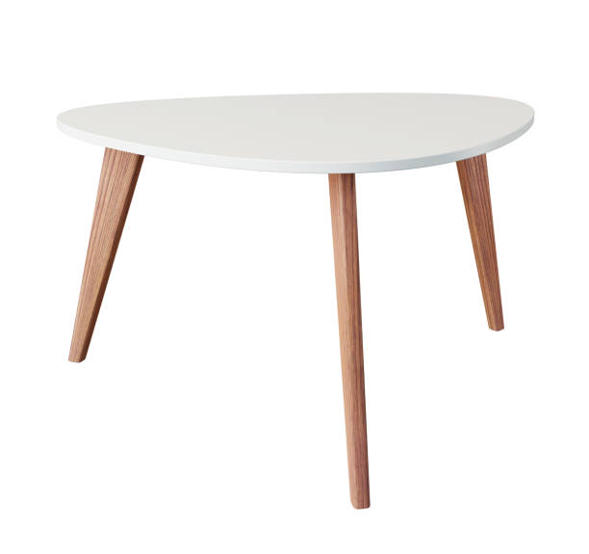
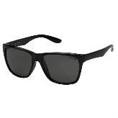
Complete the following questions with Where is, Where are, then give correct answers.
A: _________ your tablet?
B: ______ in my back plack
A: _________ your notebook?
B: ______ in the back plack
A: _________ the head phones?
B: Oh! ______ on the table
A: _________ your glasses?
B: ______ on the table

Slide 8
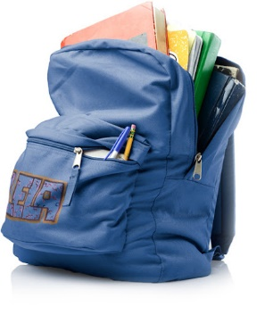
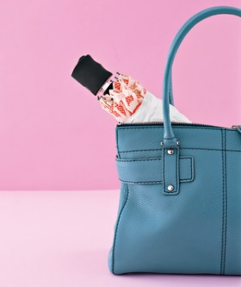
Complete the following questions with Where is, Where are, then give correct answers.
 | A: _____________ your credit card? B: __________ in my wallet
 | A: _____________ the keys? B: __________ in the table
 | A: _____________ your books? B: __________ in the backpack
 | A: _____________ my umbrella? B: Oh! __________ in my purse

Slide 9
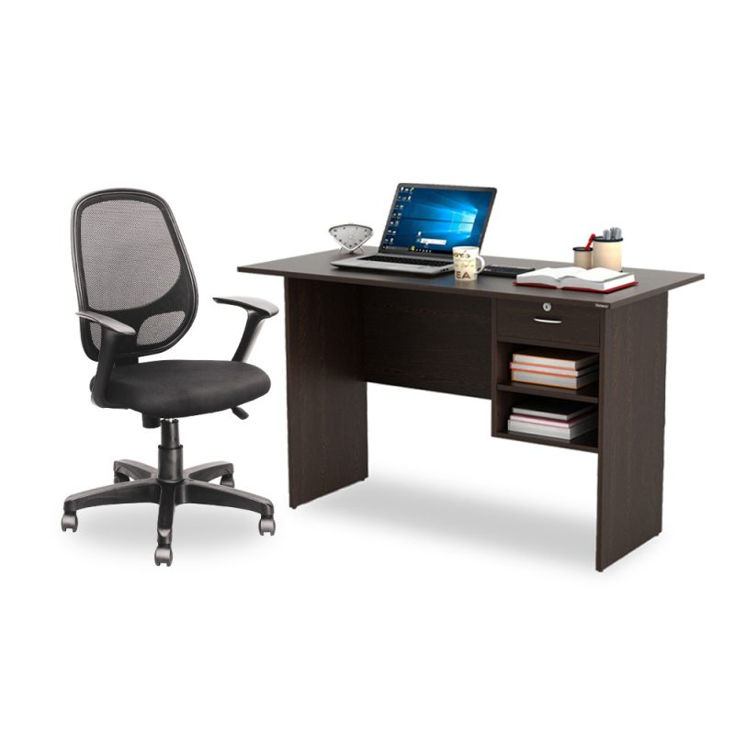
GRAMMAR “Yes/no and where questions with be”
Where´s my haibrush?
Is it on the table?
No, it is not
Is it on the desk?
No, it is not
Is it in my purse?
Yes, It is in my purse

Slide 10
_____________ my keys?
_______in my purse?
No, ___________
________on the desk?
No, __________
________on the table?
Yes, ________

Slide 11
_____________ my laptop?
_______ on the table?
No, ___________
________in the backpack?
No, __________
________on the desk?
Yes, ________

