Slide 1
UNIT 6
Lesson 3
Lesson objectives:
Learn and use simple present statements.
Know that most regular verbs use the root form, except in the third-person singular ( -s ending).

Slide 2
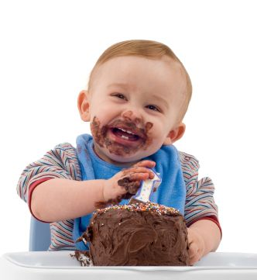
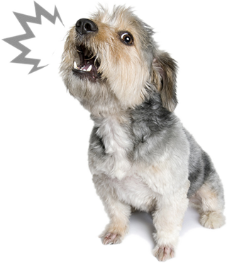
Simple present tense
The simple present tense is one of several forms of present tense in English.
It is used to describe habits, facts, feelings and emotions.
To describe habits and routines
He reads the newspaper everyday
To describe feelings and emotions
He likes chocolate cake
To describe facts
The dog barks

Slide 3
Simple present statements
The simple present tense is simple to form.
Just use the base form of the verb: (I take, you take, we take, they take)
The 3rd person singular takes an -s at the end. (he takes, she takes)
I
You
We
They
Verb
drive to work
Verb + S
He
She
it
drives to work

Slide 4
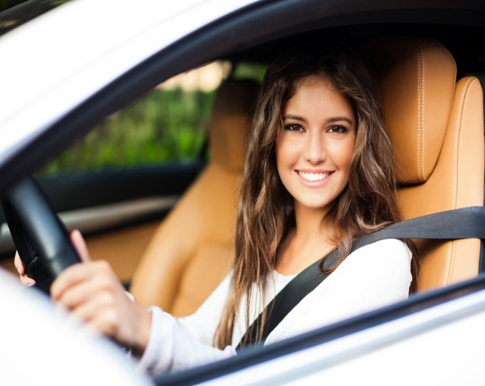
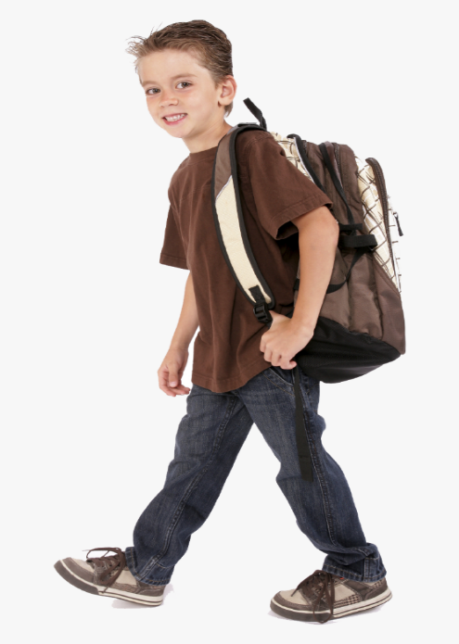
Simple present tense
The simple present tense is simple to form. Just use the base form of the verb: (I take, you take, we take, they take) The 3rd person singular takes an -s at the end. (he takes, she takes)
I drive to work everyday
My brother walks to school everyday

Slide 5
Simple present tense
Grammar Focus
I walk to school. You ride your bike to school. We live with our parents. They use public transportation.
Verb endings for: he, she, it
walk = walks ride= rides live= lives study= studies play= plays watch= watches
Spelling rules:
Normally in the present tense we add S to the end of the verb in the 3rd person .
If the verb ends in E, add + S in the third person.
He works near here. She takes the bus to work. The dog barks at night.
If the verb ends in a Consonant + Y, we remove the Y and + IES in the third person.
If the verb ends in Vowel + Y, we just add –s in the third person
If the verb ends in SS, X, CH, SH or the letter O, we add + ES in the third person.

Slide 6
Practice simple present statements Circle the correct verb the correct option
I | eat / eats | vegetables everyday
You | drink / drinks | coffe in the morning
Pam | get up/ gets up | late on sundays
Susan | drive / drives | to work

Slide 7
Write the verb in the correct form
Harry | (ride) | his bike to school
They | (cook) | lasagna everyday
Daniel | (dance) | very well
Lisa | (swim) | on sundays
My parents | (drive) | to work everyday

Slide 8
Practice simple present statements
Click on the following link to practice simple present spelling rules then share your results
https://wordwall.net/resource/21025010/english/grammar-rules-present-s-3rd-person
https://wordwall.net/resource/29468306

Slide 9
Practice simple present statements
Click on the following link to practice simple present tenses then your results
https://wordwall.net/resource/30261315
https://wordwall.net/resource/30263976

Slide 10
Practice simple present statements
Click on the following link to practice simple present tenses then your results
https://wordwall.net/resource/30264316

Slide 11
Speaking activity
Write and tell 3 affirmative statements in simple present tense about your family members
(use some pictures to describe your statements).

