Slide 1
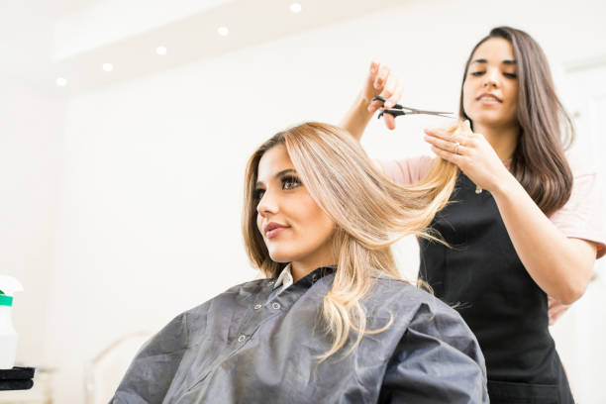
UNIT 8
Lesson 1
A hair salón..
It´s a place where you get a hair cut
LESSON OBJECTIVE:
Ask about and describe places.
Describe a neighborhood

Slide 2
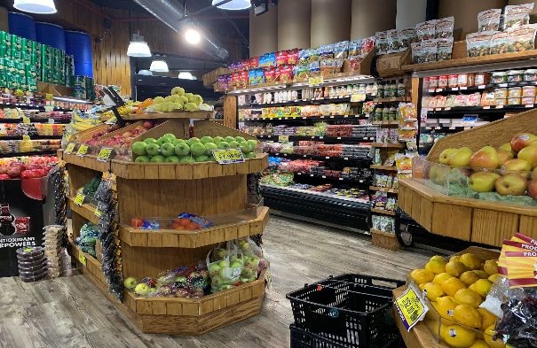
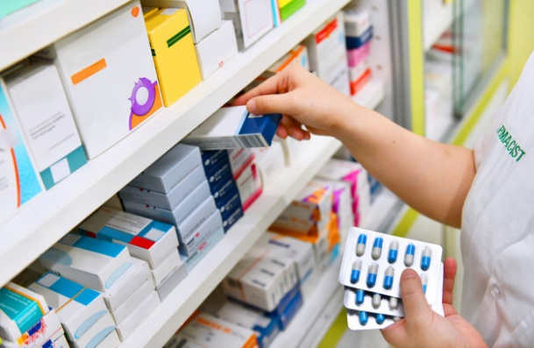
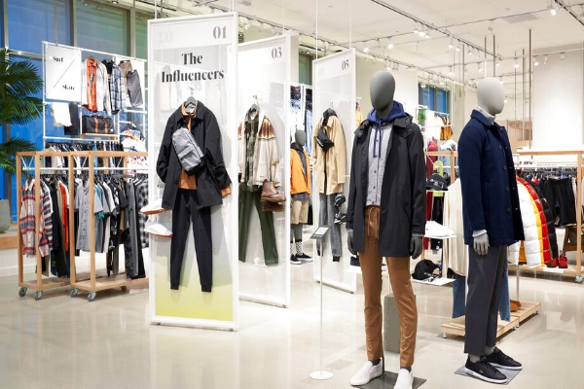
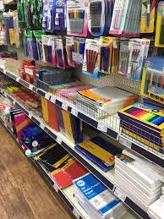
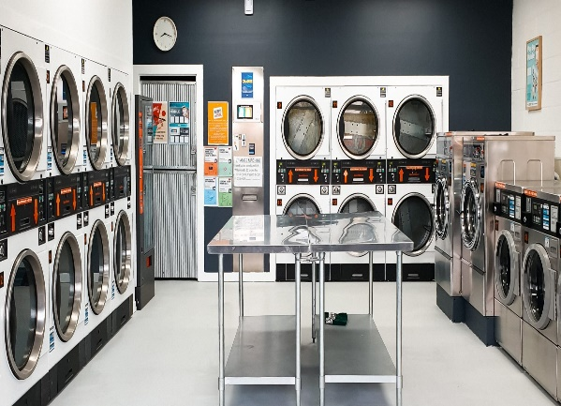
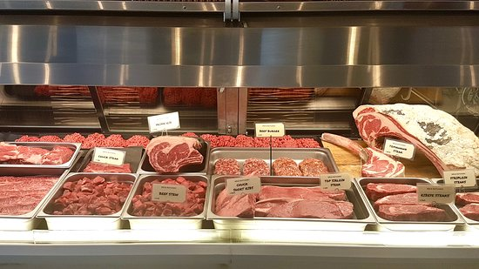
PLACES AND ACTIVITIES
Match the places and the pictures.
stationary store
clothing store
laundormat
grocery store
butchery
drugstore

Slide 3
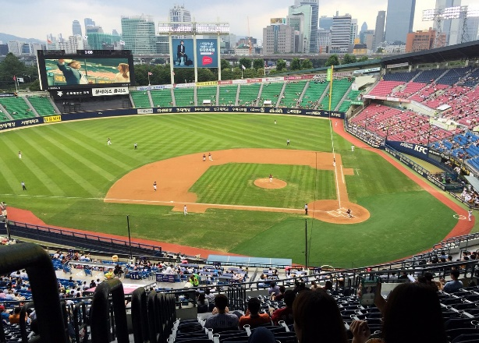
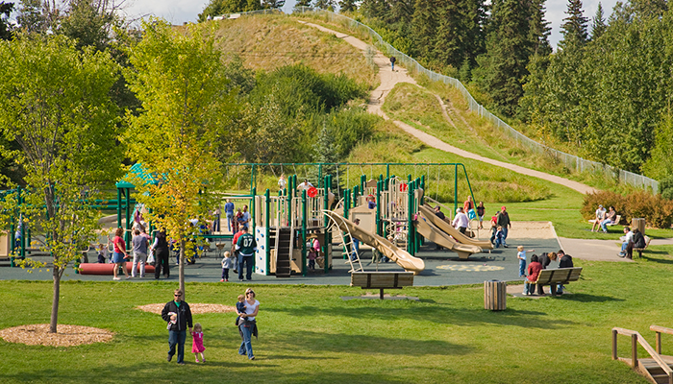
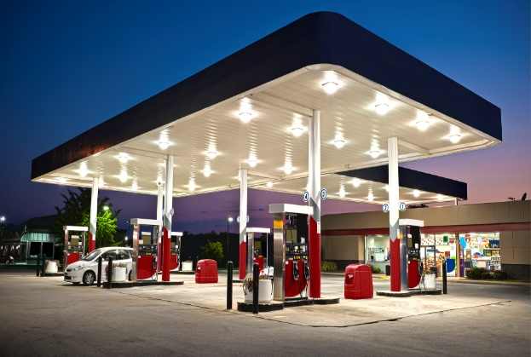
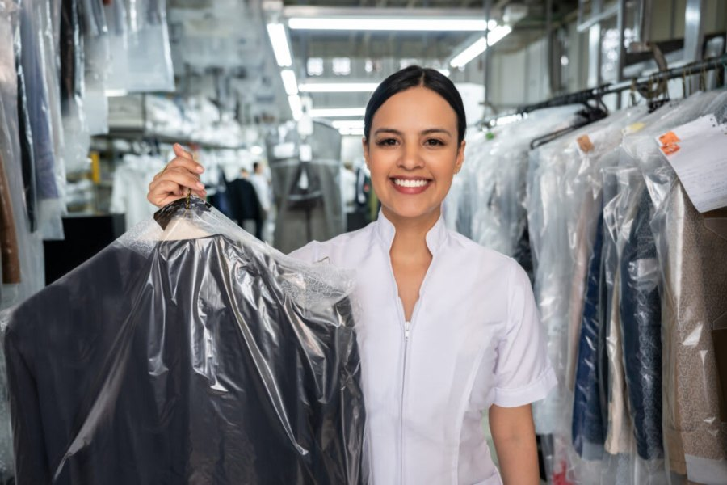
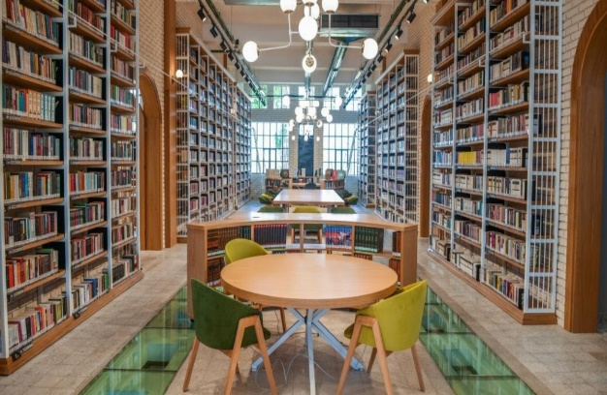
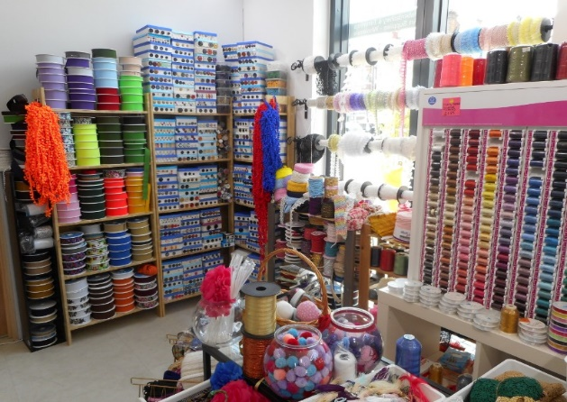
PLACES AND ACTIVITIES
Match the places and the pictures.
library
dry cleaner
haberdashery
park
gas station
stadium

Slide 4
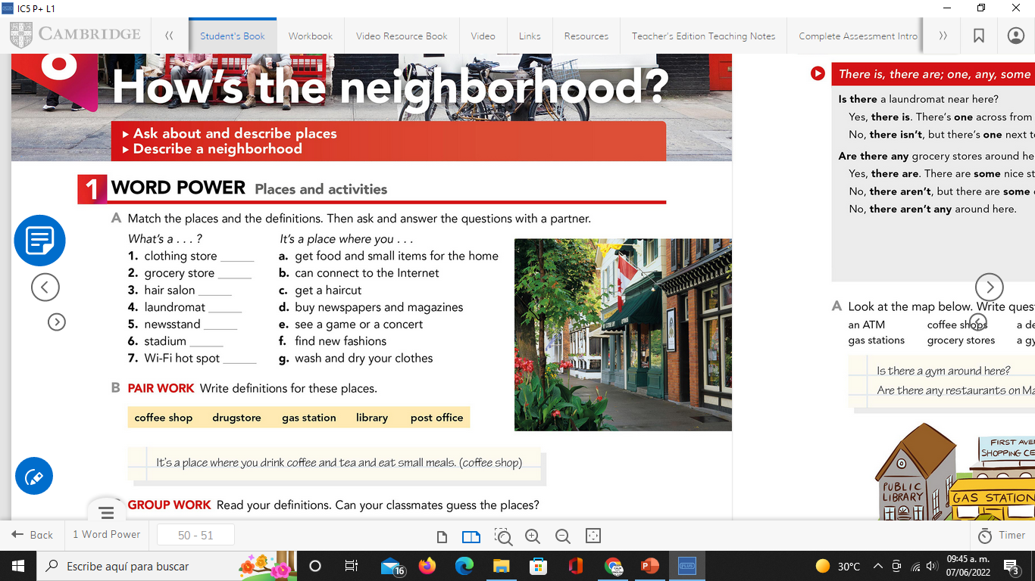
PLACES AND ACTIVITIES
Match the places and the definitions. Then ask and answer the questions with a partner.
Studentbook pg 50

Slide 5
PLACES AND ACTIVITIES
Writing/Speaking activity.
Give a description for each place. Studentbook pg 50 ex B

Slide 6
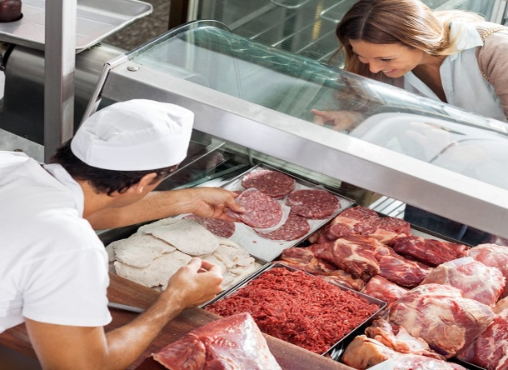
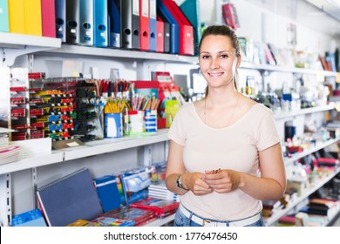
PLACES AND ACTIVITIES
What places are these? Describe each place.

Slide 7
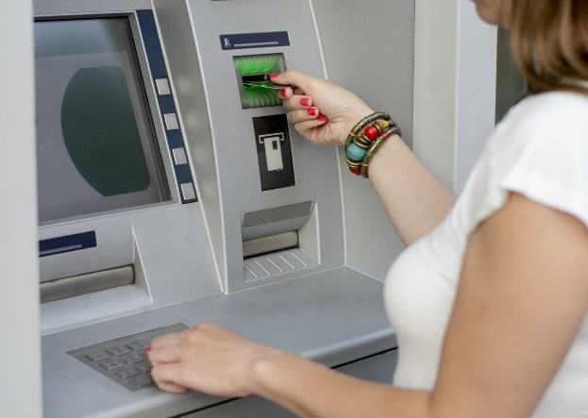
PLACES AND ACTIVITIES
What places are these? Describe each place.

Slide 8
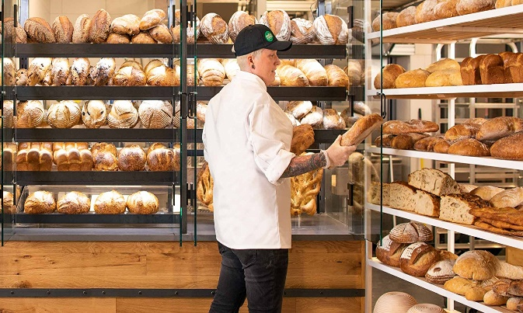

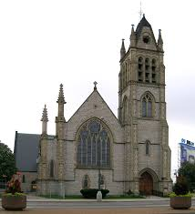
PLACES AND ACTIVITIES
What places are these? Describe each place.

Slide 9
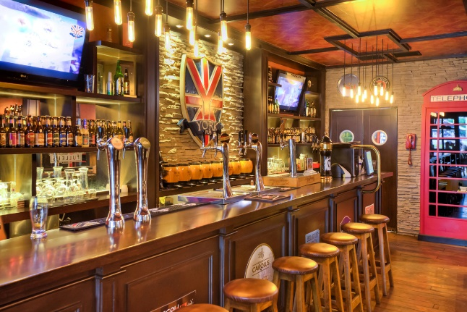
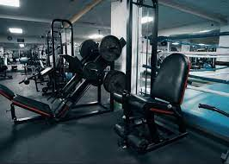
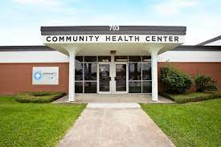
PLACES AND ACTIVITIES
What places are these? Describe each place.

Slide 10
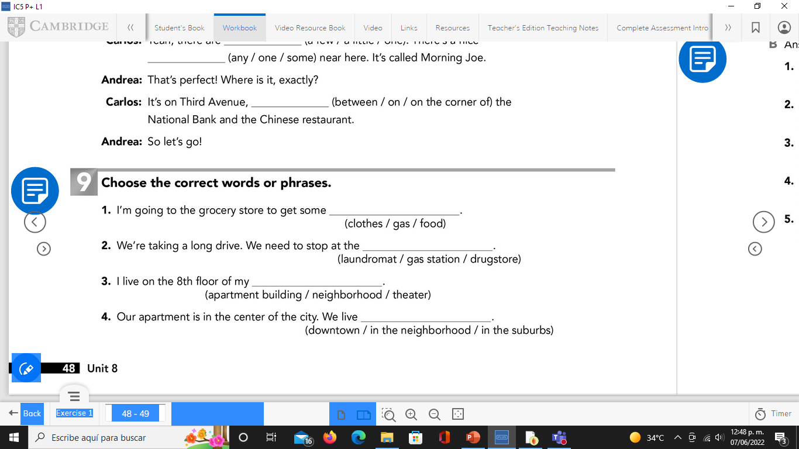
PLACES AND ACTIVITIES
Workbook pg 48

Slide 11
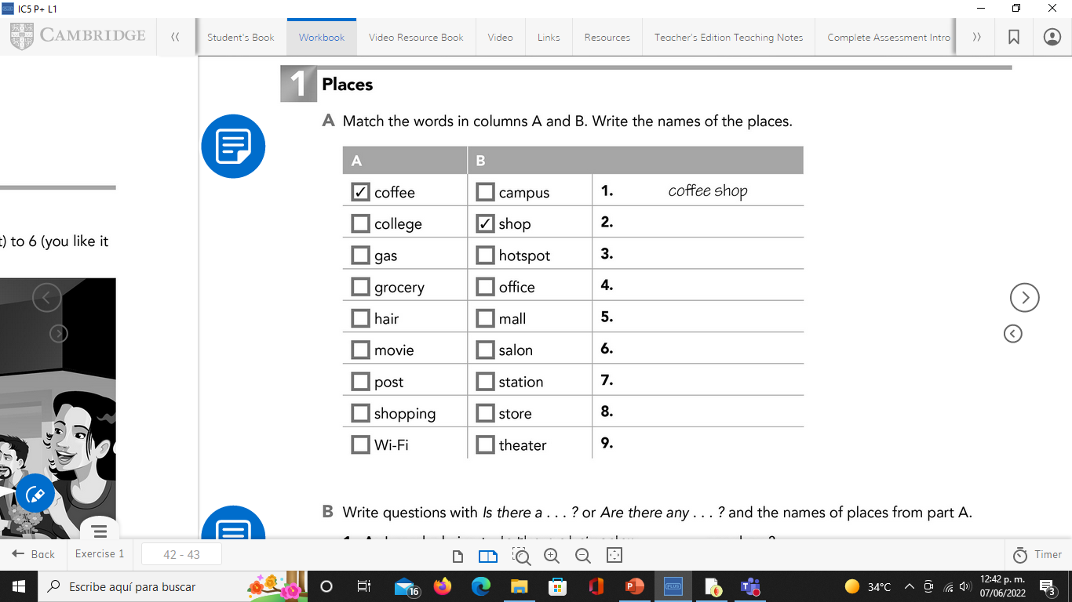
Workbook pg 43

Slide 12
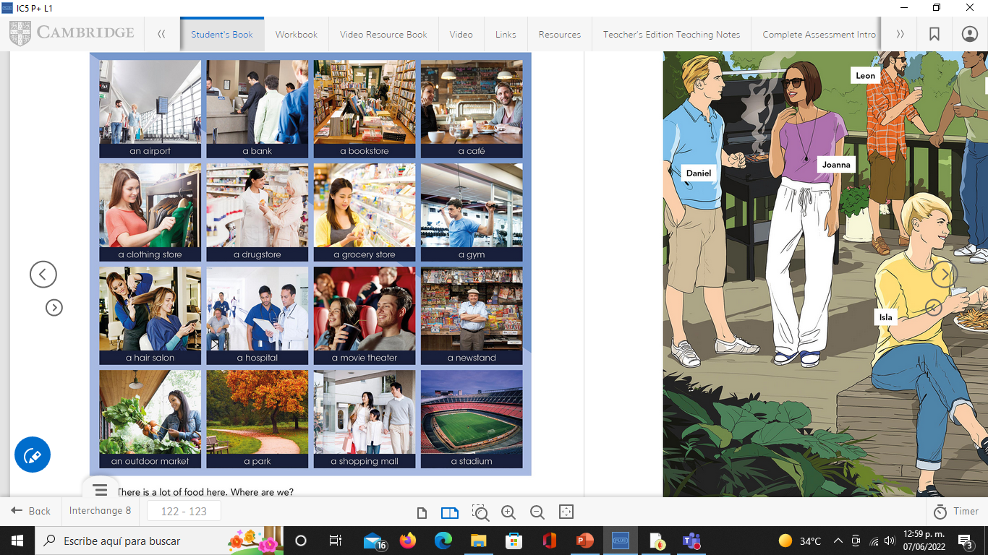
Speaking activity.
Student 1 gives the description of a place. Student 2 guesses the place. Studentbook pg 122 (modified)

Slide 13
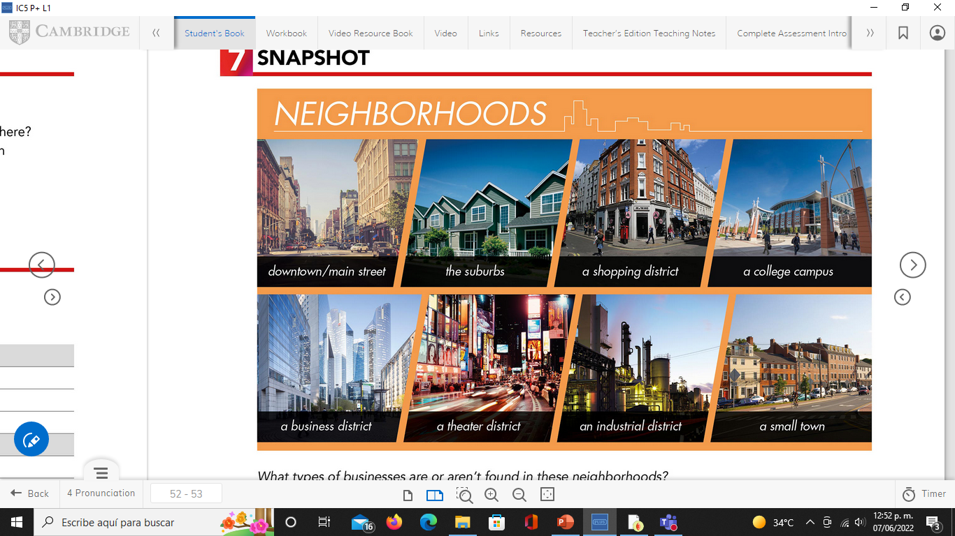
Speaking activity
Where in your city are these places? Studentbook pg 122

Slide 14
Online Practice
Click on the following links to practice
https://wordwall.net/es/resource/17574500
Insert here your results
https://wordwall.net/es/resource/5427947
Insert here your results

