Slide 1
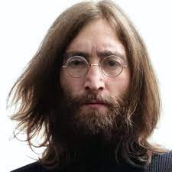
UNIT 1
Lesson 1
He was a famous Singer,
His name was Jhon Lennon
LESSON OBJECTIVE:
Learn and practice the simple past of verb to be in affirmative and negative statements.

Slide 2
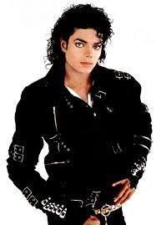
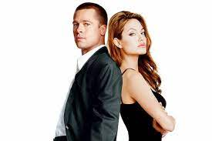
GRAMMAR FOCUS “ Past of BE ”
The past tense of the verb be is was/ were. Look at the following picture, learn and practice the past tense of the verb be.
I
(+)Was
(-)Wasn´t
he, she, it
He was a famous singer.
He wasn´t healthy when he died.
Verb
Be
we
(+)were
(-) weren´t
you
They were married.
They weren´t happy
they

Slide 3
Grammar/Speaking Practice
Match the following words with the correct category of the simple past of BE
Jhon and Jane
My friends
My dog
The flowers
The ice-cream
My cellphone
My parents
Alex and me
The classes
The weather
The teacher
My car
was
were

Slide 4
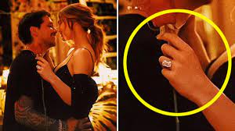
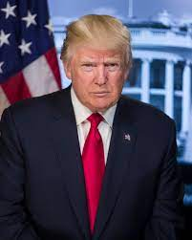
GRAMMAR FOCUS “ Past of BE ”
Complete the following statements.
Belinda and Nodal (+)_____ engaged.
But they (-)_____ in love.
Donald Trump (+)______ the president of USA in 2020, He (-) ______ very friendly though.
The superbowl (+)_____ last Sunday, but it (-)_____ interesting at all.

Slide 5
Grammar/Speaking Practice
Complete the following affirmative statements with the simple past of BE
The little princess ________ my favorite cartoon.
I___________ afraid of dogs.
The earthquake in Turkey ______ 7.8 magnitude.
Donald Trump ______ the president of USA in 2020.
My dog __________ sick last week.
My vacations _______ very short.

Slide 6
Grammar/Speaking Practice
Complete the following negative statements with the simple past of BE
The last english test ____________ easy.
The bathroom ___________ clean this morning.
Alex and me ____________ at the cinema last night
She__________ my teacher on first grade.
I _______ home on sunday afternoon.
Yesterday _______ very cold.

Slide 7
Grammar/Speaking Practice
Complete the following affirmative and negative statements with the simple past of BE
Our trip to Spain ______ (+) great, and the hotel ____ very cheap.
My parents_____ (+) at a nice restaurant, but it _____ good at all.
The weather ____ (-) good, there_____ (+) a very cold wind.
The exercises ______ (+) easy, they _____ (-) difficult.
We ______(+) at home all day, it _______(+) so boring.

Slide 8
Grammar Practice
Online activity
Click on the following links, practice with past of be.
Then share your results of your practice.
https://wordwall.net/es/resource/20379455/was-were
Insert here your results
https://wordwall.net/es/resource/2146751/was-or-were
Insert here your results

Slide 9
Reading/listening Practice
Online activity
Click on the following links, practice with past of be.
Then share your results of your practice.
https://www.liveworksheets.com/hy976706zi
Insert here your results
https://www.liveworksheets.com/qr1041823zk
Insert here your results

Slide 10
Speaking Practice
Online activity
There were no end of problems Students take turns telling a story, with one person creating problems for the main characters with sentences like “J.Lo and Benn Affleck were at the beach yesterday, it was a sunny day….

