Slide 1
UNIT 6
Lesson 8
“WH questions in simple present”
What
time
What
When
Where
Lesson objectives:
Learn to ask and answer Wh questions in simple present.

Slide 2
PRESENT CONTINUOUS WH .. QUESTIONS
A WH-question is used for seeking content specific information, related to persons, things, facts, time, place, reason, manner, etc. Wh-questions differ depending on the kind of content information sought.
Wh-questions begin with what, when, where, what time, etc..
WH question | USE
WHAT ? | to ask for information about something
WHAT TIME? | to ask for the time
WHEN? | to ask what day or date
WHERE? | to ask for what place or position

Slide 3
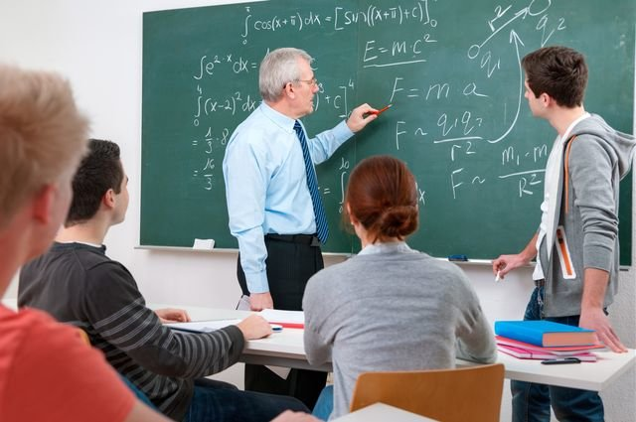
PRESENT CONTINUOUS WH .. QUESTIONS
Use WHAT to ask for information about something
What do they study?

Slide 4
PRESENT CONTINUOUS WH .. QUESTIONS
Use WHERE to ask for what place or position
Where does your brother work?

Slide 5
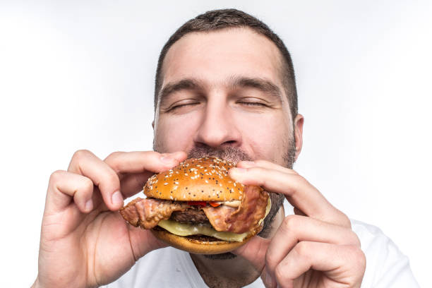
PRESENT CONTINUOUS WH .. QUESTIONS
Use WHAT TIME to ask for the time.
What time does Roberto have lunch?

Slide 6
PRESENT CONTINUOUS WH .. QUESTIONS
Use WHEN to ask what day or date.
When do you have English class?

Slide 7
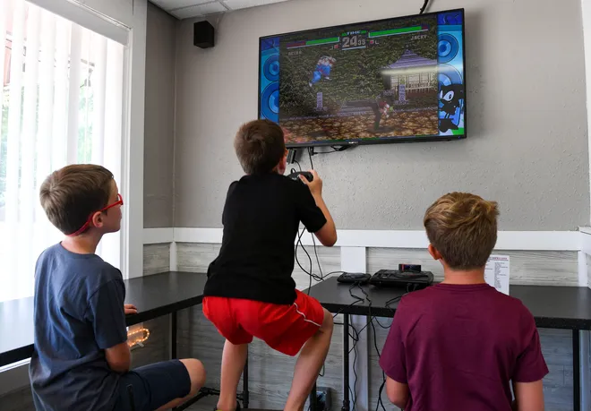
PRESENT CONTINUOUS WH .. QUESTIONS
Speaking practice:
Look at the picture, answer the following questions.
Do they play videogames?
Where do they play videogames?
What time do they play videogames?
When do they play videogames?
They play at Rik´s house
They play on weekends
Yes, they do.
They play at 6:00 in the afternoon

Slide 8
PRESENT CONTINUOUS WH .. QUESTIONS
Speaking practice:
Look at the picture, answer the following questions.
Does he work in a school?
Where does he work?
What time does he go to work?
When does he work?
He works at Muguerza Hospital
No, he doesn´t.
He works every day
He starts work at 6:00 in the morning

Slide 9
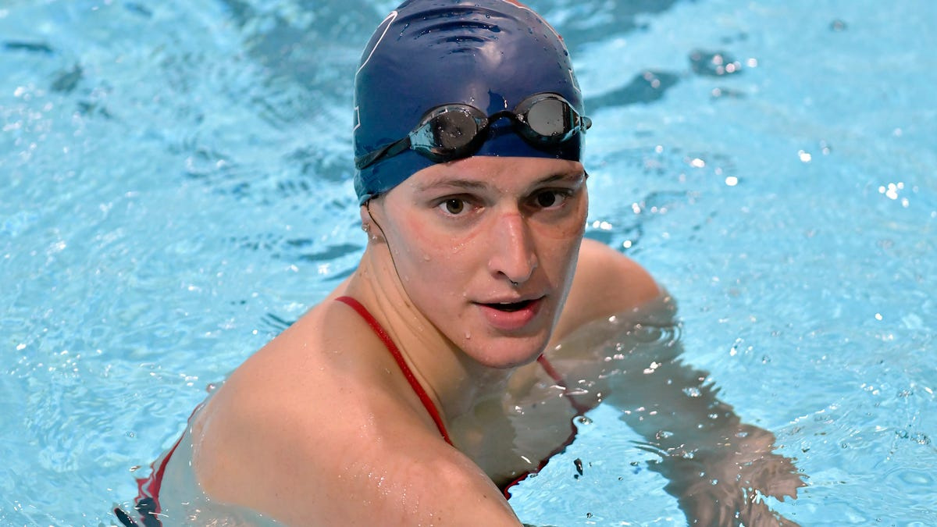
PRESENT CONTINUOUS WH .. QUESTIONS
Writing, Speaking practice:
Look at the picture, complete the following questions
Then roleplay with your partner ask and answer these questions.
Do/does (you)______________________?
What time _________________________?
Where________________________?
When ________________?

Slide 10
PRESENT CONTINUOUS WH .. QUESTIONS
Writing, Speaking practice:
Look at the picture, complete the following questions
Then roleplay with your partner ask and answer these questions.
Do/does (your mother)______________________?
What time _________________________?
Where____________________?
When ____________________?

Slide 11
PRESENT CONTINUOUS WH .. QUESTIONS
Writing, Speaking practice:
Look at the picture, complete the following questions
Then roleplay with your partner ask and answer these questions.
Do/does (Sofy)______________________?
What time _________________________?
Where____________________?
When ____________________?

Slide 12
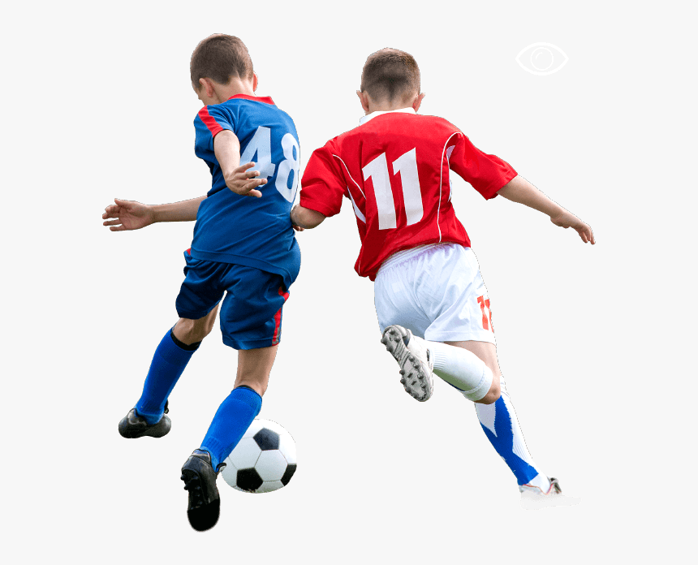
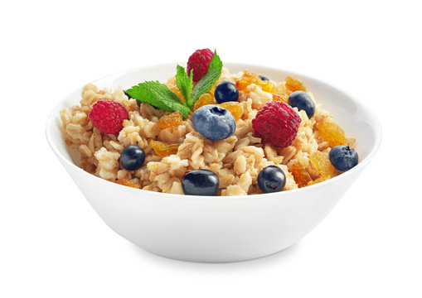
PRESENT CONTINUOUS WH .. QUESTIONS
Writing, Speaking practice:
Look at the picture, write a question for the cue answer.
Then roleplay with your partner ask and answer these questions.
Mike and Jake play soccer on Saturday.
Jessy gets up at 7:00 am on weekdays.
Adam and Dinna have cereal for breakfast.
Caroline Works as a chef in a French restaurant.

Slide 13
PRESENT CONTINUOUS WH .. QUESTIONS
Grammar practice
Complete the questions with do or does. Studentbook pg 39 Ex. A.

Slide 14
PRESENT CONTINUOUS WH .. QUESTIONS
Grammar practice
Unscramble the questions to complete the conversations Studentbook pg 39 Ex. B.

Slide 15
PRESENT CONTINUOUS WH .. QUESTIONS
Listening practice
Click on the following links to preactice wh questions in simple present.
Then share your results.
https://www.esl-lab.com/easy/daily-schedule/
Here your results:
https://test-english.com/listening/a1/daily-routines-listening-test/
Here your results:

