Slide 1
Activities
Verb be

Slide 2
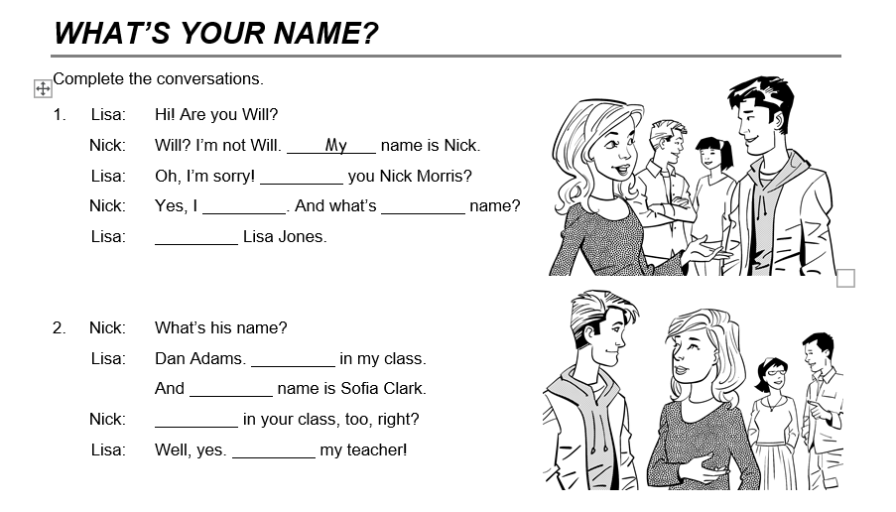

Slide 3
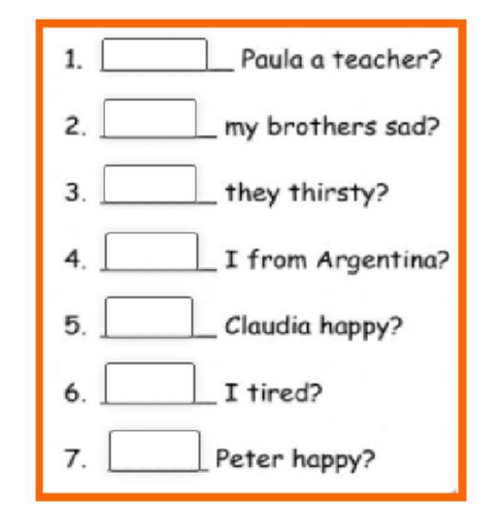
Complete using am, is or are.

