Slide 2
1.- Click on the following link watch the rules of comparatives use
https://www.youtube.com/watch?v=UeVtGgMd8H0
2.- Complete the following chart with two adjectives on each gap
Words that end in e just add … R | Words that end in y ommit y add … - ier | Short words that end in consonant preceded by vowel double the consonant | Words of two sylables just add er ending | Words more than three sylables add more adjective | Irregular adjectives
Large / Larger | pretty/ prettier | Big/ Bigger | Tall/ Taller | Expensive/ More expensive | Good/ better
3.- Click on the following link to play and practice, copy paste your final score.
http://gamestolearnenglish.com/compare/

Slide 3
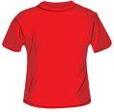
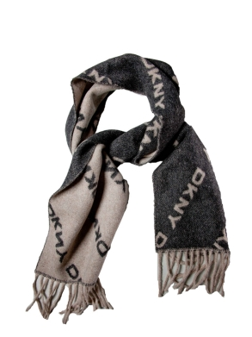
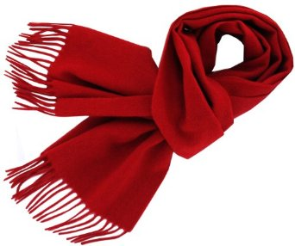
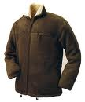
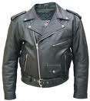
This blue shirt is than this red shirt
4.- Answer the following excercies, circle the correct comparative form
more small smaller
The DKNY scarf is than this one
more expensive expensiver
The wool jacket is than the leather jacket
more warm warmer

Slide 4
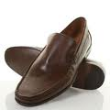
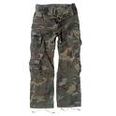
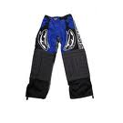
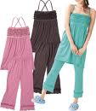
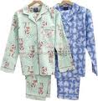
These shoes are than these ones
more big bigger
These pants are than these ones
more large larger
These pajamas are than these ones
more conforfable confortabler

Slide 5
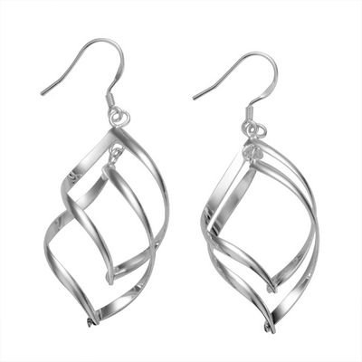
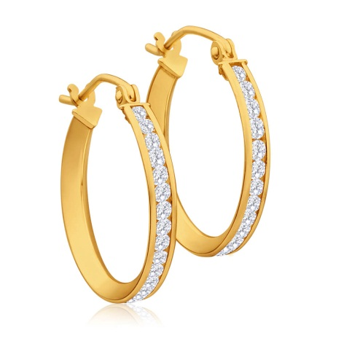
more good gooder better
more bad badder worse
The gold earings are than the silver ones
more pretty prettier
more thin thinner
more old older
more intelligent intelligenter
Juanita is than Betty
more conservative conservativer

