Slide 1
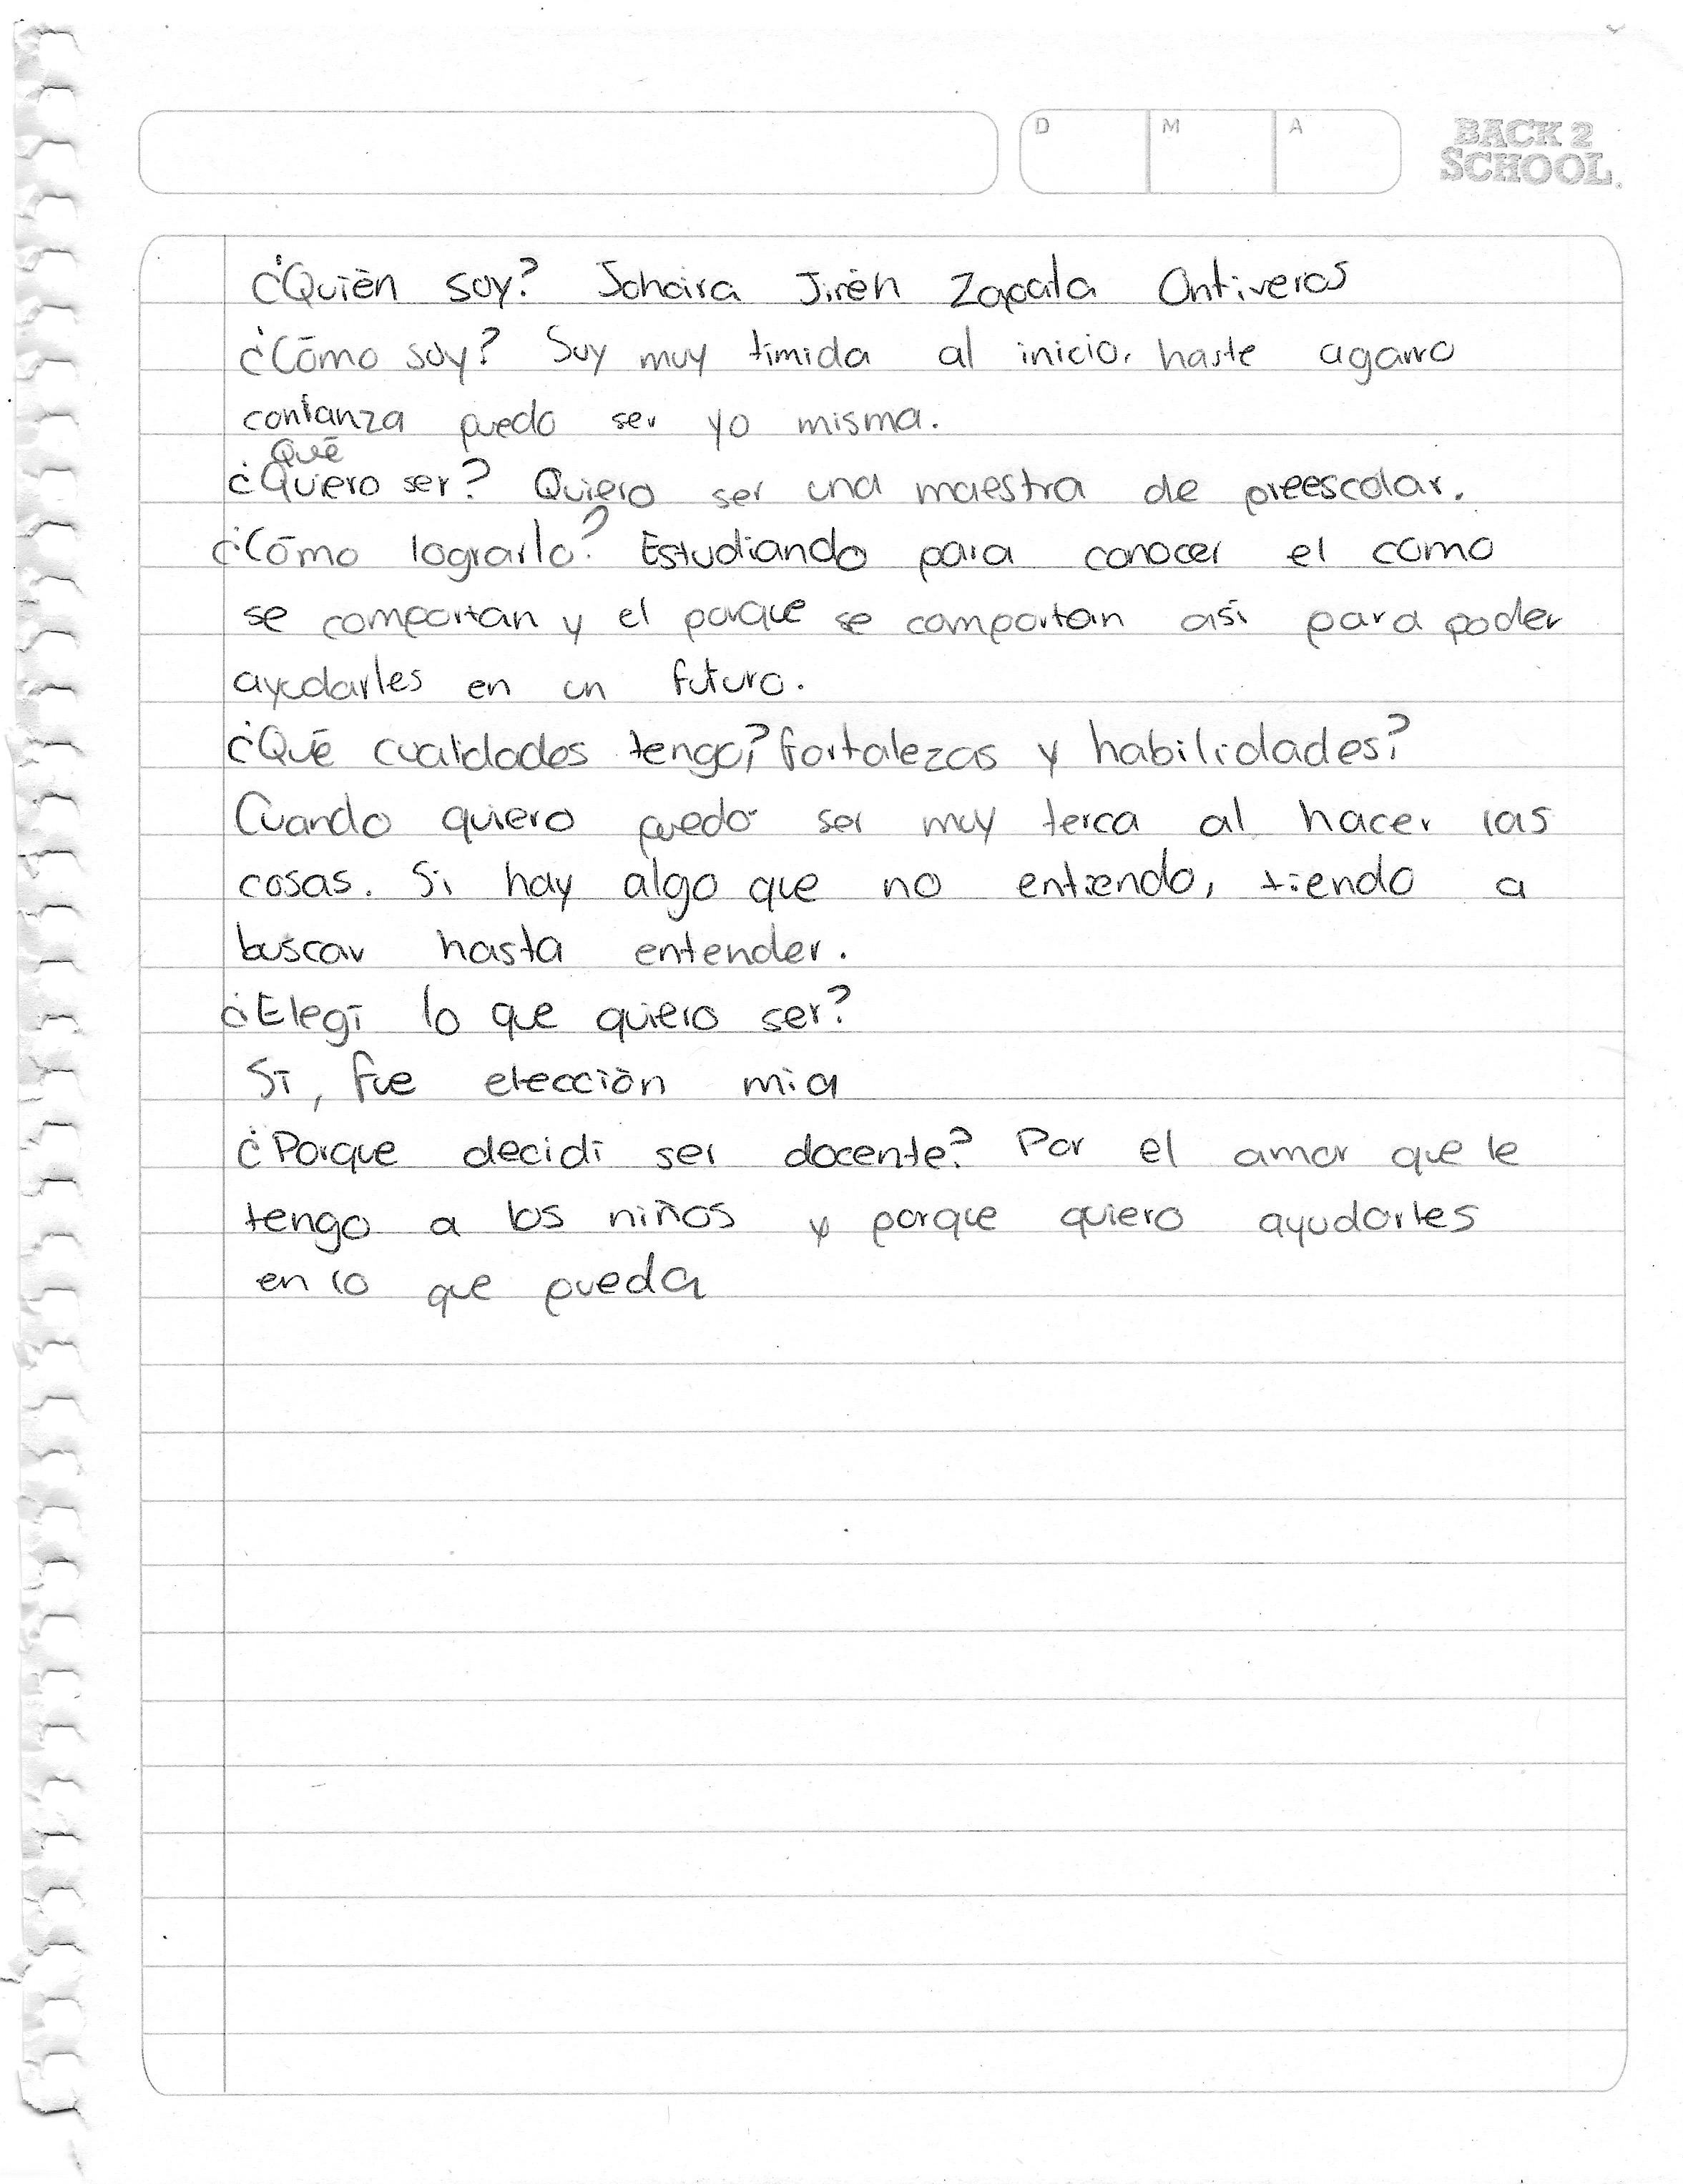
JOHAIRA JIREH ZAPATA ONTIVEROS 1B LIC EN EDUCACION PREESCOLAR N27

