Slide 1
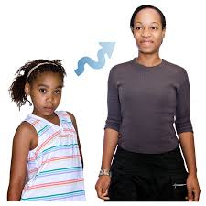
Unit 6 How have you changed?
Objectives:
Describe life changes
Describe plans for the future

Slide 2
Assessment questions
Tell me about some recent changes in your life.
Have you changed schools/learned a new sport/moved to a new apartment/got a pay raise?
Think about your life five years ago. Is your life more or less stressful now?
Have you changed your hairstyle recently? If yes, what was it like before? What is it like now?
How have your friends or family members changed recently?
What are you going to do after this course? Do you plan to take another English class? Why or why not?
Do you hope to travel abroad in the future? Why or why not?
Would you like to take a vacation somewhere? Where do you want to go?
What is something you’d love to do?
Ask me about my future plans. or Ask [classmate] about his/her future plans.

Slide 3
CONVERSATION I haven’t seen you in ages
A
What’s happening?
What do you think they are discussin?
Future plans
Robin
Matt
1
1
B

Slide 4
GRAMMAR FOCUS Verb + infinitive
Robin: I’d ______ ____ learn how to play the guitar.
Robin: I ______ ____ take lessons.
Matt: I’d ______ ____ learn how to dance.
Matt: I ______ ____ get a new job soon.
What do these structures have in common?
A=
What other structures follow this pattern?
A=

Slide 5
GRAMMAR FOCUS

